Slide 1
Biofuels
A Petroleum Industry Perspective
John Felmy
Chief Economist
American Petroleum Institute
2007 EIA Energy Outlook, Modeling & Data
March 28, 2007

Slide 2
Overview
Energy Outlook
Biofuels Overview
Ethanol
Biodiesel
Renewable Diesel

Slide 3
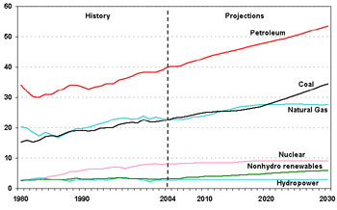
Future U.S. Energy Demand
The U.S. will consume 28 percent more oil and 19 percent more natural gas in 2030 than in 2005.
Quadrillion Btu
Source: US DOE

Slide 4
EIA AEO 2007 |  | 2005 | 2030
Consumption
Liquid Fuels and Other Petroleum |  | 40.61 | 52.17 | 28.5
Share |  | 40.5 | 39.8
Natural Gas |  | 22.63 | 26.89 | 18.8
 |  | 22.6 | 20.5
Oil and Gas |  | 63.25 | 79.06 | 25.0
 |  | 63.1 | 60.3
Coal |  | 22.87 | 34.14 | 49.3
 |  | 22.8 | 26.0
Oil, Gas and Coal |  | 86.12 | 113.20 | 31.4
 |  | 86.0 | 86.3
Nuclear Power |  | 8.13 | 9.33 | 14.8
 |  | 8.1 | 7.1
Hydropower |  | 2.71 | 3.09 | 13.8
 |  | 2.7 | 2.4
Biomass |  | 2.38 | 4.06 | 70.5
 |  | 2.4 | 3.1
Other Renewable Energy |  | 0.76 | 1.44 | 88.7
 |  | 0.8 | 1.1
Other |  | 0.08 | 0.04 | -48.3
 |  | 0.1 | 0.0
Total |  | 100.19 | 131.16 | 30.9
Source: US DOE

Slide 5
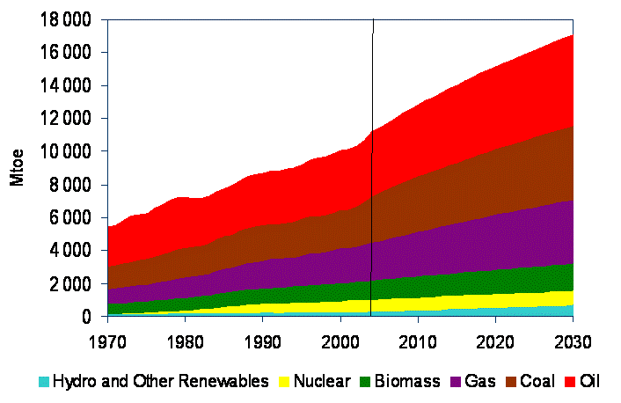
Future Global Energy Demand
Global energy demand will increase by more than 50 percent between now and 2030.
Source: IEA

Slide 6
Forecast of U.S. Energy Growth
31% Growth
2005 Actual
(1.1%/yr.)
2030 Outlook
(100 quads)
(131 quads)
Nuclear
Nuclear
8%
7%
Coal
Oil
23%
40%
Coal
Oil
26%
40%
Gas
23%
6%
Gas
7%
21%
Renewables
Source: US DOE
Renewables

Slide 7
Biofuels Overview
Given the current and projected worldwide energy demand, our nation needs all sources of commercially viable energy, as well as a greater commitment to energy efficiency and energy conservation
  Biofuels, including ethanol are an important resource
Over 40% of all gasoline now produced in the U.S. includes ethanol
  Approximately 5.4 billion gallons of ethanol was used last year – exceeding the 4 billion gallons required level set forth in the RFS
Our companies have long been pioneers in developing alternatives and expanding our utilization of existing sources of energy
  From 2000 to 2005, the U.S. oil and natural gas industry invested an estimated $98 billion in emerging energy technologies, including renewables, frontier hydrocarbons such as shale and tar sands, and end-use technologies such as fuel cells vehicles. This represents almost 75% of the total $135 billion spent.

Slide 8
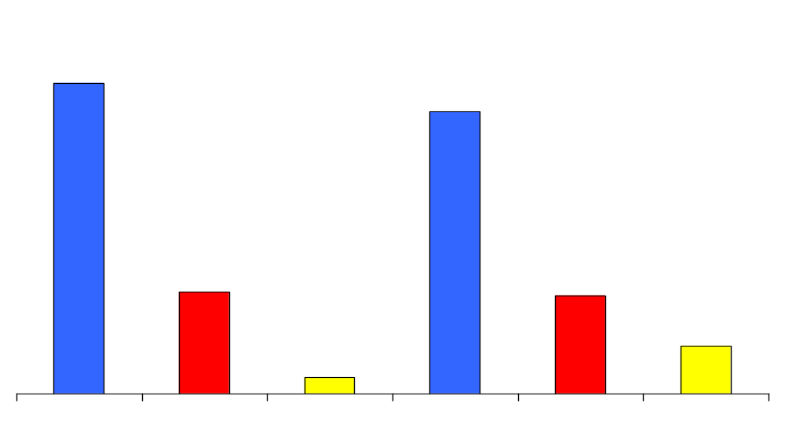
U.S. Firms Emerging Energy Investment
2000-2005
$135 Billion
$98 billion
(73%)
$89 billion
(66%)
By Investor
By Technology
$32 billion
(23%)
$31 billion
(23%)
$15 billion
(11%)
$5 billion
(4%)
Oil & Gas
Companies
Other
Private
Federal
Government
Frontier
Hydrocarbons
End
Use
Non
Hydrocarbons
Notes:
Oil companies investing in frontier hydrocarbons makes best use of our industry’s expertise.
Also note that while comparing the amount invested in renewables, $15 Bn or 11% is Not Insignificant

Slide 9
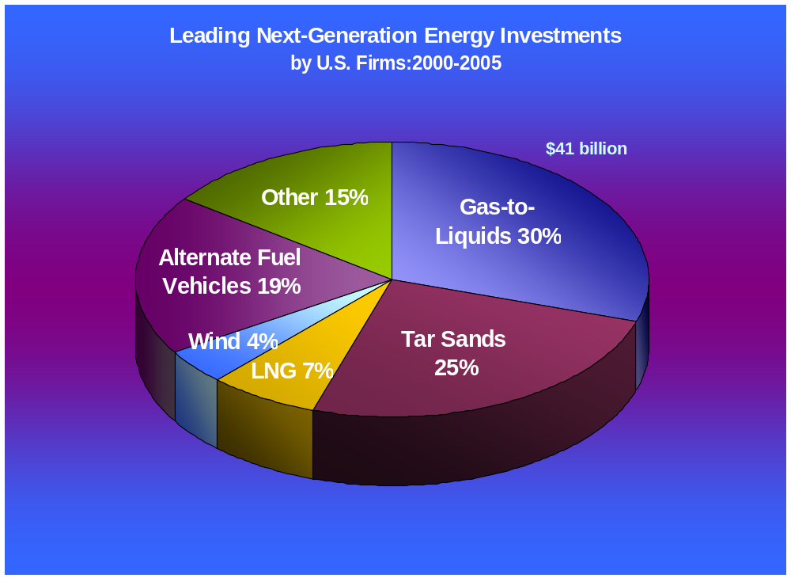
Leading Emerging Energy Investments by U.S. Firms (2000-2005)

Slide 10
Ethanol Overview
Oil companies are the leading user of ethanol and a key player in increasing the use of ethanol. The industry has invested significantly to meet and exceed the existing federal requirement for the RFS.
Under the terms of the Energy Policy Act of 2005 (EPACT05) gasoline producers will continue to increase the amount of renewables. By 2012, at least 7.5 billion gallons of biofuels per year will be used.
Flexibility in the national renewable fuel standard (RFS) program enacted last year by Congress will help ease ethanol and other biofuels integration soonest into the nation’s gasoline pool.
The current mandatory levels in concert with market forces have attracted substantial and significant investment capital to grow ethanol supplies based on market factors. Reliance on market forces is the best way to both deliver the greatest value to our customers and to ensure a long-term vibrant ethanol industry.
A patchwork of state-by-state ethanol mandates beyond the national RFS create additional boutique fuels that will likely interfere with the flexibility that Congress provided in the national RFS program. Thus state mandates could interfere with the reliable supply of fuels during times of supply disruptions.

Slide 11
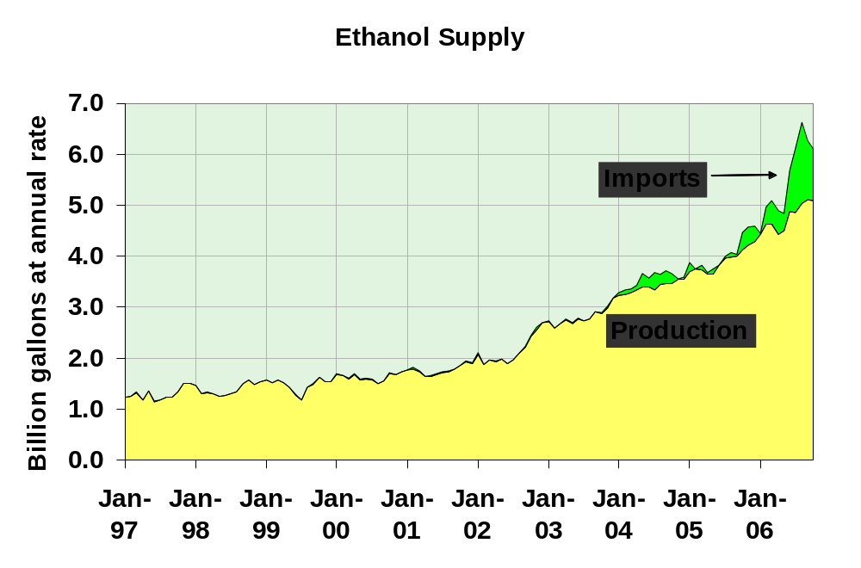

Slide 12


The limits of ethanol
U.S. gasoline
supply
If all US corn production was used for ethanol
15%

Slide 13
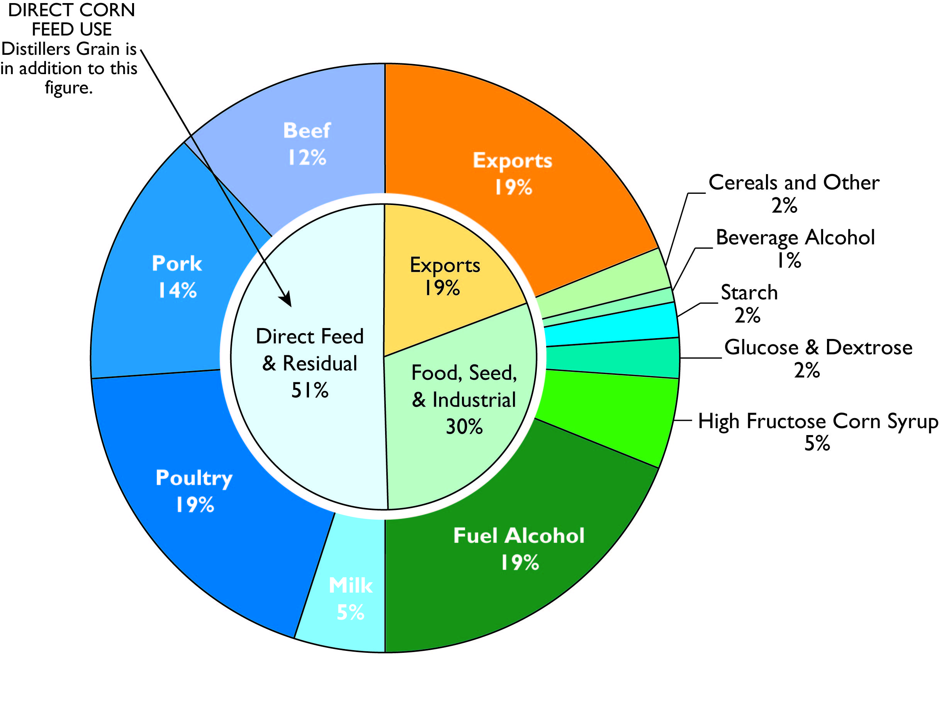
U.S. Corn Use 2006-2007
Source: USDA

Slide 14
E85 Overview
Products offered for sale must satisfy our customers expectations. Thus, care should be taken not to over-promise on E85’s capabilities and then under-produce for consumers or force a product they don’t choose to buy due to their cost tradeoffs, poorer fuel economy, and shorter range.
Ethanol has a role as a transportation energy source, but that role may be limited until significant technology breakthroughs permit production of ethanol from biomass (cellulosic) biomass. The timing of such technological breakthroughs is highly speculative. There is no assurance that technologies would emerge to enable large-scale ethanol production in the next decade, without seriously compromising other pressing policy goals, such as food production and affordable energy for U.S. consumers.
E85 is not a viable use of ethanol until cellulosic ethanol is economically viable.
Market forces and consumer preferences should determine where and how ethanol is consumed. Government policies should be performance-based and provide a level playing field for all alternative fuels. Policies should not pick winners and losers.

Slide 15
E85 Fuel Economy Penalty & Flex-Fuel Vehicles (FFVs)
E85 contains about 70% of the energy of regular gasoline on a Btu/gallon basis. Thus, fuel economy on FFVs is substantially reduced when operated on E85 and averages about 25% to 30% less than when operated with gasoline*.
Given an average reduction in fuel economy of 26% for a model year 2006 or 2007 FFV operated on E85, on a cents/mile basis, the retail price of a gallon of E85 would have to be 26% less than the retail price of gasoline in order for the fuel operating costs on E85 to be comparable with those on gasoline.
It will take years for FFVs to penetrate the vehicle fleet
  Currently, there are at most 6 million FFVs on the road (less than 3 percent)
  Even if that number increases by 2 million per year over the next several years, that percent share of the fleet would still be small. For example, 10 million FFVs in 2008 would be 4 percent of the fleet; 34 million in 2020 would be 12 percent.
97% of the cars on the road in the U.S. today are not designed to operate on fuels containing more than 10 percent ethanol
  Non-FFVs would be damaged or experience higher emissions by using higher ethanol blends
* Government fuel economy figures are listed at: http://www.fueleconomy.gov/feg/byfueltype.htm

Slide 16
Biodiesel Background
ASTM International defines biodiesel as:
  A fuel comprised of mono-alkyl esters of long chain fatty acids derived from vegetable oils or animal fats, designated B100, and meeting the requirements of ASTM D 6751
There are currently no ASTM standards for blend of biodiesel (B2, etc.)
Biodiesel is typically produced by the chemical reaction of a vegetable oil or animal fat with an alcohol in the presence of a catalyst
According to the National Biodiesel Board, there are 88 biodiesel plants in the nation producing an estimated 200-250 million gallons (largely as a result of federal excise tax incentives granted in 2005)
Biodiesel use is expected to grow as companies seek flexibility in complying with EPACT2005 requirements and ULSD regulations
Notes:
Biodiesel is not raw vegetable oil or fry grease
Energy reduction results in only a slight fuel economy hit, will likely go unnoticed

Slide 17
Biodiesel Issues
Biodiesel is more viscous (thicker) and more unstable than distillate
The energy content of biodiesel is 8% lower than distillate
Potential vehicle concerns: injector deposits, clogged fuel system and fuel filters
  These can be caused by impurities in the biodiesel or by the enhanced solvent property characteristic of biodiesel which can dissolve sediment from the fuel tank
Minnesota mandated a B2 blend for highway diesel in September 2005, but had to suspend the program twice because of biodiesel quality issues that caused clogged fuel filters
The NBB and NREL found that 50% of the samples of B100 pulled between Nov 2005 and July 2006 were out of compliance.
Biodiesel can not be shipped via pipelines. Thus it must be shipped by rail or truck to terminals where it is splash blended.
Notes:
Biodiesel is not raw vegetable oil or fry grease
Energy reduction results in only a slight fuel economy hit, will likely go unnoticed

Slide 18
Biodiesel Use in Engines
Biodiesel is a good source of lubricity
Engine manufacturers allow the use of biodiesel blends up to 5%
Biodiesel generally reduces emissions of inorganic carbon particulate matter (PM)
A DOE sponsored study compared emissions impacts from “well to wheels” and found that soy-based biodiesel in an urban bus substantially reduced lifecycle emissions of CO, SOX and CO2, but increased lifecycle emissions of HC and NOX, which contribute to ground-level ozone (smog) formation
Notes:
Soluble PM- not as harmful to the lungs when inhaled, but still a precursor to smog
J. Schramm et al, Emissions From a Diesel Vehicle Operated on Diesel and Alternative Fuels in Copenhagen, Society of Automotive Engineers, Technical Pater #1999-01-3603, October 1999
Emissions are a mixed bag and require more extensive study (EPA is undertaking over next 18 months)
Engine manufacturers say b5 or less in World Wide Fuels Charter
ULSD incentive sulfur and lubricity

Slide 19
Biodiesel Use in Home Heating Oil
Some marketers are using a 20% blend of biodiesel with home heating oil
Biodiesel has poor cold temperature operability due to the presence of saturated fatty acids
  Creates difficulty in blending
  B20 blend will decrease in cold flow properties in the range of 3 to 5°F
Biodiesel degrades certain elastomers and natural rubber compounds over time
Storage issues
  Biodiesel is biodegradable – more susceptible to biological growth during storage
  Suggested to use within 6 months (NBB)
  Distillate will last at least 1 year (ASTM)
Notes:
Biodiesel must be kept 10 degrees F above the cloud point for the blending to successfully avoid forming crystals or gel in the mixture (this assumes biodiesel is on spec)
Cold flow properties: Cold filter plugging, cloud and pour points
Some reports have concluded a cost savings to consumers due to reduced maintenance costs from reduced soot. This benefit is overstated, does not account for other reasons for an annual inspection: safety issues, motor greasing, etc. Natural Gas suppliers recommend annual inspection
Boutique fuels: In addition to the normal concerns on boutique fuels, heating oil is more than transportation convenience, it is a necessary for heat.

Slide 20
Renewable Diesel
EPACT05 recognized the potential for a variety of sources to produce bio-based diesel, and it encourages the opportunity for other undiscovered sources to be developed.
In September 2006, the U.S. Environmental Protection Agency (EPA) proposed regulations to implement the renewable fuels standard. The EPA proposal contains a two-part definition of bio-based diesel that includes:
  Mono-alkyl esters which meet ASTM specification D-6751 (the most common meaning of the term “biodiesel”) that have been registered with the EPA,
  Non-esters that are intended for use in compression-ignition engines, derived from non-petroleum renewable resources, and registered with the EPA (“renewable” diesel)
Renewable diesel uses non-petroleum resources, such as soy oil or animal fat as a feedstock at the refinery. The resulting diesel meets ASTM D975 and can be distributed via pipelines as part of diesel fuel produced at the refinery.

Slide 21
State Bio-based Diesel Mandates
Many states are moving forward with biodiesel mandates. These state mandates should broadly define this fuel.
A narrow definition that focuses on a particular feedstock or process technology may inappropriately favor one industry over another, discourage innovation and lead to inefficient use of available resources.
State-level initiatives for bio-based diesel should be based on a broad definition of this fuel that is consistent with the two-part EPA definition. Such a definition would avoid stifling the development of new technologies that show promise. It would also avoid the creation of differing definitions that could hinder the fungible flow of fuels between states.

