Slide 1
Major Issues Affecting Biofuel Growth and Development in the U.S.
EIA Energy Outlook, Modeling and Data Conference
March 28, 2007
Washington, DC
Bryan Haney, Energy Analyst
http://www.eia.doe.gov/oiaf/aeo/index.html
Notes:
Title: Major Issues Affecting Biofuel Growth and Development in the United States
Presenter: Bryan Haney
Goal of Presentation: Outline the challenges that a growing biodiesel/ethanol industry will confront in the coming years and potential develoments that may be necessary to overcome these obstacles. Talk will be mostly focused on ethanol since it is the heavyweight of the two biofuels, some interjection about biodiesel will also be made.
Further Information: Based on AEO 2007 Issues and Focus Section -- See the Website for more info

Slide 2
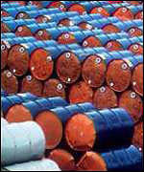
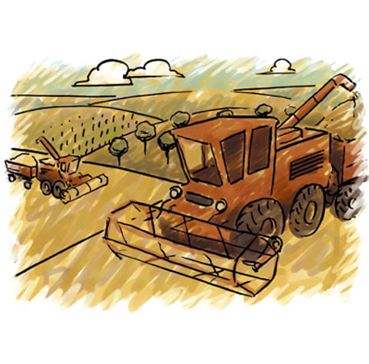

Why Biofuels?
High World Oil Prices
Renewable/Environment
Regulatory Incentive
Energy Security
Liquid Fuel
Agriculture
Because the President said so …
Notes:
Why Biofuels?
What has made Biofuels such an attractive solution recently?
High World Oil Prices
High prices have encouraged exploration for new energy sources.
Energy is Energy - biofuels compete with crude oil on a per Btu basis --> oil prices are high enough that biofuels are now roughly competitive with crude oil in the transportation sector
2. Renewable - New fuel can be grown each year, most fuels are carbon-neutral or carbon negative
Environmental - Emissions Benefits, Ethanol is an oxygenator that replaces MTBE, doesn’t pollute groundwater, biodiesel has low sulfur content
3. Regulatory - Tax incentives exist to motivate biofuel development, RFS
4. Energy Security --> reduce import dependence, energy supply-chain vulnerability, increase domestic energy supplies
5. Liquid Fuel - very energy dense medium (as compared to hydrogen, other renewables), fits easily in existing transportation infrastructure
6. Agriculture - Farmers enjoy the higher prices associated with biofuel feedstocks, good for rural economies, new source of income
7. Because the President Said so … State of the Union Address --> 35Bgal of “alternative” fuels by 2017

Slide 3
Characteristics of Biofuels
 | Biodiesel | Ethanol | Cellulosic Ethanol
Feedstocks | Soybean Oil Canola Oil Waste Grease Animal Fats | Corn Sugar Cane Sugar Beets | Switchgrass Woody Biomass Biomass Residue
Common Blends | B2, B5, B20, B100 | <E10, E20, E85
2005 Production (MMgal) | 91 | 3,900 | Small
Production Technique | Transesterification | Dry Mills Wet Mills | Hydrolysis Gasification/F-T
ASTM Standard | D 6751 | D 4806
Notes:
Major Characteristics of both Ethanol and Biodiesel
Primary Feedstocks in the United States
Biodiesel - Soybean Oil
Ethanol - Corn, Corn and More Corn
Common Blending Levels --> Each fuel can be blended with hydrocarbon equivalent in any amount
Ethanol certified for use up to 10% in all cars built since late 1970’s
E85 requires a FFV
Biodiesel blends could be used in any engine (sort of), but only warranted for use generally up to B5 or B20 level
Production Levels from 2005 --> Major growth occuring in biofuel industry
Production Technique
--> Biodiesel produced via a chemical reaction --> requires methanol, fatty-acid substance (I.e. vegetable oils)
--> Ethanol produced by distillation (I.e. just like brewing beer)
--> Cellulosic ethanol can be produced by a variety of methods --> all remain quite expensive compared to corn ethanol

Slide 4
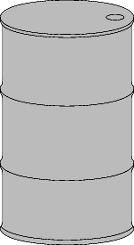

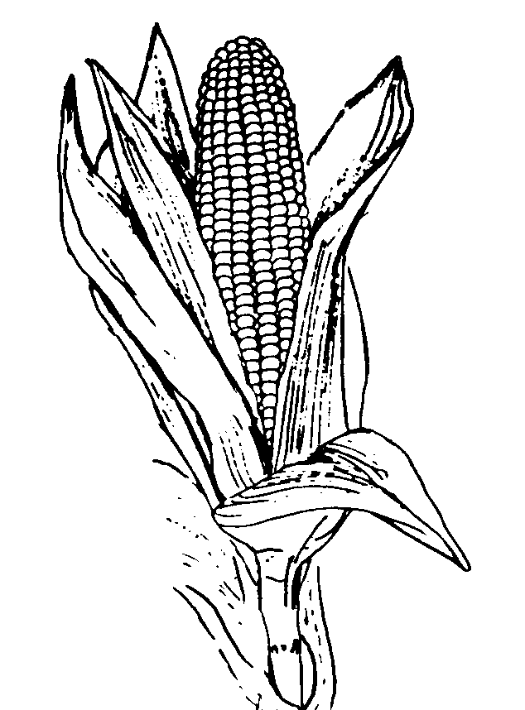
A Booming Biofuel Industry
?
Year | Gasoline (billion gal) | Ethanol (billion gal) | % of Gasoline Pool
2000 | 128.7 | 1.63 | 1.27%
2001 | 129.3 | 1.77 | 1.37%
2002 | 132.8 | 2.13 | 1.60%
2003 | 134.1 | 2.80 | 2.09%
2004 | 137.0 | 3.40 | 2.48%
2005 | 136.9 | 3.90 | 2.85%
Notes:
State of the Industry
Growth of ethanol/biodiesel industries very rapid (Figures from RFA/NBB)
Growing in both size and % of total fuel pool
Current Ethanol Production Capacity = 5.63Bgal (2/25/07)
Ethanol Capacity Under Construction = 6.19Bgal (2/25/07)
URL: http://www.ethanolrfa.org/industry/locations/
Current Biodiesel Production Capacity = 864MMgal (1/31/07)
Biodiesel Capacity Under Construction = 1.7Bgal (1/31/07)
URL: http://www.nbb.org/pdf_files/fuelfactsheets/Production_Capacity.pdf
Renewable Fuel Standard from EPAct 2005 will be surpassed

Slide 5
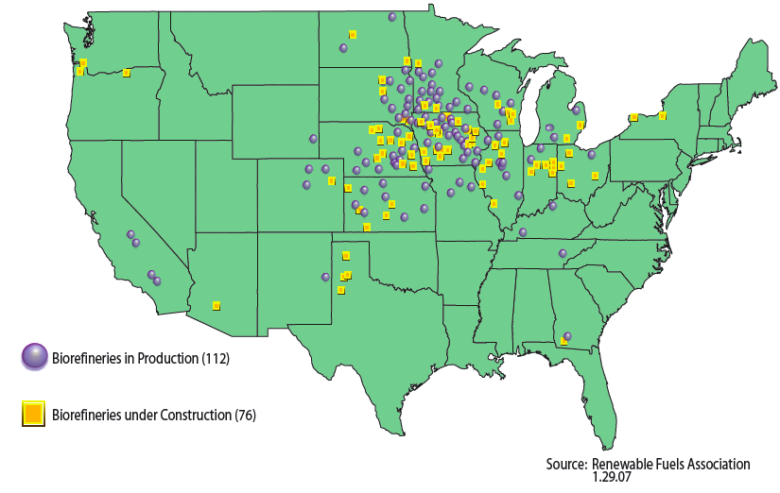
Locations of Ethanol Facilities
Notes:
Ethanol Plants are located primarily in the Mid-west close to corn supplies.
There are nearly as many plants under construction as are currently operating.
President Bush announcement in State of Union --> 35 billion gallons by 2017 --> MORE ETHANOL
Where will it stop? Can we reach the President’s Goal?
What are the major obstacles to growth?

Slide 6
What are the Major Obstacles to Growth?
Resource Limits
Biofuel
Growth
Technical
Challenges
Economic
Constraints
Infrastructure
Roadblocks
Notes:
Major Obstacles - Broken down into 4 General Categories
Resource Limitations - Where will feedstocks come from? Will there be enough land available?
Economic Constraints - WOP - will people buy it?, Production Economics (Feestock Cost, Co-product Credit), Capital Costs, State and Federal Tax Credits, RFS --> how long and how large?
Infrastructure Roadblocks - How will fuel be distributed --> will gas stations carry it? Will people buy biofuel cars? Developing new facilities to handle unique processing/transportation requirements of biofuels
Technical Constraints - Energy vs.Volume, Corrosion Issues, Fuel Quality, After-market biofuel kits, developing GMO crops

Slide 7

Resource Limitations
The amount of arable land in the United States is limited, no new land has been added, and existing land is under pressure to produce more than ever before.
Notes:
Most common challenge discussed about potential of biofuel growth
Land supply is limited and the amount of arable land is decreasing
Knee-Jerk Reaction --> Panic! There isn’t enough corn to feed all the gasoline cars in the United States! More Panic! Where will we grow our food?
2.There are competing uses for land for housing, crops, etc.
Three basic methods have been suggested to alleviate the Resource problem

Slide 8
Overcoming Resource Limitations
Find More Land - convert CRP, forestlands, and pastureland to cropland (for cellulosic)
Use Existing Land More Efficiently
  Boost Corn/Soybean Yields
  Engineer corn/soybeans to have more starch/oil
Change the Resource Limits
  Cellulosic Ethanol
  Use “2nd-Generation” feedstocks: perennials, agricultural residue, forest biomass, dedicated oilseed crops, etc.
Notes:
Three methods have been proposed
Find more land - Convert other lands to be able to grow crops (I.e. convert pastureland, forestland, CRP acres to grow crops)
Use the land more efficiently - Boost the yields of existing bioenergy crops to use existing land more efficiently
Change the rules - Switch from corn and soybeans to dedicated energy crops more appropriate for biofuel production --> cellulosic ethanol,

Slide 9
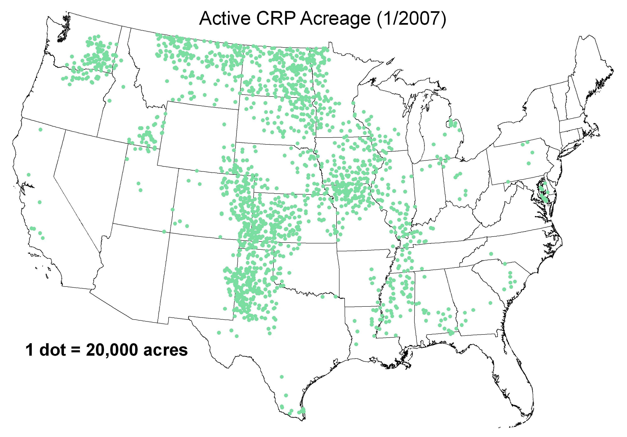
The Conservation Reserve Program
Notes:
Most commonly quoted source of new acres is the CRP --> (See graph on previous page)
How likely is it that CRP acres will be converted to grow corn/soybeans? How many acres?
Answer: Not very likely
1. Many CRP acres have been permanently converted based on landscape cover, wetland restoration, wildlife habitat
2. CRP acres are under contract --> nearly 85% renewal rate
3. Most people like the CRP, it’s a good deal for farmers, environmentalists like it, recreationists like it
4. Many acres are “marginal” and probably not suitable for mono-cropping each year anyway
AT MOST, up to 10 million acres could be converted --> 1.5 billion bushels of corn @ 150bu/ac == 4Bgal ethanol
Role of CRP for second generation biomass crops is much different
1. Perennials seen to have less impact on land - limited erosion rate
2. Pilot programs underway in MN, IA, NY, PA to explore growing biomass on CRP lands
3. 2007 Farm Bill proposes a biomass/conservation option for farmers

Slide 10

Boosting Yields of Corn/Soybeans
Notes:
Breeding of corn/soybeans could result in considerable gains of corn over time
Average annual increase in yield for corn = 1.8 bu/ac per year = 3.1 billion additional bushels by 2030 from 81 million acres of land
Average annual increase in yield for soybeans = 0.5 bu/ac per year = 1.0 billion bu by 2030 from 75 million acres
How much further can new seeds/farm practices boost the yield of corn?
What is the upper limit on the number of bushels an acre can produce?
Can high yields be sustained from an environmental perspective? Will sediment/nutrient/pesticide runoff increase?

Slide 11
The Promise of Cellulosic Ethanol
Dedicated Energy Feedstocks
  Limited Interaction with Food/Feed Markets
  More Environmentally Friendly
  Potentially much cheaper
Resources are Larger
  Derived from Waste Streams
  Grown in less favorable conditions/on marginal land
Liquid Fuel
Long-term Growth Potential
Notes:
Cellulosic Ethanol is the darling of the Biofuel Industry - Why?
--> It can overcome resource limits of corn/soybeans by changing the rules of the game
Dedicated Energy Feedstock
Crops not used food/feed - Less susceptible to price volatility, competitive pressure
Most energy crops are perennials, native plants --> reduces tilling, runoff, pesticide/fertilizer application
Resource Limits are Larger --> Billion Ton Vision
Other sources besides “food” crops can be used --> landfill, wood, ag residue, etc.
Marginal Land (I.e. CRP, pasture) can be used more efficiently
Still Liquid fuel --> bulk of transportation needs in the near future will still be ICE based
HUGE markets for the fuel, HUGE potential feedstock supply

Slide 12


Slide 13
Economic Constraints
World Oil Price
Feedstock Price/Co-Product Values
  57% of ethanol production cost is the feedstock
  70-78% of biodiesel production cost is the feedstock
  High Value Co-Products essential to lower costs
Saturation of Co-Product Markets
  Large supply of DDGS, crude glycerin can depress prices
Federal Tax Incentives
Blended Biofuels vs. Dedicated Biofuels
Notes:
World Oil Price
Price for energy is set by the world price of oil --> biofuels must be competitive or cheaper for consumers to purchase
Energy is Energy, regardless of which form it comes in. Biofuel BTU = Oil BTU. High Oil Prices are required before biofuels can compete with oil on a $/BTU basis.
What is the price of oil for which ethanol can be produced profitably?
Feedstock Prices/Co-Product Values
Biofuel production creates large quantities of co-products (DDGS, crude glycerin) --> high value for co-products offsets the feedstock costs and reduces final consumer cost. In an era of high corn prices, high value co-products will be critical for keeping prices low. Viability of new feedstocks wil depend on the value of co-products.
Oversupply of Co-products - depression of prices in other market, reduction of co-product value, less competitive with oil
Biodiesel Glycerin Example --> crude glycerin now worth less than $0.05/lb --> cheap enough to be free
DDGS --> limits to percentage that can be contained in animal feed, too much will cause prices to fall
Blend Markets vs. Dedicated Alternative Fuel Markets
Short-term --> easy to add biofuels in low-level blends and this market will absorb most of the biofuels produced for some time
Long-term --> to achieve significant reductions of oil imports, environmental benefits --> must move to high-blend biofuels
Tax Incentives
How long will they last? Will the incentives be changed as the market grows and the Federal Treasury takes a hit?

Slide 14

Notes:
What will the world price of oil be?
Corn/Soybean Biofuels can compete so long as high high oil prices are maintained
Alternative feedstocks (cellulosic, etc.) will become more competitive as prices rise
Oil Price Volatility? How will biofule market weather the highs/lows of oil prices

Slide 15
The Importance of Co-Products
Co-Products
DDGS
Crude Glycerin
Non-Fuel
Markets
Biofuel Production Facility
Biofuel Feedstock
Biofuels
Ethanol
Biodiesel
Oil/Fuel
Markets
Notes:
Co-Products play a critical role in determining biofuel prices
--> Revenue of Biofuel producers set by the price of oil --> Biofuels compete directly with oil as energy source
--> Costs determined by feedstock cost and co-product credits --> coproducts critical if revenues > costs
--> Current co-products: DDGS from Ethanol, Crude Glycerin from Biodiesel
--> Co-products must have high value to offset costs, maintain competitiveness with oil
--> Tell Biodiesel/Glycerin story
--> New feedstocks must have high-value coproducts
--> Mustard Seed for Biodiesel --> use meal as a pesticide, etc.

Slide 16
Regulatory Incentives
EPAct 2005 - Renewable Fuel Standard
  7.5 billion gallons by 2012, 250 million from cellulosic
Biofuel Tax Credits
  $0.51/gal for ethanol - expire/reauthorize in 2010
  $1.00/gal for biodiesel from virgin oil feedstocks
  $0.50/gal for biodiesel from recycled/waste feedstocks
  Biodiesel tax credit - expire/reauthorize in 2008
Import Tariff on Ethanol - $0.54/gal extended to 2009
State Incentives?
Notes:
Many Regulatory Incentives to produce Biofuels
Outline incentives - note they are critically important to the biofuel industry
Incentives have historically been renewed, extended or altered
Will they continue in the future?
The cost to the Federal Treasury will be significant over time
RFS set to be surpassed, does the government really need to provide support to biofuels?

Slide 17
Blended vs. Dedicated Biofuels
Short-term demand for biofuels is primarily for blends. Long-term demand required for sustained industry growth must come from high-percentage, dedicated biofuels.
2005 Biofuel Production (billion gallons)
Biodiesel | Ethanol
0.091 | 3.904
Potential Blend Market (billion gallons)
E10 | 13.7
B2 | 0.86
B5 | 2.16
B20 | 8.64
Notes:
Ethanol Biodiesel have some benefits over oil that a premium can be charged for
--> Ethanol is an oxygenator used in Reformulated Gasoline
--> Biodiesel increases lubricity, has some net emission benefits
--> Both of these provide an incentive to blend small fractions of biofuels with oil
Result: In the short-term all biofuels will be blended --> potential markets listed above (note they are less than the 35 billion gallons that President Bush recommended)
Problem: Long-term growth cannot be for the same reasons as the blend market
--> Long-term growth will require dedicated, high-blend biofuels
--> Cost must be extremely competitive with oil --> consumers will buy least-cost energy source
--> Need pumps, pipelines, biofuel vehicles.
The major growth obstaclee facing biofuels is bridging the gap between “blend market” and “total market” --> requires whole new paradigm
-->

Slide 18
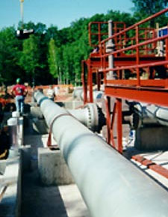
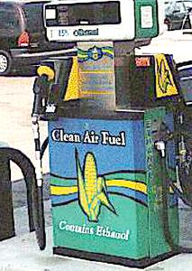

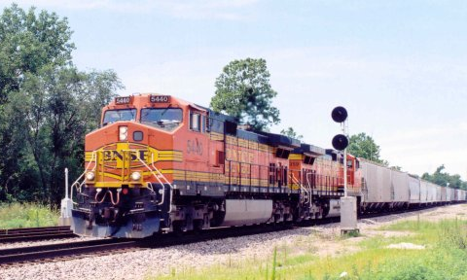
Infrastructure Roadblocks
“Pumps, Pipelines and People”
  Pumps - limited # of high-blend biofuel pumps
  Pipelines - high transportation costs to end-markets
  Low consumer awareness, limited # of FFV’s
Notes:
Pumps, Pipelines and People

Slide 19
Limited Biofuel Pump Availability
Fuel | # of Stations | % of Total
All Fuels | ~169,000 | 100%
Biofuels (Total) | 2,125 | 1.25%
E85 | 1,157 | 0.7%
Biodiesel | 968 | 0.5%
Notes:
Many Many gas stations in the United States
< 2% carry some kind of dedicated biofuel blend
many are required to carry E10, but all cars can use E10, so it does little to improve biofuel availability for dedicated fuels
National Ethanol Vehicle Coalition keeps track of all the E85 pumps --> numbers are increasing rapidly, but some states have far more than others --> most E85 vehicles are not near and E85 pump
How many pumps are required to make E85 available nearly everywhere? --> Don’t know, but look at the fact that Diesel isn’t available at many gas stations, yet is still considered easily available.

Slide 20
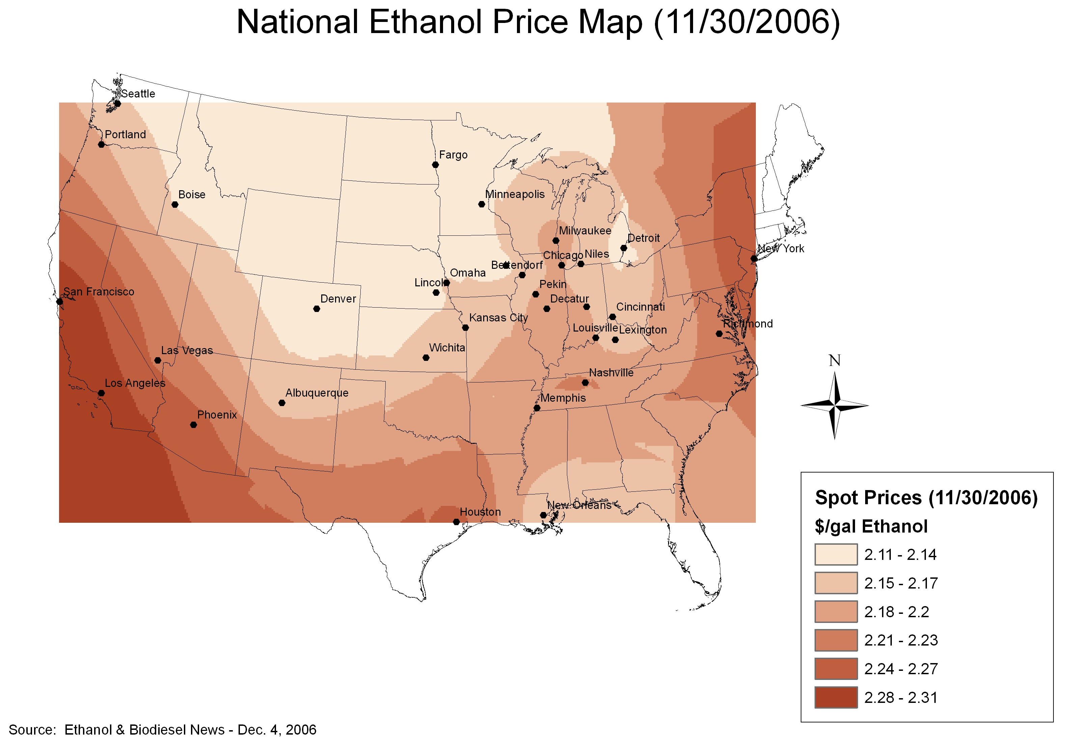
Transporting Biofuels to Market
Notes:
Ethanol Price Map
Major Producing Regions are in the Mid-west
Major Consuming Regions are on the Coasts
Map above shows how retail spot prices for ethanol rise for areas most distant from the producing regions --> Transportation costs are a significant factor!!
Most Ethanol transported by tanker car --> shuttle trains much more efficient, reduce switching costs
Ethanol cannot be batched through existing pipelines because easily contaminated with water
Will a pipeline be built in the future? To where?

Slide 21







Limited Numbers of FFV’s
Notes:
Very few FFV’s produced relative to normal cars each year
Per-unit incremental cost is small (~$200) but requires a whole engine assembly plant
FFV’s that are produced are generally very large, low-mpg, large, expensive vehicles --> CAFÉ Credits
Many people not aware they have an FFV --> “Go Green, Get Yellow” Campaign --> tell Dad Story :)
~5-6 million FFV’s have been produced for the domestic market

Slide 22
Technical Challenges
Cellulosic Ethanol Capital Costs/Production Technology
Retrofitting Pumps, Fuel Systems, Fuel Distributors
Maintaining Fuel Quality
After-market Biofuel Kits - emissions certification
New Engine Designs - Biofuel Only?
Energy Content and Fuel Volume
Notes:
Significant Technical Challenges must be overcome by industry
--> Cellulosic Ethanol --> make it cheap enough to compete not only with corn-ethanol, but with Oil
--> Capital Costs are very, very large --> R&D required or cost-sharing (gov’t loans) necessary to bring costs down
--> Infrastructure --> Ethanol/Biodiesel have unique transportation requirements --> Retailers/Distributors must retool to accommodate new fuels, but also blends of fuels (I.e. Biodiesel must be kept warm in Winter)
--> Fuel Quality is of critical importance for consumer acceptance
--> How to convert existing cards to run on Biofuel --> after market kits technically illegal
--> New engine designs may be biofuel only to optimize energy recovery of fuel --> R&D necessary
--> Energy Content vs. Fuel volume --> will consumers pay more per Btu? Can new engine designs overcome this problem?

Slide 23

Energy Content and Fuel Volume
Notes:
GGE
Gasoline: 1.00
E100: 0.67
E85: 0.76
Diesel: 1.11
Biodiesel: 0.95

Slide 24
Conclusion
Resource Limits
Biofuel
Growth
Technical
Challenges
Economic
Constraints
Infrastructure
Roadblocks

Slide 25
Thank you
Energy Information Administration
www.eia.doe.gov
Bryan Haney
bhaney@udel.edu

