Slide 1
U.S. State and Regional Action on Climate Change
Patrick Hogan
State Solutions Research Associate
Pew Center on Global Climate Change
2007 EIA Energy Outlook, Modeling, and Data Conference
March 28, 2007

Slide 2

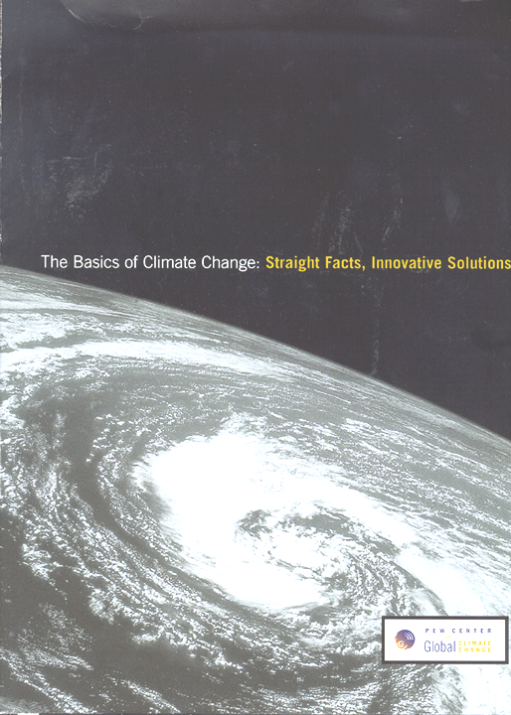
The Pew Center
Founded in May 1998
Independent, Non-Profit, Non-Partisan
Research (science and impacts, policy, economics, solutions)
Education and Outreach
Business Environmental Leadership Council

Slide 3
Overview
Context
Motivation for state action
The landscape of state policies that address climate change
Highlights from states taking the lead
State policy diffusion

Slide 4
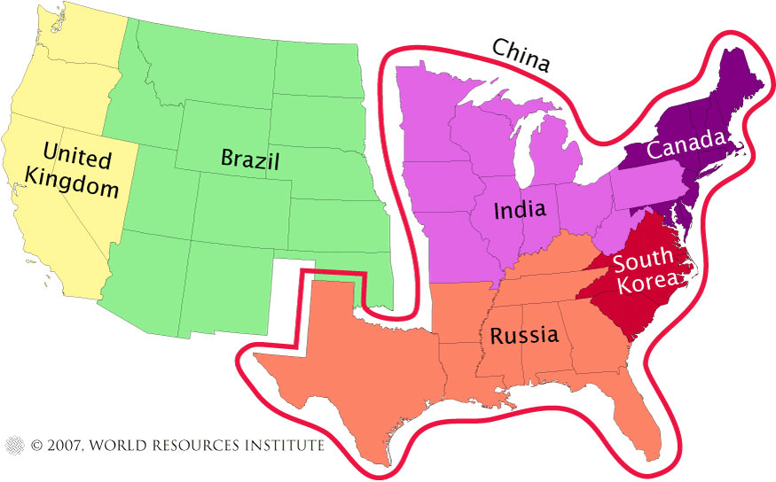
State Emissions Are Significant…
Source: World Resources Institute (Climate Analysis Indicators Tool; online at http://cait.wri.org/figures.php)

Slide 5
Motivations for GHG reductions
Concern about climate impacts
Economic development
Energy price volatility
Energy independence
Air quality concerns
Traffic congestion
Other

Slide 6
The Landscape of State Policies
Direct and Indirect GHG Emission Reductions
Governors and legislators are acting
Almost Every State is Doing Something:
  Regional Initiatives
  Targets, Climate Action Plans and GHG reporting
  Electricity (renewable energy mandates, carbon adders, public benefit funds, green pricing, REC tracking)
  Transportation (CA GHG vehicle standards, smart growth, transportation management, cleaner fuels and vehicles)
  Ag and Forestry (sequestration, renewable energy, biofuels, ethanol)
  Other (e.g., energy efficiency, waste management)

Slide 7

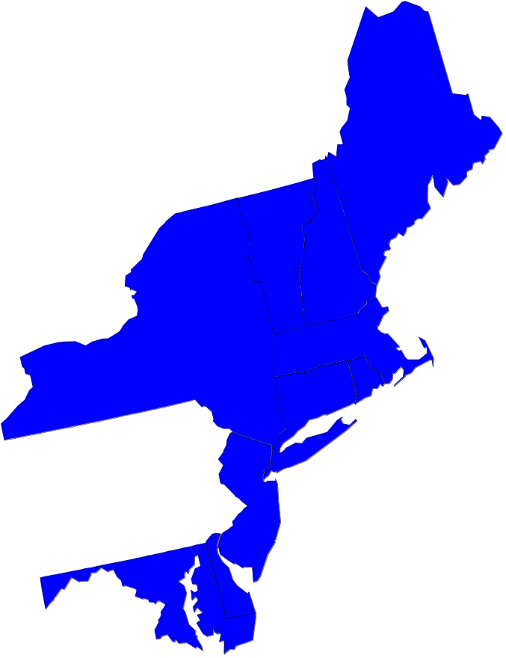
RGGI
First mandatory U.S. GHG cap-and-trade program
Regional; power plant CO₂ emissions
Initiated 2003 by NY Gov. Pataki; MOU announced Dec. 2005
Stabilize emissions at current levels 2009-2015, 10% reduction by 2019
Model rule (template) announced August 2006
Each state must adopt final model rule through legislation or regulation by Dec. 31, 2008
MA is back in; RI joining; MD joining later this year

Slide 8
Implications of RGGI
Potential model for national policy
First U.S. mandatory cap-and-trade system for GHG emissions
Possible linkage to CA, EU-ETS, CDM
Novel standards approach to offsets
Real data to inform policy
Allowance allocation is the forum for equity issues

Slide 9
California Actions
AB 32: Global Warming Solutions Act of 2006
  Set California’s targets at 1990 levels by 2020
  First enforceable state-wide program to cap major industrial GHG emissions and include penalties
  Authorizes market-based mechanisms (cap-and-trade); allows one-year extension on targets
  Possible linking with RGGI, EU-ETS
Low Carbon Fuels Standard (reduce carbon intensity of vehicle fuels sold in California at least 10% by 2020)
SB 1368: greenhouse gas performance standard for new long-term electricity contracts
Renewable Portfolio Standard (20% by 2010)
Vehicle GHG standards: 22% reduction by 2012; 30% by 2016

Slide 10
State Action Across the Country
South Carolina – Governor’s Climate, Energy, and Commerce Advisory Committee (Feb. 2007)
Illinois
  Governor announced new statewide targets (1990 levels by 2020, 60% below by 2050); Advisory Group to recommend strategies (Feb. 2007)
New Jersey: Executive order establishing new greenhouse gas emissions targets for the state of 1990 levels by 2020 and 80 percent below 2006 levels by 2050 (Feb. 2007)
Florida
  Energy Commission (June 2006)
Alaska
  Climate Impact Assessment Commission (May 2006)

Slide 11
State Action Across the Country
Arizona
  Targets (Sept. 2006): GHG emissions at 2000 levels by 2020, 50% below this by 2040
New Mexico
  2000 levels by 2012, 10% below 2000 by 2020
  Governor’s Dec. 2006 executive order carries out recommendations from Governor’s Advisory group (est. June 2005) to achieve emissions targets
North Carolina
  Legislative Commission on Global Climate Change (est. Sept. 2005)
Montana
  Governor created climate change advisory council (April 2006)

Slide 12
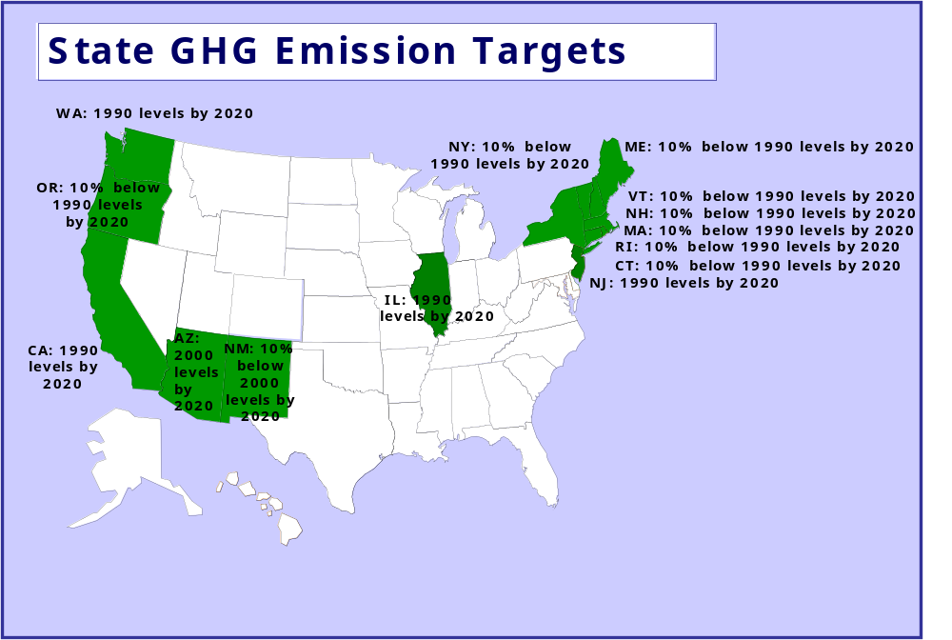

Slide 13
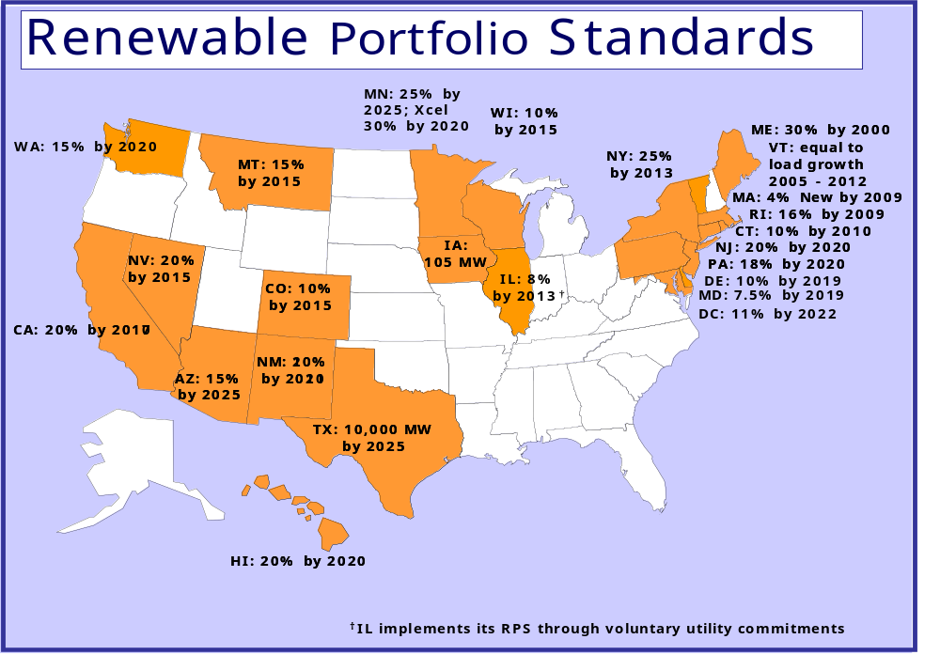

Slide 14
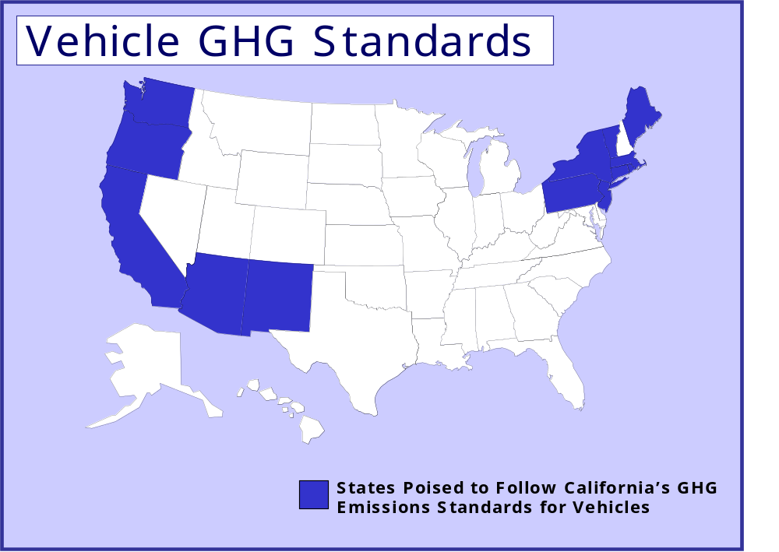

Slide 15
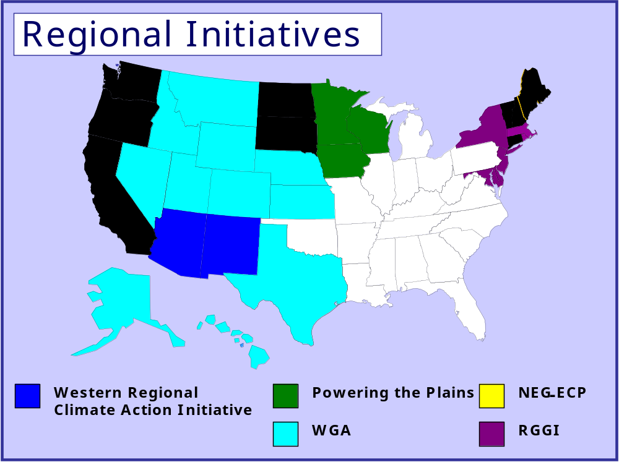

Slide 16
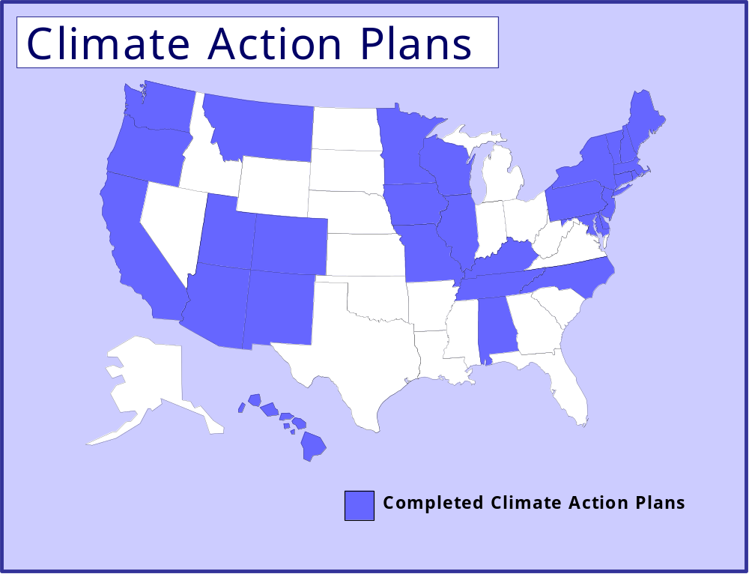

Slide 17
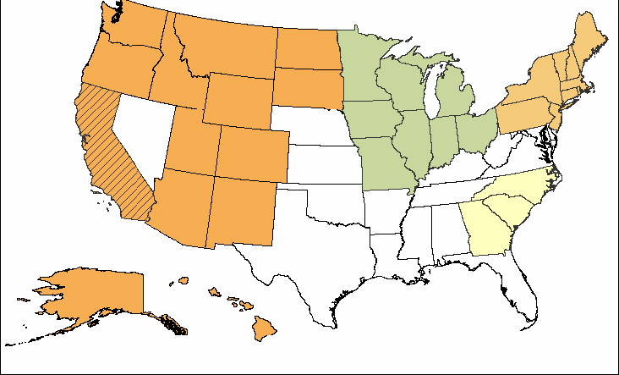
Multi-State Climate Registry
Source: NESCAUM MSCR Fact Sheet
California Climate Action Registry (CCAR)
Lake Michigan Air Directors Consortium (LADCO)
Observer States
Eastern Climate Registry (ECR)
Western Regional Air Partnership (WRAP)

Slide 18
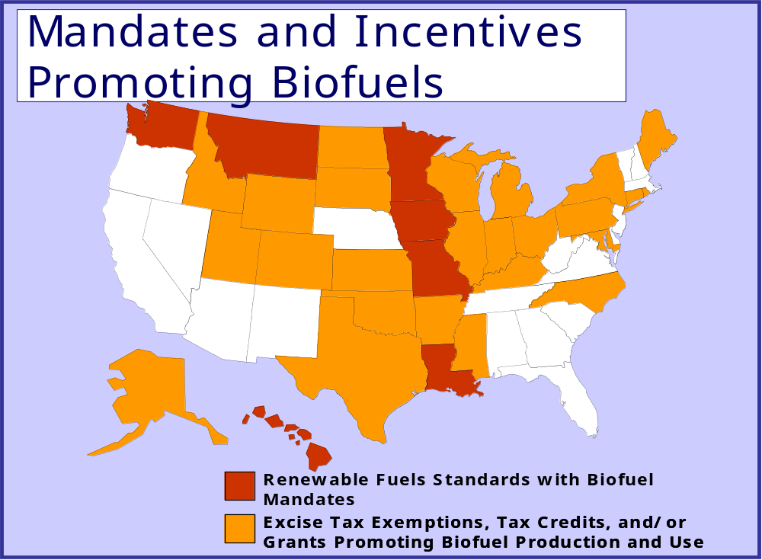

Slide 19
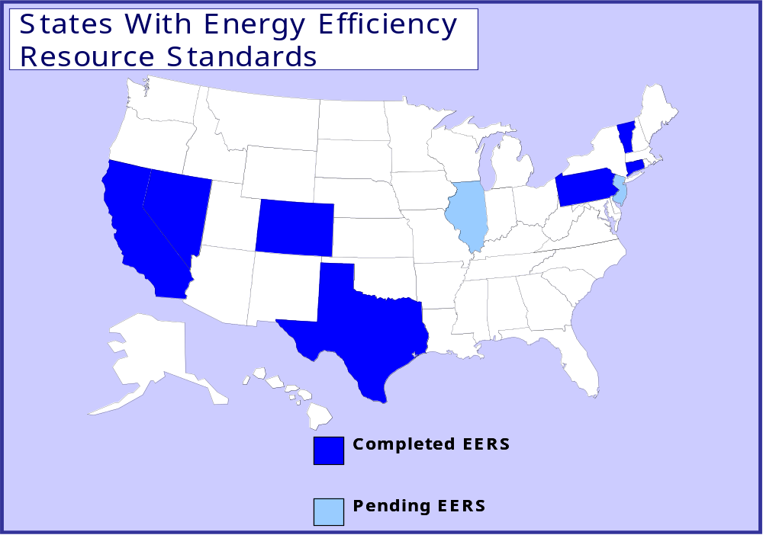

Slide 20
Conclusion
Momentum is picking up at the federal level, but states are still leading on climate
Achieving real emissions reductions
States provide lessons for federal action
Even with federal action, states will play a key role
Trend toward regional action
Multiple drivers, multiple benefits

Slide 21
Further information
Pew Center on Global Climate Change
www.pewclimate.org

