Slide 1
Power Sector Views on
Climate Change Legislation
EIA Energy Outlook and Modeling Conference
Washington, D.C.
March 28, 2007

Slide 2
Industry Efforts To Date
EEI keenly understands importance of climate change
EEI members are leaders in reducing greenhouse gases
  1994
    Part of “Climate Challenge” joint government / industry partnership
    Eliminated 237 million metric tons of carbon dioxide equivalent “greenhouse” gas (GHG) emissions in 2000 alone
    More than 2/3 of all reported reductions under 1605(b) program
  2004
    Industry reduced, avoided or sequestered more than 282 million metric tons of carbon-equivalent GHG emissions
    Formed Power Partners; pledged to reduce GHG intensity 3-5% by 2012
  Currently
    Leader in Asia-Pacific Partnership on Clean Development and Climate emphasizing importance of technologies
    Involves Australia, China, India, Japan, Republic of Korea and U.S. – which together produce ~50% of world’s CO₂
    Continuing Power PartnersSM programs

Slide 3
Baseline: Challenges Going Forward
EIA projects energy demand will grow 40% by 2025
292 GigaWatts of new capacity needed by 2030
  Coal’s share of generation mix will increase to 57%
  Assumes 12 new GW of nuclear power
  Renewables will grow but still only 8-9%, including large-scale hydro
Must invest now in new generation, T&D to meet this demand
No short-term options to significantly reduce GHG emissions from power generation

Slide 4
Baseline: Challenges Going Forward
Need to focus on developing cleaner coal, nuclear and gas generation technologies, while continuing efforts on renewables, energy efficiency and demand-side management
Current efforts yielding results:
  IGCC costs coming down
  Major RDD&D effort could decrease cost of generation with capture
  FutureGen (1st zero-emission coal plant) 2012 operational start
Against this backdrop, EEI has developed a set of principles to guide member involvement in ongoing public policy debate

Slide 5
EEI Global Climate Change Principles
EEI will continue to emphasize the importance of:
A reliable, stable and reasonably-priced electric supply to maintain the competitiveness of the U.S. economy
A fuel-diverse generation portfolio to assure system reliability, energy security and price stability
Public policies and initiatives to accelerate the development of viable and cost-effective energy efficiency programs and technologies, including carbon capture and storage
International partnerships
Solutions compatible with a market economy that deliver timely and reasonably priced GHG reductions

Slide 6
EEI Principles: Primary Components
Ensure the development and cost-effective deployment of a full suite of “climate friendly” technologies;
Minimize economic disruptions to customers and avoid harm to the competitiveness of U.S. industry, and
Ensure an economy-wide approach to carbon reductions

Slide 7
EEI Principles: All Technology Options Critical
Addressing climate change requires an aggressive and sustained commitment to a full set of technology options, including:
  Intensified national commitment to energy efficiency – advanced efficiency technologies and new regulatory and business models
  Accelerated development and cost-effective deployment of demand-side management and renewable energy resources
  Advanced, clean coal technologies
  Carbon capture and storage of all types of coal-based generation
  Increased nuclear capacity and advanced nuclear designs
  Plug-in electric hybrid vehicles

Slide 8
Landscape: Administration and States
Administration
  Continued support for Climate VISION, emission intensity reduction goals
  Expansion and implementation of Asia-Pacific Partnership initiatives
  Softening in Administration position?
States
  Some moving aggressively given perception of federal inactivity
  State CO₂ regulations in place – NH, MA, OR, WA
  RGGI states finalizing implementation; 10th state (MD) to join soon
  California – GHG cap and emissions performance standards program
  30+ state national GHG registry underway
  Carbon capture and storage continuing – IL, MT, TX, WY, etc.

Slide 9
Landscape: Congress
House of Representatives
  House Energy and Commerce Committee (Dingell, D-MI) hearings
  Speaker Pelosi (D-CA) formed Select Committee on climate change – goal is legislation by July 4 recess
Senate
  Environment and Public Works Committee Chair Boxer (D-CA) moving aggressively, with numerous hearings expected during 2007
  Multiple bills have been introduced or are being prepared: McCain-Lieberman, Sanders, Feinstein, Kerry-Snowe, Bingaman
  Erosion of opposition to mandatory cap; desire “to do something”
  Senate vote on climate amendment likely this year
  Linkage to renewable portfolio standard; RPS legislation creates a new “baseline” for any climate vote

Slide 10
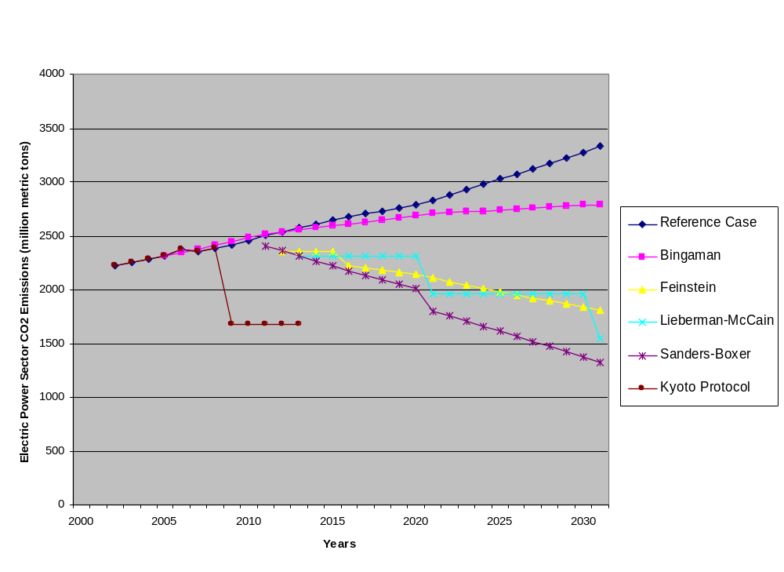
Comparison of Key Bills

Slide 11
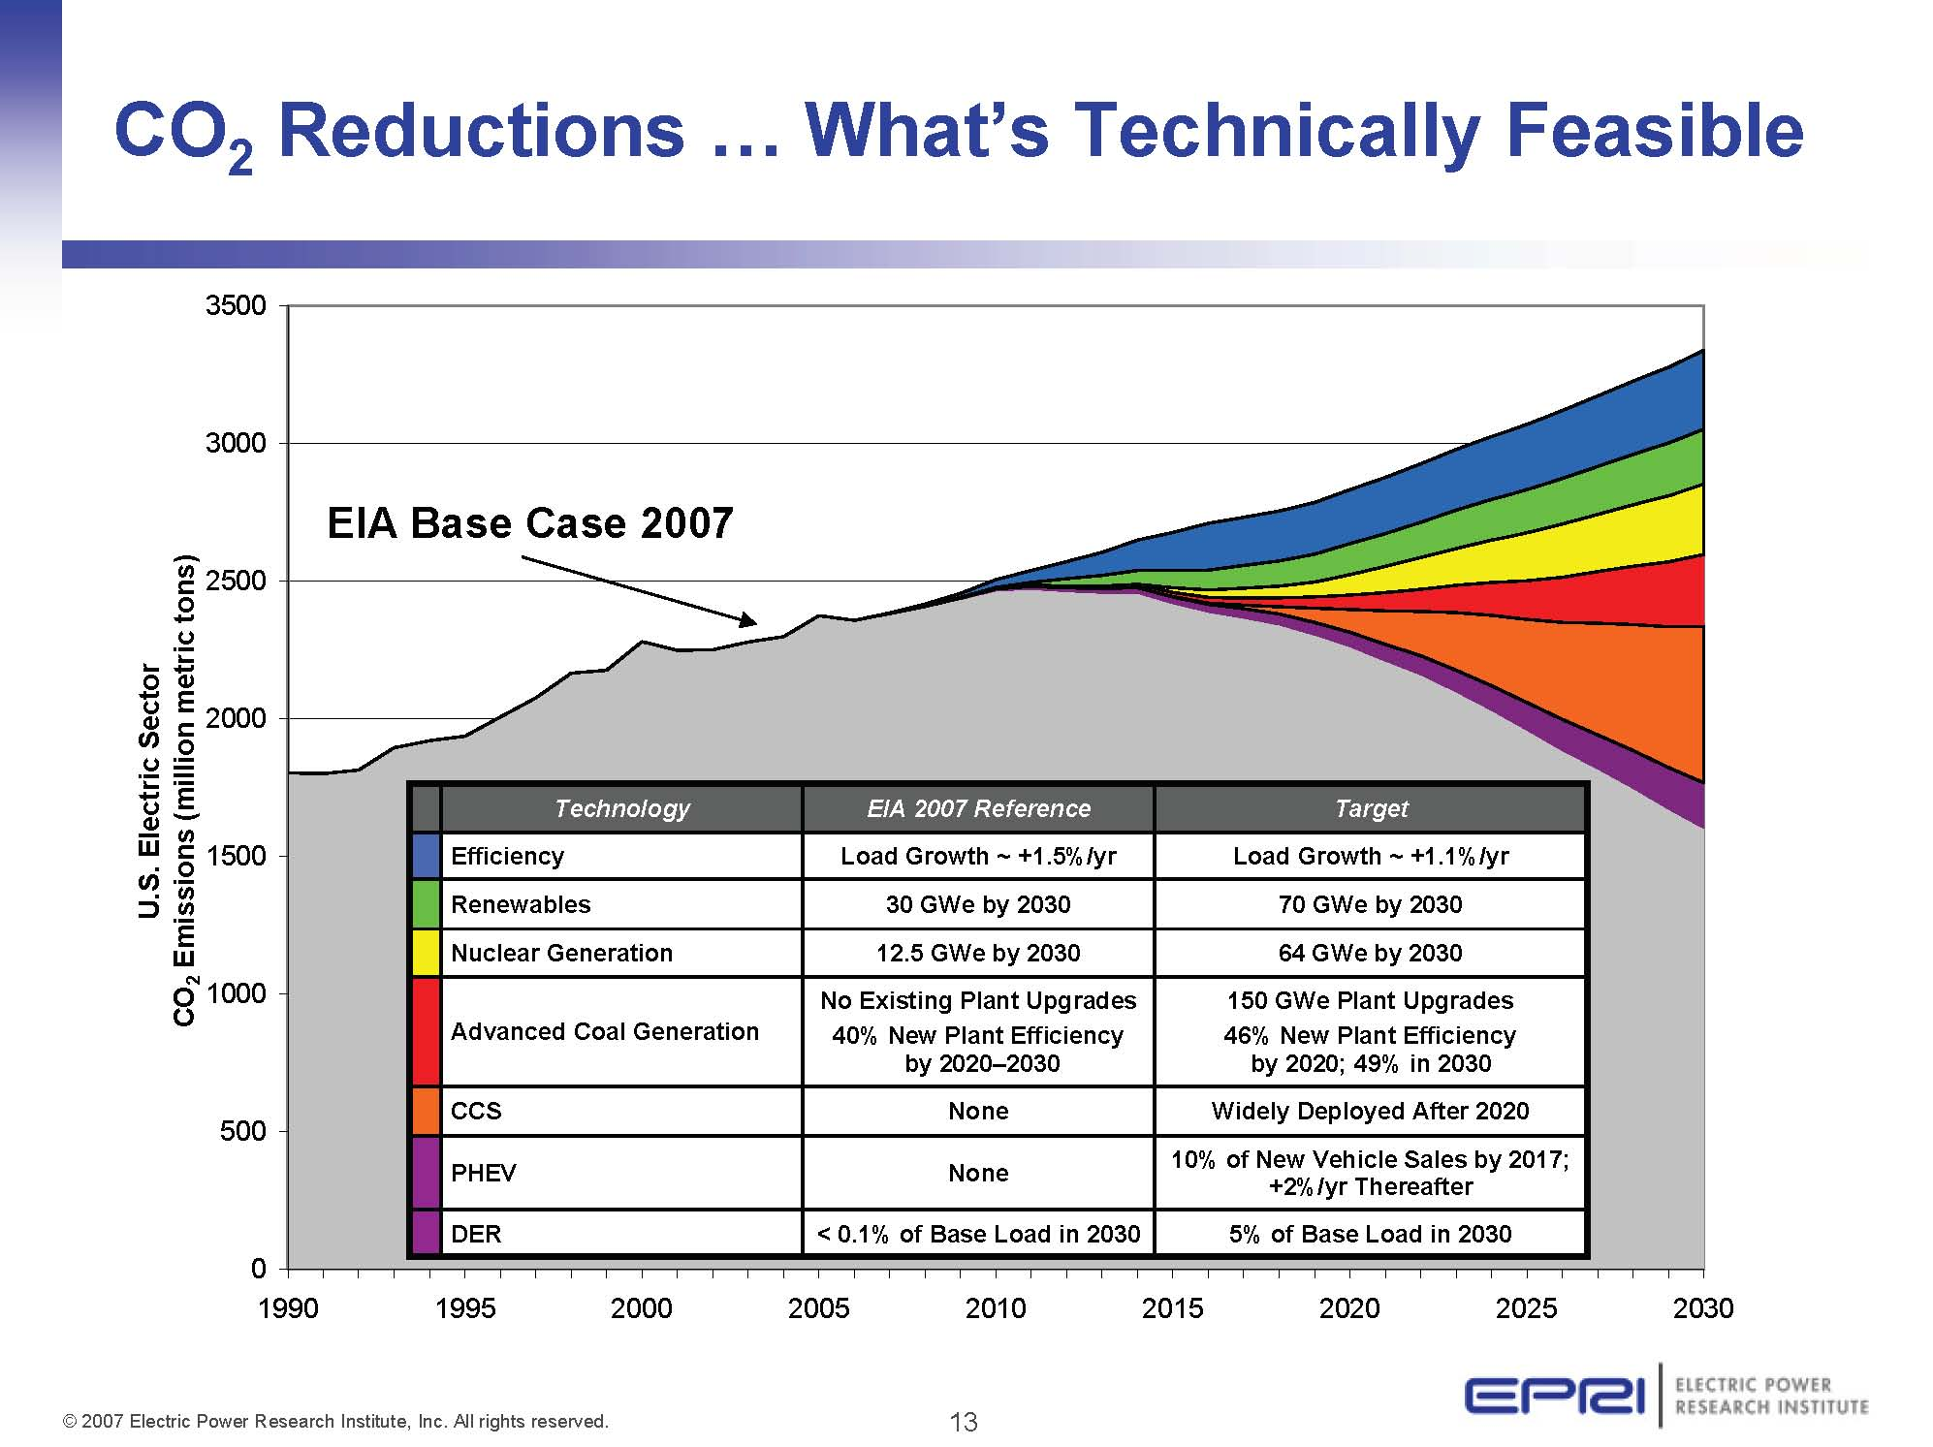
CO₂ Reductions…What’s Technically Feasible
*
* Achieving all targets is very aggressive, but potentially feasible

Slide 12
Key Technology Challenges
It is technically feasible to reduce U.S. electric sector CO₂ emissions significantly, but to do so the U.S. electricity system will need ALL of the following components:
Smart grids and communications infrastructures to enable end-use efficiency and demand response, distributed generation, and PHEVs
A grid infrastructure with the capacity and reliability to operate with up to 30% intermittent renewable generation
Significant expansion of nuclear energy enabled by continued safe and economic operation of existing nuclear fleet; and by a solution for managing spent fuel
New commercial-scale coal-based generation units operating with 90+% CO₂ capture and storage in a variety of geologies

Slide 13
Challenge: Technologies and Timeframes
Clean coal technologies not commercially available until 2015
  IGCC / gasification and advanced combustion systems
  Will improve plant efficiencies and achieve some GHG reductions
  Widespread deployment not expected until then due to cost differential with conventional systems
Carbon capture and storage (CCS) technologies not commercially available until 2020-2025
  EPRI estimates 2025 for commercial availability at today’s pace
  Possibly by 2020 with more aggressive funding and more pilot projects
  Would make coal-fired generation zero or near-zero GHG emissions
Deployment of nuclear plants not possible until 2015-2020 at earliest
Deployment of CCS and nuclear would buy time for developing next generation technologies (e.g., hydrogen, advanced nuclear, etc.)

Slide 14
Challenges Are Plentiful
Urgent need for action on environment / energy efficiency
Supply margins are declining and demand is increasing
Cost of producing electricity no longer declining
Significant need for infrastructure investment
Lead times on permitting and construction are longer
Diversity and aging workforce increasingly important
New technologies must be developed and commercialized

Slide 15
EEI Principles: Primary Components
Ensure the development and cost-effective deployment of a full suite of “climate friendly” technologies;
Minimize economic disruptions to customers and avoid harm to the competitiveness of U.S. industry, and
Ensure an economy-wide approach to carbon reductions

Slide 16
Eric Holdsworth
202-508-5103
eholdsworth@eei.org

