Slide 1
Update on Federal Climate Legislation
Joe Kruger
EIA Energy Outlook, Modeling, and Data Conference
March 28, 2007

Slide 2
Overview
Political context for legislation in the U.S.
  What has changed?
  What hasn’t changed?
Key design elements of legislative proposals
Conclusions

Slide 3
Political context: What has changed?
Increased public awareness
Changes in Congress
State greenhouse gas programs
New players at the table: evangelicals, farmers, hunters/fishermen, security hawks
Political tipping point for some industry groups/companies

Slide 4
Political context: What hasn’t changed?
Federal policy
Regional differences (coal vs. non-coal)
Competitiveness concerns
Need 60 votes in Senate
Learning curve for legislative complexities

Slide 5
Key design elements
Targets
Scope and point of regulation
Allowance distribution
Mechanisms to limit price uncertainty (safety valve)
Additional incentives for R&D, technology deployment
International and competitiveness issues

Slide 6
Emission Reduction Targets
(From BAU)
 | 2020 | 2030
Sanders-Boxer | 42.0% | 63.0%
Kerry-Snowe | 42.0% | 61.0%
McCain-Lieberman | 39.0% | 59.0%
Feinstein-Carper (electricity only) | 25.0% | 45.0%
Bingaman-Specter | 7.6% | 21.9%
Source: Resources for the Future

Slide 7
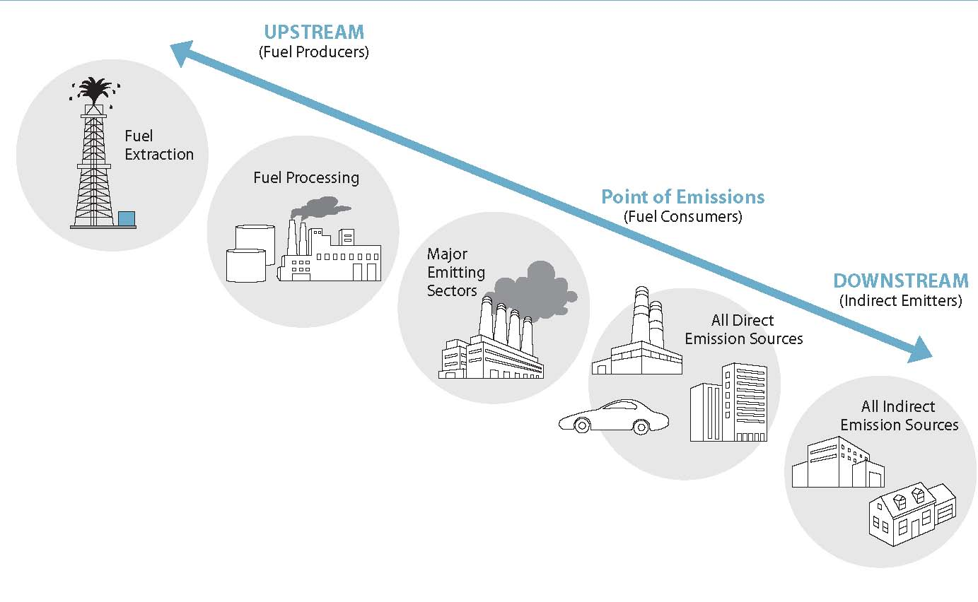
Scope & Point of Regulation
Some proposals are economy-wide, others are just the power sector
Economy-wide
  some have regulation only upstream
  others are a hybrid of upstream and downstream

Slide 8
Allowance distribution
Some proposals include auctions
  Bingaman: 10% auction increases to 55% over 30 years
  McCain-Lieberman: Climate Change Trust fund will auction a portion
Some proposals use auction proceeds or allowances to compensate groups that aren’t at point of regulation
Some proposals defer to Executive Branch

Slide 9
Cost containment
Proposals use a variety of measures that address different aspects of costs: e.g., overall costs, price certainty, price volatility
Proposals:
  Safety valve
  Borrowing
  Circuit breaker
  Offsets, with varying degrees of restrictions

Slide 10
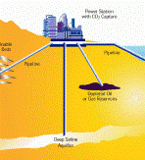
Incentives for R&D, technology deployment
Most legislative proposals provide additional incentives for R&D, technology deployment
  Funded through auction revenues or other means

Slide 11
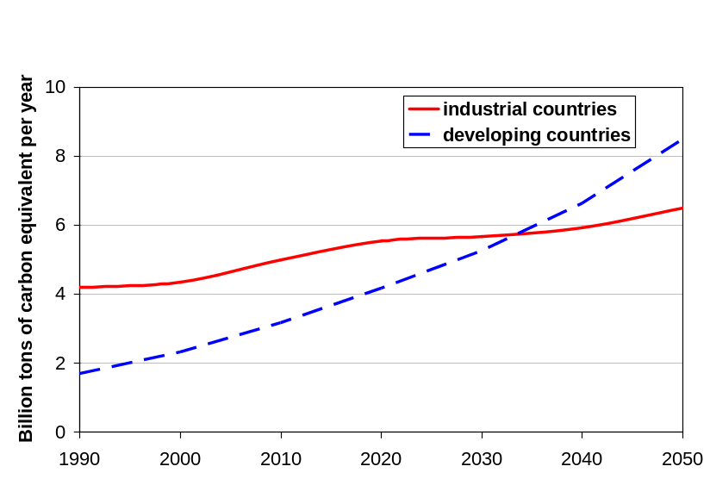
International issues
Carrots
  Incentives for developing country projects
Sticks
  After first step, further U.S. action would be dependent on actions of large trade partners and emitters
Even bigger sticks?

Slide 12
Conclusions: Five Things to Watch
Organized labor
Key Republican senators
Influence of state programs
2008 Presidential campaign
Impending economic analysis of bills

