Slide 1
Gasoline Demand Trends
EIA Energy Outlook, Modeling and Data Conference
March 28, 2007
Washington, DC
Tancred Lidderdale
Energy Information Administration

Slide 2
Traditional Issues
Demographics
  Age distribution of population
  Location of home and work
Socioeconomics
  Number of cars per household
  Cars versus light trucks (including SUVs)
  Travel to Work
  Discretionary travel

Slide 3
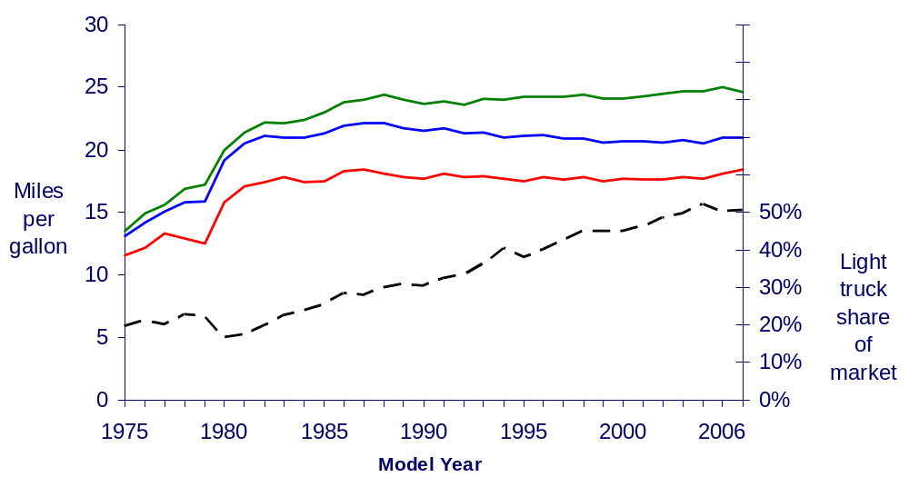
Increasing Light Truck Market Shares
Average fuel economy new cars
Average fuel economy all new vehicles
Average fuel economy new light trucks
Light truck share of new vehicle market

Slide 4
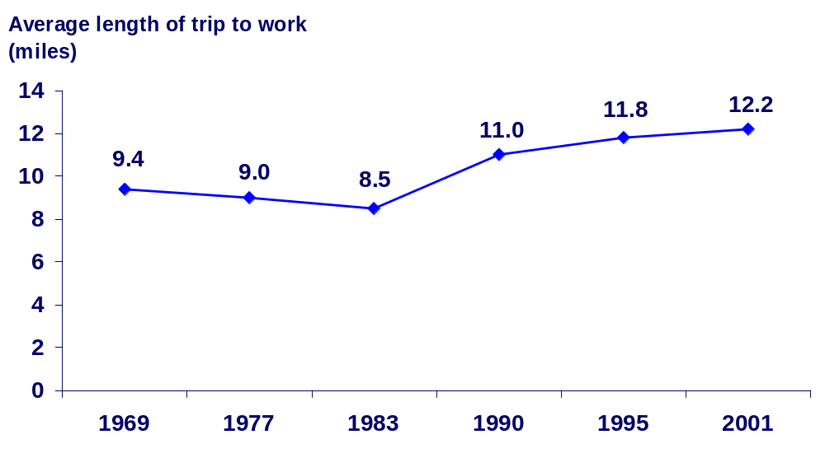
Longer Trip to Work is a Cost of Lower Priced Houses in the Suburbs
Source: Federal Highway Administration, Nationwide Personal Transportation Surveys

Slide 5
More People Are Driving Alone to Work
Principal Means of Transportation to Work (percent of all workers)
 | 1997 | 1999 | 2001 | 2003 | 2005
Drives Self | 77.5 % | 78.2 % | 78.3 % | 79.4 % | 79.3 %
Car Pool or Mass Transportation | 14.6 % | 14.3 % | 14.4 % | 13.1 % | 13.5 %
Works at Home | 3.1 % | 2.8 % | 2.8 % | 3.1 % | 3.4 %
Source: U.S. Census Bureau, American Housing Surveys. No shown: Bicycle, motorcycle, taxi cab, walk to work, other means

Slide 6
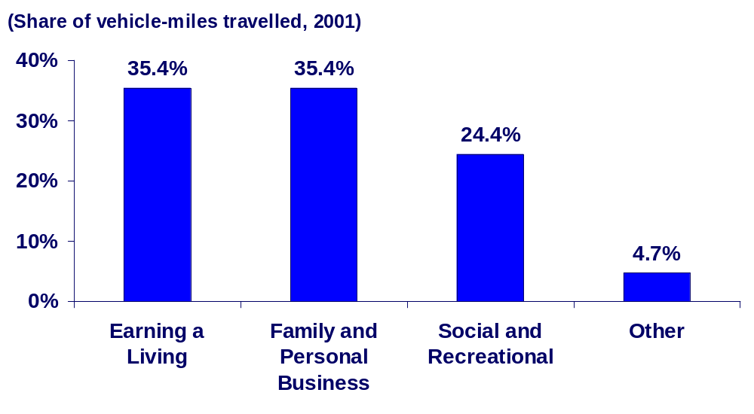
Only About 1/3 of Travel is Work-Related

Slide 7
Non-Traditional Issues
Gasoline Consumption Survey Accuracy
Miles Driven
  Premium or regular gasoline
Vehicle Fuel Efficiency
  Ethanol Reduces Fuel Efficiency

Slide 8
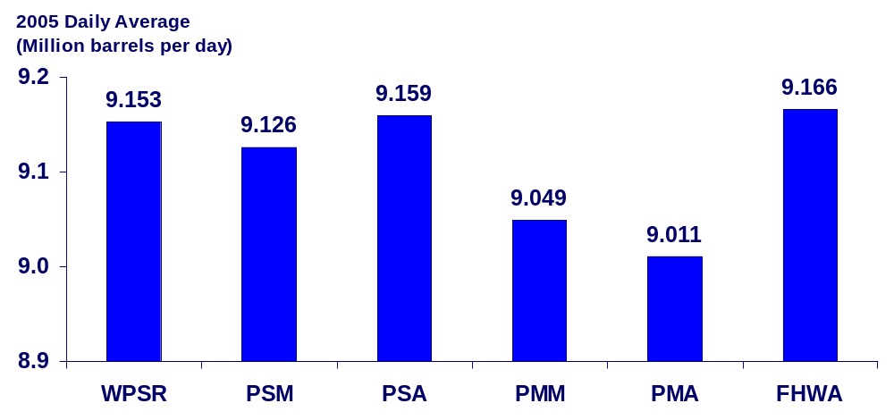
Monthly Gasoline Consumption Surveys
WPSR – EIA Weekly Petroleum Status Report
PSM – EIA Petroleum Supply Monthly PSA – EIA Petroleum Supply Annual
PMM – EIA Petroleum Marketing Monthly PMA – EIA Petroleum Marketing Annual
FHWA – Federal Highway Administration

Slide 9
Annual Consumption Growth Rate Depends on Which Surveys Are Compared
2004 Survey | 2005 Survey | 2004 –> 2005 Change
WPSR | WPSR | 0.90 %
PSM | WPSR | 1.00 %
PSM | PSM | 0.70 %
PSA | PSM | 0.22 %
PSA | PSA | 0.59 %
WPSR – EIA Weekly Petroleum Status Report PSM – EIA Petroleum Supply Monthly PSA – EIA Petroleum Supply Annual PMM – EIA Petroleum Marketing Monthly PMA – EIA Petroleum Marketing Annual FHWA – Federal Highway Administration

Slide 10
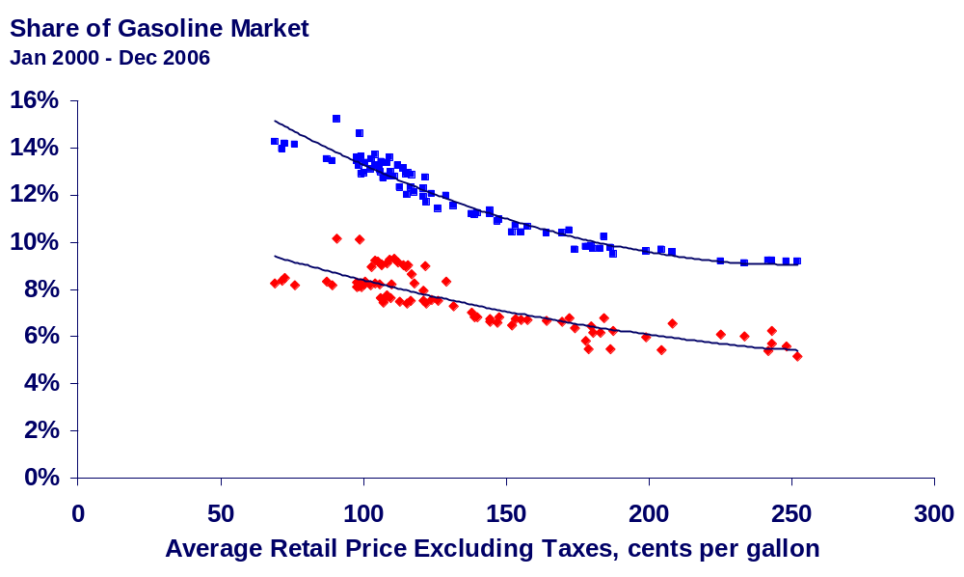
Switching To Regular Gasoline Reduces Price Impact
Premium Grade Gasoline
Mid-Grade Gasoline
Source: EIA, Petroleum Marketing Monthly, March 2007.

Slide 11
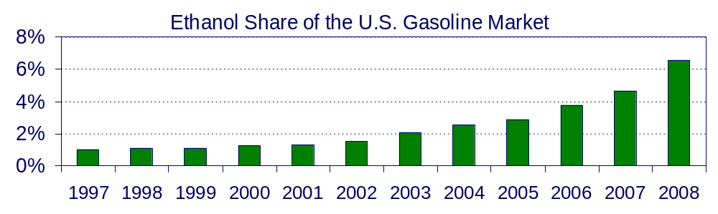
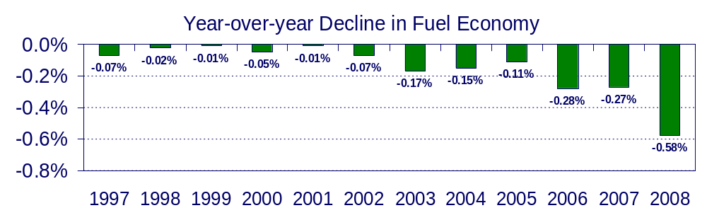
Ethanol Reduces Fuel Economy
Forecast
Ethanol = 76,000 Btu/gal
Gasoline = 114,000 Btu/gal
Source: EIA, Short-Term Energy Outlook, March 2007, and EIA calculations.

Slide 12
Thank you
Energy Information Administration
www.eia.doe.gov
Tancred Lidderdale
Tancred.Lidderdale@eia.doe.gov
202-586-7321

