Slide 1
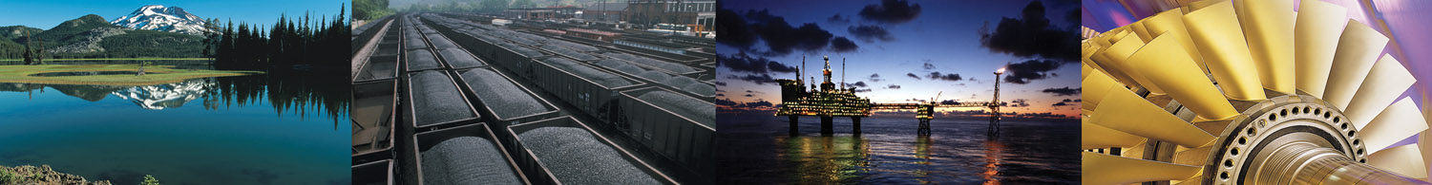

Coal Conversion – Pathway to Alternate Fuels
C. Lowell Miller
Director, Office of Sequestration, Hydrogen,
and Clean Coal Fuels
Office of Fossil Energy
U.S. Department of Energy
2007 EIA Energy Outlook Modeling and Data Conference
Washington, DC
March 28, 2007

Slide 2
Overview
DOE and Coal Liquefaction RD&D
Coal – A Significant Source of Energy
Coal Liquefaction Technology and Status
Current and Growing Interest in Liquefaction

Slide 3
Components of Earlier DOE RD&D
Coal Liquefaction Program
Technology Screening – Bench and pilot plant projects
(1964–1976)
Component I (1976–1982)
  Large-scale demos of Phase I processes
  Thermal and catalytic hydrogenation processes
Component II (1976–1999)
  Research program
  Pursue improvements and alternatives based on better scientific understanding
Component III (1980–1998)
  Bench-scale development of Phase II processes
  Overcome techno-economic limitations of Phase I processes
  Catalytic hydrogenation processes

Slide 4
Coal Conversion Processes
Carbonization and Pyrolysis
  Low severity (mild gasification)
  High temperature
Direct Liquefaction
  One-stage reactor technology
  Two-stage reactor technology
  Co-processing
  Hybrid
Indirect Liquefaction
  Gas reactors
  Slurry reactors

Slide 5
Coal Liquefaction Technologies
Mild Pyrolysis | Single-Stage Direct Liquefaction | Two-Stage Direct Liquefaction | Co-Processing and Dry Hydrogenation | Indirect Liquefaction
Liquids from Coal (LFC) Process – Encoal Coal Technology Corporation Univ. of North Dakota Energy and Environmental Center (EERC)/AMAX R&D Process Institute of Gas Technology Char, Oil Energy Development (COED) | Solvent Refined Coal Processes (SRC-I and SRC-II) – Gulf Oil Exxon Donor Solvent (EDS) Process H-Coal Process – HRI Imhausen High-Pressure Process Conoco Zinc Chloride Process Kohleoel Process – Ruhrkohle NEDO Process | Consol Synthetic Fuel (CSF) Process Lummus ITSL Process Chevron Coal Liquefaction Process (CCLP) Kerr-McGee ITSL Work Mitsubishi Solvolysis Process Pyrosol Process – Saarbergwerke Catalytic Two-Stage Liquefaction Process – DOE and HRI Liquid Solvent Extraction (LSE) Process – British Coal Brown Coal Liquefaction (BCL) Process – NEDO Amoco CC-TSL Process Supercritical Gas Extraction (SGE) Process – British Coal | MITI Mark I and Mark II Co-Processing Cherry P Process – Osaka Gas Co. Solvolysis Co-Processing – Mitsubishi Mobil Co-Processing Pyrosol Co-Processing – Saabergwerke Chevron Co-Processing Lummus Crest Co-Processing Alberta Research Council Co-Processing CANMET Co-Processing Rheinbraun Co-Processing TUC Co-Processing UOP Slurry-Catalysed Co-Processing HTI Co-Processing | Sasol Rentech Syntroleum Mobil Methanol-to-Gasoline (MTG) Process Mobil Methanol-to-Olefins (MTO) Process Shell Middle Distillate Synthesis (SMOS)
Source: “Coal Conversion – A Rising Star,” 23rd Int’l Pittsburgh Coal Conference, September 25-28, 2006.

Slide 6
Why Coal-To-Liquids (CTL)?
Energy Security
  Size of coal resources
  Distribution of resources
Environment
  Utilization of clean coal technology
  Sequestration technology expected
Flexibility
  Advanced technology
  Co-production capability
Economics
  Competitive with alternatives
  World oil price volatility

Slide 7
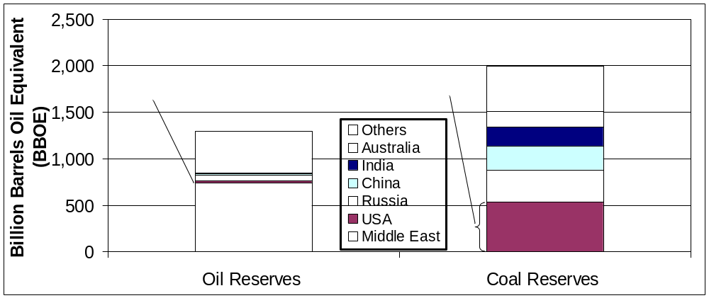
Global Supplies
Comparison of World Oil and Coal Reserves
World oil demand will grow by 40% to 50% by 2030
Coincidentally, crude supplies increasingly concentrated in OPEC/ politically unstable geographies
Coal offers opportunity to diversify worldwide liquid fuel supplies

Slide 8
Coal-to-Liquids – Part of an Unconventional Fuels Portfolio
Growing consensus on need to diversify transportation
fuel sector
  Long term: hydrogen
  Intermediate term: liquids from coal, oil shale, liquids from biomass, increased domestic petroleum production, efficiency
Advantages of Coal and CTL Technology
  U.S. coal reserves amount to 250-year supply at current rates of consumption
  Coal resources are dispersed (proven reserves in 26 states)
  1 ton of coal can be processed into 2 barrels of high-quality
  liquid fuels
  Offers opportunity to pre-invest in eventual hydrogen-from-coal production facility

Slide 9
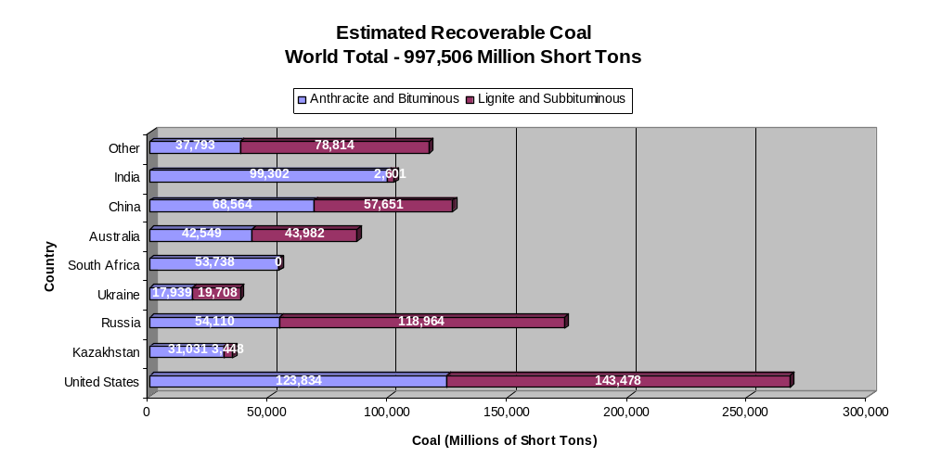
The U.S. Leads in Coal Reserves
Source: Energy Information Administration, World Recoverable Coal Reserves

Slide 10
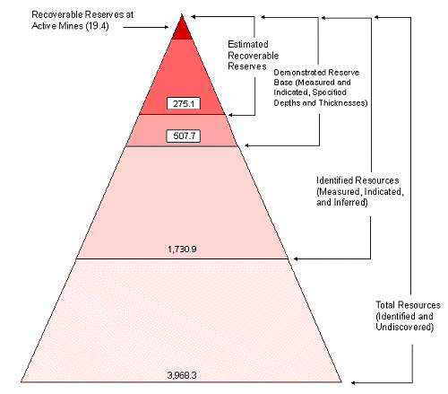
Delineation of U.S. Coal
Reserves and Resources
RESERVES – quantities of coal anticipated to be commercially recoverable from known accumulations from a given date forward under defined conditions.
RESOURCES – quantities of coal estimated, as of a given date, to be potentially recoverable from known accumulations, but which are not currently considered commercially recoverable.
There is sufficient reserve to meet projected demand for electricity and up to 4MM bpd CTL industry for over 100 years
Source: EIA Coal Reserves Data 1997
Notes:
Based on current annual production of nearly 1.1 billion short tons, the United States has an approximate 250-year coal supply; but
EIA projects a steady rise in coal consumption to 1.78 billion short tons by 2030 in its reference economic growth case… largely due to the need for new coal-fired power generating capacity; however:
the EIA estimates the “demonstrated coal reserve base”*(DRB) at 508 billion short tons, which should provide an ample cushion to counter any additional increase required for CTL production
4MM bpd @ 2 barrels per ton requires 2MM tpd coal x 365 = 730 MMtpy which would consume over a 100 year period about 15% of the DRB
*” resources that meet specified minimum physical and chemical criteria related to current mining and production practices.”

Slide 11
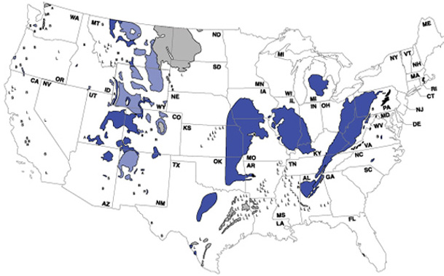

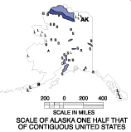

U.S. Coal Reserves Distribution
Powder River
Greater
Green River
Coal Region
Northern
Appalachian
Central
Appalachian
Uinta
Small Field
or Isolated
Occurrence
Rank
Piceance
San Juan
Raton
Arkoma
Cherokee
Black Warrior

Slide 12
Direct Coal Liquefaction Process
H₂S, NH₃, CO_{x}
Recycle H₂
Gas Recovery
Treatment
C₁ – C₂
Make-Up H₂
LPG
Coal + Catalyst
Coal
Liquefaction
HTU
Refining
Gasoline
Diesel Fuel
H-Donor
Slurry
Slurry
Fractionation
HVGO
DAO
Solvent
De-ashing
Ash Reject

Slide 13
Hybrid DCL/ICL Plant Concept
Coal
Gasification
Indirect Coal
Liquefaction (F-T)
Raw ICL Products
F-T Tail Gas
H₂
Product Blending and Refining
Final Products
Hydrogen
Recovery
H₂
Direct Coal Liquefaction
Coal
Raw DCL Products

Slide 14
Shenhua DCL Process
Light Gases
Catalyst
Recycle Solvent
Gasoline
Coal
Coal Prep
Slurry Mixing
Liquefaction
Fractionation
Jet Fuel
Separation
Upgrading
Diesel
Residue
N₂
H₂
Air
Air Separation
Gasification
Purification
O₂
First Train: 1 MT/a Liquefaction Oil

Slide 15
Indirect Coal Liquefaction Overview
Synthesis Gas
Production
Gasification
Reforming
  Steam
  POX
  ATR
Natural Gas
Coal
Pet Coke
Biomass
Wastes
F-T
Liquid
Synthesis
Slurry/Fixed/
Fluid-Bed
Tail
Gas
Product
Recovery
Power
Generation
Hydrogen
Recovery
Liquid
Fuels
Wax
H₂
O₂
Air
Oxygen
Plant
Wax
Hydrocracking
Liquids
Product
Storage
Naphtha/
Diesel
Notes:
For indirect liquefaction, coal is gasified with oxygen to produce a synthesis gas consisting of carbon monoxide and hydrogen. This gas is cleaned of all impurities and the clean synthesis gas is sent to a Fischer-Tropsch (F-T) reactor where most of the clean gas is converted into zero sulfur liquid hydrocarbon fuels (6).

Slide 16
Coal-To-Liquids: Current Status
Costs – many systems analyses ongoing; for 50,000 bpd plant:
  Capital costs estimated at $3.5–4.5 billion
  Product cost at $40/bbl
Technology considered commercial
  DOE/industry completed program for development of direct liquefaction technology
  Sasol producing 150,000 bpd of F-T products
  Shenhua China Coal Liquefaction Corp. constructing 20,000 bpd plant; additional 180,000 bpd planned
  Shenhua supports feasibility studies for two 80,000 bpd coal-to-liquid plants
  Improved processes, catalysts, and slurry reactors available
  Bench and pilot facilities at Rentech, Headwaters, Syntroleum, and ConocoPhillips

Slide 17
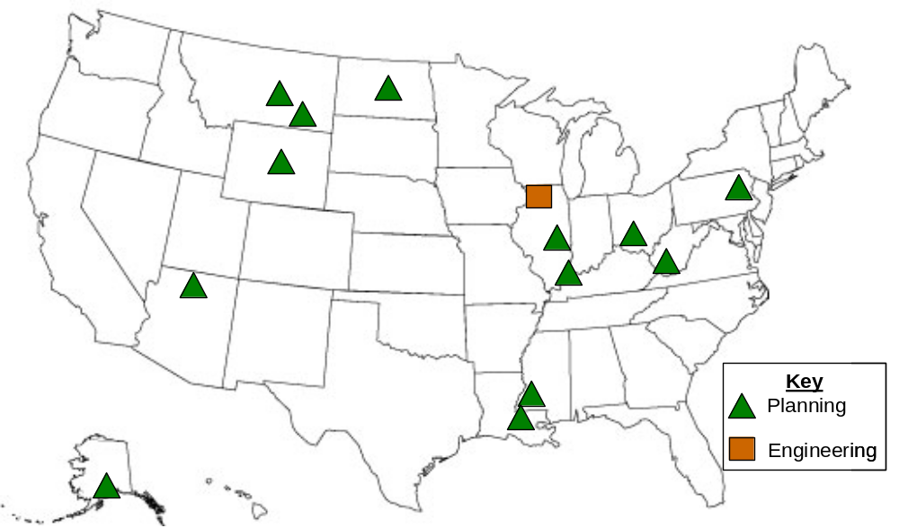
Location of Proposed CTL Projects in the United States

Slide 18
Coal-to-Liquids Plants Under Consideration in the United States
Project Lead | Project Partners | Location | Feedstock | Status | Capacity | Cost
American Clean Coal Fuels | None cited | Oakland, IL | Bituminous | Feasibility | 25,000 | N/A
Synfuels Inc. | GE, Haldor-Topsoe, NACC, ExxonMobil | Ascension Parish, LA | Lignite | Feasibility | N/A | $5 billion
DKRW Advanced Fuels | Rentech, GE | Medicine Bow, WY | Bituminous | Design (2011) | 13,000 bpd | $1.4 billion
DKRW Advanced Fuels | Rentech, GE, Bull Mountain Land Company | Roundup, MT | Sub-bituminous/ Lignite | Feasibility | 22,000 bpd | $1–1.5 billion
AIDEA | ANRTL, CPC | Cook Inlet, AK | Sub-bituminous | Feasibility | 80,000 bpd | $5–8 billion
Mingo County | Rentech | WV | Bituminous | Feasibility | 20,000 bpd | $2 billion
WMPI | Sasol, Shell, DOE | Gilberton, PA | Anthracite | Design | 5,000 bpd | $612 million
Rentech/Peabody | N/A | MT | Sub-bituminous/ lignite | Feasibility | 10,000–30,000 bpd | N/A
Rentech/Peabody | N/A | Southern IL, Southwest IN, Western KY | Bituminous | Feasibility | 10,000–30,000 bpd | N/A
Rentech* | Kiewit Energy Company, WorleyParsons | East Dubuque, IL | Bituminous | Construction (2010) | 1,800 bpd* | $800 million
Rentech | Adams County | Natchez, MS | Coal/Petcoke | Feasibility | 10,000 bpd | $650–750 million
Rentech | Baard Energy | Wellsville, OH | Sub-bituminous | Feasibility | 35,000 bpd | $4 billion
Headwaters | Hopi Tribe | AZ | Bituminous | Feasibility | 10,000–50,000 bpd | N/A
Headwaters | NACC, GRE, Falkirk | ND | Lignite | Feasibility | 40,000 bpd | $3.6 billion
*Co-producing fertilizer

Slide 19
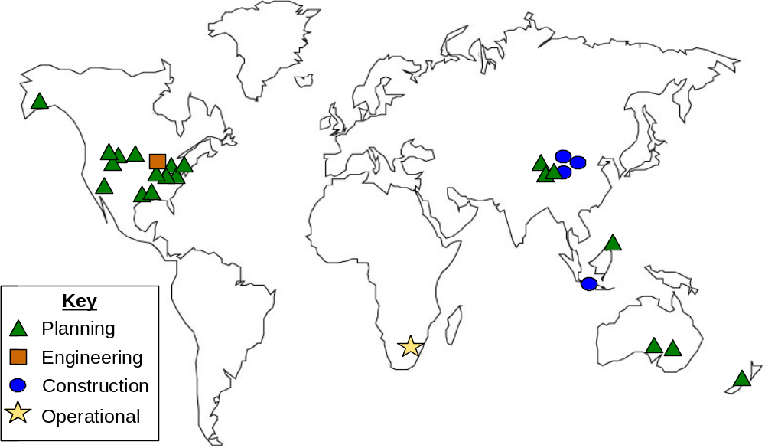
CTL Projects Worldwide

Slide 20
International CTL Plants and Projects
Country | Owner/Developer | Capacity (bpd) | Status
South Africa | Sasol | 150,000 | Operational
China | Shenhua | 20,000 (initially) | Construction Operational in 2007–2008
China | Lu’an Group | ~3,000–4,000 | Construction
China | Yankuang | 40,000 (initially) 180,000 planned | Construction
China | Sasol JV (2 studies) | 80,000 (each plant) | Planning
China | Shell/Shenhua | 70,000–80,000 | Planning
China | Headwaters/UK Race Investment | Two 700-bpd demo plants | Planning
Indonesia | Pertamina/Accelon | ~76,000 | Construction
Australia | Anglo American/Shell | 60,000 | Planning
Australia | Altona Resources plc, Jacobs Consultancy, MineConsult | 45,000 | Planning
Philippines | Headwaters | 50,000 | Planning
New Zealand | L&M Group | 50,000 | Planning

Slide 21
Congressional Interest in CTL
Previous Congress (109th)
  H.R. 4761 – Deep Ocean Energy Resources Act of 2006
  H.R. 5965 – Progress Act
  H.R. 5653 – Investment in American Energy Independence
  Act of 2006
  H.R. 5890 – American-Made Energy Trust Fund Bill
  S. 1920 – Renewable Diesel Standard Act of 2005
  S. 2446 – American Fuels Act of 2006
  S. 3325 – Coal-to-Liquid Fuel Promotion Act of 2006
Current Congress (110th)
  S. 154
  S. 155 Coal-to-Liquid Fuel Promotion Act of 2007
  H.R. 370

Slide 22
Reports and Studies – CTL Processes
Department of Defense
  OSD Assured Fuels Initiative
  Flight Test of F-T Jet Fuel Blend
  Air Force Energy Industry Forum
Mitretek
  Techno-Economic Analysis of Wyoming Located CTL Plant
  Gasification of Kemmerer Coal at the Mine Mouth in Wyoming for Production of Zero Sulfur Liquid Transportation Fuels and Electric Power: A Feasibility Study
  Clean Transportation Fuels from Domestic Coal
National Coal Council
  America’s Energy Future
Southern States Energy Board
  American Energy Security Study
Scully Capital Services, Inc.
  The Business Case for Coal Gasification with Co-Production

Slide 23
Reports and Studies – CTL Processes
(continued)
Conference Report 109-360 - National Defense Authorization Act for Fiscal Year 2006
  A Development Plan for a Coal-to-Liquid Fuel Program
Energy Policy Act - 2005, Section 369
  Commercialization of America’s Strategic Unconventional Fuels:
  Oil Shale • Tar Sands • Coal Derived Liquids • Heavy Oil • CO₂ Enhanced Recovery and Storage
Rand Corporation
  Unconventional Fuels: Strategic and Program Options
World Coal Institute
  Coal: Liquid Fuels

Slide 24
CTL Technology – Economics
Remain Key Issue
Conceptual plant designs estimate $3.5–4.5 billion required for initial 50,000-bpd plants (Capital cost = $70–90K/daily barrel)
Plants may be profitable with crude oil price between $45–60/bbl with carbon storage (carbon storage estimated to account for $4/barrel of the required selling price)
Higher unit investment costs for pioneer demonstration plants (10,000- to 20,000-bpd plants)
Difficult to accurately estimate costs since no plants have been built worldwide since the 1980s

Slide 25
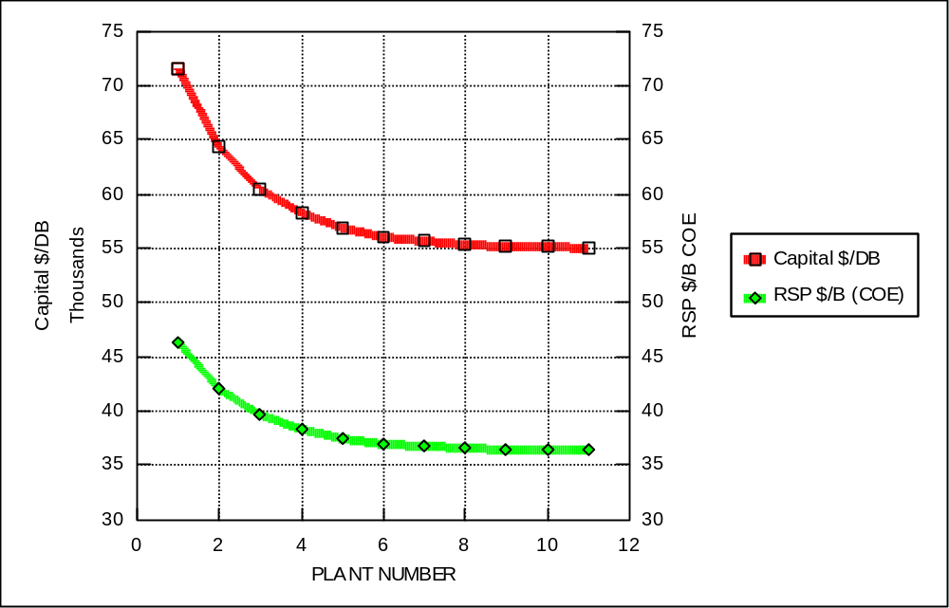
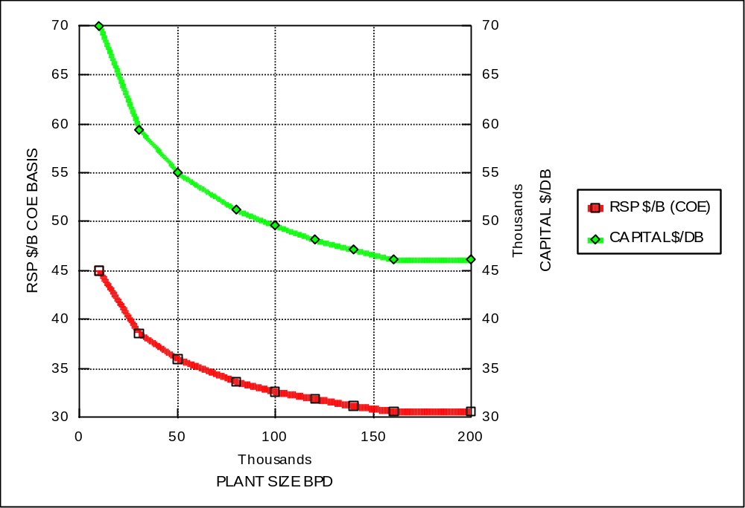
Potential Impacts on Cost

Slide 26
Barriers to Coal-To-Liquids
Technical
  Integrated operations of advanced CTL technologies have never been demonstrated
Economic
  Uncertainties about future world oil production
  High capital and operations costs
  Investment risks
  Energy price volatility
Environmental
  CO₂ and criteria pollutant emissions
  Expansion of coal production and requisite infrastructure (railroads, railcars, etc.)
  Water use
Commercial Deployment
  Competition for critical process equipment, engineering, and skilled labor
  Who would take the lead in commercial deployment? Part power part liquid fuels
Social
  NIMBY and public resistance to coal use
Notes:
These barriers can be classified as technical, economic, environmental, commercial, and social. Under technical barriers, the integration of advanced entrained coal gasification and advanced slurry phase F-T synthesis technologies has never been attempted. This poses moderate-to-high technical risks that may be an impediment to potential process developers on a risk – reward basis even with today’s high WOP.
In addition, the uncertainties about future oil prices and the high capital expenditures needed for large scale CTL plants are significant economic barriers,
It is anticipated that the capital for large (greater than 50,000 BPD) CTL plants will be between $55,000 and $50,000 per daily barrel. Therefore, a 50,000 BPD plant will cost about $2.75 billion. The investment risk for such a large sum is considerable and could impede third party financing.

