Slide 1
Motor Gasoline Model:
Major Developments and Issues
Short-Run Motor Gasoline Demand Model
EIA Energy Outlook,
Modeling and Data Conference
March 28, 2007
Washington, DC
Michael A. Morris
Industry Economist

Slide 2
Price Elasticity
Range of estimates
  Most short-run estimates are between zero and -0.5
  Most long-run estimates are between -0.5 and -1.5
Decline in price responses
  EIA short-run estimates:
    1977 to 1989: -0.05 to -0.08
    1994 to 2006: -0.02 to -0.04

Slide 3
Income Elasticity
Most estimates are between 0.2 and 1.5
Estimates have declined over time
  EIA:
    1977 to 1989: .85
    1994 to 2006: .50

Slide 4
Possible Reasons for Elasticity Declines
Motor vehicle travel is a mature product
Fuel efficiencies have increased
Real cost per mile is lower
Gasoline’s share of disposable income has declined

Slide 5
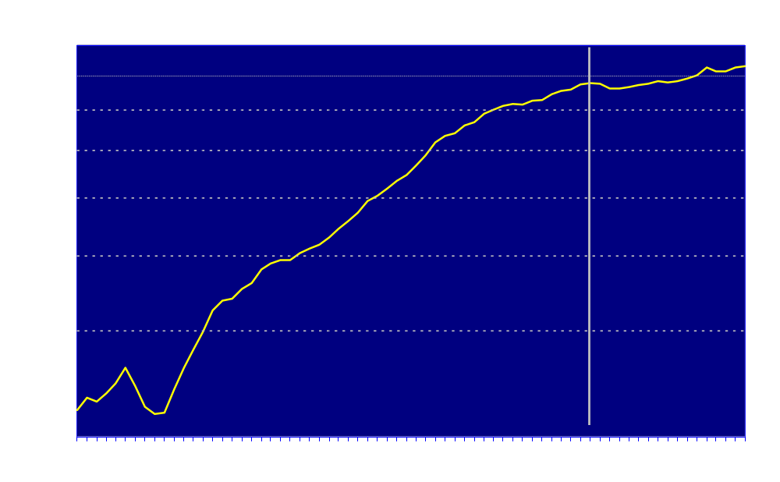
Growth in Vehicles per 1000 People
Has Slowed Sharply

Slide 6
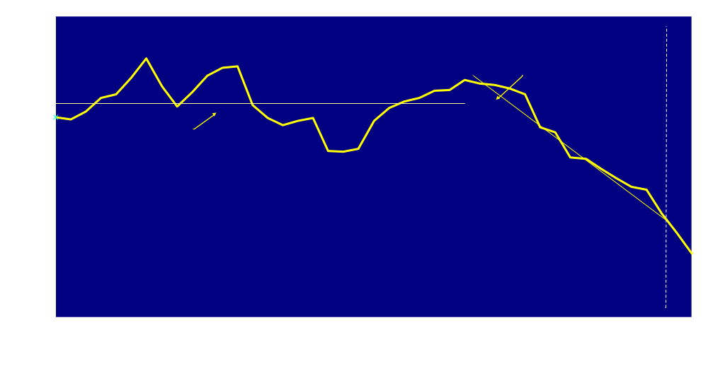
Ratio of Passenger VMT to Real Personal Disposable Income (1966=1)

Slide 7
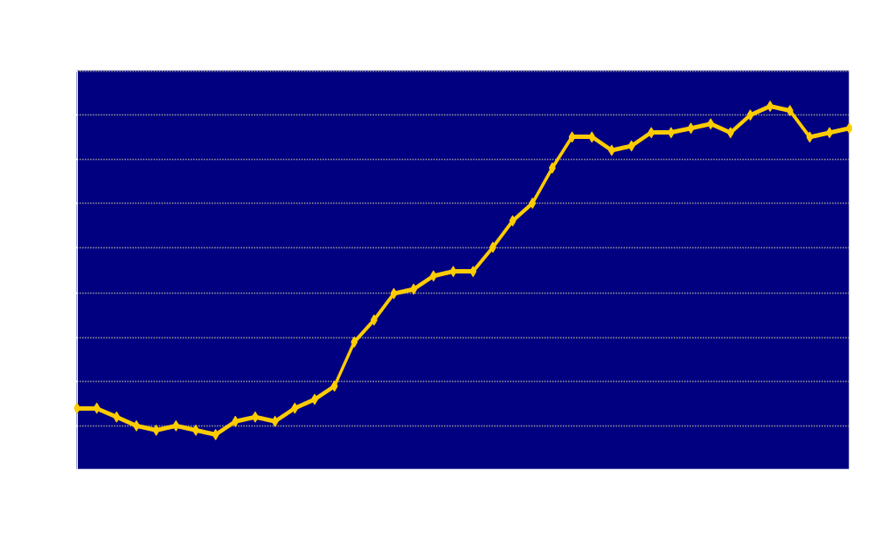
Motor Gasoline Vehicle Fuel Efficiency

Slide 8
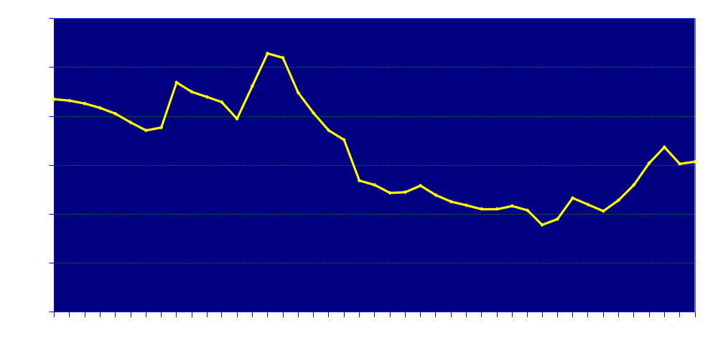
Inflation-Adjusted Motor Gasoline
Cost per Mile (1982-84 $)

Slide 9
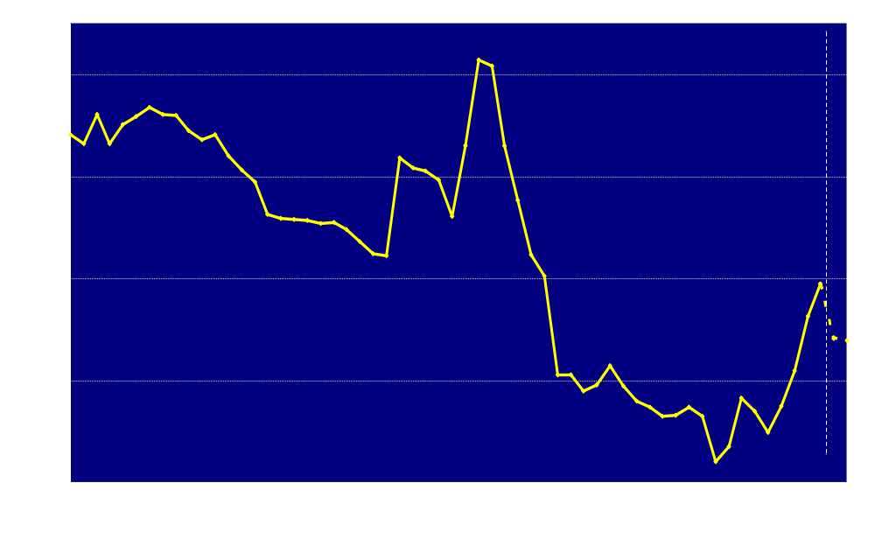
Motor Gasoline Expenditures as a Share of Personal Disposable Income

Slide 10
Short-Term Energy Outlook Motor Gasoline Model
Total motor gasoline demand =
Highway demand + Non-highway demand
Highway demand accounts for 97 percent of total motor gasoline demand. It is derived from the following identity:
Highway Demand = Highway Travel
Fuel Efficiency
Each component is estimated separately.

Slide 11
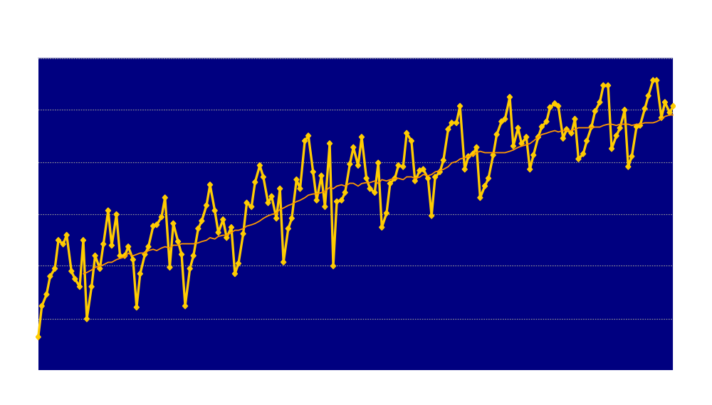
Highway Motor Gasoline Demand is Highly Seasonal

Slide 12
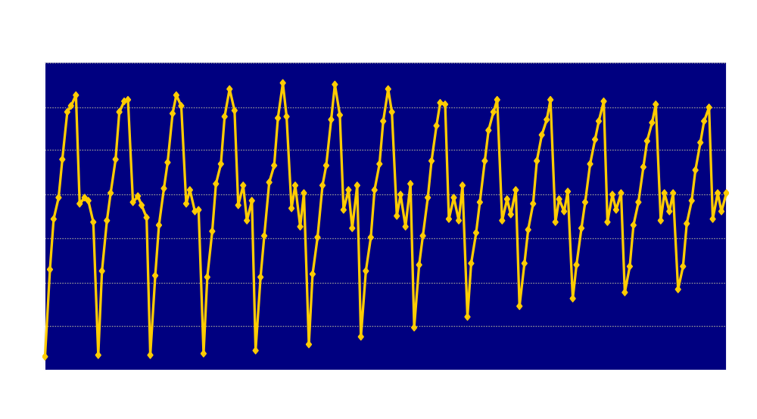
Highway Motor Gasoline Demand
Is Becoming Less Seasonal

Slide 13
Seasonally-Adjusted Per-Capita Motor Gasoline-Related Vehicle Miles Traveled Per Day
Dependent Variable: LOG(MVMGPUS_SA/POP)
Estimation Interval 1994:01 to 2006:12
Variable Coefficient Std. Error t-Statistic
C 1.594 0.035 45.164
LOG(YD87OUS/POP) 0.500 0.012 40.440 (Per Capita RDI)
LOG(CPMMG_SA) -0.018 0.006 -2.967 (Real Cost Per Mile)
DGT250 -0.013 0.005 -2.587 (= 1 if Reg. Gr. $/gal > 2.50)
DGT275 -0.007 0.007 -1.052 (= 1 if Reg. Gr. $/gal > 2.75)
LOG(ZWHDDUS1/ZSAJQUS) -0.003 0.001 -3.835 (Asymmetric Weather Var.)
D9401 -0.035 0.010 -3.401 (Severe Weather)
D9602 -0.042 0.010 -4.332 (Severe Weather)
D9901 -0.033 0.010 -3.409 (Severe Weather)
D0109 -0.030 0.010 -3.096 (9/11 Impact)
R-squared 0.948
Durbin-Watson stat 1.617

Slide 14
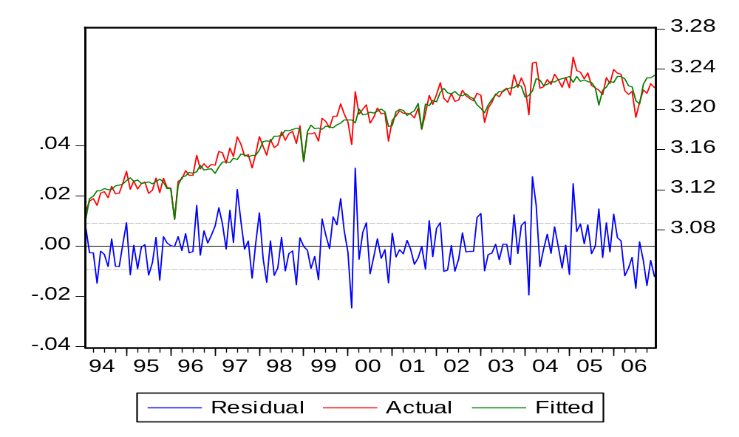
Seasonally-Adjusted Log Per-Capita Motor Gasoline-Related
Vehicle Miles Traveled Per Day

Slide 15
Seasonally-Adjusted Per-Capita Motor Gasoline-Related Vehicle Miles Traveled Per Day
(Alternative estimation with lagged dependent variable)
Dependent Variable: LOG(MVMGPUS_SA/POP)
Estimation Interval: 1994:02 to 2006:12
Variable Name Coefficient Std. Error t-Statistic
C 1.229 0.107 11.516
LOG(MVMGPUS_SA(-1)/POP(-1)) 0.231 0.064 3.630 (Lagged Dep. Var.)
LOG(YD87OUS/POP) 0.386 0.034 11.243 (Per Capita RDI)
LOG(CPMMG_SA) -0.021 0.005 -3.758 (Real Cost per Mile)
DGT275 -0.013 0.006 -2.199 (= 1 if Reg. Gr. $/Gal >2.75)
LOG(ZWHDDUS1/ZSAJQUS) -0.003 0.001 -3.480 (Asymmetrical HDD Variable)
D9602 -0.040 0.009 -4.190 HDD Variable
D9901 -0.036 0.010 -3.761 HDD Variable
D0109 -0.028 0.009 -2.950 (9/11 Effect)
R-squared 0.948
Durbin-Watson stat 2.089

Slide 16
Results Using a Lagged-Dependent Variable in the VMT Equation
Partial Adjustment Hypothesis log (VMT/POP) _{t} – log (VMT/POP) _{t-1} = λ (log (VMT*/POP) _{t} – log (VMT/POP)) _{t-1} where 0 < λ < 1 and VMT* = desired (target) level of vehicle travel log (VMT/POP) _{t} = λά + (1 - λ) log (VMT/POP) _{t-1}+ λβ log (Y/POP)_{t} + λγ log CPM _{t}
Adjustment Coefficient = λ = .769
Average lag = λ / (1 - λ) = 3.32 months
Elasticity Estimates
Income Price
Short Run λβ (.386) λγ (-0.021)
Long Run β (.502) γ (-0.027)

Slide 17
Seasonally-Adjusted Motor Gasoline-Related Fuel Efficiencies
Dependent Variable: MPGMG_SA
Estimation Interval 1994:01 to 2006:12
Variable Coefficient Std. Error t-Statistic
C 16.231 0.221 73.428
TIME 0.012 0.001 14.756 (Time Trend)
MGRARUS_SA/CICPIUS 0.005 0.002 2.338 (Real Reg Gr. $/gal)
EOTCPUS_SA/MGTCPUS_SA -34.264 6.000 -5.711 (Ethanol Share)
ZWHDDUS1/ZSAJQUS -0.149 0.029 -5.232 (Asym. HDD Var.)
D9602 -0.961 0.234 -4.106 (Severe Weather)
D9901 -0.398 0.235 -1.693 (Severe Weather)
D9912 -0.940 0.234 -4.019 (Y2K Shift)
D0001 0.621 0.233 2.661 (Y2K Shift)
D0109 -0.388 0.234 -1.657 (9/11 Impact)
R-squared 0.769
Durbin-Watson stat 2.011

Slide 18
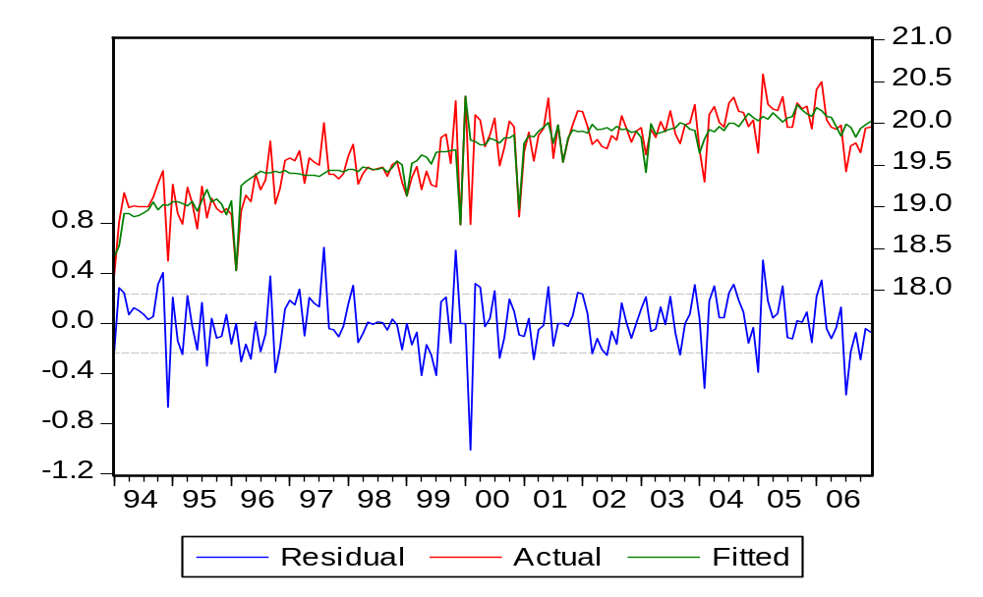
Seasonally-Adjusted Motor Gasoline-Related Fuel Efficiencies

Slide 19
Future Modeling Issues
Future Modeling Issues
Asymmetrical Demand Reponses to Price Changes
Price Shocks
Seasonal Differences in Demand Behavior
Co-integration Techniques

Slide 20
Thank You
Energy Information Administration
www.eia.doe.gov
Michael Morris
michael.morris@eia.doe.gov
202-586-1199

