Slide 1




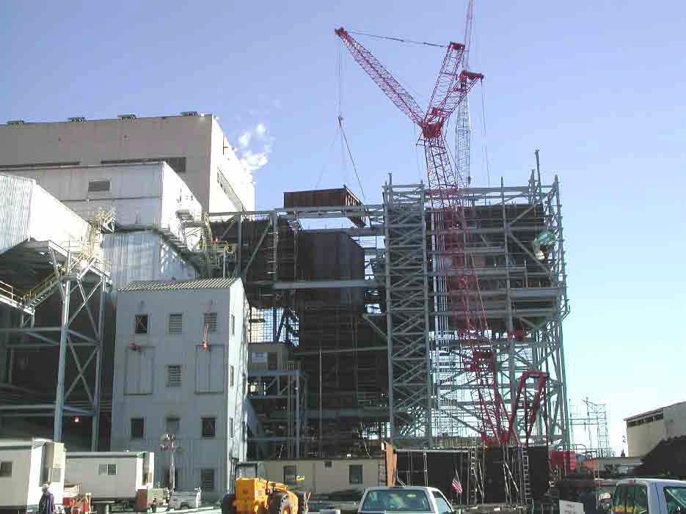



- EIA’s Electric Power Surveys -
Value of EIA Form 767 Data
Presentation for
Energy Information Administration’s
2007 Energy Outlook, Modeling, and Data Conference
U.S. Environmental Protection Agency
Office of Air and Radiation
March 28, 2007

Slide 2

EIA-767
EIA-767 collects annual data from electric power facilities:
Plant identification
  company name, plant name, plant status, plant type
Plant configuration
  boiler, associated generators, stacks, flue information
Plant information
  fly ash, bottom ash, thermal output quantity and fuel use
Boiler information
  boiler I.D., boiler standards, design parameters, emission controls
Generator information
  maximum capacity, monthly generation
Stack and flue information
  rate, temperature, and velocity at different loads
Flue gas particulate collector information
  status, type, removal efficiency
Cooling system information
  annual operations, design parameters
FGD unit information
  hours in service, percent removal, type of sorbent

Slide 3
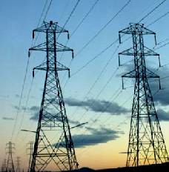
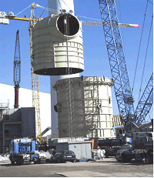


EIA-767
EIA-767 provides EIA with boiler-specific steam-electric plant data that is critical to the formation of multiple EPA analytical tools and programs, such as:
  Integrated Planning Model (IPM)
  (eGRID) Emissions & Generation Resource Integrated Database
  CAIR NO_{x} Allowance Allocations
The above tools are used to develop environmental policies that have billions of dollars in public health and economic benefits

Slide 4
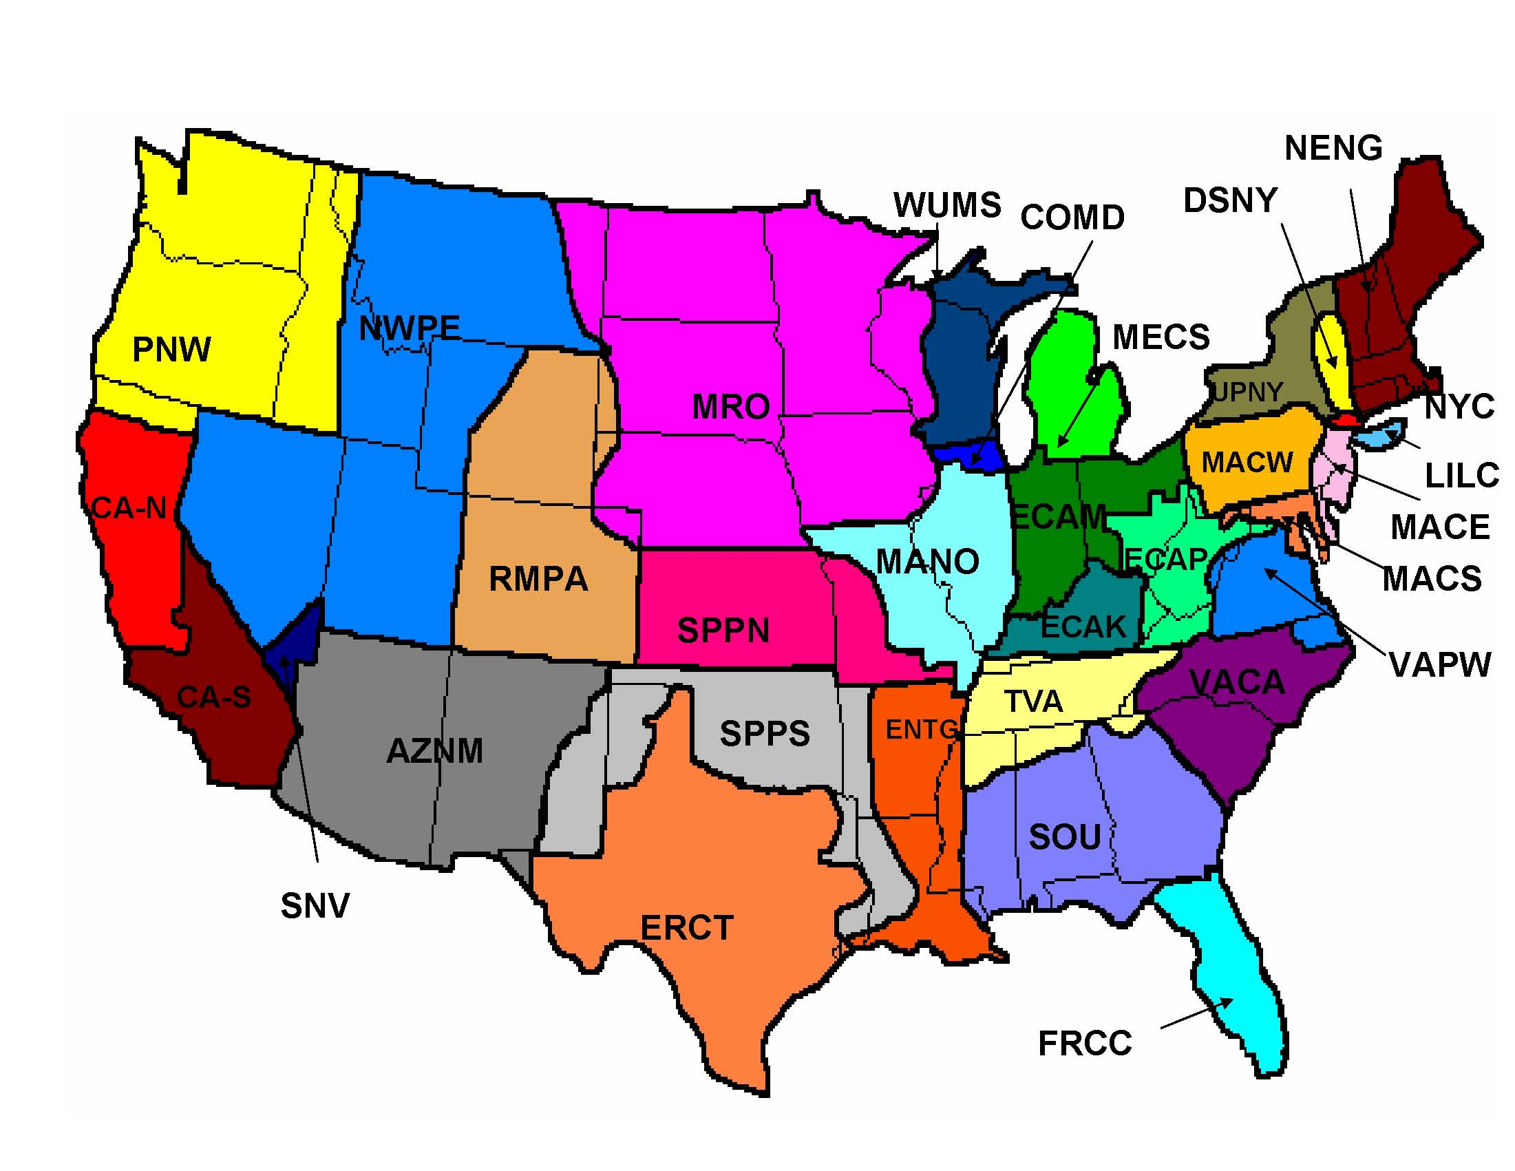
What Is the Integrated
Planning Model (IPM)?
IPM is a long-term capacity expansion and production costing model for analyzing
the U.S. electric power sector
EPA uses IPM to analyze emissions policies
affecting the power sector
IPM outputs are used in
EPA’s air quality models
IPM was used on:
  Clean Air Interstate Rule (CAIR)
  Clean Air Mercury Rule (CAMR)
  Clean Air Visibility Rule (CAVR)
  Clear Skies Initiative
  NO_{x} Budget Trading Program (NBP)
Model Regions in Recent Update of IPM

Slide 5
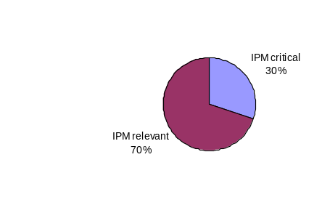
EIA-767 Is Critical to IPM
Form EIA-767 contains 163 data fields:
  IPM relies on data from all 163 fields
  IPM considers 49 of the 163 fields to be critical data
EIA-767 Data Relevance to IPM
IPM relevant and critical (30%)
IPM relevant (70%)

Slide 6
EPA Is One of Many Users of IPM
EPA has used IPM to:
Support rules
  CAIR ─ Title IV SO₂
  CAMR ─ NOx SIP Call
  CAVR ─ Revised NAAQS
  Cooling Water Standards
Evaluate effects of 1990
Clean Air Act Amendments
Analyze environmental
impacts of restructuring
Provide key inputs to EPA’s
air quality models
Other IPM users include:
Government agencies
  FERC ─ OTC
  WRAP ─ OTAG
  RGGI
Industry groups
  EPRI ─ AEP
  EEI ─ Florida Power
  SoCal ─ Cinergy
  PacifCorp ─ National Coal
  TVA Association
Other organizations
  Center for Clean Air Policy
  Clean Air Task Force
  Clean Energy Group

Slide 7

What Is eGRID?
eGRID is EPA’s nationally recognized, comprehensive tool that uniquely links emissions, generation, and fuel use at all electric power plants in the U.S. on an annual basis
  Generation (MWh)
  Emissions (NO_{x} SO₂ CO₂ Hg)
  Fuel Use (MMBtu)
  Boiler data, generator data, integrated plant level data
  Plant data aggregated to different levels:
      state, electric generating company, parent company, power control area, eGRID subregion, NERC Region, U.S.
eGRID has a broad user base
  eGRID EPA’s most popular clean energy webpage
  Supports decisions of users and tools they produce
    Labeling/environmental disclosure
    RPS & RECS attributes
    EPA’s Power Profiler tool
    Policy and research use: analysis (e.g. RGGI) & direct input to other tools (e.g. RMI tool, NREL’s HOMER)

Slide 8
eGRID Uses and Clients
eGRID used for other EPA tools/programs
  Power Profiler – CPPD website for general public relating electricity use and emissions
  Climate Leaders – CO₂ emission factors for electricity use
  Portfolio manager (pending) – Relates CO₂ emissions to building energy use
  Personal GHG Calculator (pending) – Relates CO₂ emissions with electricity use
Used by Federal Government
  NETL, ORNL, ANL, NREL
    ORNL - CHP Calculator
    NETL - NATCARB website
    NREL – HOMER
Used by RECS Tracking Systems
  Emission and fuel use attributes for RECs Tracking Systems:
    PJM’s Generation Attribute Tracking System (GATS)
    ISO-NE’s Generation Information System (GIS)
Notes:
RECs = Renewable Energy Credits

Slide 9
eGRID Uses and Clients
Heavily used by states
  Many electricity labeling (environmental disclosure programs) rely on eGRID
  Many states rely on data for policy decisions/impacts (e.g. output based standards)
  Many states publish state-specific eGRID data on the web
  Greenhouse Gas Inventory & Registry efforts (e.g. California Climate Action Registry)
Used by Non Governmental Organizations in tools and for analyses
  NESCAUM analysis, Powerscorecard.org, OTC’s Emission Workbook, GHG Protocol Initiative, RMI Community Energy Finder, Powerscorecard.org, Leonardo Academy “Cleaner and Greener Environmental Program”, NRDC’s Benchmarking Air Emissions, Emission solutions carbon footprint calculator
Used by universities
  Texas A&M, Stanford, NCU, Penn State, Eastern Connecticut University’s lesson on Energy Education, Michigan Tech’s lesson on Energy Resources, etc.
  Cited in many academic papers and theses
Notes:
Also used by utilities, generators, and trade groups.

Slide 10
CAIR NO_{x} Allowance Allocations
EIA-767 data along with EIA-860 data is used to identify potential CAIR units and to determine a unit’s share of the state-budgeted NO_{x} allowances
    1,445,000 annual NO_{x} allowances are based on EIA data for phase I
    $1.8 billion/yr of NO_{x} allowances are based on EIA data for phase I
    850 of 2,665 potential CAIR units were identified with EIA data

Slide 11
Other Groups/Organizations Using
EIA-767 Data
States use the data for a host of reasons including:
  Emission Inventories (which are critical to air quality modeling efforts and efforts to understand what sources contribute to air quality problems)
  Rule development (including trading rules, renewable portfolio standards and high energy demand day strategies)
Many organizations use the data for power sector modeling including:
  CRA International
  Massachusetts Institute of Technology (MIT)
  Resources for the Future (RFF)
  Other members of the Stanford Modeling Forum

Slide 12
Conclusion
EIA-767 collects vital data for federal and state environmental and energy regulatory agencies to use in their efforts to protect human health and the environment.
EPA requests EIA to continue collection of this data on behalf of the public that we serve.

