Slide 1
Outlook for U.S. Ethanol and Biodiesel in AEO2007
EIA Energy Outlook, Modeling and Data Conference
March 28, 2007
Washington, DC
Tony Radich, Economist

Slide 2
Laws and Regulations in AEO2007
Analysis based on current laws and regulations…
  Average 30-ppm sulfur limit for all gasoline in 2007
  Average 15-ppm sulfur limit for all highway diesel in 2010 and for all non-highway diesel in 2012
  7.5 billion gallons of renewable motor fuels required in 2012
  250 million gallons of cellulose ethanol in 2013
  Biodiesel tax credits expire after 2008
  E85 flex-fuel vehicle production limited to number needed to fully exploit CAFÉ credits

Slide 3
Laws and Regulations in AEO2007 (Cont.)
Analysis based on current laws and regulations… …with a few exceptions
  Ethanol tax credit and tariff are assumed to be extended at their nominal levels through 2030
  MTBE phased out by voluntary action, not regulation

Slide 4
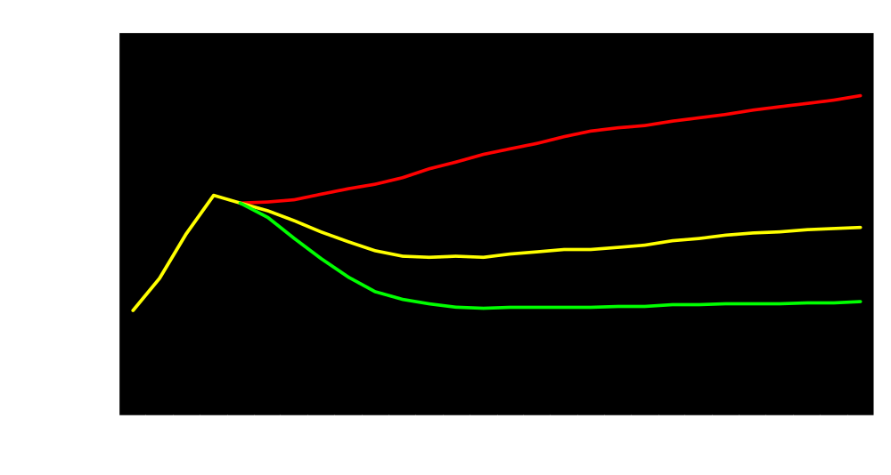
Foreign Low-Sulfur Light Crude Price Cases
High Price
Reference
Low Price

Slide 5
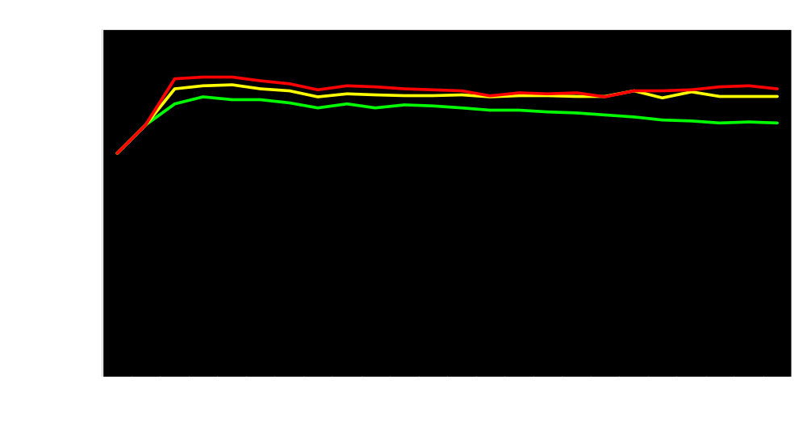
Corn Price Projections By Case
High Price
Low Price
Reference

Slide 6
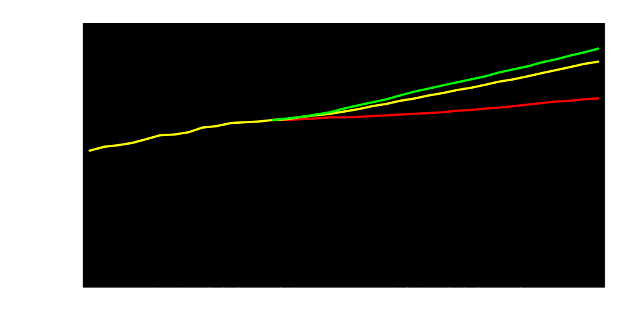
U.S. Gasoline Use By Case
Low Price
Reference
High Price

Slide 7
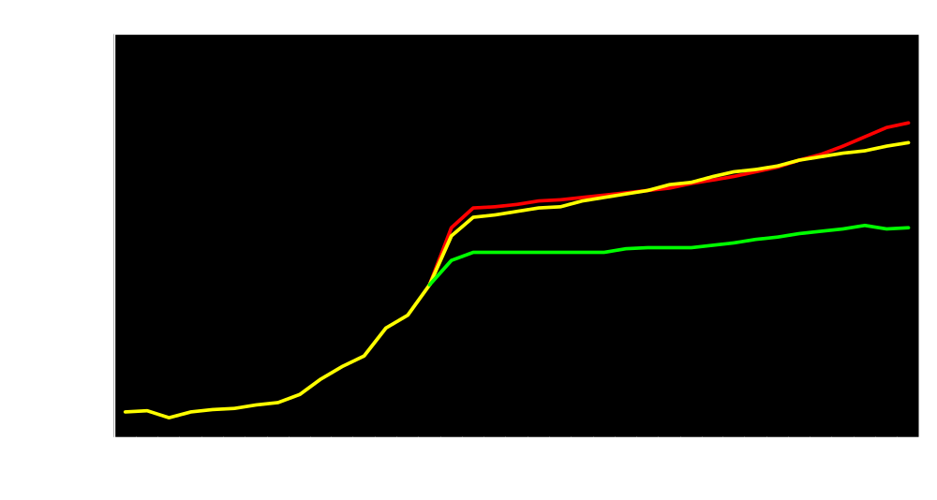
U.S. Ethanol Use By Case
High Price
Reference
Low Price

Slide 8
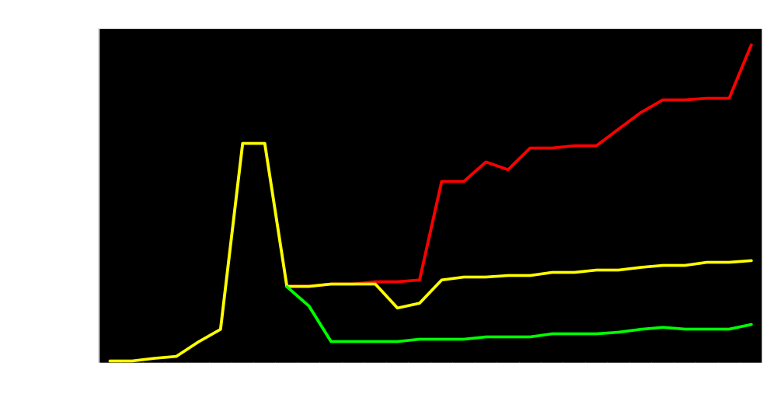
U.S. Biodiesel Use By Case
High Price
Reference
Low Price

Slide 9
Thank you
Energy Information Administration
www.eia.doe.gov
Tony Radich
Anthony.radich@eia.doe.gov
202-586-0504

