Slide 1
Varying Views on the Future of the Natural Gas Market
Secrets of Energy Price Forecasting
2007 EIA Energy Outlook, Modeling, and Data Conference Washington DC March 28, 2007
Adam Sieminski
Chief Energy Economist
Deutsche Bank AG
adam.sieminski@db.com +1 212 250 2928
All prices are those current at the end of the previous trading session unless otherwise indicated. Prices are sourced from local exchanges via Reuters, Bloomberg and other vendors. Data is sourced from Deutsche Bank and subject companies. Deutsche Bank does and seeks to do business with companies covered in its research reports. Thus, investors should be aware that the firm may have a conflict of interest that could affect the objectivity of this report. Investors should consider this report as only a single factor in making their investment decision. Independent, third-party research (IR) on certain companies covered by DBSI's research is available to customers of DBSI in the United States at no cost. Customers can access this IR at http://equities.research.db.com, or call 1-877-208-6300 to request that a copy of the IR be sent to them.
DISCLOSURES AND ANALYST CERTIFICATIONS ARE LOCATED AT THE END OF THIS PRESENTATION

Slide 2
Summary of Long-Term View on Gas
North American gas supply is declining due to eroding rig productivity
North American gas demand growth is now driven by electric generation
The push for new energy sources is increasing production costs for both traditional and alternative fuels
The push for alternative fuels to reduce greenhouse gas emissions and oil imports will displace resources in agricultural markets, a politically sensitive economic sector, and increase demand for natural gas
These fundamentals have attracted global capital to the longer-dated natural gas financial instruments
The same geopolitical forces constraining global oil production capacity will weigh on expansion of LNG liquefaction
Long-dated natural gas futures may be a better guide to prices than the oil futures markets

Slide 3
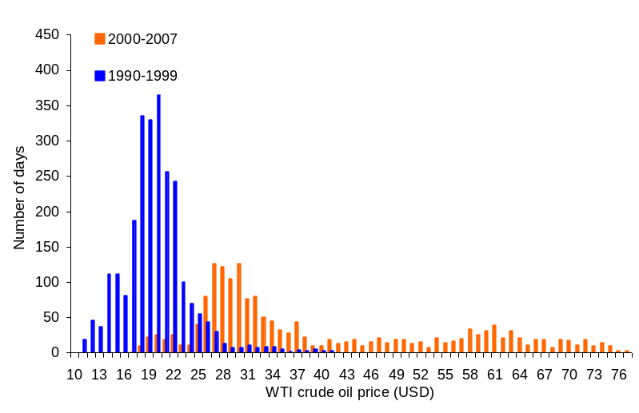
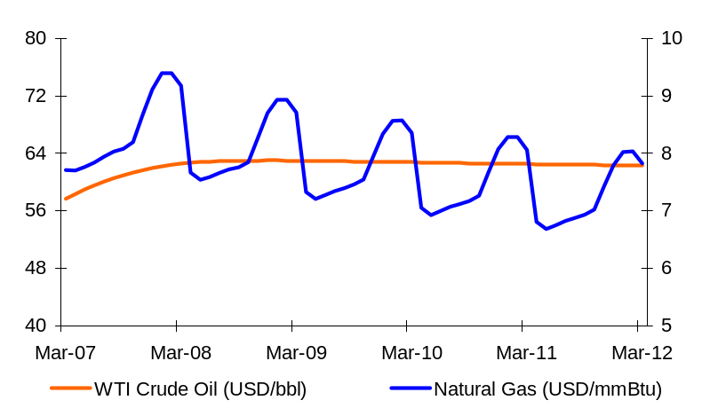
New World Order For Oil & Gas Prices
We expect oil and natural gas prices to settle lower over the next few years, but not back to the old USD21/bbl and USD3.50/mmBtu means
Distribution of Oil Prices Then and Now
Futures Prices for Oil and Natural Gas
Source: NOAA, DB Global Markets Research
Outlook
The WTI crude oil prices averaged just under USD20/barrel in the 1990s. So far in this decade, the oil price has averaged nearly USD40/barrel.
We expect oil prices will average around USD50/barrel during the current decade, or more than double the average of the 1990s.
Natural gas prices have been climbing with increased demand, limited domestic supply, tight global LNG markets and rising infrastructure costs; we see price averaging USD7.00/mmBtu over the next five years.
Gas was selling at a discount to crude oil in the long-dated futures in 2H 2006, but now seems more in line.

Slide 4
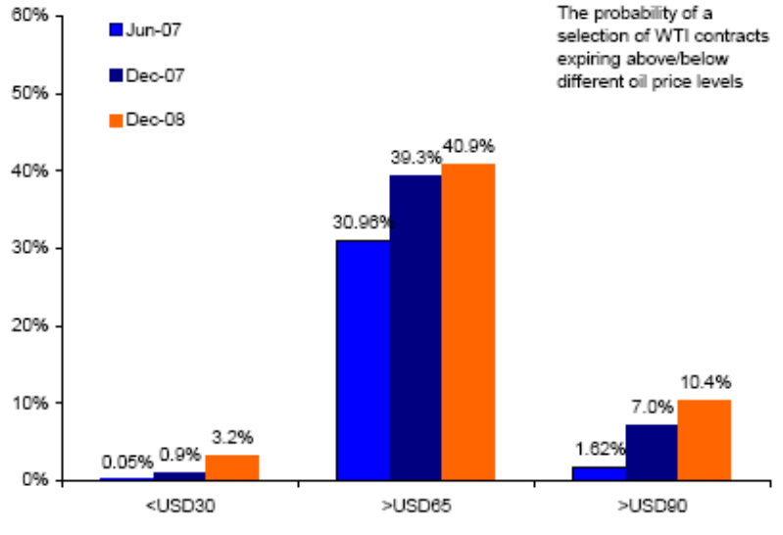
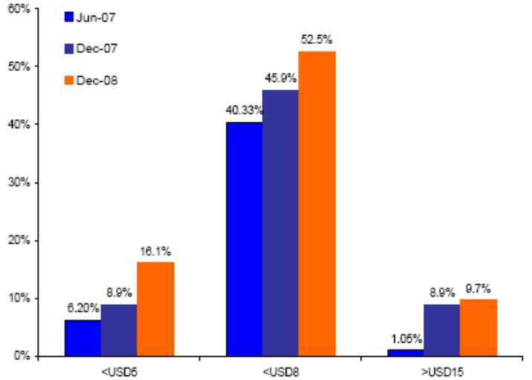
Energy Markets: Tail Events
The options market has become relaxed about the risk of an energy price spike.
The Options Market & Oil Price Spikes
The Options Market & Gas Price Spikes
Source: DB Global Markets Research
Outlook
Lower oil demand growth, rising non-OPEC supply and an easing in geopolitical risk recently have led the WTI crude oil and US natural gas options markets to downgrade the probability of an oil and natural gas price spike over the coming year. Currently, the options market attaches a less than one-in-twelve chance of the Dec-07 WTI contract expiring above USD90/barrel.
Throughout most of last year, crude oil vol has trended lower. We believe vol is now trading cheap and the options market has become too complacent towards geopolitical risk and the potential of world growth to snap back.

Slide 5
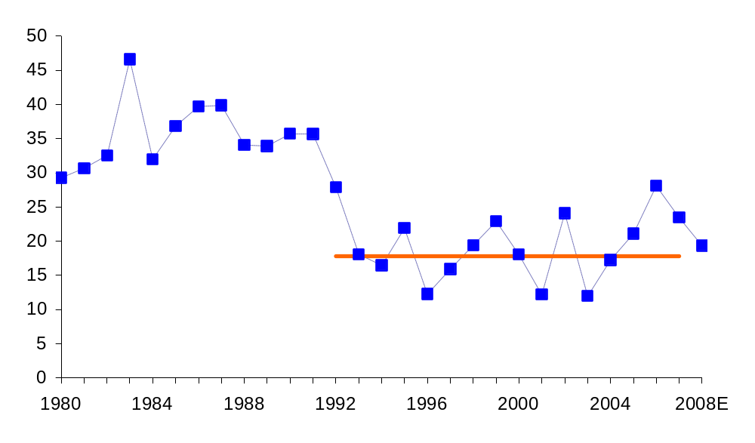
US Natural Gas: Storage Relative to Demand
US Natural Gas Storage Levels Days of Forward Demand Cover
We expect days forward cover of natural gas demand to fall in 2007-08 as the storage surplus is resolved and demand continues to rise.
Source: DOE/EIA, DB Global Markets Research
Outlook
The absolute level of storage is often used as an indictor for natural gas pricing over the 2nd and 3rd quarter – with low storage signalling stronger prices. One shortcoming of this “single value” approach is that it ignore demand.
This graphic illustrates the number of days that storage on March 31 can supply (cover) the average annual consumption of the year. Over the period 1993-2005, the average level of days cover at the end of the heating season has been circa 18 days.
The jump to 28 days cover in 2006 was cause by the impact of the extremely warm January 2006 and weak industrial demand. We project that with demand rising and storage correcting lower, 2007 cover will drop to 23 days, and it should fall further in 2008.

Slide 6
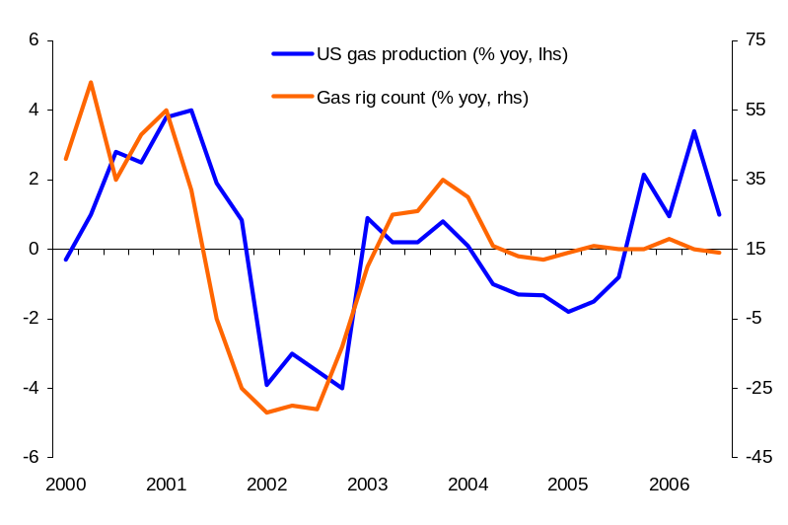
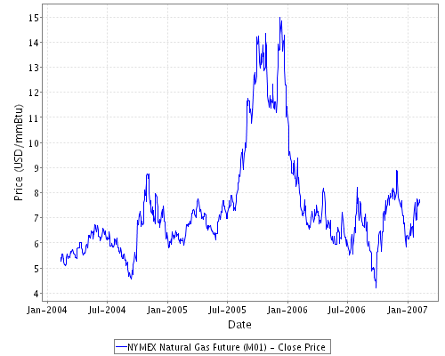
US Natural Gas Production: Rig Count
We expect US natural gas prices will surprise to the upside this year are US gas production disappoints.
US Gas Production & Rig Counts
US Natural Gas Price
Source: Baker Hughes, EIA
Outlook
We are cautiously bullish natural gas prices during the remainder of the year as we expect to see domestic US gas production surprise to the downside.
We find that over the past six years it has required 13% compound annual average growth in the US gas rig count just to keep gas production levels flat. If this relationship holds in 2007, it will require an average of 1,500 to 1,600 domestic rigs just to keep gas production flat. This would represent at least a 140-rig (10%) rise from current levels.
In addition, production of exiting wells have a very high decline rate. For example, for every Pinedale well that come on at 9MMcfe/d last summer, it will be producing roughly 2.5MMcfe/d by this summer.
The reduction in drilling investments in Canada are also expected to limit Canadian imports into the US.

Slide 7
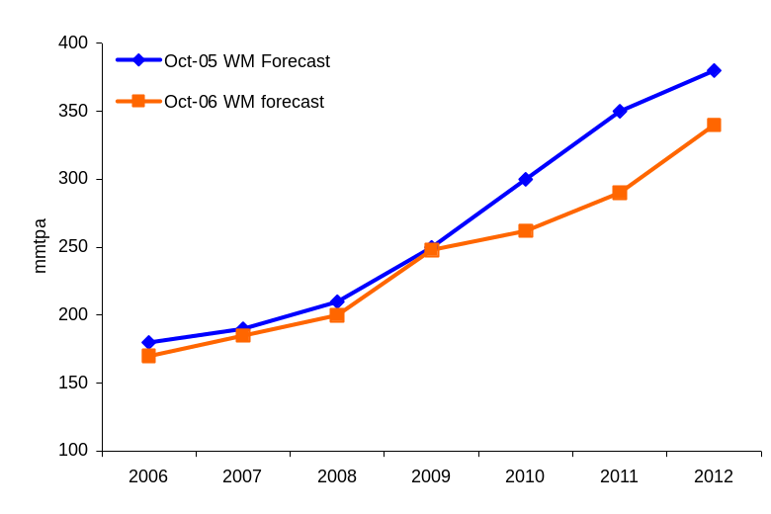
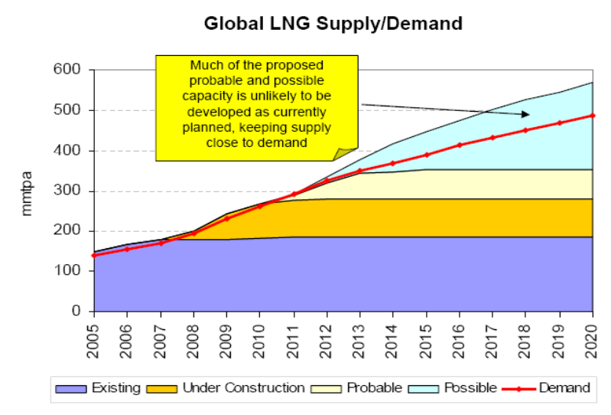
Energy: Global LNG
Global LNG Supply Disappoints
A Tight Global LNG Supply-Demand Balance
Source: Wood Mackenzie
Outlook
Wood Mackenzie forecast global LNG demand will treble by 2020. However, new capacity construction continues to be challenging due to delays most notably in Australia, Egypt, Iran and Nigeria among others. This is leading to downward revisions to global LNG supply.
Given the problems associated with supply, Wood Mackenzie expect the supply-demand balance to be tighter.

Slide 8
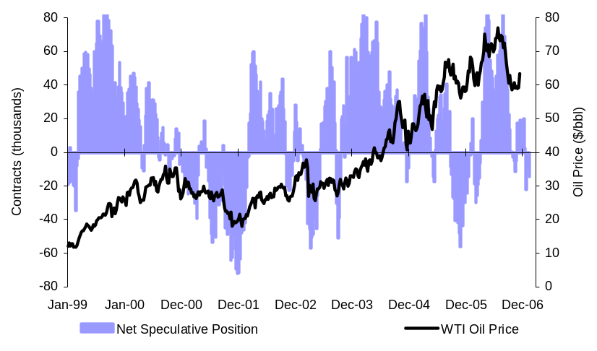
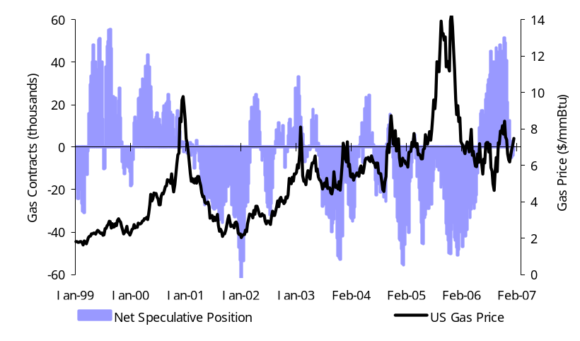
Energy: Speculative Positioning & Prices
CFTC data has flaws in definition and scope, but studies show that speculators tend to follow prices rather than set them.
Crude Oil
Natural Gas
Source: CFTC, Bloomberg, DB Global Markets Research
Source: CFTC, Bloomberg, DB Global Markets Research
Outlook
Some economists and analysts claim that rising speculative activity has been a major contributor to the surge in energy, metals and agricultural prices. A recent Commodities Futures Trading Commission (CFTC) study using disaggregated unpublished data collected by the CFTC suggest that among commercial traders the main groups that may potentially be involved in speculation (managed money traders, including hedge funds) act more as providers of liquidity and do not appear to significantly impact price volatility.
Results from an International Monetary Fund (IMF) study indicate that the short-run causality generally runs from spot and futures prices to speculation, and not vice versa for five commodities examined (crude oil, copper, sugar, coffee, and cotton). The IMF found that for crude oil speculation had a small effect on futures, but this was not translated into a causal impact on sport prices.

Slide 9
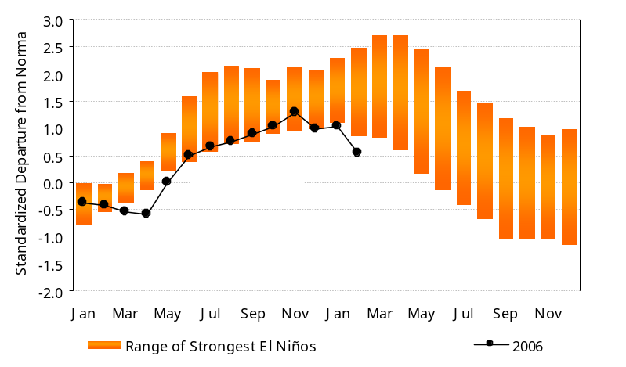
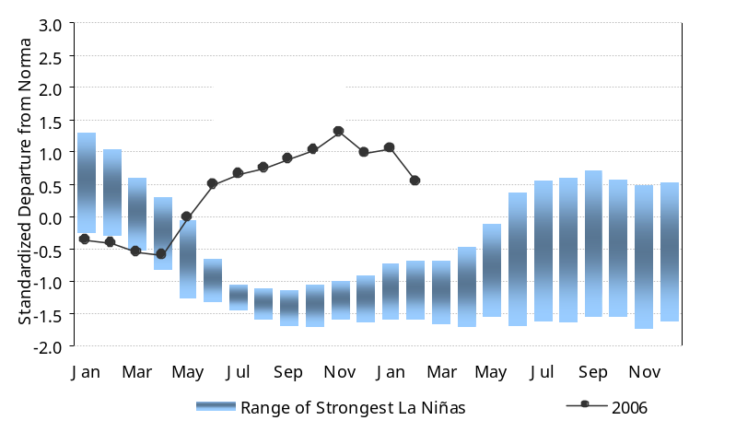
US Natural Gas: Weather Risks
Weather outlook suggests that a moderate El Niño event was underway, but could be giving way to a weak La Niña.
Major El Niño Events vs. Current Index
Major La Niña Events vs. Current Index
Source: DOE/EIA, DB Global Markets Research
Source: NOAA, DB Global Markets Research
Outlook
El Niño describes a phenomenon during which ocean surface temperatures become warmer than normal in the tropical Pacific. The Multivariate ENSO Index show above is based on six main tropical Pacific weather variables. These include: sea-level pressure, zonal and meridional components of the surface wind, sea surface temperature, surface air temperature, and a total cloudiness fraction of the sky. Values of the ENSO index are normalized to have an average of zero and a standard deviation of one.
Current weather data suggests a moderate to weak El Niño event this winter. Strong El Niño events typically imply a milder US winter (bearish energy) and droughts extending to most of Asia (bullish grains). The relationship between El Niño and La Niña events and weather is strong but not perfect. The most recent data point suggest that the El Niño is weakening.
Researchers continue to investigate possible interactions between hurricane frequency and El Niño. In general, El Niño events are characterized by more tropical storms and hurricanes in the eastern Pacific and a decrease in the Atlantic, Gulf of Mexico and the Caribbean Sea.

Slide 10
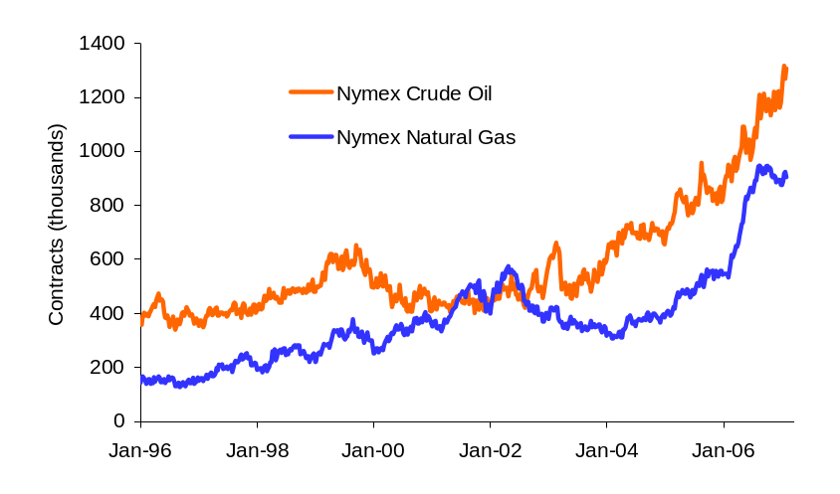
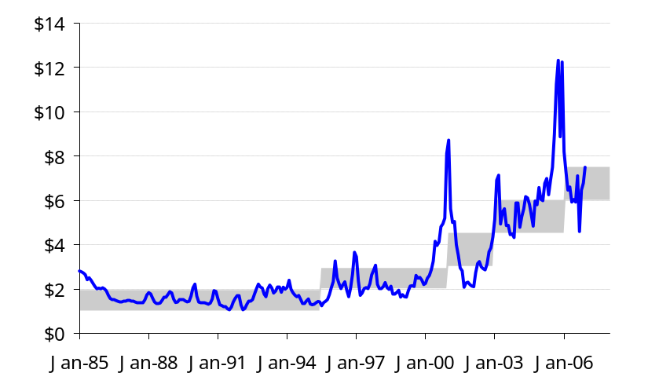
US Natural Gas: Open Interest and Trading Ranges
Natural gas nearly caught up again with oil in Nymex open interest.
Nymex Open Interest in Gas and Oil
Trading Ranges for Natural Gas
Source: CFTC; DB Global Markets Research
Source: Natural Gas Week, DB Global Markets Research
Outlook
Open interest in natural gas has climbed significantly during 2006.
A new trading range for monthly average prices circa USD6.00-7.50 appears to be in place. Weather events can play a strong role in taking prices above or below this range.

Slide 11
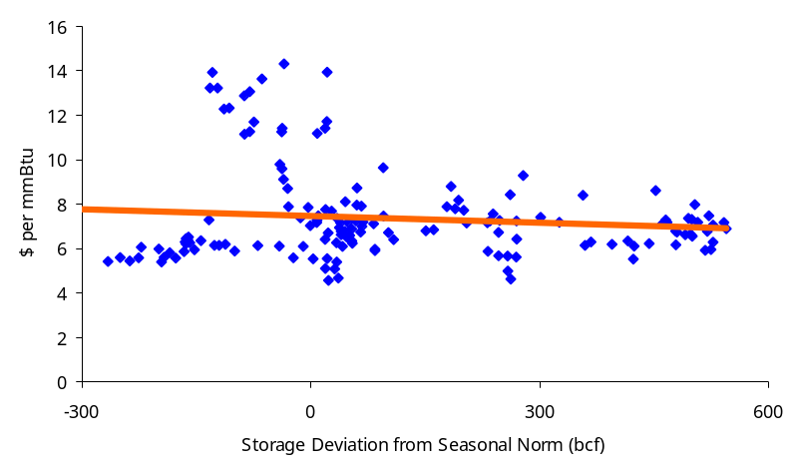
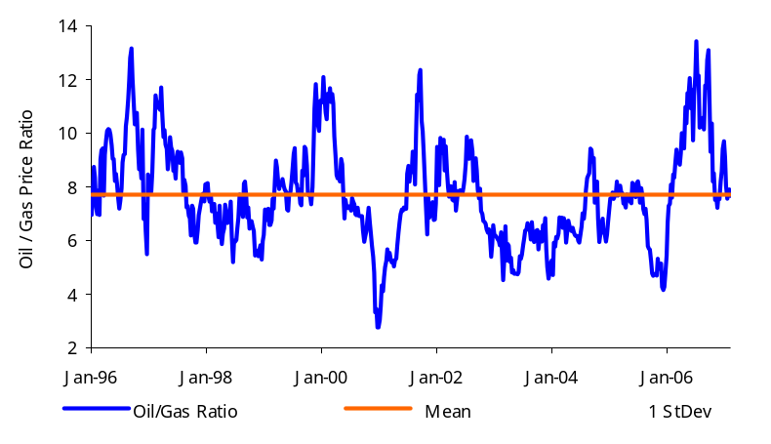
US Natural Gas: Storage Competitive Fuel Anchors
Price beginning to get more in line with storage and oil price historical relationships .
Natural Gas Prices vs. Storage Deviation
Oil / Gas Ratio
Source: Nymex, DOE/EIA, DB Global Markets Research
Source: Nymex, DB Global Markets Research
Outlook
Natural gas prices tend to be related to the deviation in storage levels from historical norms. Recently, prices are starting to respond again to this concept, but at a higher price level than in the earlier this decade.
The relationship between Nymex WTI oil prices and natural gas prices tends to revert toward 8 to 1, although volatility is high.

Slide 12
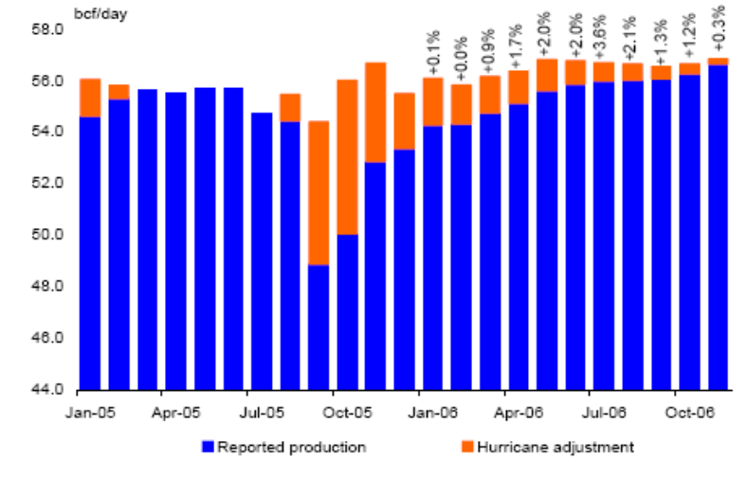
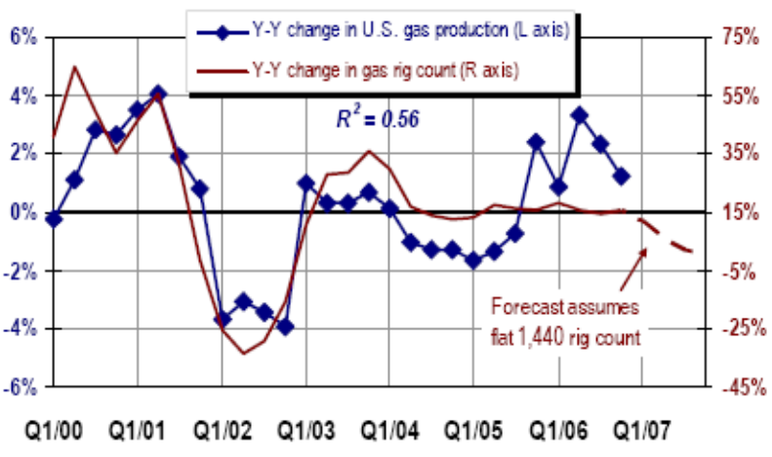
US Natural Gas: Production Could Disappoint
Natural Gas Production (Hurricane Corrected)
Gas Rig Count Drives Production
Source: DOE/EIA, MMS, DB Global Markets Research
Source: DOE/EIA, DB Global Markets Research
Outlook
Gulf production has still not recovered 100% from 2005 events. However, higher onshore production has compensated for the loss and production rose in 2006 by 1%. Hurricane-adjusted US gas production has risen by a relatively meager 1Bcf/d over the past year. We see a strong likelihood that US gas production will disappoint this year, given a stagnating US rig count and accelerating decline rates.
Over the past six years it has required 13% compound annual average growth in the US gas rig count to keep production levels flat. If this relationship holds, in 2007 we will need 1,500 to 1,600 domestic rigs in operation to maintain current production levels. Assuming the current 1,440 rig count holds steady for 2007, production will decline in the year ahead.

Slide 13
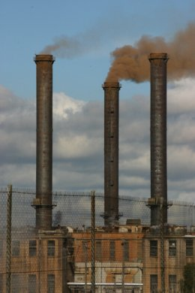
TXU’s Cancellation of 8 Coal Plants Increases Gas Demand

Assuming:
Average heat rate: 8.00
Number of cancelled plants: 8
Average cancelled coal plant size: 1,000 MW
The cancelled coal supply will require an equivalent incremental natural gas supply of 47 bcf per month (4,700 natural gas contracts/month)
This is the equivalent of adding 1.5 bcf/day of additional US gas supply to analysts’ forecasts, starting in 2009
Source: DB Global Markets Research, Jason Oakes

Slide 14
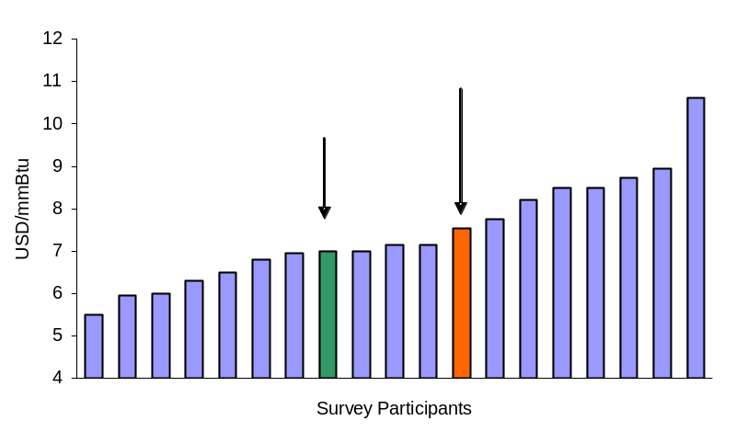
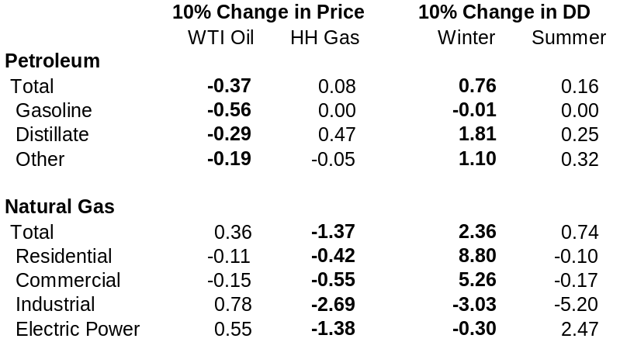
Natural Gas Price Forecasts
We believe that price elasticities of demand and supply are likely to result in lower prices in 2010 than consensus forecasts were assuming in early 2007.
Natural Gas Price Forecasts for 2010
Average Net Demand Elasticities (%)
Source: Reuters, DB Global Markets Research
Source: DOE/EIA, DB Global Markets Research
Outlook
In early January, a poll by Reuters showed analysts expected natural gas prices to average $7.81/mmBtu in 2010.

Slide 15
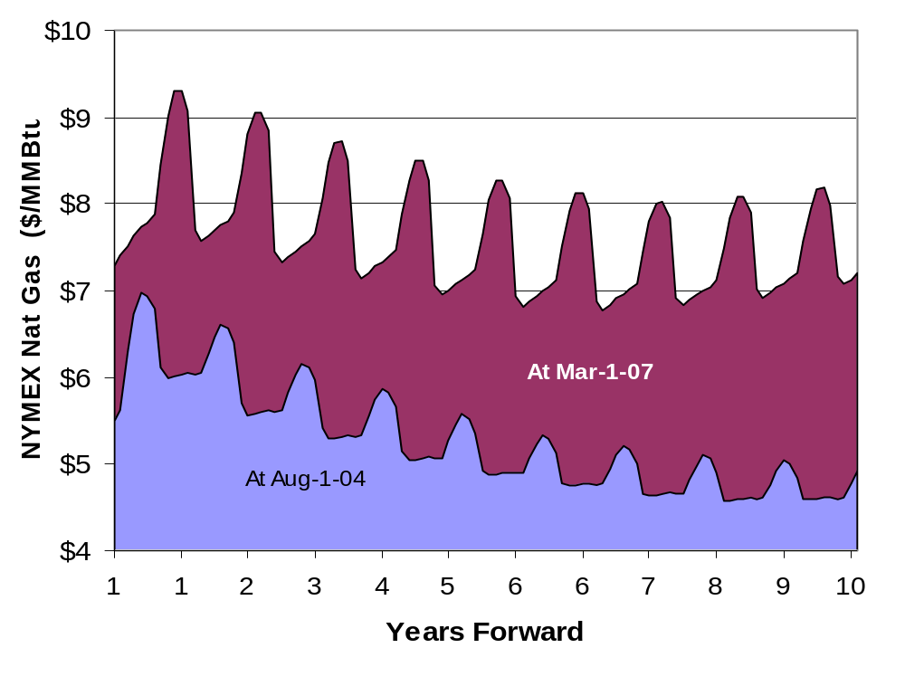
Prices of Long-Term Paper Natural Gas Markets
…higher today than ever
Reported volumes from NYMEX / Globex do not include trading on ICE, which last year surpassed NYMEX in contract volume
The curve shape indicates the growing investor interest in the longer dates
The Amaranth experience shows that liquidity in longer dates is less than in shorter dates
Natural Gas Forward Curves (2007 vs. 2004)
Source: DB Global Markets Research

Slide 16
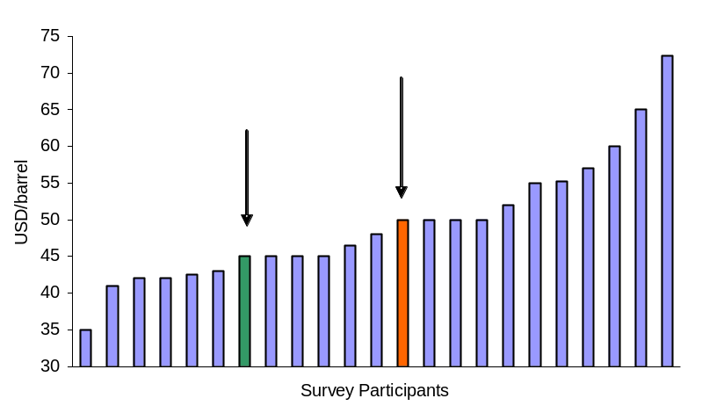
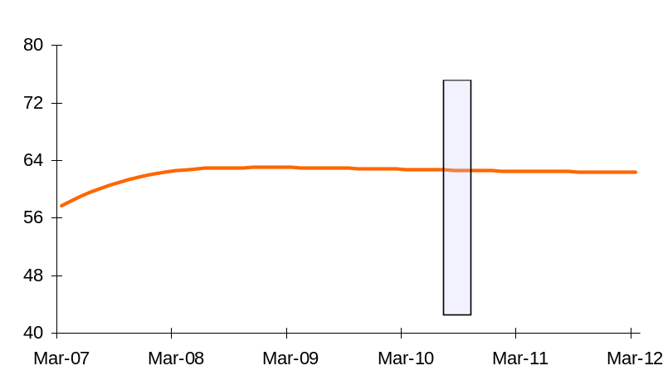
Oil Price Forecasts
Oil Price Forecasts for 2010 (Analysts)
Oil Price Forecasts for 2010 (Others)
Source: Reuters, DB Global Markets Research
Source: Reuters, IEA, DB Global Markets Research
Outlook
Many academic studies have shown that futures markets are poor predictors of future prices. Furthermore, we believe that analysts forecasts are significantly biased by current prices.
In our view, current consensus estimates for oil and gas have likely been set too high because to the sharp increases in oil and gas prices that have occurred over the last few years.
We believe that marginal supply costs for oil point to mid-cycle prices near USD45-50/barrel (real 2005), and equivalent prices for natural gas near USD7.00/mmBtu.

Slide 17
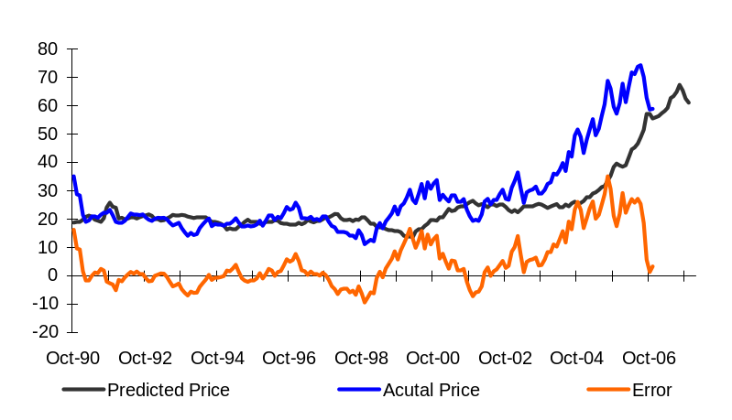
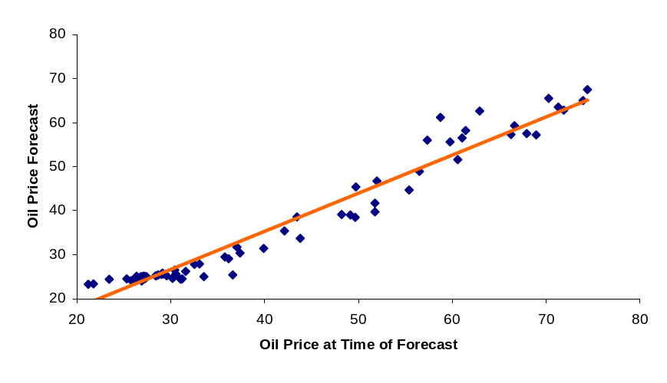
Nasty Secret of Oil Price Forecasts Revealed
There is a 95% correlation between the consensus oil price forecast for 12 months out and the oil price at the time the survey is taken.
Consensus Oil Price Forecasts vs. Actual
Oil Price Forecasts Bias
Source: Consensus Economics, DB Global Markets Research
Source: Consensus Economics, DB Global Markets Research
Outlook
It is very hard for analysts and economists to NOT be biased by current events.
Oil price forecasting was an easier business when oil was mean reverting to $21.
The “error” in the consensus forecast has recently declined – but it took a combination of more aggressive (higher) oil price forecasts AND a decline in the actual price to make that happen.

Slide 18
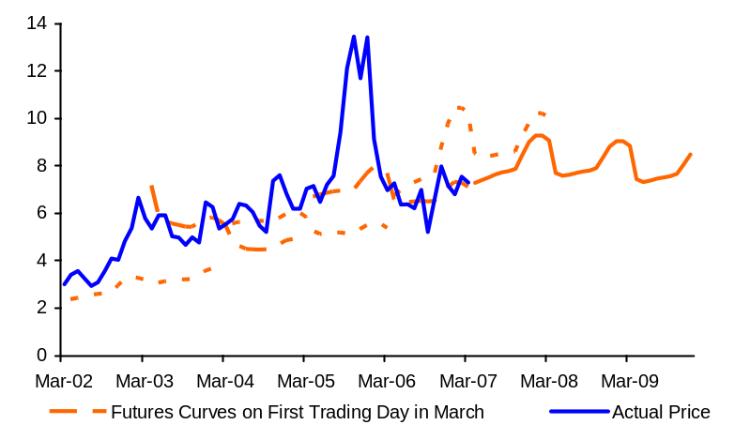
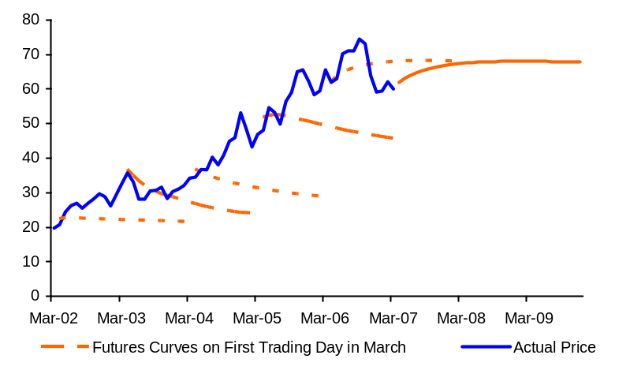
Do Natural Gas Futures Provide Better Forecasts
…than WTI oil futures?
We are not claiming this to bean exhaustive econometric analysis, but the visual evidence since early 2002 seems compelling.
Nymex natural gas futures have been much more accurate than oil futures in signaling actual prices.
Natural gas futures as a predictor
Oil futures as a predictor
Source: Consensus Economics, DB Global Markets Research
Source: Consensus Economics, DB Global Markets Research
Outlook
In our view, US natural gas trades on a narrower set of factors, i.e. mostly North American supply/demand fundamentals, as opposed to global economic trends, unpredictable geopolitics and host of other un-knowable supply/demand shocks that are often prevalent in the oil markets.
The statistical data in the US and Canada are more timely and generally more accurate than global records. The huge hurricane impacts of 2005 were not predictable, and the markets may have given those prices too much weight in the 2006 “forecasts” for natural gas in 2007, but in general we would characterize the gas record as satisfactory and demonstrably better than crude oil.

Slide 19
CERTIFICATION
The views expressed in this report accurately reflect the personal views of the undersigned lead analysts. In addition, the undersigned lead analysts have not and will not receive any compensation for providing a specific recommendation or view in this report. Adam Sieminski
Global Disclaimer
The information and opinions in this report were prepared by Deutsche Bank AG or one of its affiliates (collectively “Deutsche Bank”). The information herein is believed by Deutsche Bank to be reliable and has been obtained from public sources believed to be reliable. With the exception of information about Deutsche Bank, Deutsche Bank makes no representation as to the accuracy or completeness of such information.
This published research report may be considered by Deutsche Bank when Deutsche Bank is deciding to buy or sell proprietary positions in the securities mentioned in this report.
For select companies, Deutsche Bank equity research analysts may identify shorter-term opportunities that are consistent or inconsistent with Deutsche Bank's existing, longer-term Buy or Sell recommendations. This information is made available on the SOLAR stock list, which can be found at http://gm.db.com.
Deutsche Bank may trade for its own account as a result of the short term trading suggestions of analysts and may also engage in securities transactions in a manner inconsistent with this research report and with respect to securities covered by this report, will sell to or buy from customers on a principal basis. Disclosures of conflicts of interest, if any, are discussed at the end of the text of this report or on the Deutsche Bank website at http://gm.db.com.
Opinions, estimates and projections in this report constitute the current judgment of the author as of the date of this report. They do not necessarily reflect the opinions of Deutsche Bank and are subject to change without notice. Deutsche Bank has no obligation to update, modify or amend this report or to otherwise notify a reader thereof in the event that any matter stated herein, or any opinion, projection, forecast or estimate set forth herein, changes or subsequently becomes inaccurate, except if research on the subject company is withdrawn. Prices and availability of financial instruments also are subject to change without notice. This report is provided for informational purposes only. It is not to be construed as an offer to buy or sell or a solicitation of an offer to buy or sell any financial instruments or to participate in any particular trading strategy in any jurisdiction or as an advertisement of any financial instruments.
The financial instruments discussed in this report may not be suitable for all investors and investors must make their own investment decisions using their own independent advisors as they believe necessary and based upon their specific financial situations and investment objectives. If a financial instrument is denominated in a currency other than an investor’s currency, a change in exchange rates may adversely affect the price or value of, or the income derived from, the financial instrument, and such investor effectively assumes currency risk. In addition, income from an investment may fluctuate and the price or value of financial instruments described in this report, either directly or indirectly, may rise or fall. Furthermore, past performance is not necessarily indicative of future results.
Unless governing law provides otherwise, all transactions should be executed through the Deutsche Bank entity in the investor’s home jurisdiction. In the U.S. this report is approved and/or distributed by Deutsche Bank Securities Inc., a member of the NYSE, the NASD, NFA and SIPC. In Germany this report is approved and/or communicated by Deutsche Bank AG Frankfurt authorised by Bundesanstalt für Finanzdienstleistungsaufsicht. In the United Kingdom this report is approved and/or communicated by Deutsche Bank AG London, a member of the London Stock Exchange and regulated by the Financial Services Authority for the conduct of investment business in the UK and authorised by Bundesanstalt für Finanzdienstleistungsaufsicht (BaFin). This report is distributed in Hong Kong by Deutsche Bank AG, Hong Kong Branch, in Korea by Deutsche Securities Korea Co. and in Singapore by Deutsche Bank AG, Singapore Branch. In Japan this report is approved and/or distributed by Deutsche Securities Inc. The information contained in this report does not constitute the provision of investment advice. In Australia, retail clients should obtain a copy of a Product Disclosure Statement (PDS) relating to any financial product referred to in this report and consider the PDS before making any decision about whether to acquire the product. Deutsche Bank AG Johannesburg is incorporated in the Federal Republic of Germany (Branch Register Number in South Africa: 1998/003298/10) Additional information relative to securities, other financial products or issuers discussed in this report is available upon request. This report may not be reproduced, distributed or published by any person for any purpose without Deutsche Bank's prior written consent. Please cite source when quoting.
Copyright © 2007 Deutsche Bank AG.
Disclaimer

Slide 20
Disclosures required by United States laws and regulations
See company-specific disclosures above for any of the following disclosures required for covered companies referred to in this report: acting as a financial advisor, manager or co-manager in a pending transaction; 1% or other ownership; compensation for certain services; types of client relationships; managed/comanaged public offerings in prior periods; directorships; market making and/or specialist role. The firm may trade as principal in the fixed income securities (or in related derivatives) that are the subject of this research report.
The following are additional required disclosures:
Ownership and Material Conflicts of Interest: DBSI prohibits its analysts, persons reporting to analysts and members of their households from owning securities of any company in the analyst's area of coverage.
Analyst compensation: Analysts are paid in part based on the profitability of DBSI, which includes investment banking revenues.
Analyst as Officer or Director: DBSI policy prohibits its analysts, persons reporting to analysts or members of their households from serving as an officer, director, advisory board member or employee of any company in the analyst's area of coverage.
Distribution of ratings: See the distribution of ratings disclosure above.
Price Chart: See the price chart, with changes of ratings and price targets in prior periods, above, or, if electronic format or if with respect to multiple companies which are the subject of this report, on the DBSI website at http://gm.db.com.
Additional disclosures required under the laws and regulations of jurisdictions other than the United States
The following disclosures are those required by the jurisdiction indicated, in addition to those already made pursuant to United States laws and regulations.
Analyst compensation: Analysts are paid in part based on the profitability of Deutsche Bank AG and its affiliates, which includes investment banking revenues.
Australia: This research, and any access to it, is intended only for "wholesale clients" within the meaning of the Australian Corporations Act. EU: A general description of how Deutsche Bank AG identifies and manages conflicts of interest in Europe is contained in our public facing policy for managing conflicts of interest in connection with investment research.
Germany: See company-specific disclosures above for (i) any net short position, (ii) any trading positions (iii) holdings of five percent or more of the share capital. In order to prevent or deal with conflicts of interests Deutsche Bank AG has implemented the necessary organisational procedures to comply with legal requirements and regulatory decrees. Adherence to these procedures is monitored by the Compliance-Department. Hong Kong: See http://gm.db.com for company-specific disclosures required under Hong Kong regulations in connection with this research report. Disclosure #5 includes an associate of the research analyst. Disclosure #6, satisfies the disclosure of financial interests for the purposes of paragraph 16.5(a) of the SFC's Code of Conduct (the "Code"). The 1% or more interests is calculated as of the previous month end. Disclosures #7 and #8 combined satisfy the SFC requirement under paragraph 16.5(d) of the Code to disclose an investment banking relationship. Japan: See company-specific disclosures as to any applicable disclosures required by Japanese stock exchanges, the Japanese Securities Dealers Association or the Japanese Securities Finance Company. Russia: The information, interpretation and opinions submitted herein are not in the context of, and do not constitute, any appraisal or evaluation activity requiring a licence in the Russian Federation. South Africa: Publisher: Deutsche Securities (Pty) Ltd, 3 Exchange Square, 87 Maude Street, Sandton, 2196, South Africa. Author: As referred to on the front cover. All rights reserved. When quoting, please cite Deutsche Securities Research as the source. Turkey: The information, interpretation and advice submitted herein are not in the context of an investment consultancy service. Investment consultancy services are provided by brokerage firms, portfolio management companies and banks that are not authorized to accept deposits through an investment consultancy agreement to be entered into such corporations and their clients. The interpretation and advices herein are submitted on the basis of personal opinion of the relevant interpreters and consultants. Such opinion may not fit your financial situation and your profit/risk preferences. Accordingly, investment decisions solely based on the information herein may not result in expected outcomes. United Kingdom: Persons who would be categorized as private customers in the United Kingdom, as such term is defined in the rules of the Financial Services Authority, should read this research in conjunction with prior Deutsche Bank AG research on the companies which are the subject of this research.
Regulatory Disclosures

