Slide 1
EIA Renewable Energy Projections in Alternative Scenarios
EIA Energy Outlook, Modeling and Data Conference
March 28, 2007
Washington, DC
Robert K. Smith, OIAF

Slide 2
Annual Energy Outlook
AEO contains mid-term projections of U.S. energy markets
  AEO2006 and AEO2007 project through 2030
  Reference Case represents current laws and regulations
  Contain over 30 sensitivity cases with varying technology and market assumptions
Reference Case is also used as a baseline to analyze the potential impacts of proposed laws and regulations at the request of Congress
See http://www.eia.doe.gov/oiaf/aeo/index.html

Slide 3
National Energy Modeling System (NEMS)
Used to develop AEO and policy analysis scenarios
Integrated U.S. energy sector model with macro-economic feedback
  Captures market feedback among different sectors (such as natural gas price response to increased share of renewable generation)
  Electricity sector modeled at a 13 region level based on NERC sub-regions
Updated annually
  Key assumptions continuously revisited
  New modeling techniques added to improve representation
Adaptable to represent new policies or policy detail variations (for example, several different approaches to RPS structures)

Slide 4
Alternative Cases Impacting Renewables using AEO2006 Assumptions
Policy | Policy Assumptions | Additional Information
Clean Energy Portfolio Standard (CEPS) Requested by Senator Coleman | Suppliers must generate specific percentage of total sales from low-carbon energy including renewables and nuclear. Credit price is capped. | Follow-up on earlier analysis, reducing the credit to nuclear and increasing the required clean energy shares.
Alternative Greenhouse Intensity Reduction Goals Requested by Senator Salazar | Based on 12/2004 NCEP report, with additional GHG intensity reduction cases . | Range of GHG intensity reductions also include alternative safety values.
Ten-Year PTC Extension | Assumed PTC would not expire until 2016. Renewable technologies receive 1.9 cents/kWh, except biomass which receives half of the credit. | PTC modeled in AEO2006 and AEO2007 to expire January 1st, 2008. Has since been extended another year.
GHG Intensity Reductions with Cap-and-Trade Requested by Senators Bingaman, Landrieu, Murkowski, Specter, Salazar, Lugar | GHG emissions to be reduced through cap-and-trade. 90 percent of emission allowances are initially given away, but auction share grows over time. | Sensitivity cases included a full auction case.

Slide 5
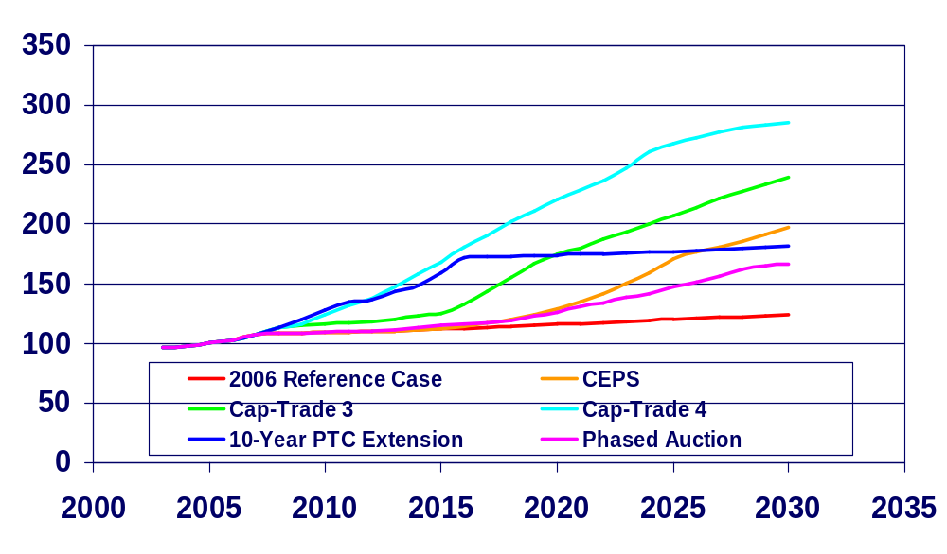
Renewable Capacity
(Gigawatts)

Slide 6
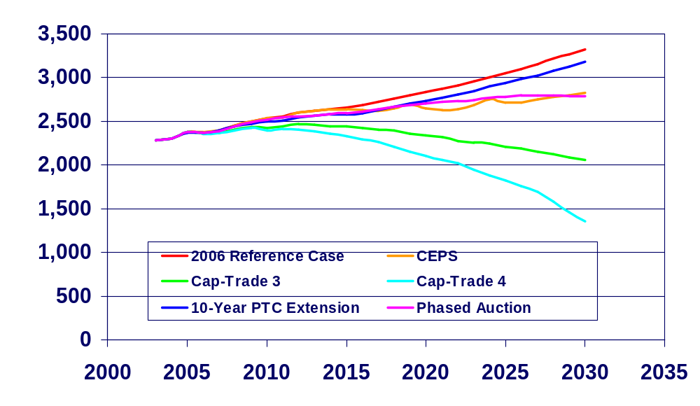
Power Sector CO₂ Emissions
_{(million metric tons)}
Notes:
Data Source: Place holder data.

Slide 7
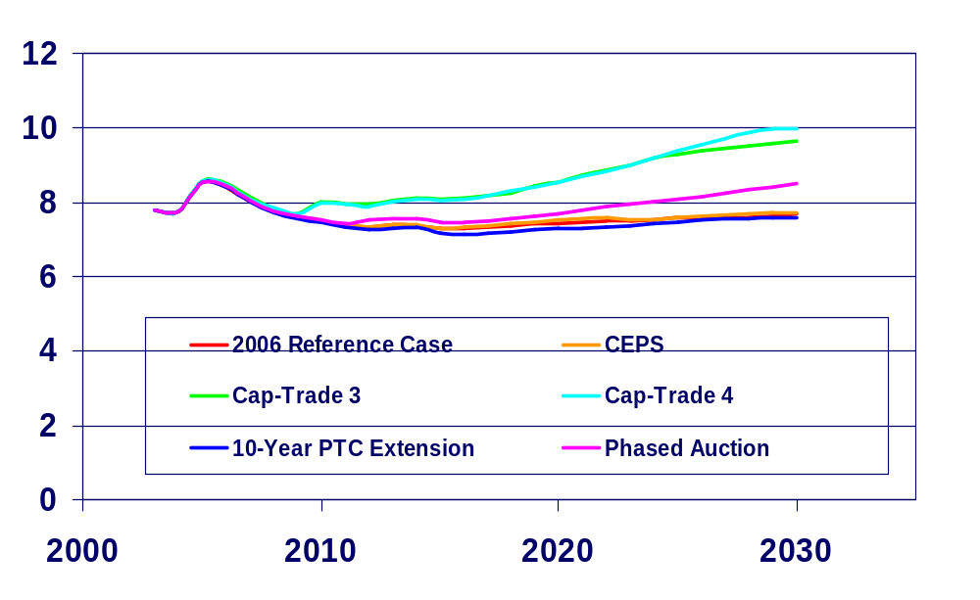
Average End Use Electricity Prices
(2005 cents per kilowatthour)

Slide 8
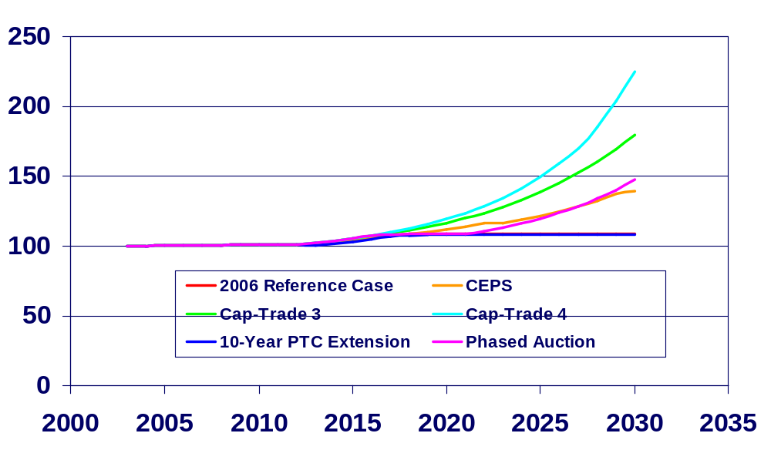
Nuclear Capacity
(gigawatts)

Slide 9
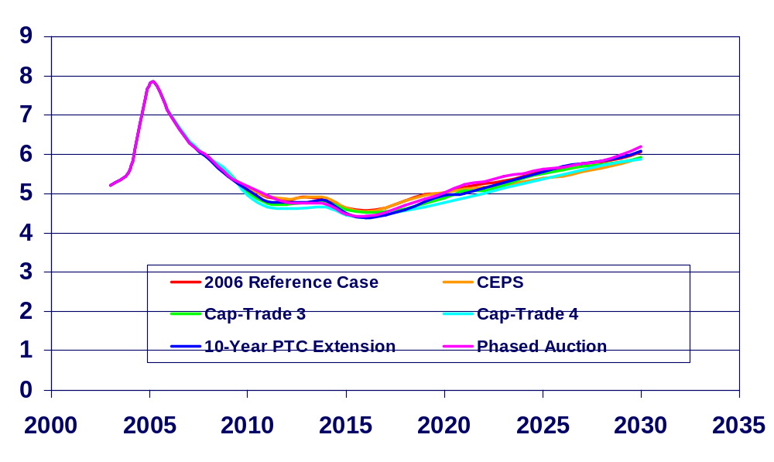
Natural Gas Wellhead Prices
(2005 dollars per thousand cubic feet)

Slide 10
AEO2007 Renewable Technology Modifications and Alternate Cases
Wind performance assumptions changed to better reflect recent performance
Geothermal costs and resource potential updated from recent studies.
Case | Assumptions | Additional Information
Ten-Year PTC Extension | PTC expiration delayed until 2017. Renewable technologies receive 1.9 cents/kWh, except biomass which receives half of the credit | Same tax credit assumptions as in AEO2006, however different results due to revised renewable technology assumptions.
Regional RPS Case | Assumes most states with RPS provisions meet their targets. | Aggregates state requirements up to NEMS regions. Does not assume interregional qualifying generation.

Slide 11
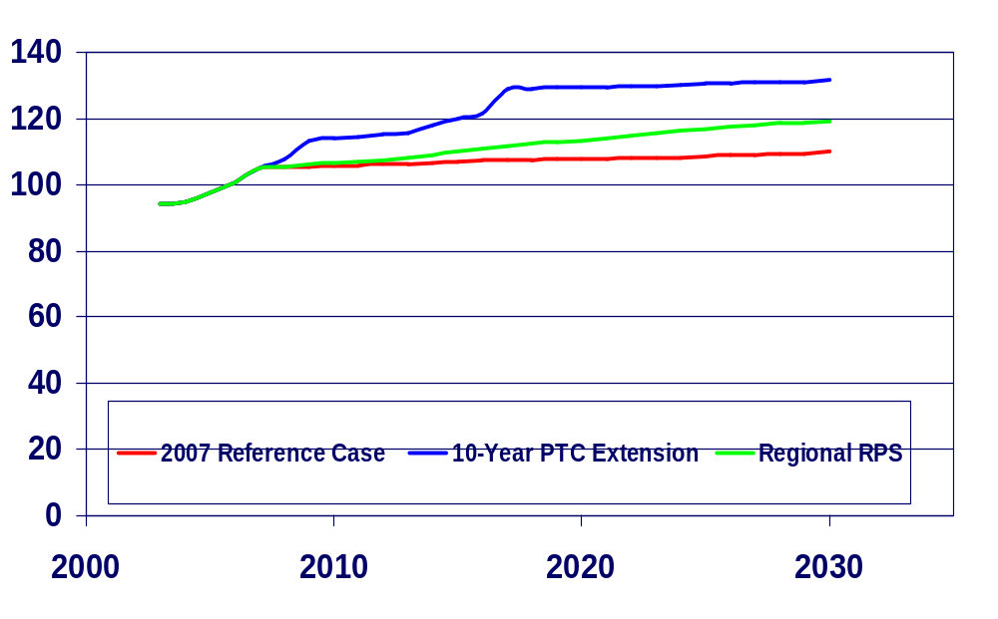
Renewable Capacity
(gigawatts)

Slide 12
Summary
Portfolio standards, extended tax credits and GHG cap-and-trade program cases examined by EIA all stimulated increased renewable capacity additions and generation.
All cases also showed reduced GHG emissions, but the impacts were much larger in the GHG cap-and-trade cases.
With the exception of the extended tax credit cases, all cases led to higher electricity prices, with GHG cap and trade cases having the largest impacts.

Slide 13
Contact Information
Energy Information Administration
www.eia.doe.gov
Robert K. Smith
robert.smith@eia.doe.gov
202-586-9413

