Slide 1
AEO 2007 International Oil (Liquids) Production
EIA Energy Outlook, Modeling and Data Conference
March 28, 2007
Washington, DC
John Staub, Economist

Slide 2
Overview
AEO2007 Reference Case
  OPEC vs non-OPEC Production
  Conventional Oil Production
  Unconventional Liquids Production
Reserves and Production
  Reserves
  Reserves-to-Production (R/P) Ratios
Low and High Price Cases
  Several Interesting Observations
Notes:
In the next few minutes I will try to provide both an overview of the three AEO2007 world liquids production scenarios, and additional detail which is not published in the AEO2007 but that provides context for thinking about the next 25 years of “oil” supply. This talk also provides a preview of new analysis being developed for the International Energy Outlook 2007, which should be release in June of this year.
I need to emphasize that when EIA talks about world oil supply, we are talking about all energy liquids including crude oil, lease condensates, natural gas plant liquids, net refinery gain, Canadian oil sands, ultra heavy oils, biofuels, CTL, GTL, and shale oil.
We will first examine the AEO2007 reference case. Here I will provide additional details that are not published in the AEO2007, mainly because of space constraints.
I’ll spend some time discussing recent work examining reserve-to-production ratios. RP ratios provide insight into the ability of the current reserves’ ability to meet world demand.
We will then briefly review a few relationships between the reference case and the low and high price cases.

Slide 3
AEO2007 Reference Case
OPEC vs non-OPEC Production
Conventional Oil Production
Unconventional Liquids Production

Slide 4
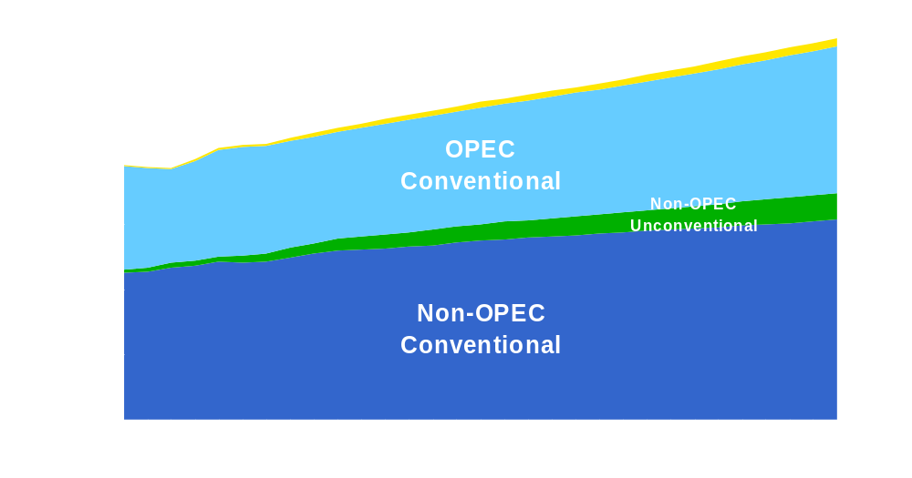
World Liquids Production
Source: AEO2007 Ref. Case Table 19
Notes:
The AEO2007 reference case projects continued growth in OPEC and Non-OPEC Conventional and Unconventional liquids.

Slide 5
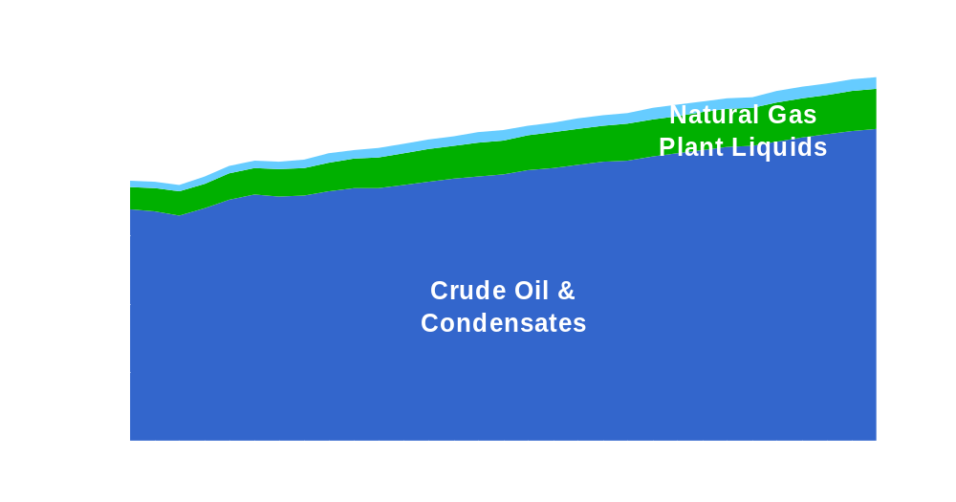
World Liquids Production
Conventional Liquids
Source: AEO2007 Ref. Case Unpublished Table
Notes:
Focusing on conventional liquids for a moment, we see that natural gas plant liquids make up about 10 percent of the conventional liquids stream.

Slide 6
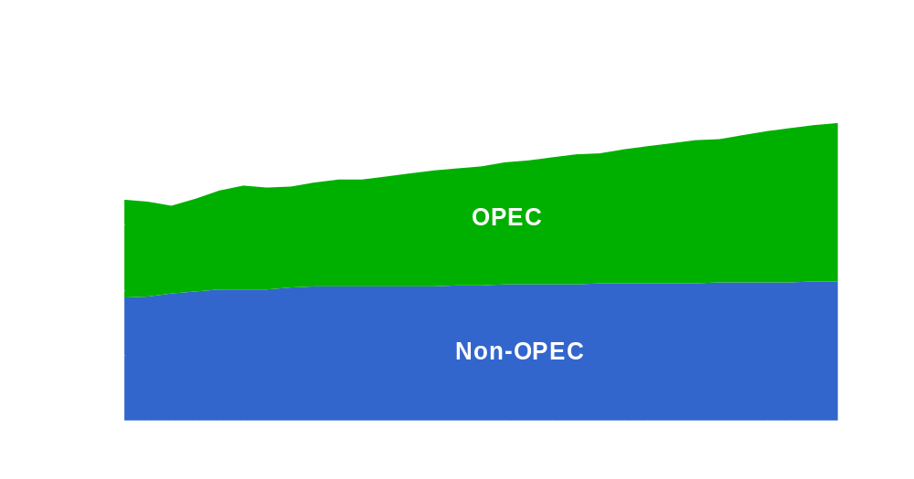
World Liquids Production
Crude Oil and Condensates
Source: AEO2007 Ref. Case Unpublished Table
Notes:
Looking only at crude oil and condensates, we see slow Non-OPEC growth between 2004 and 2030.
Is this the peak that some are worried about?
However, crude oil and condensates are not the whole story. As the previous slide showed NGPLs are an important source of liquids.

Slide 7

World Liquids Production
Unconventional Liquids
Source: AEO2007 Ref. Case Unpublished Table
Notes:
Unconventional liquids currently provide a small share of total liquids.

Slide 8
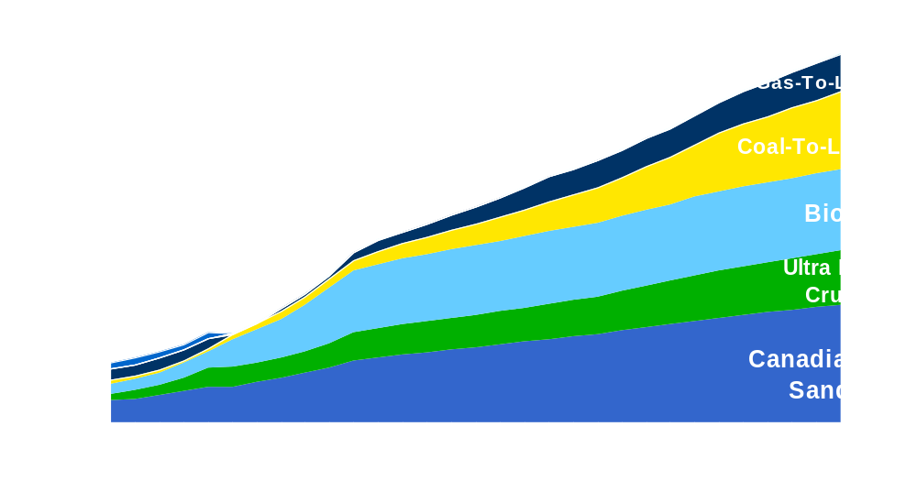
World Liquids Production
Unconventional Liquids
Source: AEO2007 Ref. Case Unpublished Table
Notes:
Changing the scale allows us to see the details. The Canadian oil sands provide the largest share of unconventional liquids. They are expected to grow through 2030. Venezuelan ultra heavy oils could be an equally large source if provided adequate investment.
Biofuels production is expected to grow more quickly than oil sands, though they are starting from a smaller share.
Coal-To-Liquids (i.e. CTLs) and Gas-To-Liquids (i.e. GTLs) are expected to also expand.

Slide 9
Reserves and Production
Reserves
RP Ratios

Slide 10

Reserves
Conventional Crude & Condensates
Source: EIA Int’l Energy Annual Table 8.1. PennWell Corporation, Oil & Gas Journal, various issues, except as noted for the United States, and British Petroleum definition of Canadian oil sands under active development.
Notes:
Reserves are by no means a perfect measure. They are often measured/calculated with different definitions and at different points in time.
All companies publicly trading on U.S. markets are required to report to the Securities and Exchange Commission “proved” reserves or “one P.” Generally this is understood as the amount of oil that can be extracted with current technologies and prices, both of which are constantly changing. Proved reserves are estimated quantities that analysis of geologic and engineering data demonstrates with reasonable certainty are recoverable under existing economic and operating conditions.
Another measure of reserves is “two P” or “proved plus probable.” This measure gives a larger, though less certain estimate.

Slide 11
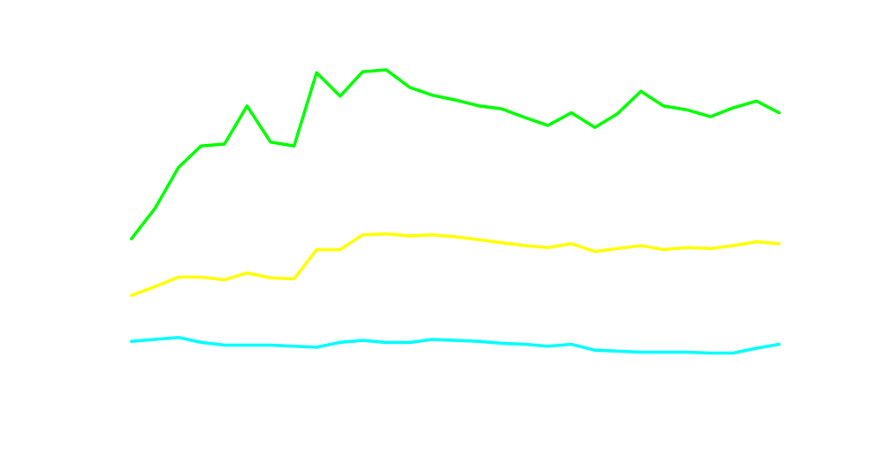
Reserves to Production Ratio
Conventional Crude & Condensates
Source: EIA Int’l Energy Annual 2004 Table 2.2 and EIA estimates of crude oil reserves http://www.eia.doe.gov/emeu/international/oilreserves.html
Notes:
RP ratios (Reserves-to-Production ratios) are a measure of how long current reserves would support continued production at today’s production rate. They are measured in years.
I don’t want to suggest that RP ratio are perfect.
First, note that Non-OPEC RP ratios have declined following low world oil prices. RP ratios are beginning to rise as more exploration is conducted.

Slide 12
Low & High Price Cases
Prices
OPEC vs non-OPEC
  Total Production
  Conventional Liquids Production
  Unconventional Liquids Production
Unconventionals’ Market Share
Regional Production Shares
OPEC Market Share

Slide 13
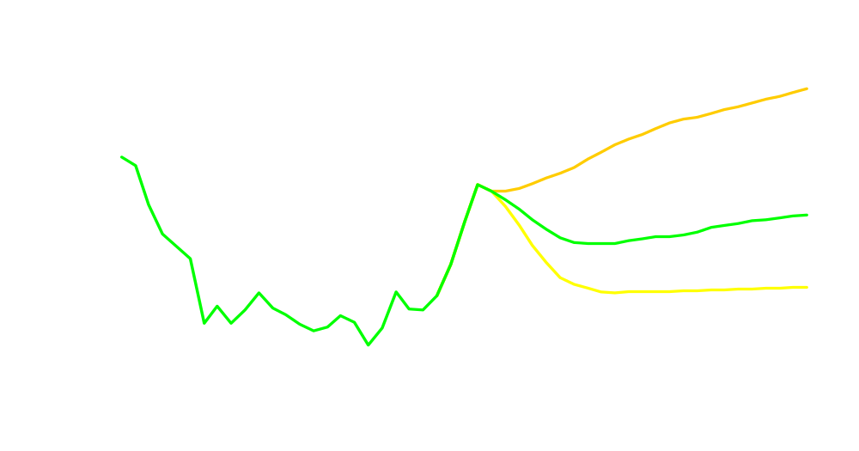
AEO 2007 Oil Price Paths
Low Sulfur, Light Crude
Source: AEO2007 Figure 10
Notes:
As we saw earlier today, the three oil price paths represent a range of possible price scenarios. There are no probabilities associated with the price paths.

Slide 14
OPEC vs Non-OPEC
Total Liquids Production
 | Low price | Reference | High price
OPEC
2005 | 34.0 | 34.0 | 34.0
2010 | 34.7 | 34.7 | 31.2
2015 | 39.3 | 37.5 | 29.1
2020 | 43.9 | 40.2 | 29.3
2025 | 49.2 | 43.7 | 31.4
2030 | 54.7 | 47.6 | 33.3
Non-OPEC
2005 | 50.3 | 50.3 | 50.3
2010 | 57.5 | 56.3 | 55.6
2015 | 62.1 | 60.2 | 60.9
2020 | 66.2 | 63.1 | 64.1
2025 | 70.1 | 66.3 | 66.0
2030 | 73.4 | 69.7 | 68.3
Source: AEO2007 Table 19

Slide 15
OPEC vs Non-OPEC
Conventional Liquids Production
 | Low price | Reference | High price
OPEC
2005 | 33.4 | 33.4 | 33.4
2010 | 33.3 | 33.3 | 29.8
2015 | 37.8 | 35.9 | 26.8
2020 | 42.4 | 38.3 | 26.2
2025 | 47.7 | 41.4 | 27.8
2030 | 53.3 | 44.9 | 28.9
Non-OPEC
2005 | 48.2 | 48.2 | 48.2
2010 | 53.6 | 52.1 | 51.1
2015 | 57.9 | 55.0 | 54.2
2020 | 61.8 | 57.1 | 54.8
2025 | 65.3 | 59.2 | 53.7
2030 | 68.4 | 61.4 | 52.6
Source: AEO2007 Table 19

Slide 16
OPEC vs Non-OPEC
Unconventional Liquids Production
 | Low price | Reference | High price
OPEC
2005 | 0.6 | 0.6 | 0.6
2010 | 1.4 | 1.4 | 1.4
2015 | 1.5 | 1.6 | 2.3
2020 | 1.5 | 1.9 | 3.1
2025 | 1.5 | 2.3 | 3.6
2030 | 1.4 | 2.7 | 4.4
Non-OPEC
2005 | 2.1 | 2.1 | 2.1
2010 | 3.9 | 4.2 | 4.5
2015 | 4.2 | 5.2 | 6.7
2020 | 4.4 | 6.0 | 9.3
2025 | 4.8 | 7.1 | 12.3
2030 | 5.0 | 8.3 | 15.7
Source: AEO2007 Table 19

Slide 17
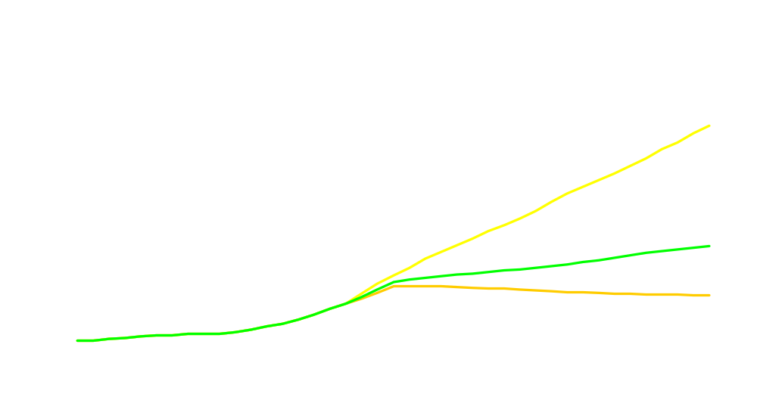
Unconventional Liquids Production as a Share of World “Oil” Market
High Price Case
Reference Case
Low Price Case
Source: AEO2007 Figure 31

Slide 18

Regional Liquids Production as a Share of World Liquids Market
Source: AEO2007 Figure 32

Slide 19

OPEC Market Share as a Share of World Liquids Market
Source: AEO2007 Table 19

Slide 20
Thank you
Energy Information Administration
www.eia.doe.gov
John Staub
John.Staub@eia.doe.gov
202-586-6344

