Slide 1
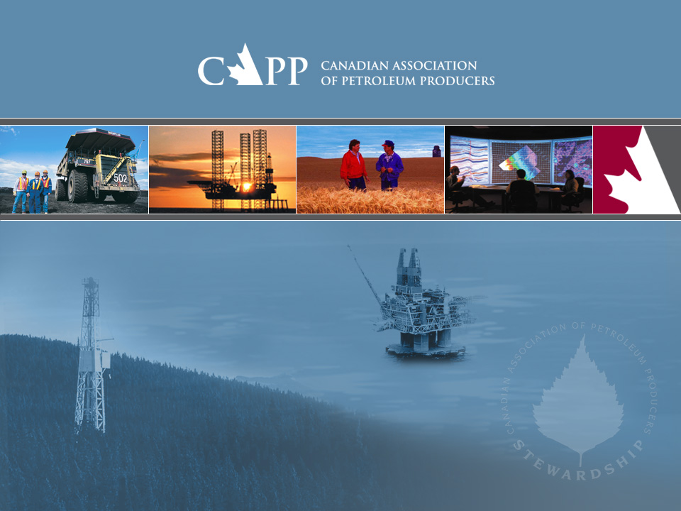
Canadian Oil Sands Outlook
EIA 2007 Annual Energy Outlook
March 2007

Slide 2

Canadian Association of Petroleum Producers
150 producer member companies
Explore for, develop and produce natural gas, natural gas liquids, crude oil, synthetic crude oil, bitumen and sulphur throughout Canada
Members produce more than 95 per cent of Canada’s natural gas and crude oil
130 associate members provide a wide range of services that support the upstream crude oil and natural gas industry

Slide 3
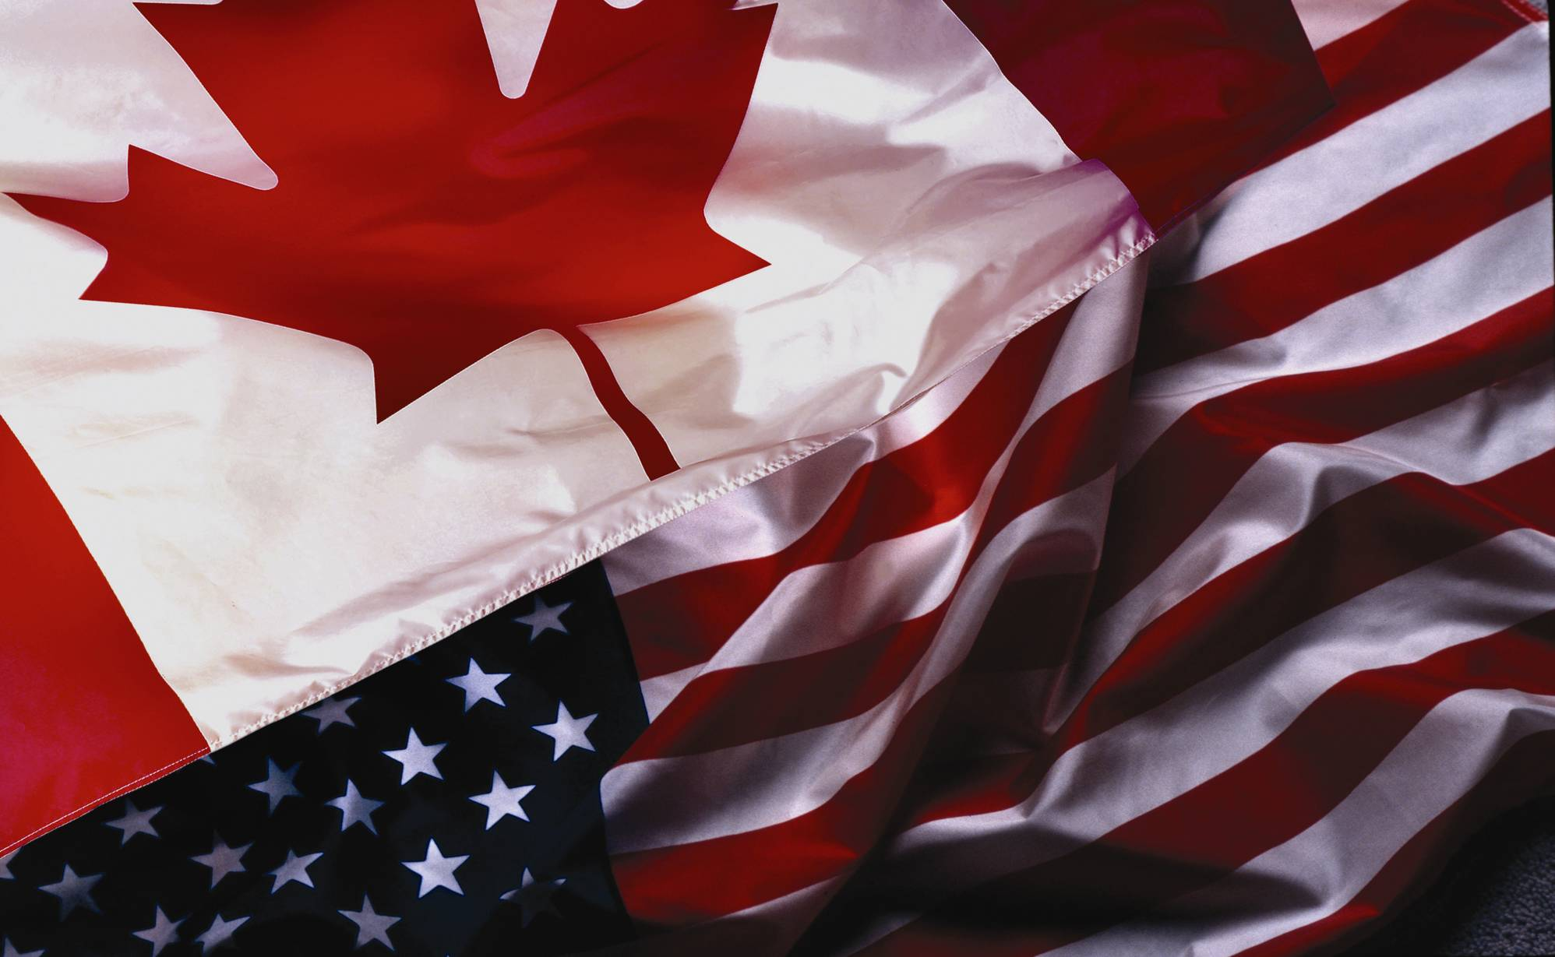
Canada’s Oil and Gas Industry in the North American Energy Economy
Canada is the world’s 3rd largest natural gas producer
Canada is the world’s 8th largest crude oil producer
  and moving up the list quickly with oil sands production increasing
Canada is the largest supplier of energy to the United States
2006 | Canadian Natural Gas | Canadian Petroleum
Ranking of importers to U.S.
Share of U.S. consumption | 16% | 11%
Share of U.S. imports | 86% | 16%
#1
#1

Slide 4
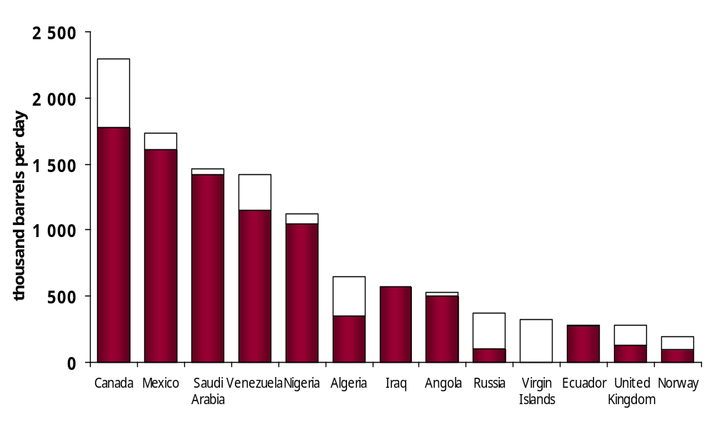

U.S. Imports of Crude Oil and Petroleum Products by Country of Origin
Petroleum Products
#1
Crude Oil
Canada, is the largest (#1) supplier of crude oil and of crude oil and petroleum products to the US.
Source: EIA, Jan-Nov 2006

Slide 5

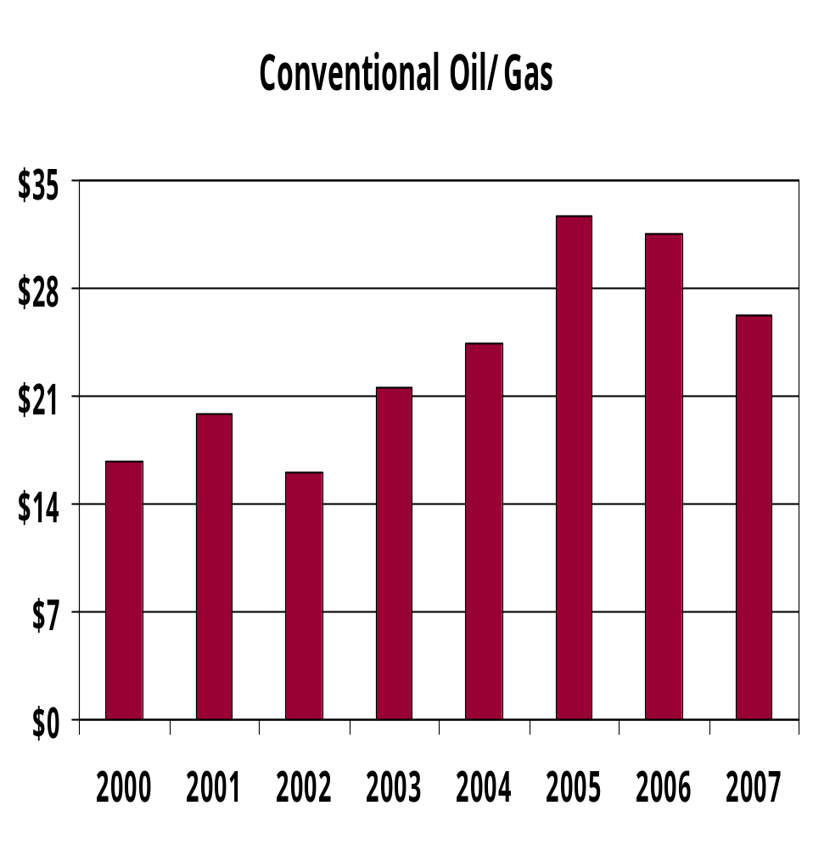
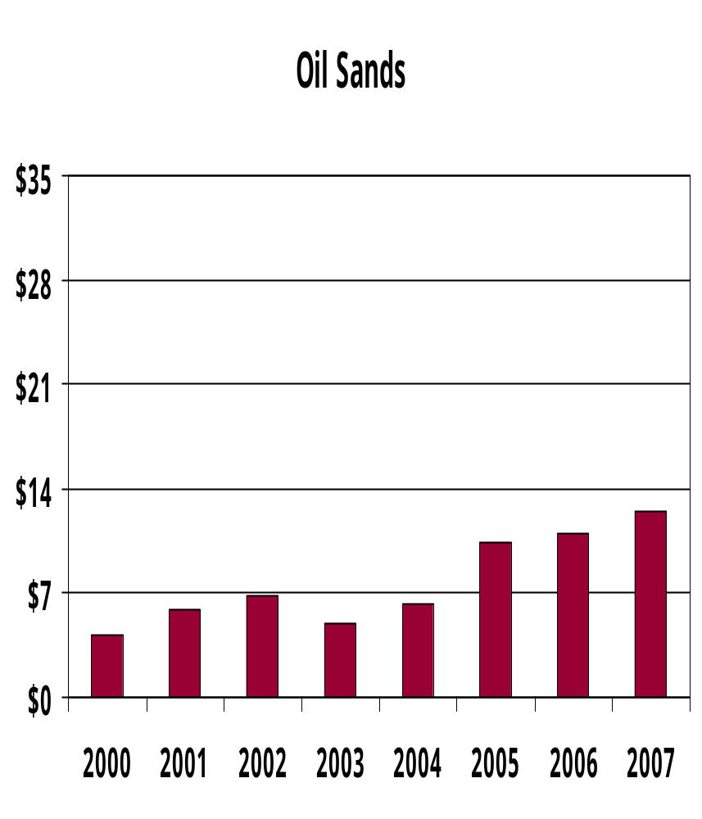
Oil & Gas Investment in Western Canada
(Cdn $ billion)

Slide 6
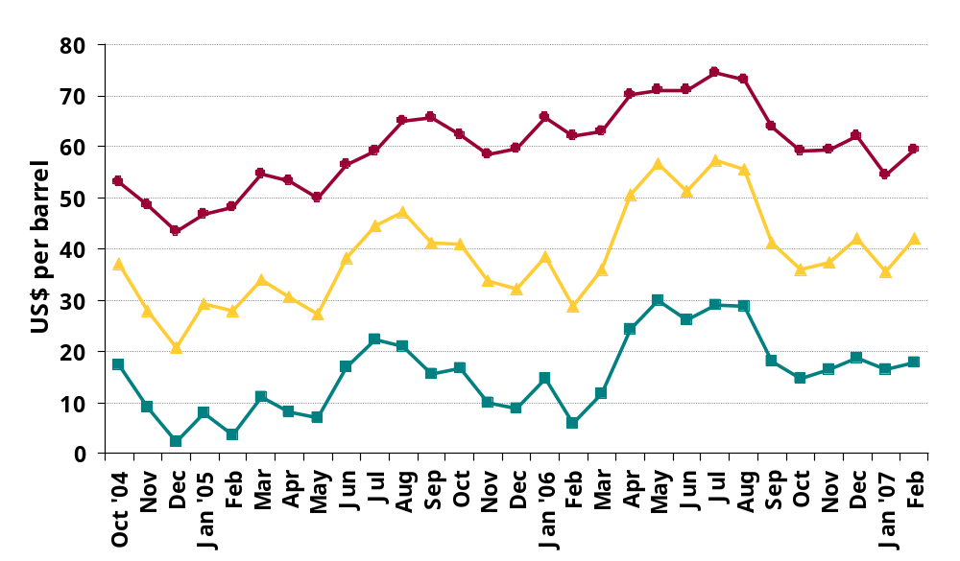
Comparative light, heavy and bitumen crude oil price
Light crude oil price quoted in media
(West Texas Intermediate)
Heavy crude oil price at Hardisty
Estimated bitumen price netback

Slide 7
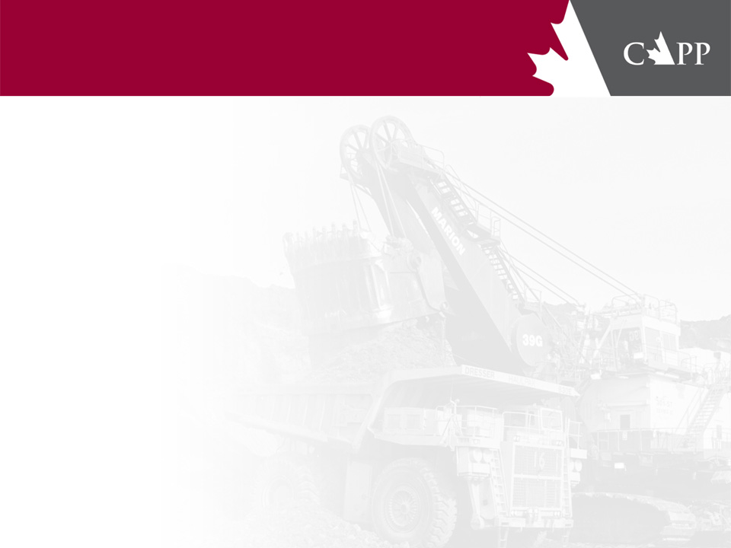
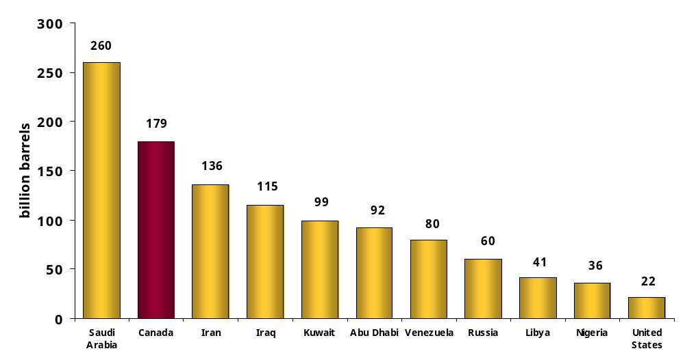
Global Crude Oil Reserves by Country
Includes 175 billion barrels
of oil sands reserves
Canada, with 175 billion barrels in oil sands reserves, ranks 2nd only to Saudi Arabia in global oil reserves
Source: Oil & Gas Journal Dec. 2006

Slide 8
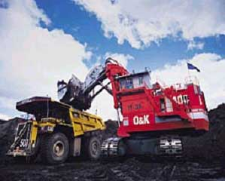
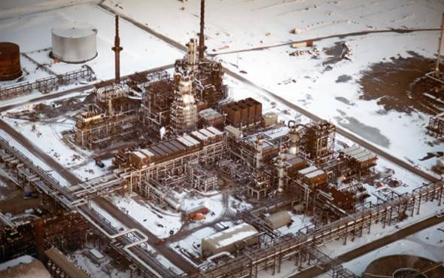
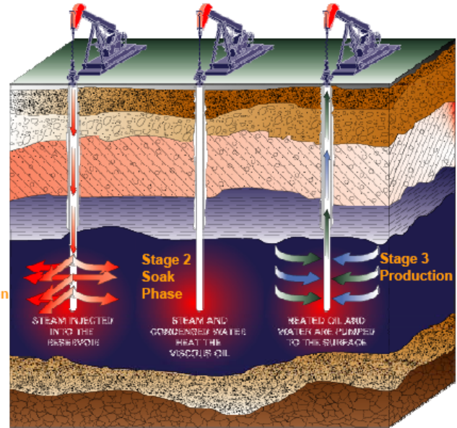

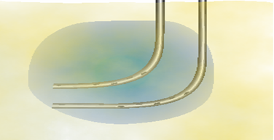

Oil Sands Production Technologies
20% less than 50 m deep
Mining & Upgrading
Recoverable reserves
= 35 billion barrels
Source: Syncrude
Source: Shell Canada
80% more than 50 m deep
Cyclic Steam Process
In-situ
Steam Assisted Gravity Drainage
Recoverable reserves
= 140 billion barrels
Oil Production
Steam Injection
Steam
Chamber
Steam Injection
Oil Production
Reservoir
Source: Petro-Canada
Source: Imperial Oil

Slide 9
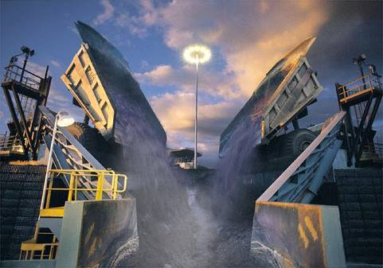
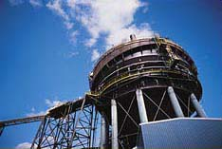
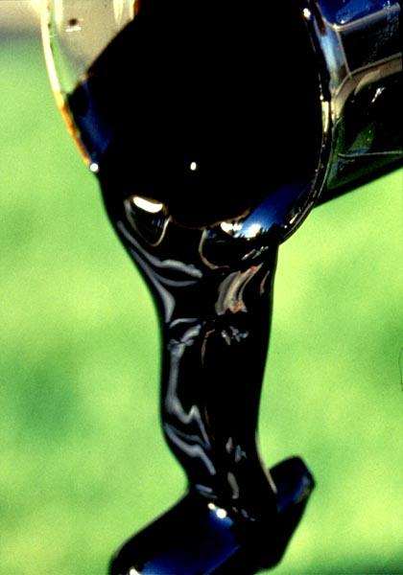
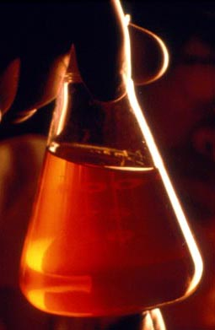
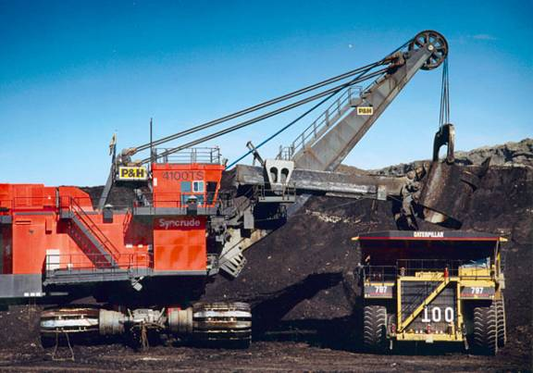
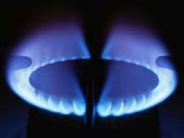
Oil sands Mining and Upgrading Process
2 tonnes of oil sands
through separator
1.2 barrels
bitumen
1 barrel synthetic
(upgraded) crude oil
2 tonnes of oil sands
4 tonnes material
0.5 - 0.7 mcf/barrel
Photos courtesy of Syncrude Canada

Slide 10
Oil Sands Projects in Three Deposits
Fort Hills
Athabasca – Mining Barrels per day
Operator | Project | Initial | Potential
Albian/Shell | Muskeg/Jackpine | 150,000 | 550,000
Suncor | Base Plant | 280,000 | 550,000
Syncrude | Base Plant | 300,000 | 600,000
CNRL | Horizon (2008) | 110,000 | 232,000
Imperial | Kearl (2010) | 100,000 | 300,000
Petro-Canada | Fort Hills (2011) | 50,000 | 190,000
Synenco | Northern Lights (2010) | 50,000 | 100,000
Total E&P | Joslyn Creek Mine (2013) | 50,000 | 200,000
Athabasca – In Situ Thermal
JACOS | Hangingstone (pilot) | 10,000 | 30,000
Suncor | Firebag | 35,000
ConocoPhillips | Surmont (2006) | 16,000 | 110,000
Devon | Jackfish (2008) | 35,000 | 70,000
Encana | Christina/Foster (2006) | 30,000 | 400,000
Husky | Sunrise (2012) | 60,000 | 240,000
OPTI/Nexen | Long Lake (2007) | 70,000 | 140,000
Petro-Canada | MacKay River (2009) | 24,000 | 60,000
Total E&P | Joslyn Creek (2006) | 10,000 | 40,000
Cold Lake – In Situ Thermal
Blackrock | Orion-Hilda Lake pilot | 500 | 20,000
CNRL | Wolf Lake/Primrose | 50,000 | 120,000
Imperial | Cold Lake | 130,000 | 180,000
Husky | Tucker (2006) | 18,000 | 35,000
Peace River – In Situ Thermal
Shell | Peace River | 12,000 | 100,000
Kearl Lake
Northern Lights
Horizon
Joslyn Creek
Muskeg River
Albian
Syncrude
Sunrise
Firebag
Peace River
Seal (Blackrock)
MacKay River
Suncor
Jackpine
Fort
McMurray
Peace River
Hangingstone
Surmont
Christina Lake
Long Lake
Whitesands
Jackfish
Foster Creek
Cold Lake
Athabasca
Hilda Lake
(Orion)
Peace
River
Ft. McMurray
Wolf Lake/Primrose
Cold Lake
Edmonton
Cold
Lake
Tucker Lake
Calgary
In Situ Projects
Mining Projects

Slide 11
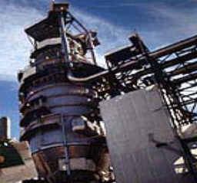
Bitumen Upgraders in Alberta
Capacity by 2015
Existing: | Volume (bpd)
Albian-Scotford | 158,000
Husky-Lloydminster | 59,000
Suncor | 260,000
Syncrude | 350,000
Expansions: Comment
Albian-Scotford | 397,000 | Expansion w/plans for a total of 555,000 bpd
Husky-Lloydminster | 65,600 | Expansion (2011)
Suncor | 287,000 | 97,000 b/d expansion of Upgrader 2 & in-situ to total planned 357,000 b/d in 2008. Upgrader 3, additional 190,000 b/d to 550,000 b/d in 2012.
Syncrude | 160,000 | Phased expansion (2012-2015) – 510,000 bpd
New projects:
BA Energy-Heartland | 260,000 | Phase 1 - 77,500 bpd (2008). 3-phase expansion to 260,000 bpd
CNRL-Horizon | 232,000 | Phase 1-3 (2011). Phase 1 in 2008 – 110,000 bpd.
Nexen/Opti-Long Lake | 173,000 | On-stream late 2007.
North American (Kai Kos Dehseh) | 250,000 | Phase 1 – 76,000 bpd (2012). Phase 2 to 250,000 bpd by 2015
Northwest Upgrading | 150,000 | 3 phased expansion. On stream in 2010, phase 2 – 2012-2014
Petro-Canada | 85,000 | Refinery conversion to upgrader/refinery in late 2008
Petro-Canada/UTS-Fort Hills | 240,000 | Phase 1 – 140,000 bpd (2011). Phase 2 - 240,000 bpd by 2014
PRO (Bluesky) | 50,000 | Phase 1 on-stream 2011.
SynEnCo-Northern Lights | 100,000 | Phase 1 – 50,000 bpd in 2010, phase 2 – 50,000 bpd in 2012
Total E&P | 85,000 | On-stream in 2014
TOTAL | 3,361,600

Slide 12

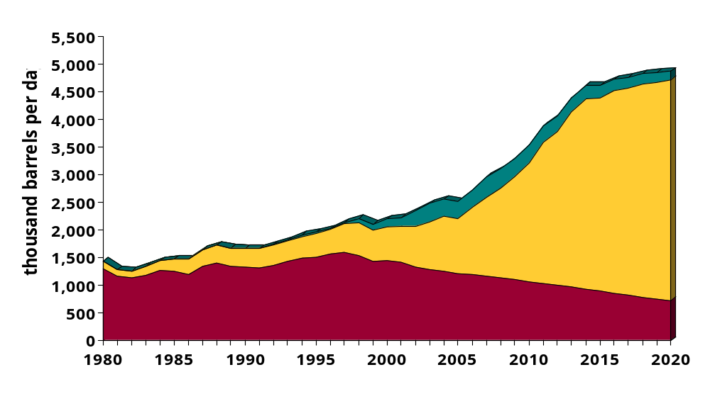
Canadian Oil Production
Conventional, Oil Sands and Offshore
Oil Sands Production:
2006 = 1.1 million b/d
2015 = 2.9-3.5 mm b/d
2020 = 3.3-4.0 mm b/d
Actual
Forecast
Offshore
Constrained
Case
Oil Sands
Western Canadian Conventional Oil
Source: CAPP

Slide 13
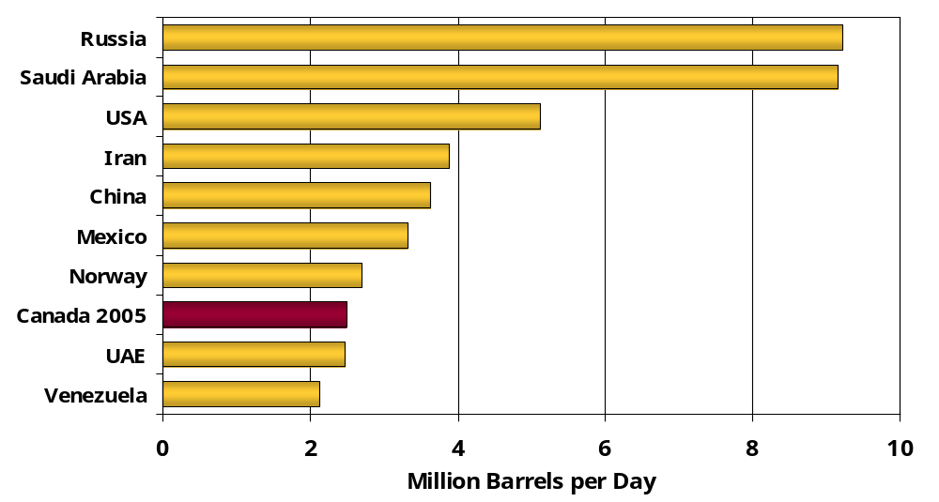
Top 10 World Crude Oil Producers in 2005
Oil sands growth will move Canada from #8 to #4 in the world by 2015
Source: EIA & CAPP

Slide 14
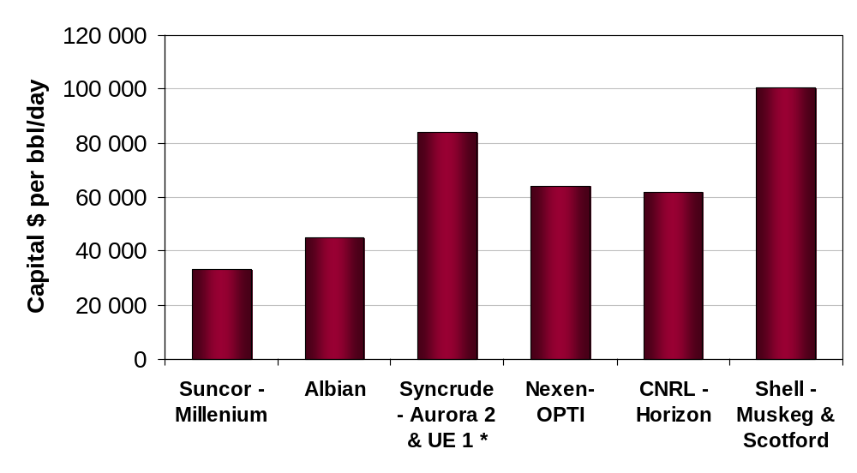
Oil Sands Capital Costs Increases
Global Cost Increases Not Just Local
Capital Cost of 100,000 bbl/day project
$3.3 billion $10 billion
Production
Start Date
2001
2003
2006
2007
2008
2010
*Syncrude includes base plant quality improvements and power

Slide 15
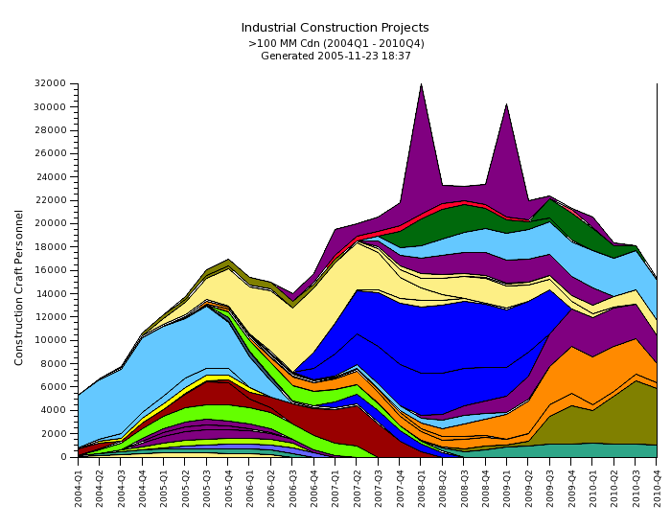
Construction Workforce Outlook – Nov 2005
IOL – Mackenzie Gas Project
Synenco Northern Lights
Phases 1 & 2
EnCana Foster Creek
Syncrude SERP
Suncor Firebag
mining & extraction
OPTI Canada/ Nexen Upgrader
North West Upgrader
Syncrude S3dbn
Husky Tucker Thermal
CNRL Horizon Phase 3
CNRL – Horizon
Phases 1 &2
Albian Sands Downstream Exp
IOL Oilsands Mine
Syncrude UE1 & SERP
Suncor Firebag &
Voyageur
Albian Sands Jackpine Mine
IOL
Petro Canada
PC/UTS Forth Hill
Conoco Surmont
Source: Construction Owners Association of Alberta (COAA) Nov 2005

Slide 16
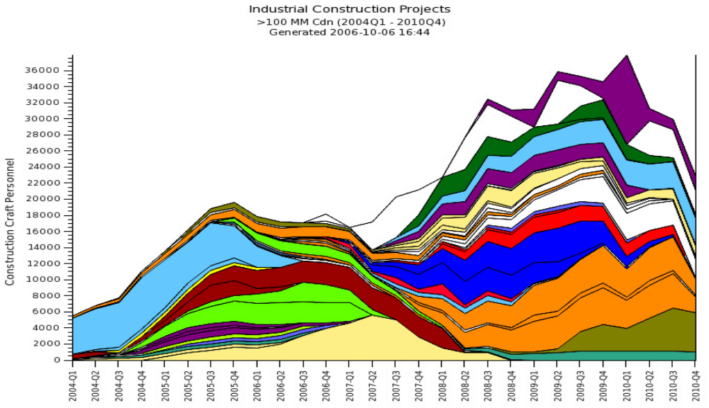
Construction Workforce Outlook – Oct 2006
IOL – Mackenzie Gas Project
Synenco Northern Lights
Phases 1 & 2
Syncrude
Northwest
OPTI Canada/ Nexen Upgrader
North
American
Joslyn
Syncrude UE1
& SERP
Albian Sands – Jackpine & Upgrader Expansion
Petro Canada
Suncor Firebag &
Voyageur
IOL Cold Lake
CNRL – Horizon
Phases 1 &2
PC/UTS Fort Hill
Conoco Surmont
Source: Construction Owners Association of Alberta (COAA) Oct 2006

Slide 17
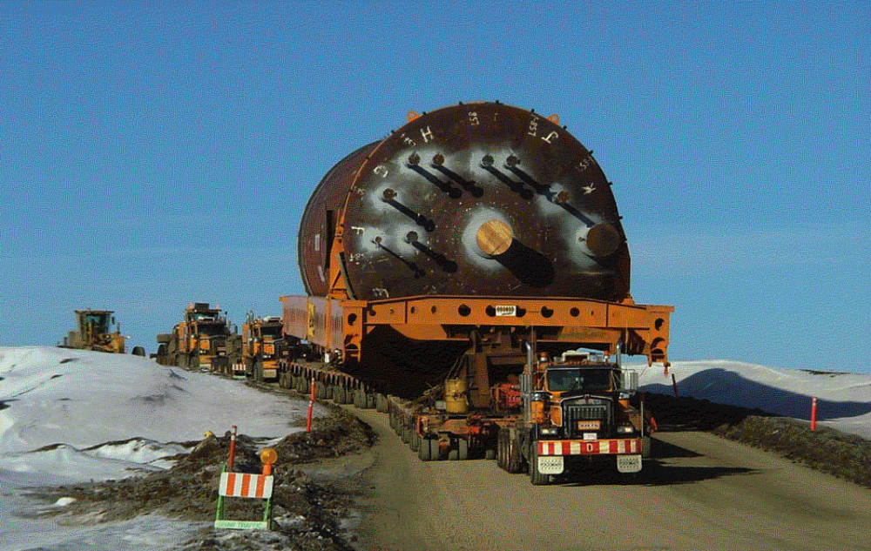
Need for Infrastructure
Moving a Suncor Coker at 10-15 km
per hour all the way from Edmonton

Slide 18
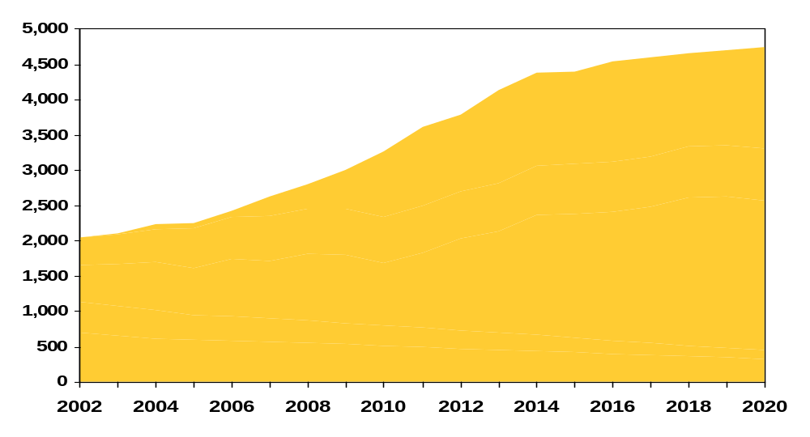
Crude Oil Supply and Pipeline Expansions
Existing / Planned
Expansions
New Pipelines/Expansions
Constrained
Case
Enbridge Clipper
Thousand Barrels Per Day
TransCanada Keystone
TransMountain TMX 1
Enbridge Southern Access

Slide 19
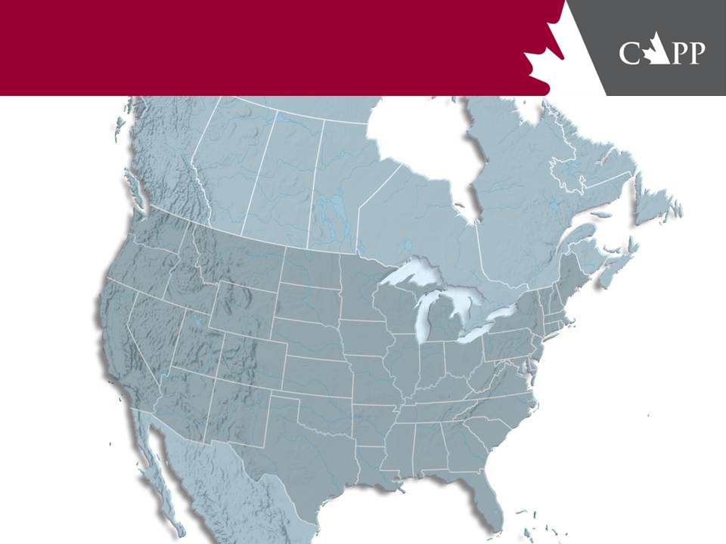
Canadian & U.S. Crude Oil Pipelines
existing
proposed
possible
Kinder Morgan
TMX Northern Leg
Capacity 400 kbpd
In service 2012
TMX2 Expansion
Capacity 100 kbpd
In service 2011
TMX3 Expansion
Capacity 300 kbpd
In service 2011
Enbridge Gateway
Capacity 400 kbpd
In service 2012-14
TransCanada
Keystone
Capacity 435 kbpd
In service late 2009
Cushing Extension
Capacity 155 kbpd
In service late 2010
Heartland Extension
Capacity 600 kbpd
In service 2009-10
Enbridge North
Alberta Clipper
Capacity 450+ kbpd
In service mid-2010
Southern Access
Capacity 400 kbpd
In service 2009
Southern Lights
Capacity 185 kbpd
In service 4Q 2008
Line 5 Expansion
Capacity 50 kbpd
In service 2008
Line 6B Expansion
Capacity 44 kbpd
In service 2009
Line 6C New Line
Capacity 350 kbpd
In service 2011
Line 9 Reversal
Capacity 180 kbpd
In service 2009
Trans Mountain
Edmonton
Hardisty
Sunoco New Line
Capacity 200 kbpd
In service 2012
Burnaby
TransCanada
AB-California
Capacity 400 kbpd
In service 2012
AB-USGC
Capacity 400-600 kbpd
In service 2012
Anacortes
Express
Montreal
Portland
BP
Light line ex-Chicago
Capacity 180 kbpd
In service 2009
Enbridge
Sarnia
Salt Lake City
Guernsey
Altex
Capacity 250+ kbpd
In service 2011
Platte
Chicago
Lima
Enbridge South
New Line
Capacity 450 kbpd
In service 2010
New Line
Capacity na
In service 2012-14
Spearhead Expansion (N/S)
Inc. Capacity 65 kbpd
In service 2009
North Loop to Chicago
In service 2009
Enbridge New Line
Capacity 400 kbpd
In service 2010
BP
Wood
River
Patoka
Kinder Morgan
Express Option 1
Capacity 160 kbpd
In service 2010
Express Option 2
Capacity 55 kbpd
In service 2010
Express Bullet
Capacity 400+ kbpd
In service 2010
Express Routing
Patoka South
Cushing
ExxonMobil
ExxonMobil
Mustang Expansion
Capacity 38 kbpd
In service late 2008
Pegasus Expansion
Capacity 31 kbpd
In service late 2008
Clydesdale New Line
Capacity 280+ kbpd
In service 2010
Houston
St. James

Slide 20
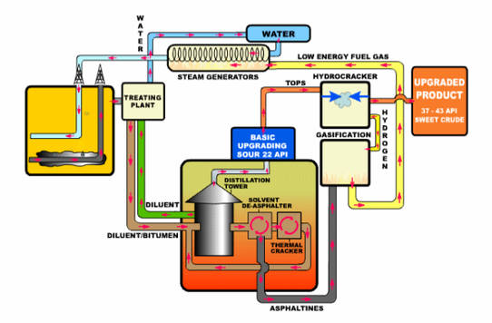
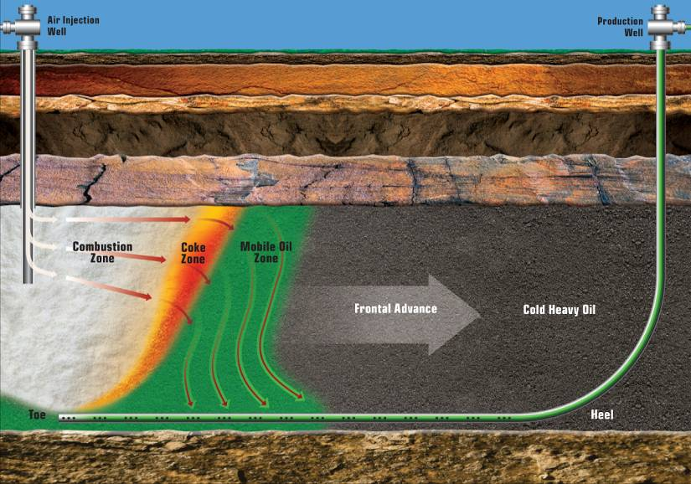
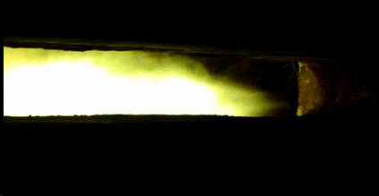
Oil Sands Production Technologies
Alternatives to Natural Gas
THAITM (Toe-to-Heel Air Injection)
Petrobank Whitesands Project
OrCrude Process - Nexen/OPTI Longlake
Multiphase Superfine Atomized Residue - DeerCreek
Suncor 3rd Upgrader - Coke Gasification
OXYGEN
WASTE WATER
PETROLEUM COKE
GASIFIER
SYNTHETIC GAS
(CO, H2, CO2)
CO2 CAPTURE &
SEQUESTER
HYDROGEN
FUEL
HYDROTREATORS
BOILERS
STEAM & ELECTRICITY
Notes:
2003 a land mark as oil sands production hits 1 million b/d
Most development concentrated in Athabasca and Cold Lake areas - only Shell at Peace River since 1941
$87 billion not ion this forecast time frame, this figure includes some infrastructure like pipelines $
Significant Potential - EUB has over 100 scheme registered

Slide 21
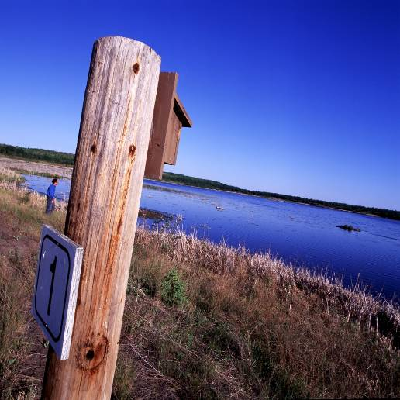
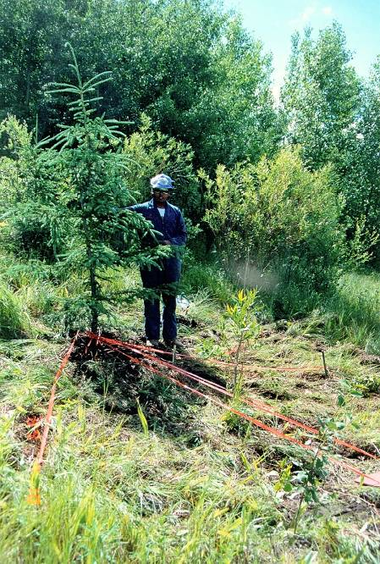
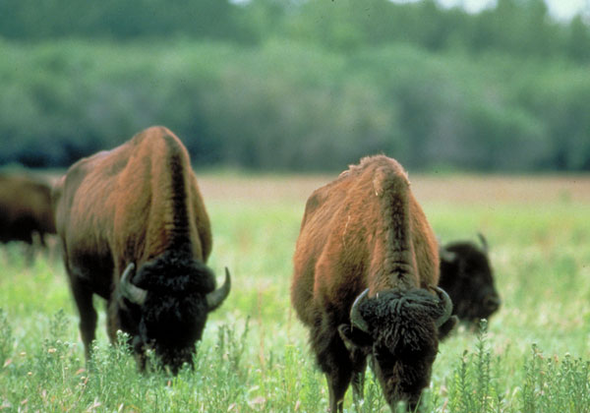
Environmental Stewardship
Air
  Monitoring programs
  Reducing emissions
  CO2 capture and EOR
Water
  Reduce, recycle and reuse
  Insitu using “saline” aquifers
  More efficient, 90+% recycle
Land
  Reclamation and remediation
  Directional drilling from single site to reduce impact

Slide 22
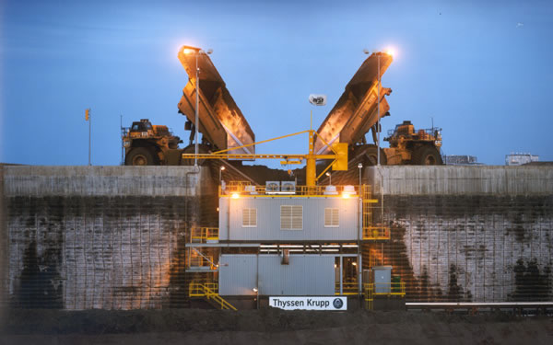
100th Caterpillar 797 Truck sold to the oil sands March 14, 2007
Photo: Shell Canada

