Slide 1
Comparison of Views On The Outlook
For Natural Gas Markets
Prepared for
EIA Energy Outlook, Modeling and Data Conference
Renaissance Hotel
Washington, D.C.
Prepared by
Energy Ventures Analysis, Inc.
1901 N. Moore Street, Suite 1200
Arlington, VA 22209-1706
(703) 276-8900
March 28, 2007

Slide 2
Outline
Compare EIA and EVA Forecasts for Natural Gas
  Where do they differ and why
Demand
  Electric Sector
Supply
  LNG
Prices

Slide 3
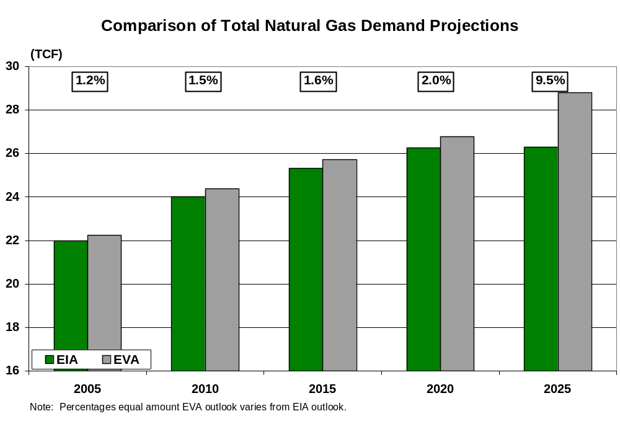
Total Natural Gas Demand
2005 to 2020: Amazingly Close in Projections
  Difference for 2005 reflects recent revisions in historical data
2025: Distinct Difference Emerges: Difference equals 6.8 BCFD
Comparison Of Total Natural Gas Demand Projections

Slide 4
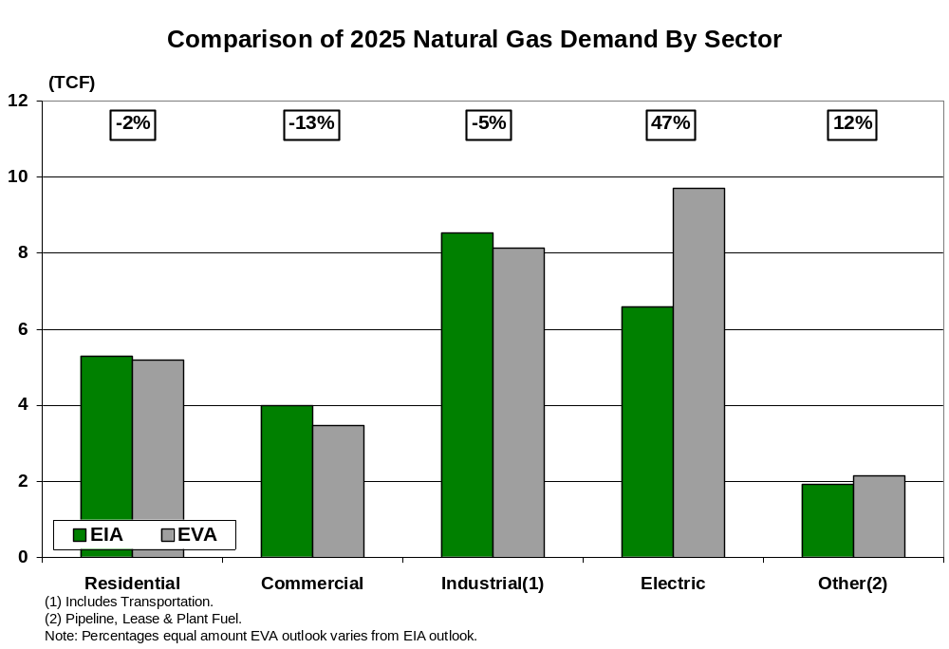
Natural Gas Demand By Sector
While Outlook For Total Demand Is Close, There Are Differences For Individual Sectors
  Key concern is the potential impact of EIA being correct on Resid, Comm and Ind Sectors and EVA being correct on the Elect Sector
    Equates to a 2.5 to 9.3 BCFD increase, depending upon one’s reference point.
Comparison Of 2025 Natural Gas Demand By Sector

Slide 5
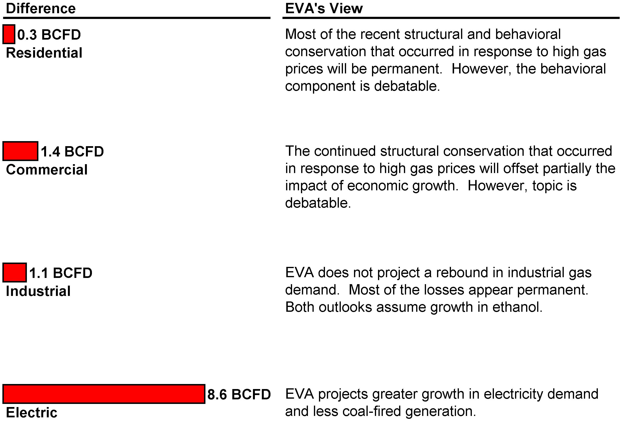
Observations Concerning Sectors

Slide 6
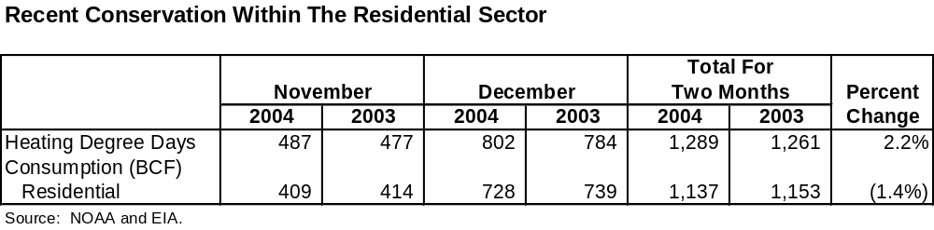
Residential Sector
High Gas Prices Have Resulted In Both Structural And Behavioral Conservation Within The Sector
  Structural: Insulation, double pane windows, etc.
  Behavioral: Reduced thermostat settings, etc.
Permanence Of The Behavioral Component Is The More Debatable Of The Two Phenomena
  Anecdotal data from LDC’s
  Models
  Recent empirical evidence
    Table for November and December 2004.
    Similar results for February 2006.

Slide 7
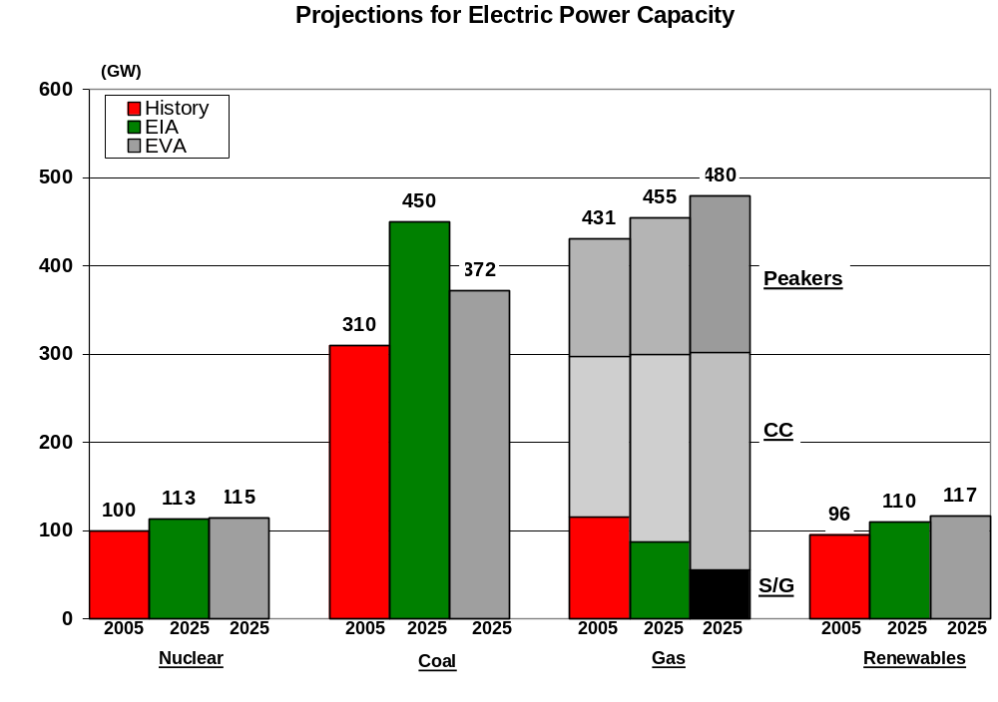
Electric Sector
Major Areas Of Difference
  EVA projects higher electric demand growth rate (1.3 vs. 1.8%/annum)⁽¹⁾
    Critical issue because gas-fired generation is at the margin.
  EVA projects less coal-fired capacity and thus more gas-fired capacity
    Key driver is differing views on ‘future’ CO₂ requirements.
(1) Net energy available to grid.

Slide 8
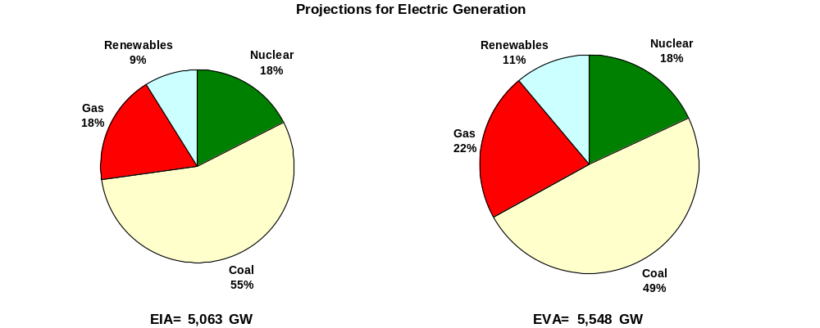
Electric Sector Generation
Net Result Of Two Factors Is 32 Percent More Gas-Fired Generation In 2025

Slide 9
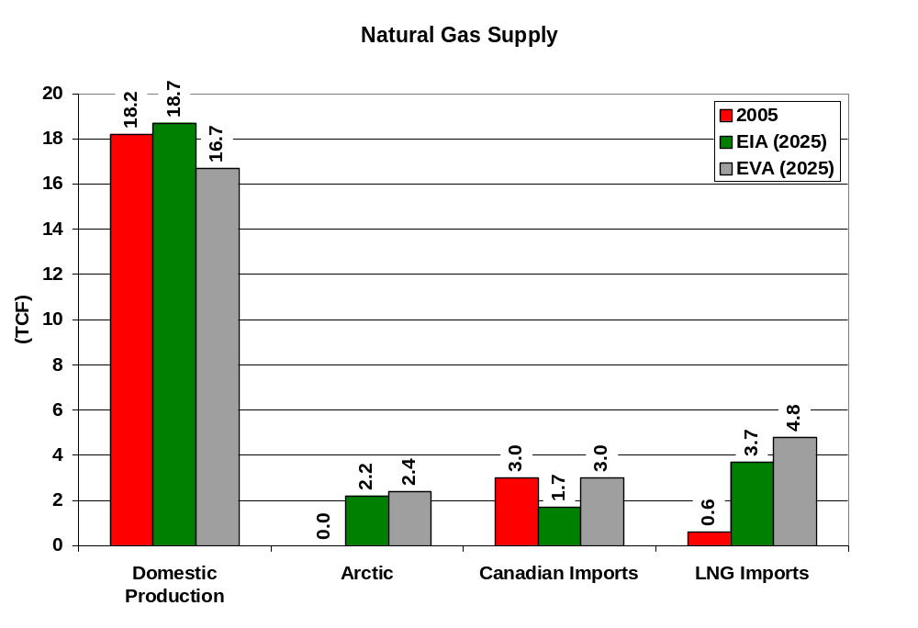
Natural Gas Supply

Slide 10
Natural Gas Supply
Key Differences
  Domestic Production (2.0 TCF): For years EIA has been more optimistic on domestic production than EVA. Also, EVA’s view is that the hyper-inflation in drilling costs will dampen long-term production, but this is debatable
  Canadian Imports (1.37 TCF): EVA is likely more optimistic on the potential for offshore British Columbia and Nova Scotia. Could be a timing difference, as EVA projects a sharp decline in Canadian imports in the next five-year period
  Arctic (0.2 TCF): Assumptions are similar
  LNG (1.14 TCF): EVA is more bullish; relates to the amount of domestic production

Slide 11
LNG: Highlights
Global Capacity
  U.S. regasification capacity will be over built and could exceed 20 BCFD
  European regasification capacity likely will be over built, but specifics vary by country
  Asian regasification capacity likely will match supply requirements with terminals continuing to operate at about historical capacity factors
    Expansion in India and China has been downsized.
    Indonesia is a wild card.
  Liquefaction capacity likely will increase dramatically (i.e., from 14 BCFD prior to 2000 to 43 BCFD by 2010 and possibly 65 BCFD by 2015)
Spot Market
  Currently very small (i.e., 2.5 BCFD in 2005), but likely will increase in size over the decade (i.e., potentially 12.5 BCFD by 2012)

Slide 12
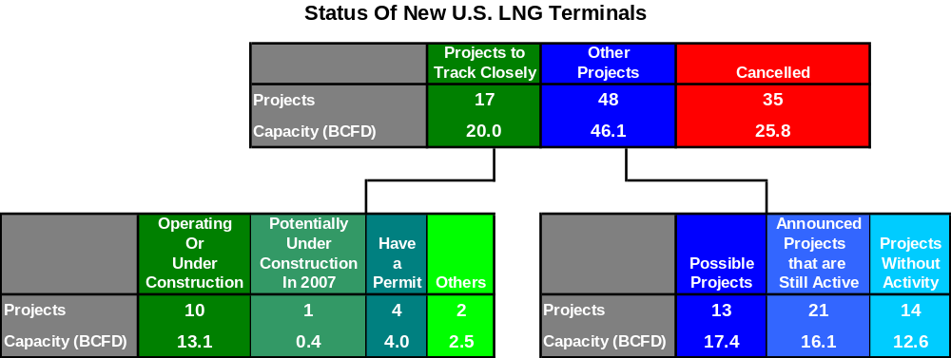
New North American Regasification Terminals
Development Of New Terminals Still In A Relatively Dynamic State
  Likely Projects: 17 out of 100 proposed new terminals and expansions likely to be completed (i.e., 20.0 BCFD out of 91.9 BCFD)⁽¹⁾
  Possible Projects: Another 13 proposed projects (17.4 BCFD) still have the potential to be completed
    However, their status is difficult to predict and, in one case, depends upon a future Supreme Court decision.
(1) The 100 proposed projects include 10 project expansions. The ‘Likely’ projects are at 14 sites.

Slide 13
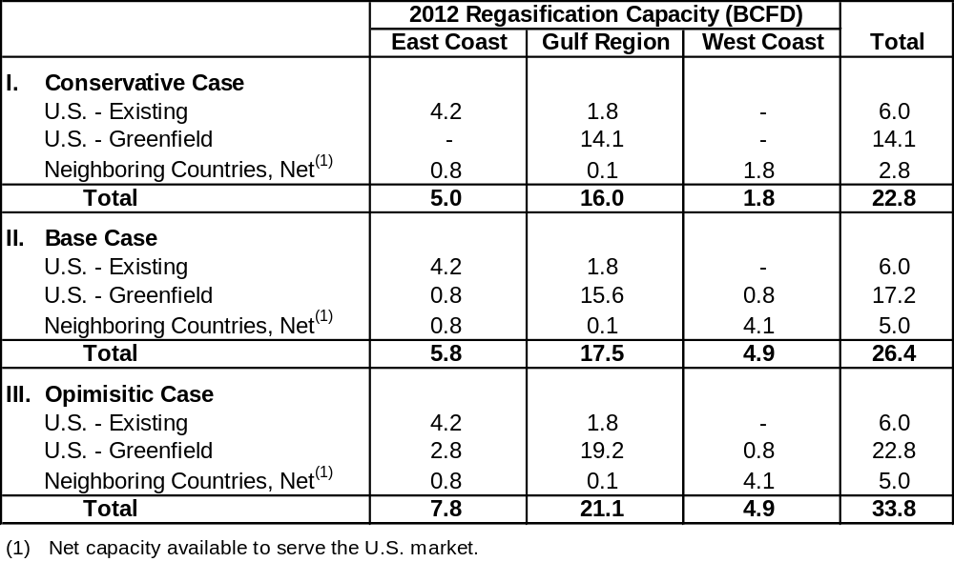
U.S. Regasification: Plausible Scenarios For 2012
Three Plausible Scenarios
  Key Conclusion: U.S. regasification will be over built
    Excess capacity a critical requirement for a robust spot market.
  Key Observation: Major project shakeout likely to occur in 2006/2007
    First movers secure available LNG supplies, market share and key infrastructure (e.g., pipeline and storage capacity).
    Recent series of proposed expansions may be a signal to second movers.*
* Five expansions totaling 6 BCFD.

Slide 14
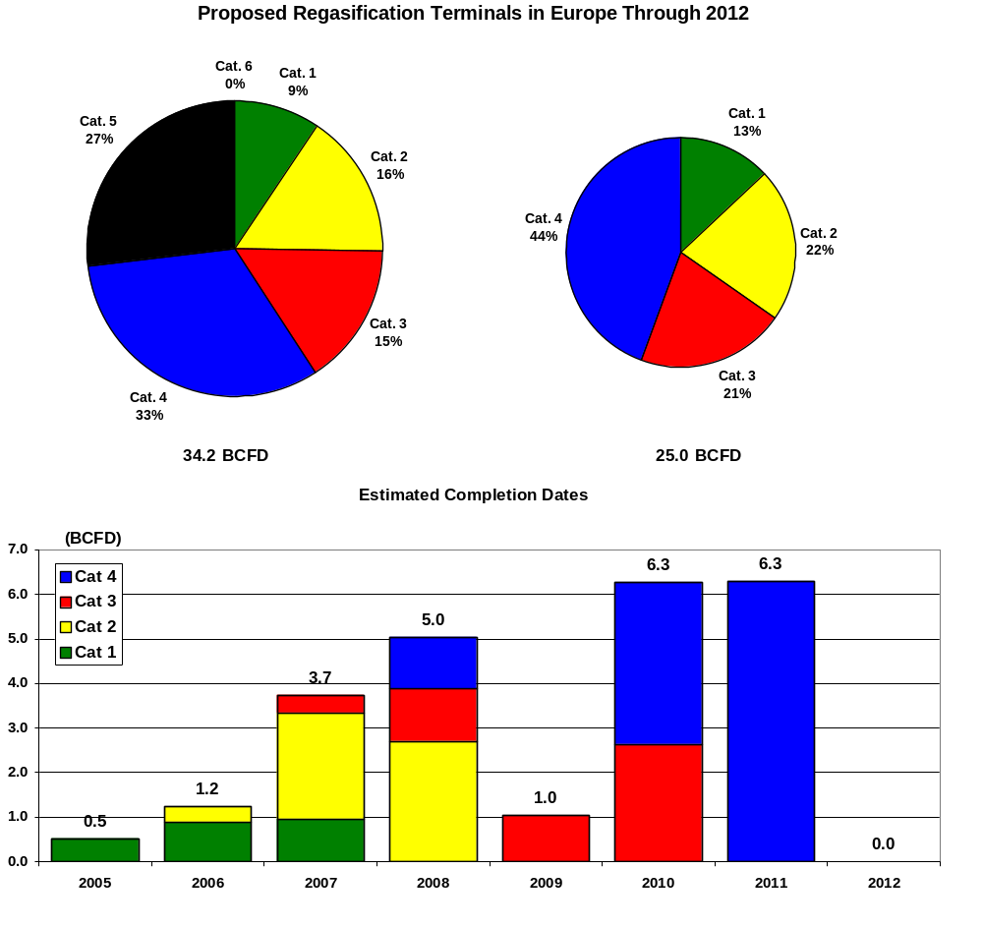
2012 Foreign Regasification Projects: Europe
Note: Cat 1 (built); Cat 2 (under construction); Cat 3 (has permit); Cat 4 (in process); Cat 5 (unlikely); Cat 6 (cancelled).

Slide 15
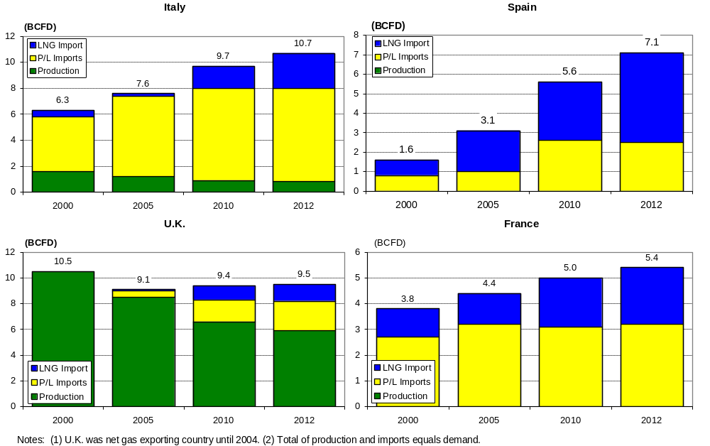
Europe: Supply And Demand Analysis For Big Four

Slide 16
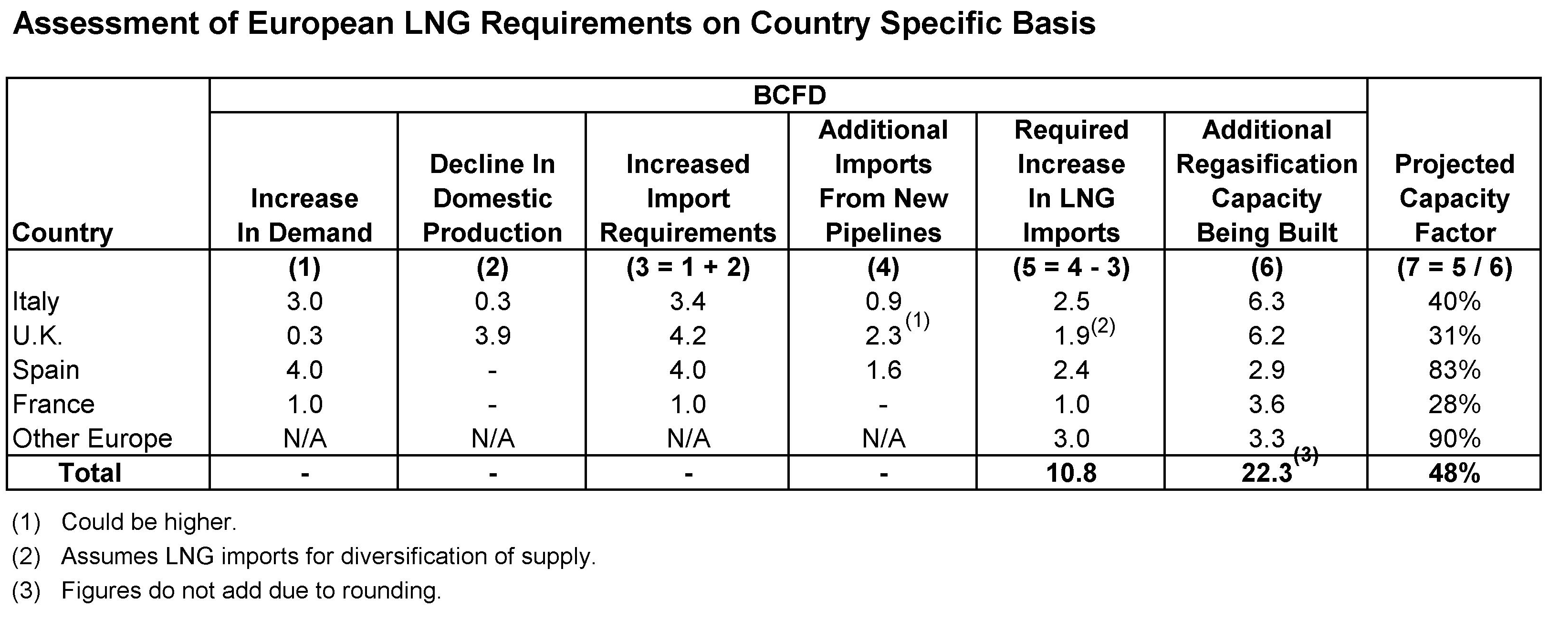
Europe: Country Specific Assessment For 2012
About 81% of New Capacity in Four Countries: Italy, U.K., Spain and France
  There are sharp contrasts in the outlook for LNG imports within each of these countries (i.e., see table below)
    General conclusion is that Italy, U.K. and France will be over built, while Spain’s terminals will operate at high capacity factors.
  Remaining 19% of capacity are single terminals in seven countries

Slide 17
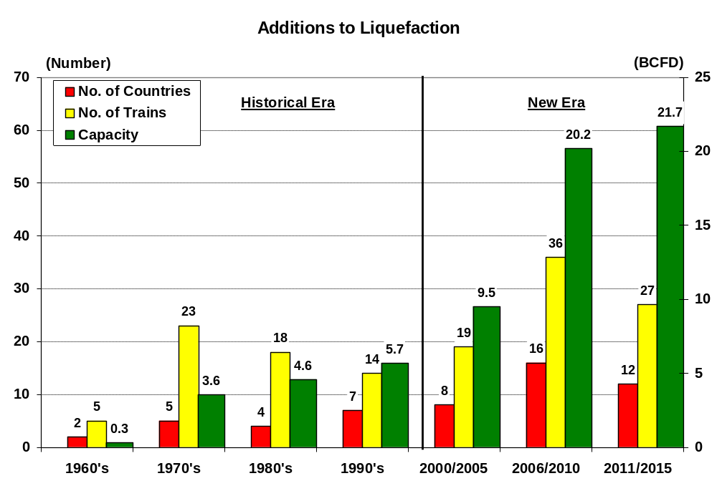
New Liquefaction Capacity
Liquefaction Capacity Added This Decade Will Exceed The Capacity Added Over the Last Forty Years
  By 2010 world liquefaction capacity will increase by more than three fold
  By 2012 world liquefaction capacity likely will increase more than four fold

Slide 18
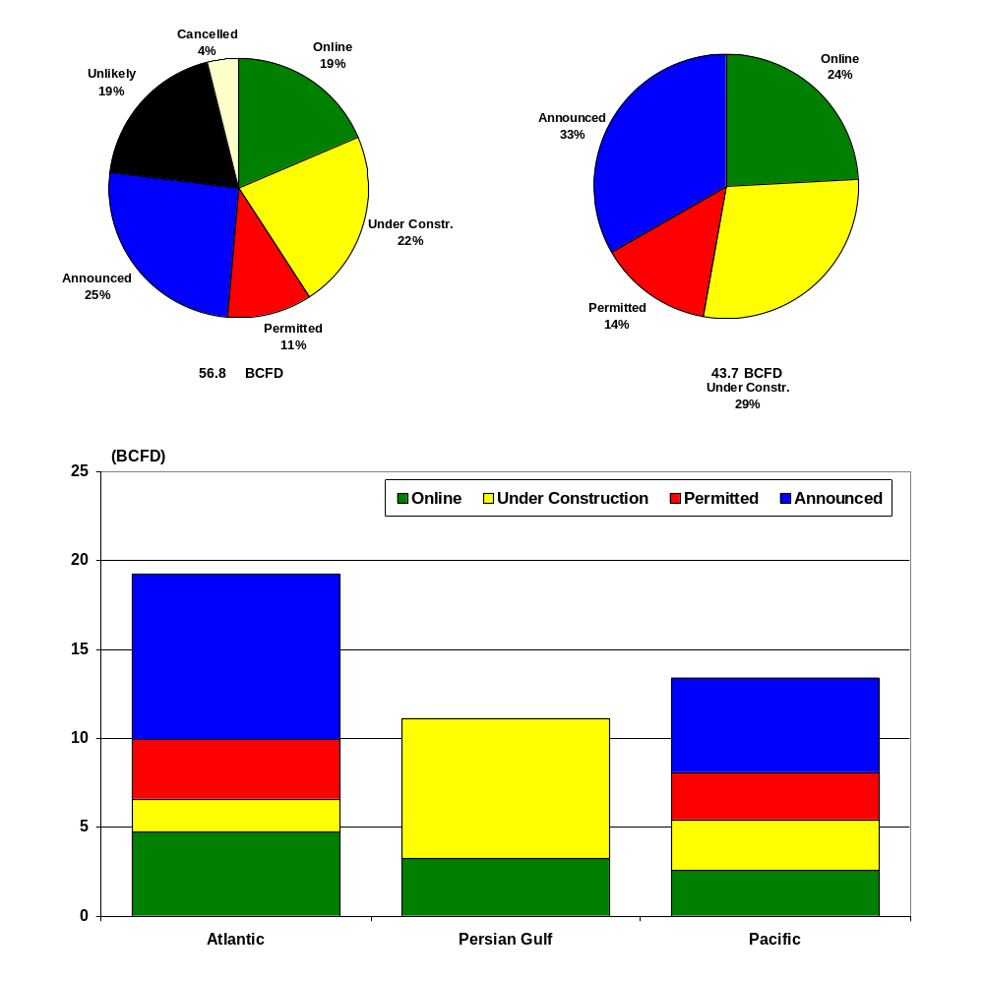
New Liquefaction Facilities For 2012

Slide 19
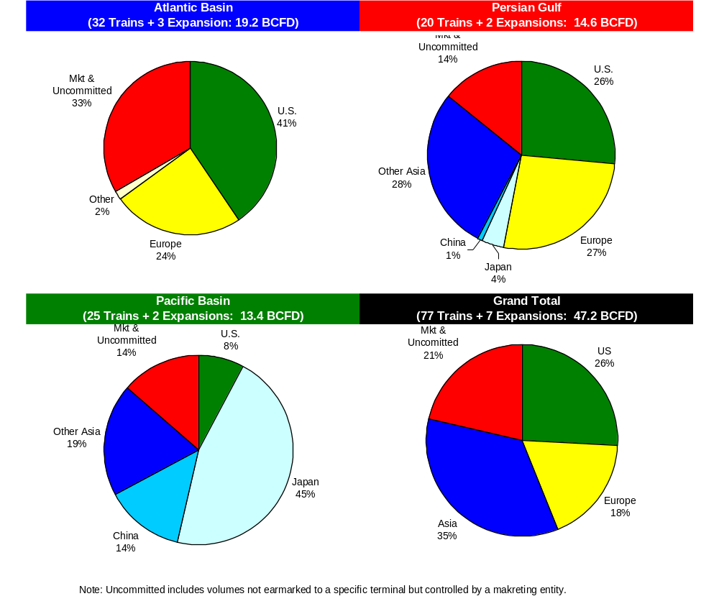
Supply Commitments (2000-2012)
Note: Potential 2012 LNG imports are 12.3 + 3.3 = 15.6 BCFD.

Slide 20
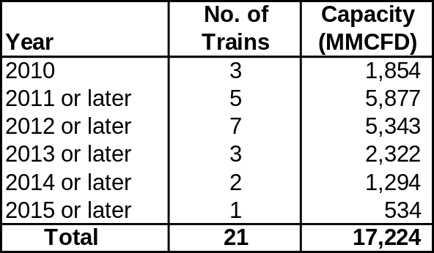
New Liquefaction Capacity
Excluded From Prior Analysis Are a Series of Liquefaction Projects Because:
  Data on supply commitments not available
  Project is still in its early stages of development

Slide 21
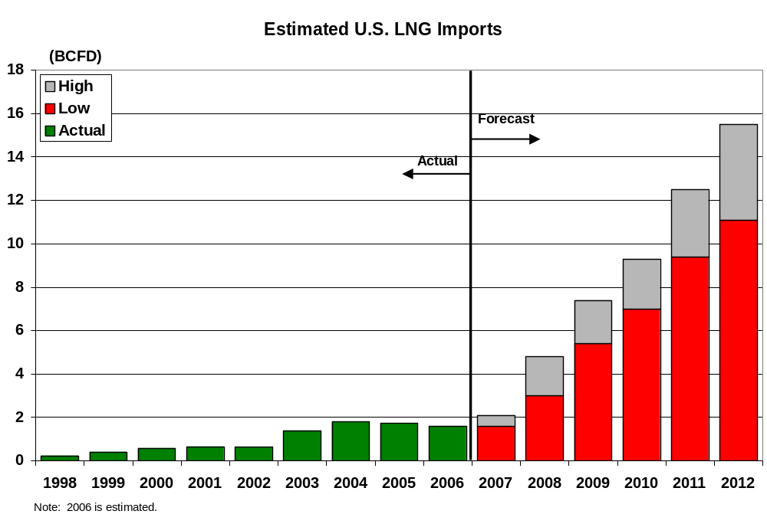
U.S. LNG Imports
Near-Term
  Overly dependent on very competitive spot market
  As a result, likely to be rather volatile
  Watch out for upset conditions
Long-Term
  Likely will reach 7.5 BCFD by 2010 and could approach 15 BCFD in 2012

Slide 22
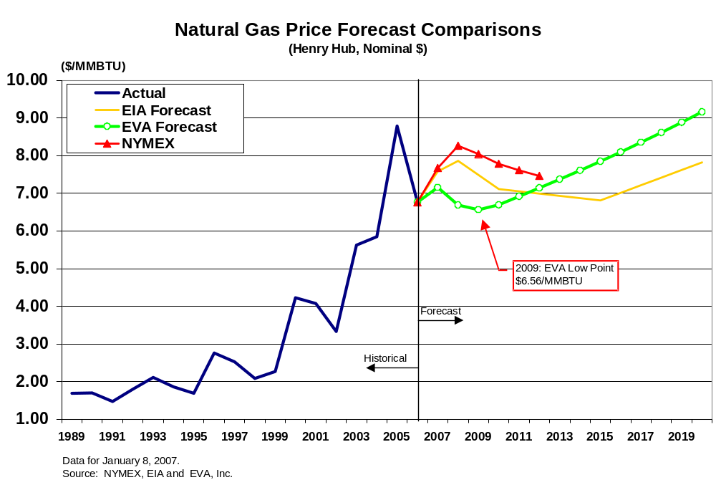
Natural Gas Prices

Slide 23
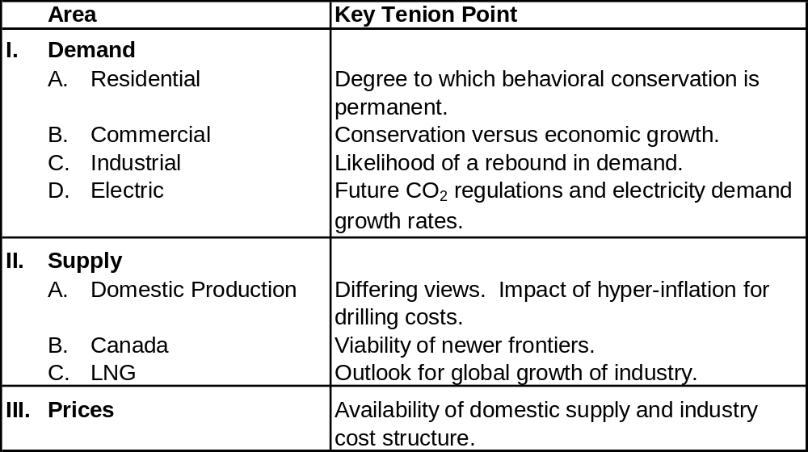
Summary: Key Tension Points

