Slide 1

2012 Commercial Building Energy Consumption Survey (CBECS) Stakeholder Meeting
Tom Leckey, Joelle Michaels, Alan Swenson
May 15, 2012 | Washington, DC

Slide 2
Agenda
Welcome
CBECS background
2012 CBECS general changes
2012 CBECS changes and new questions by questionnaire section
Potential new questions for audits
Future CBECS considerations
How you can still help us on the 2012 CBECS

Slide 3
EIA CBECS Team Members
Core CBECS Team: Survey Operations, Sampling, Data Processing, Editing, Imputation, Analysis…
Joelle Michaels, Survey Manager
Katie Lewis
Jay Olsen
Alan Swenson
Marilyn Worthy
Vincent LeMoine
Management
Tom Leckey, Director, Office of Consumption and Efficiency Statistics
Eileen O’Brien, Team Lead, Buildings Surveys Statistics
Hiro Minato, Team Lead, End Use Consumption Statistics

Slide 4
Welcome
CBECS Stakeholder Input
EIA action
Benefits to EIA of this interaction
Constraints
Length of survey, cost
Instrument reliability
OMB approval
Scope of survey
Respondent capability
New technologies

Slide 5
What is CBECS?
Commercial Buildings Energy Consumption Survey (CBECS)
the only national level source of data on the characteristics and energy use of commercial buildings
conducted every 3 or 4 years since 1979
mandated by the Department of Energy (DOE) Organization Act of 1977, Public Law 95-91

Slide 6
What is CBECS?
CBECS interviews…
conducted by professional interviewers using a computerized survey instrument, usually in-person – average interview lasts 30 minutes
advance package of materials (including worksheets) is provided to the building a few days before the interview
sample size historically 5,000-7,000 buildings
building interview covers many topics – building size and use; ownership and occupancy; energy sources, uses, and equipment; energy consumption and cost
building survey is followed by an energy supplier survey – if useable energy usage information is not available from the building respondent
the 2012 CBECS interviews will be conducted between April 2013 and Sept 2013, with the energy supplier survey following

Slide 7
CBECS Sample Overview
Multistage area probability sample
statistically select from increasingly smaller geographic areas
“field listers” walk each block in selected areas and list every commercial building within the segments
CBECS area sample is selected from that list
Supplemented with additional list samples
use several special lists in order to efficiently sample enough large buildings
Federal buildings (GSA)
hospitals
colleges/universities
airports (FAA)
other large buildings

Slide 8
2012 CBECS: General Changes
Sample update using proven methodology
Sample size increased 150% - target of 8,400 buildings for 2012
Subset of buildings will be re-interviewed/verified using energy audit techniques
Some interviews to be conducted by telephone (ability to locate more knowledgeable respondents)
Streamlined editing procedures

Slide 9
2012 CBECS Changes and New Questions By Questionnaire Section
Overview of planned substantive changes for each questionnaire section
Following each section, we would like to hear your questions and comments

Slide 10
Section A: Building Size, Structural Characteristics, and Age
Square footage
clarifying questions about total/gross square footage
does the reported square footage include parking?
completely enclosed and physically connected to the building (e.g. underground parking levels)
partially open garages or garages separate from the building
does it include “non-leasable” areas (e.g. lobbies, hallways, stairways)?
NEW: Floor-to-ceiling height
NEW: “Cool roof” materials
Escalators
specify that moving walkways should be counted as escalators

Slide 11
Section A: Building Size, Structural Characteristics, and Age
Renovations
remove the word “major” from the filter question
list of renovation types may be overly inclusive, but we can exclude minor improvements when we report the data
NEW CATEGORIES
“exterior replacement” split into “exterior roof replacement” and “exterior wall replacement or renovation”
building automation/management system
electrical upgrade
fire/safety/security upgrade
we ask about renovations done “since 1980”
is this still a meaningful reference date?
Questions/comments on Section A?

Slide 12
Section B: Building Activity
A few points of clarification:
we purposely duplicate activity subcategories within the main activity categories
the survey instrument automatically reclassifies the activity to the correct CBECS principal building activity so that we can ask the appropriate follow-up questions
example: libraries are “public assembly” by CBECS definition but are also available as an option within office, education, service, and other
if a building is not 75% or more of a single activity, we ask for the top three activities and collect the percent of floorspace used for each
military bases are not included in the CBECS sample
laboratories have always been classified separately in the CBECS, but are combined into “other” for reporting because of sample size constraints
increase in sample size may allow reporting for laboratories
New details on specialized uses of space – Section E
Questions/comments on Section B?

Slide 13
Section C: Ownership, Occupancy, Operating Hours, Employment
Building ownership
NEW: ask if the building is owned as an investment (i.e. for leasing) or for occupancy
NEW CATEGORY: add “Real estate investment trust (REIT)” as a building owner category
Ask whether the building is leased by a government agency?
would this be useful information?
Purchasing power
NEW: ask who pays the energy bills?
Hours of operation
better alignment with Energy Star definitions (e.g. for offices, define as the time when 75% or more of the people are in the building)

Slide 14
Section C: Ownership, Occupancy, Operating Hours, Employment
Number of building occupants
NEW: collect information to better define usage levels in building types that are public/customer oriented (e.g. average meals served in restaurants, room- nights at a hotel, number of visitors to a museum)
Vacancy rates
NEW: ask for the average yearly occupancy rates for certain building types
Fire station staffing levels
NEW: is the staffing at the station usually constant, highly variable, or is the building usually unoccupied (e.g. volunteer station)
Questions/comments on Section C?

Slide 15
Section D: Energy Sources, Uses, Equipment
Heating equipment types
furnace type
add “Individual room high efficiency condensing furnace”
boiler and district system distribution types
add “Radiant panels in walls/floors”
heat pump type
add “Dual source” and “Dual fuel” (clarify)
individual heater type
add “High temperature infrared radiant heater”
add “Low temperature electrical radiant panels”
add “Chiller heater”

Slide 16
Section D: Energy Sources, Uses, Equipment
Heating (and cooling) ventilation types
add “Underfloor air distribution”
add “natural ventilation” to “No mechanical ventilation”
Reduce heating (and cooling)
add “Manual operation”
Cooling equipment types
chiller type
add “Absorption chiller”
chiller/district chilled water distribution type
add “Chilled beam”
heat pump type
add “Dual source”

Slide 17
Section D: Energy Sources, Uses, Equipment
Other energy sources/HVAC equipment items under consideration
use of air- and waterside economizers
use of demand controlled ventilation
energy recovery and energy storage systems
cogeneration
dual fuel sources for heating
solar thermal
age of HVAC equipment
variable air-volume system (heating components)

Slide 18
Section D: Energy Sources, Uses, Equipment
Regular HVAC maintenance
add follow-up question to characterize the maintenance program
Water heating sources/equipment
add “Heat recovery”
Separate question for building automation system (BAS)

Slide 19
Section D: Energy Sources, Uses, Equipment
Generation technologies
add “Small wind turbines”
add “Reciprocating (gas/diesel) engines”
add “Gas turbines”
Use of generated electricity
capture amount generated in Section F (Electricity)
New question to characterize how excess generated electricity is used
sold to the local utility or another electricity supplier
stored onsite for later use by the building

Slide 20
Section D: Energy Sources, Uses, Equipment
How purchase electricity
add “Amalgamated contract purchase”
Questions/comments on Section D?

Slide 21
Section E: Miscellaneous Space Uses and Equipment
Food preparation or serving areas
in addition to simply the presence of these types of areas, collect the percent of floorspace (NEW)
snack bar/concession stand
fast food/small restaurant
cafeteria/large restaurant
large kitchen/commercial kitchen/other large food preparation area
Medical-related
NEW: for health care buildings, collect the number of MRI, X-ray, CT, linear accelerators
NEW: for hospitals, collect the percent of the building used for outpatient care
NEW: for outpatient health care, ask if there is an ambulatory surgery center, and if so, the number of operating rooms

Slide 22
Section E: Miscellaneous Space Uses and Equipment
Lodging-related
NEW: percent of building used for conferences/special events
Refrigeration equipment
NEW: ask lodging buildings if there is a small refrigerator in each guest room
Fire station use
NEW: percent of building used for non-fire department activities (e.g. hall rental, police station, local government offices)
NEW: are there living quarters in the station?

Slide 23
Section E: Miscellaneous Space Uses and Equipment
Computer-related
currently collect the number of: computers, laptops, servers
clarify to exclude any tablet PCs
high-density computing areas
collect presence and percent of square footage (NEW) for each:
data center/server farm
NEW: trading floor
computer-based training room
student or public access computer center

Slide 24
Section E: Miscellaneous Space Uses and Equipment
Other equipment
NEW: ask for the number of video displays (e.g. televisions, flat panel displays)
NEW: for schools, collect the number of interactive whiteboards (e.g. SMART boards)
Plug load controls
NEW CATEGORY: add “sleep mode” or Energy Star setting as a method to turn off computers
NEW: controlled receptacles (i.e. power outlets) that automatically turn equipment off at certain times or when the space is vacant?

Slide 25
Section E: Miscellaneous Space Uses and Equipment
Lighting
add “induction lighting” as a type of lamp?
instead of just “daylighting features” ask two sets of lighting feature questions:
lighting controls
scheduling, occupancy sensors, multi-level lighting or dimming, high-end trim or tuning, personal light control, demand responsive lighting
daylighting features
tinted window glass, reflective window glass, external overhangs or awnings, skylights or atriums, automatic controls that increase or reduce lighting in response to natural light, automated or motorized window shades
remove question about “specular reflectors”?
is it outdated?

Slide 26
Section E: Miscellaneous Space Uses and Equipment
NEW: ask about building certification
Energy Star, LEED, Green Globes, Other
NEW: ask whether the building has an AMI meter
Questions/comments on Section E?

Slide 27
Sections F-J: Consumption and Expenditures
Enclosed malls
collect information on how electricity/HVAC responsibilities are divided between the landlord and the tenants
clarify which portions of the mall are included in the consumption data that we obtain: common area, tenants, anchor stores
On-site generation
NEW: for buildings with on-site generation, ask for the amount of electricity produced
Better accounting of whether non-building uses are included in the consumption figures
parking lot lights (added in 2007)
other exterior lighting
outdoor swimming pools
Questions/comments on Sections F-J?

Slide 28
Section K: Water
Water consumption
collect information on the units (gallons, cubic feet, etc.)
in Section D, for buildings with central chillers, heat pumps or packaged units as their cooling systems, ask if there is a cooling tower
determine whether water is metered separately for cooling towers and/or irrigation
if so, collect the volume used for each separate use

Slide 29
Potential Questions for the Audit Subsample
Building orientation
Building footprint and the site footprint
Building codes/energy codes
Wall construction
number of layers and associated insulation values
Information on pumps (how many, motor sizes)
Peak electricity/energy loads
Exhaust hoods/fume hoods, including size
Linear feet of open and closed refrigeration units

Slide 30
Future CBECS Considerations
Additional reporting for units of analysis other than the building
campuses
establishments within strip shopping centers (e.g. grocery stores)
Multifamily residential buildings

Slide 31
We still need your help on the 2012 CBECS
Endorsement insert/letters
for inclusion with the advance packet of materials provided to respondents
please let EIA know if you would like your organization listed in association with the following statement:
The following organizations recognize that the Commercial Buildings Energy Consumption Survey (CBECS) provides critically important information to support programs that promote energy efficiency in commercial buildings in the U.S. These organizations strongly encourage participation in the 2012 CBECS.
we would also welcome individual endorsement letters that the interviewer would use as a tool for gaining respondent cooperation
Trade magazines/journals
increase awareness that CBECS is in the field (April 2013-Sept 2013)

Slide 32
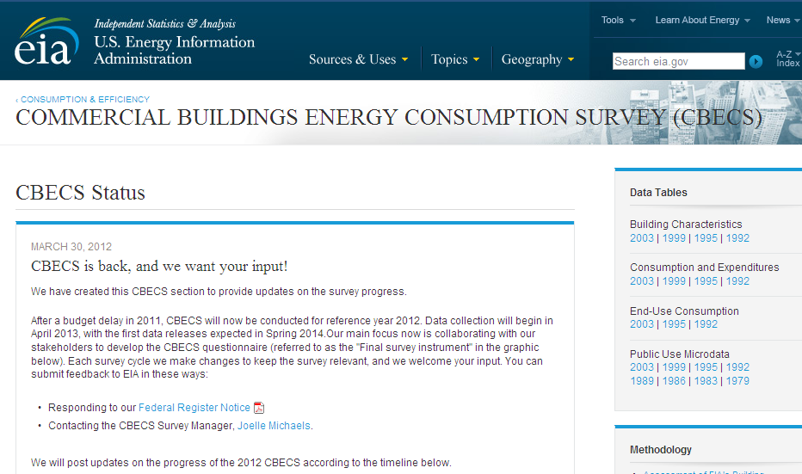
The new CBECS “blog”
Periodic updates on 2012 CBECS progress will be posted at www.eia.gov/consumption/cbecs

Slide 33
For more information:
CBECS home page | www.eia.gov/consumption/commercial
Tom Leckey, Director, Office of Energy Consumption and Efficiency Statistics | thomas.leckey@eia.gov
Joelle Michaels, Survey Manager | joelle.michaels@eia.gov

