Slide 1



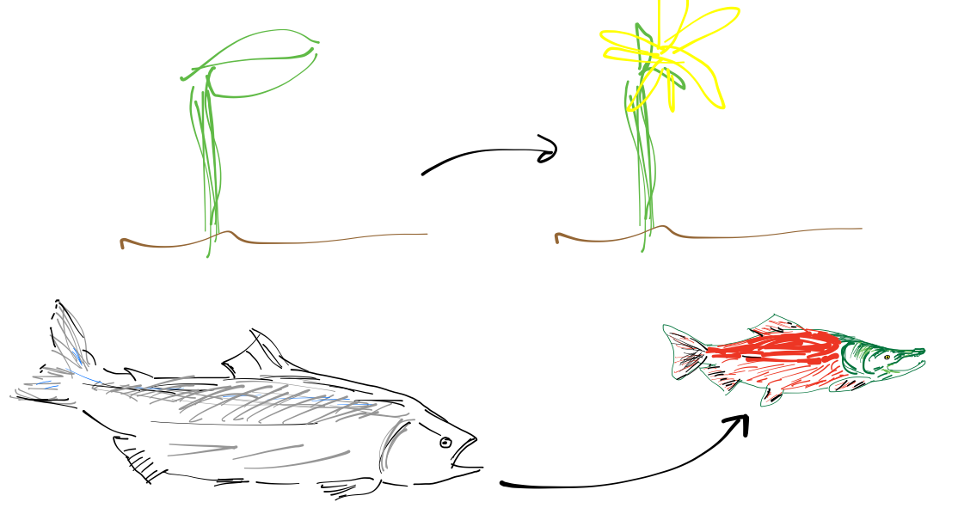
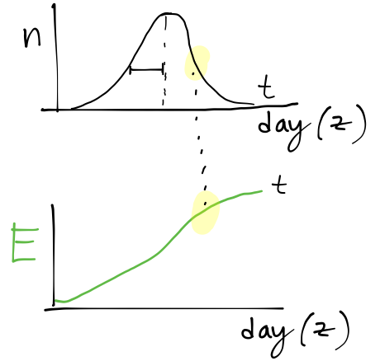
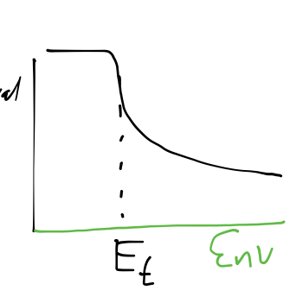







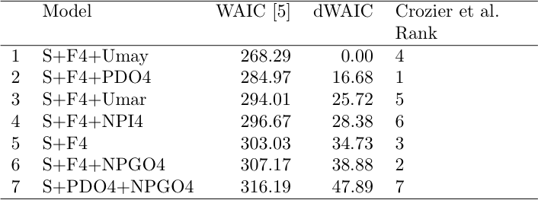







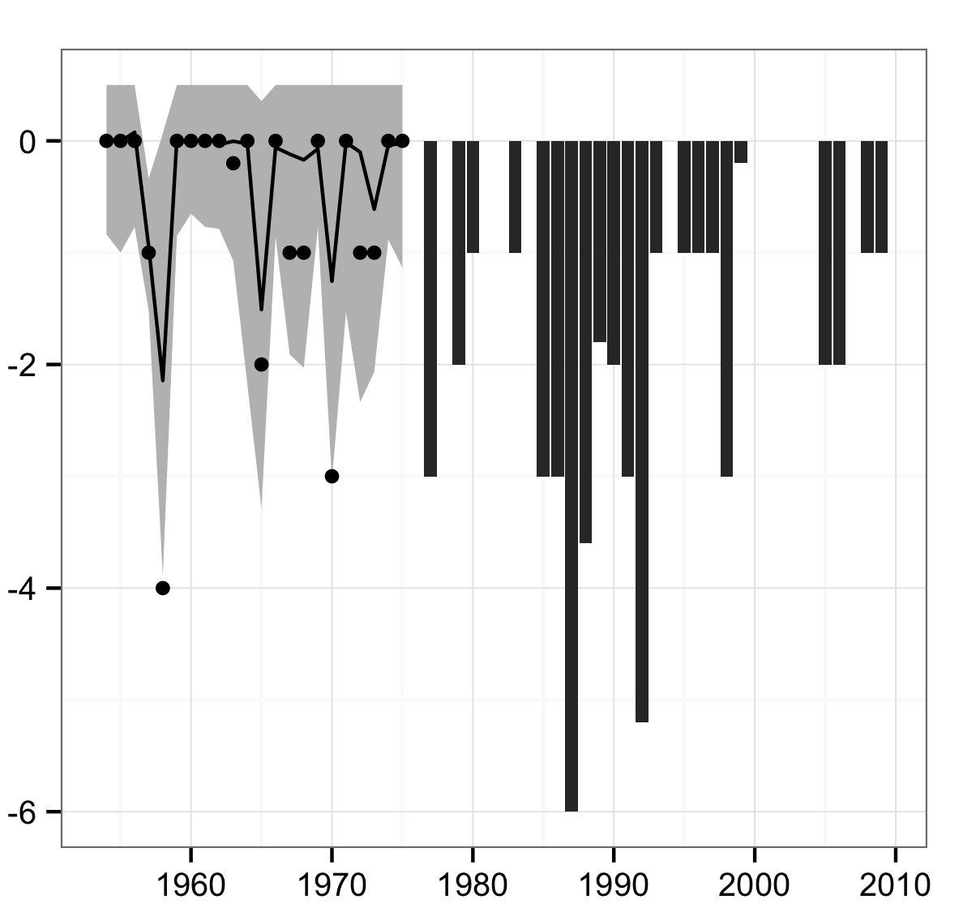






Understanding the joint effects of plastic and evolutionary change on demography from time series
Jaime Ashander^{1,2}
¹Center for Population Biology, ²Department of Environmental Science and Policy at UC Davis
jashander@ucdavis.edu
Motivation
  Environment 1
  Environment 2
Applying the framework
  Traits that govern life-history timing often respond plastically to aspects of the environment (a). Seasonal trends (b) mean such traits also determine the environment experienced. An environment that imposes differential mortality (c) causes selection on timing, potentially affecting demographic trajectories. To forecast responses to environmental change we wish to predict population and trait dynamics, and to do so we must leverage prior studies to help us reduce uncertainty concerning the interaction of plasticity and selection in our focal system.
(a)
Population and trait dynamics are influenced by three interdependent processes: selection, response to selection and plastic change ➔ prior information on two of these can help us infer the action of the third, and thus predict the trajectories of interest.
  infer &
  predict
USFWS
Case study: Sockeye (O. nerka) in the Columbia River
(b)
(c)
Strong prior on population dynamic parameter for growth, assuming Ricker form (Myers et al. [3])
Backcast selection differentials based on temperature-survival relationship (after Crozier et al [1])
I: heritability v plasticity
A Bayesian approach to eco-evo dynamics
Strong priors on population dynamics
Assume backcast selection gradients reflect actual selection
Accommodate prior estimates of heritability, plasticity, and/or demography, while admitting uncertainty about “backcasting” [e.g., 1,4] selection gradients by assuming the true gradient is some smooth function of the environment (see Box II)
Outcomes
Prediction for population dynamics given out-of-sample environment
Re-ranking models for best predictors
  Trait mean
  Abundance
Outcomes
Assess plasticity versus selection
Determine most-explanatory covariates
Population predictions provide additional data for predictive inference
  Data
  Process
  Latent trait mean
  Latent abundance
II: past selection by environment
  Parameters
Strong priors on population dynamics
Strong priors on evolutionary processes
Variation in confidence of backcast selection
  Heritability, plasticity, process noise
  Selection
  Differential
  Productivity, carrying capacity, process noise
Table: Model scores based on WAIC [5] for a selection of covariates used to predict migration date and abundance. S=selection, F=mean June flow, NPGO/PDO=oceanographic indices, U=upwelling indices. The same covariates were considered in Crozier et al. [1], but as shown, including population in the model results in a different ordering of the models.
  Hyperparameters
  Gaussian-process
  priors
  Covariates
  S_{t}
Acknowledgements
  Plasticity-inducing
  Selecting
  Trait variance
Figure: Prior to 1976 selection differential S_{t} is modeled as a Gaussian Process based on the relationship between selection and the environment from 1976-2009.
Special thanks to Lisa Crozier for encouragement. Discussions with Marissa Baskett, my PhD supervisor, have been instrumental in developing these ideas. Baskett Lab for feedback, and Richard McElreath and Michael Turelli for advice. Funding from NSF REACH IGERT at UC Davis, Center for Population Biology, ESP Travel Award to J.A. and Hellman Foundation Award to M.B. Cluster time from M.B. account on FARM.
Methods
  Year
Assumed Gaussian error (i.e., Kalman filter)
Priors used
  Heritability of focal trait
  Population dynamic parameters
  Reconstructed selection differentials
Outcomes
Understand selection by the environment over time
Determine most-explanatory covariates
References
State-space model in Bayesian framework implemented and sampled using MCMC via Hamiltonian Monte Carlo sampler in Stan (Gelman et al. [2])
Crozier, L. G. et al. 2011. Am Nat doi:10.1086/662669.
Gelman et al. 2013. mc-stan.org
Myers, R. A. et al. 1999. CJFAS doi:10.1139/cjfas-56-12-2404.
Swain, D. P. et al. 2007. Proc R Soc B. doi:10.1098/rspb.2006.0275.
Wanatabe. 2010. arXiv:1004.2316.

