Slide 1
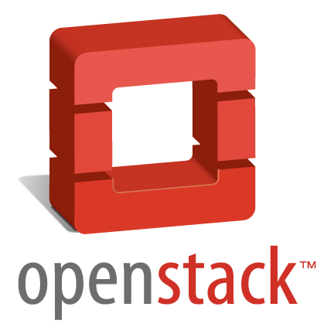

OpenStack 功能及应用简介
联通云数据有限公司

Slide 2
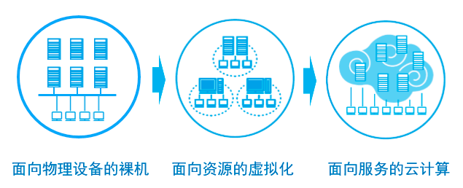
IT系统架构的发展过程
Notes:
所有的新事物都不是突然冒出来的，都有前世和今生。 云计算也是IT技术不断发展的产物。 要理解云计算，需要对IT系统架构的发展过程有所认识。
IT系统架构的发展到目前为止大致可以分为3个阶段：
物理机架构
这一阶段，应用部署和运行在物理机上。 比如企业要上一个ERP系统，如果规模不大，可以找3台物理机，分别部署Web服务器、应用服务器和数据库服务器。 如果规模大一点，各种服务器可以采用集群架构，但每个集群成员也还是直接部署在物理机上。 我见过的客户早期都是这种架构，一套应用一套服务器，通常系统的资源使用率都很低，达到20%的都是好的。
虚拟化架构
摩尔定律决定了物理服务器的计算能力越来越强，虚拟化技术的发展大大提高了物理服务器的资源使用率。 这个阶段，物理机上运行若干虚拟机，应用系统直接部署到虚拟机上。 虚拟化的好处还体现在减少了需要管理的物理机数量，同时节省了维护成本。
云计算架构 虚拟化提高了单台物理机的资源使用率，随着虚拟化技术的应用，IT环境中有越来越多的虚拟机，这时新的需求产生了： 如何对IT环境中的虚拟机进行统一和高效的管理。 有需求就有供给，云计算登上了历史舞台。

Slide 3
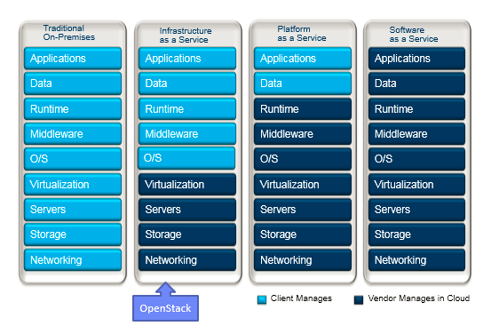
云计算平台架构

Slide 4
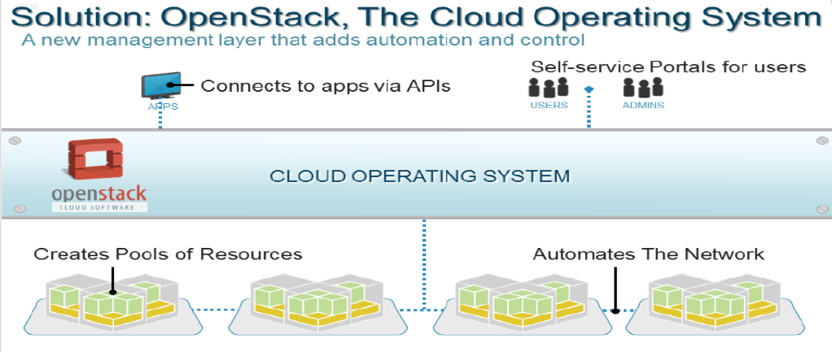
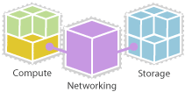
Openstack 是什么？
OpenStack is an open source infrastructure and application middleware for building private and public clouds.
OpenStack is a cloud operating system that controls large pools of compute, storage, and networking resources throughout a datacenter.
OpenStack is backed up by a global community of technologists, developers, researchers, corporations and cloud computing experts.
Notes:
OpenStack is a cloud operating system that controls large pools of compute, storage, and networking resources throughout a datacenter. It is all managed through a dashboard that gives administrators control while empowering their users to provision resources through a web interface.
OpenStack is a global collaboration of developers and cloud computing technologists producing the ubiquitous open source cloud computing platform for public and private clouds. The project aims to deliver solutions for all types of clouds by being
Simple to implement
Massively scalable
Feature rich.

Slide 5
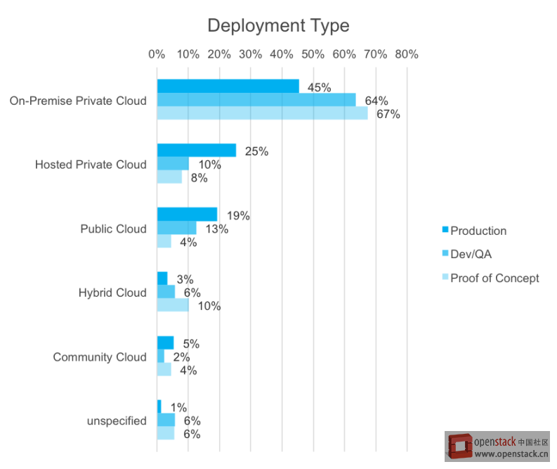
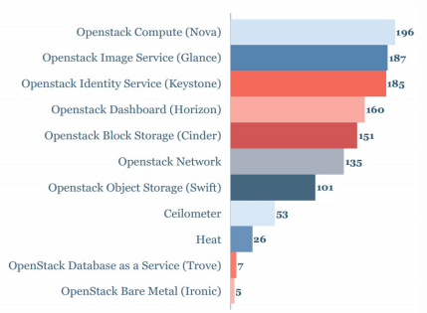
主要应用于私有云、测试开发环境居多，生产环境部署越来越多
OpenStack 2014 用户调查，Moor Insights & Startegy

Slide 6
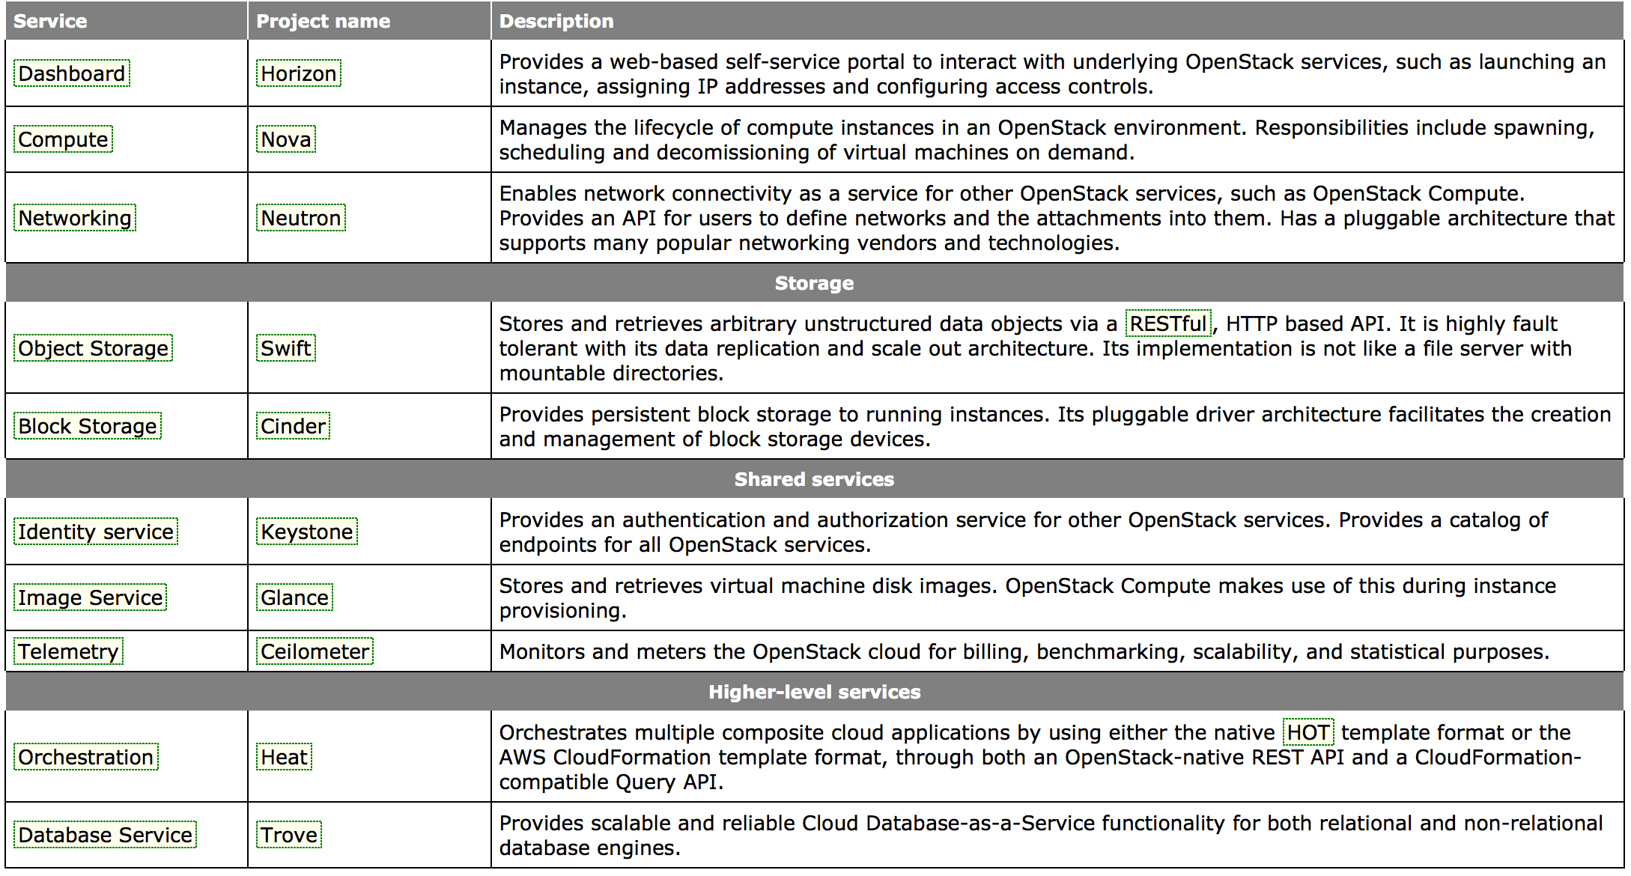
模块- Icehouse
Compute (Nova)
Object Storage (Swift)
Image Service (Glance)
Identity (Keystone)
Dashboard (Horizon)
Networking (Neutron)
Block Storage (Cinder)
Telemetry (Telemetry)
Orchestration (Heat)
Database Service (Trove)
Data processing (Sahara*)
Bare metal (Ironic*)
Queue service (Marconi*)
Key management (Barbican*)
DNS Services (Designate*)
Common Libraries (Oslo)
重用了各种开源技术
Notes:
The OpenStack platform is actually composed of multiple components, called projects. Each project is managed by a technical committee and the OpenStack Foundation decides which projects are ready to be included in the OpenStack core. These projects work together to provide the services required to deliver the Cloud.
Nova – The compute project responsible for on-demand creation and termination of compute instances. Nova leverage a number of hypervisors, including KVM, Xen, Hyper-V, and vSphere.
Glance – The OS image management project responsible for storage and management of images used to create compute instances with OSes installed, such as Windows and Linux.
Quantum – The network project that provides network access and security services to compute instances. Quantum uses plugins to leverage virtual switches and SDN-enabled devices.
Swift – The object storage project that provides a scalable repository for storing large quantities of objects such as files and media content. It can also be used as an repository for Glance images.
Cinder – The block storage project that provides a virtual storage array that can export out iSCSI volumes. A Cinder/virtual storage array server can be a server with local storage or a server using an external storage array.
Horizon – The interactive dashboard project that provides users and admins provisioning and management access to the OpenStack Cloud via a web GUI.
Keystone – The identity management project that provides authorization and access security control for all the other OpenStack projects.
New projects are being added with each release and as the OpenStack community calls for them. New projects underway include metering, application orchestration, and database-as-a-service.

Slide 7
IaaS 架构
运营支撑
展现层
运维管理
System API
Orchestration API
User Dashboard
Portal/Catalog
Billing
Admin API
逻辑层（控制）
Orchestration
Scheduling
Policy
Image Registry
Logging
Identity
Monitoring
资源层
Compute
Volume
Network
Notes:
In this model, imagine four sets of users (developers, devops, owners and operators) that need to interact with the cloud and then separated out the functionality needed for each. From there, I’ve followed a pretty common tiered approach to the architecture (presentation, logic and resources) with two orthogonal areas (integration and management). Let’s explore each a little further:
As with presentation layers in more typical application architectures, components here interact with users to accept and present information. In this layer, you will find web portals to provide graphical interfaces for non-developers and API endpoints for developers. For more advanced architectures, you might find load balancing, console proxies, security and naming services present here also.
The logic tier would provide the intelligence and control functionality for our cloud. This tier would house orchestration (workflow for complex tasks), scheduling (determining mapping of jobs to resources), policy (quotas and such) , image registry (metadata about instance images), logging (events and metering).
There will need to integration functions within the architecture. It is assumed that most service providers will already have a customer identity and billing systems. Any cloud architecture would need to integrate with these systems.
As with any complex environment, we will need a management tier to operate the environment. This should include an API to access the cloud administration features as well as some forms of monitoring. It is likely that the monitoring functionality will take the form of integration into an existing tool. While I’ve highlighted monitoring and an admin API for our fictional provider, in a more complete architecture you would see a vast array of operational support functions like provisioning and configuration management.
Finally, since this is a compute cloud, we will need actual compute, network and storage resources to provide to our customers. This tier provides these services, whether they be servers, network switches, network attached storage or other resources.

Slide 8
IaaS 架构——Openstack模块对应
Integration
Presentation
Management
System API
Orchestration API
User Dashboard
Portal/Catalog
Billing
OS API(s)
Heat
Horizon
Horizon
Admin API
Telemetry
OS API(s)
Logic (Control)
Orchestration
Scheduling
Policy
Image Registry
Logging
All Services
All Services
All Services
Glance
Telemetry
Identity
Monitoring
Keystone
Resources
Telemetry
Compute
Volume
Network
Nova
Cinder
Neutron
Openstack架构和目前云计算架构类似，而且覆盖大部分功能
Notes:
Most OpenStack services are covered, the one potential gap is in the billing section, where Telemetry helps, but does not provide a complete billing integration answer
There is also no real “portal/catalog” interface, though Horizon may address this in future releases

Slide 9
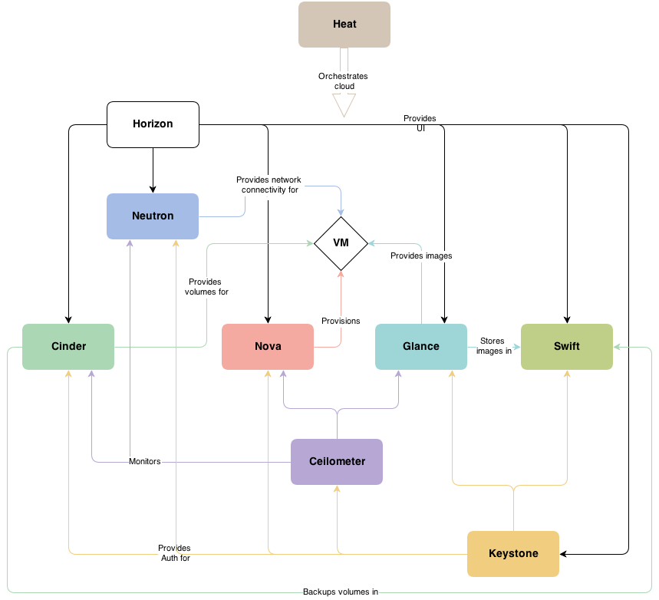
松耦合架构
模块化：独立部署使用
nova-network-》Quantum-》Neutron
Nova-volume-》Cinder，……

Slide 10
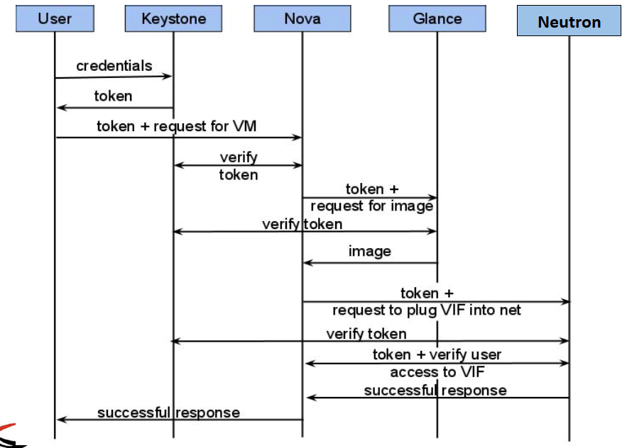
Messaging
OpenStack是一个消息机制系统，API’s, 数据库和Tokens
消息机制：RPC方式来实现异步消息通信 模式：典型的发布(Publish)/订阅(subcribe)模式
Notes:
So.. What happened when we create a VM?
OpenStack is a messaging system that uses API’s, Databases and Tokens

Slide 11
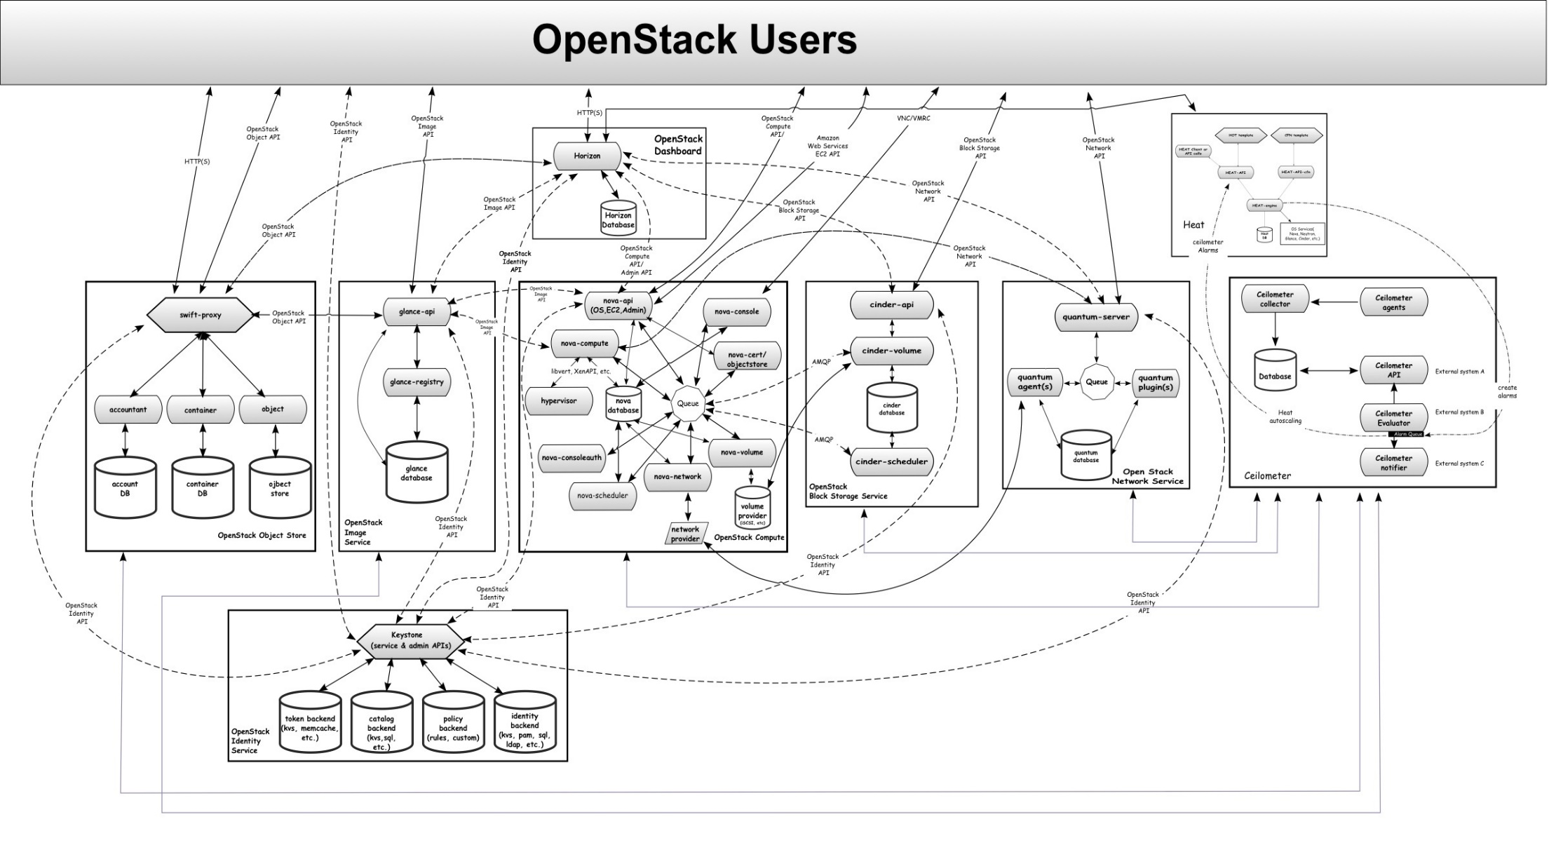
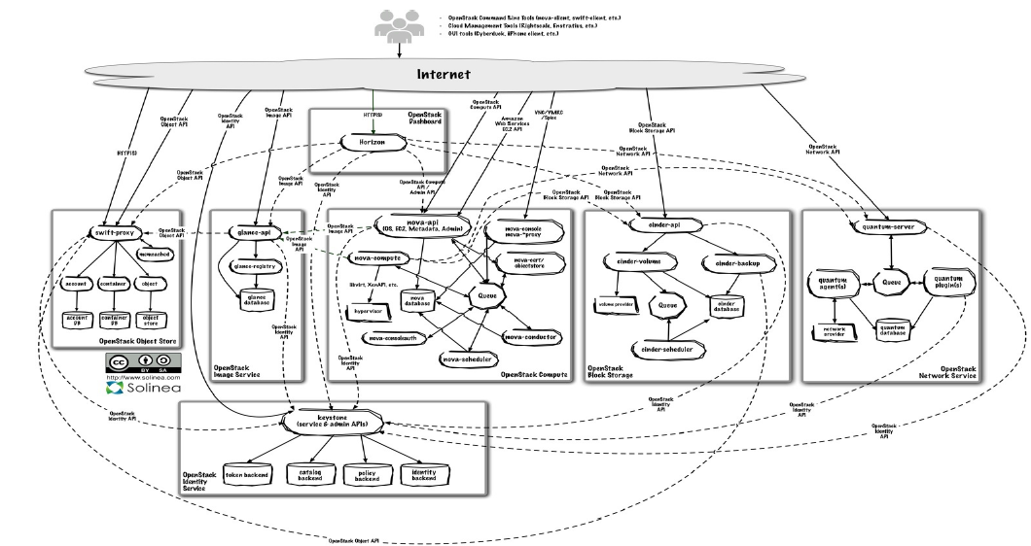
Notes:
End users can interact through a common web interface (Horizon) or directly to each service through their API
All services authenticate through a common source (facilitated through keystone)
Individual services interact with each other through their public APIs (except where privileged administrator commands are necessary)
In the sections below, we'll delve into the architecture for each of the services.
OpenStack is a dynamic distributed system of distributed systems

Slide 12
Horizon (门户)
OpenStack Identity API
OpenStack Network API
提供了图形化的用户和管理员门户
基于Django的开源MVC的Web开发框架实现，Python实现
api package访问其他模块的API
Horizon模块化的，可以单独部署
Heat
HTTP(S)
Horizon
Horizon Database
OpenStack Compute API
OpenStack Image API
OpenStack Block Storage API
Notes:
As with most web applications, the architecture is fairly simple:
Horizon is usually deployed via mod_wsgi in Apache. (mod_wsgi is a simple to use Apache module which can host any Python application that supports the Python WSGI interface.)
The code itself is separated into a reusable python module with most of the logic (interactions with various OpenStack APIs) and presentation (to make it easily customizable for different sites).
A database (configurable as to which one) which relies mostly on the other services for data. It also stores very little data of its own.
From a network architecture point of view, this service will need to be customer accessible as well as be able to talk to each service's public APIs. If you wish to use the administrator functionality (i.e. for other services), it will also need connectivity to their admin API endpoints (which should be non-customer accessible).

Slide 13
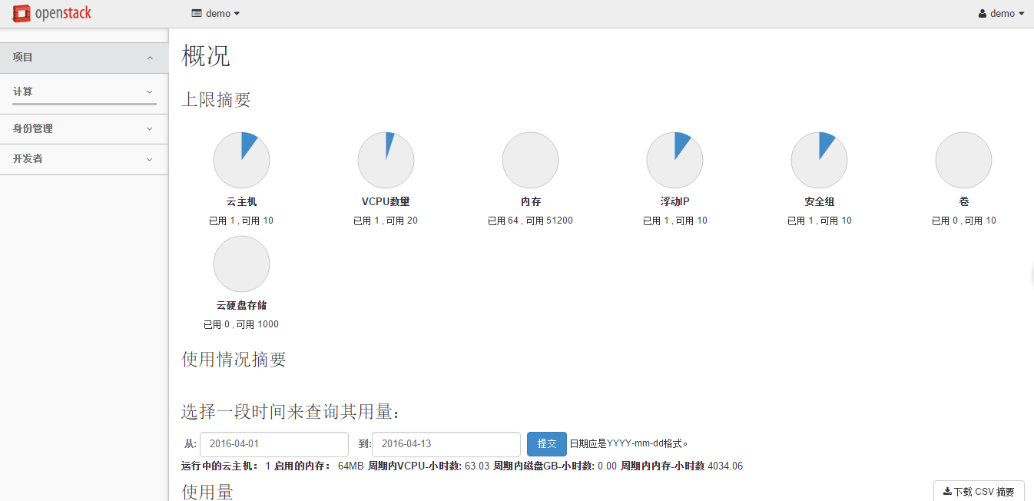
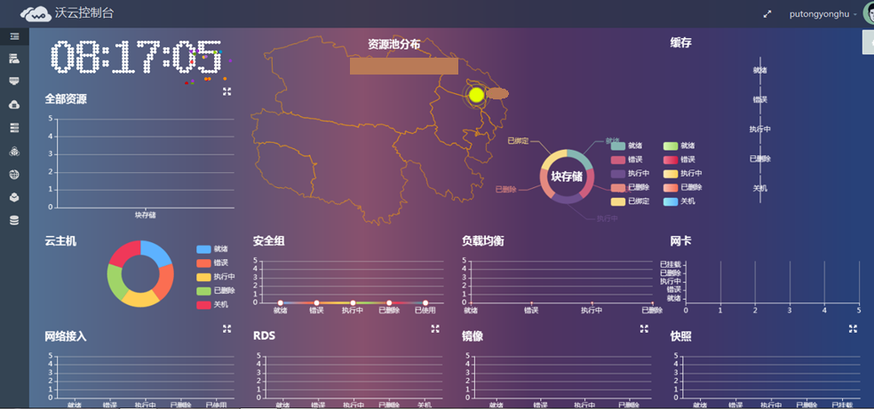
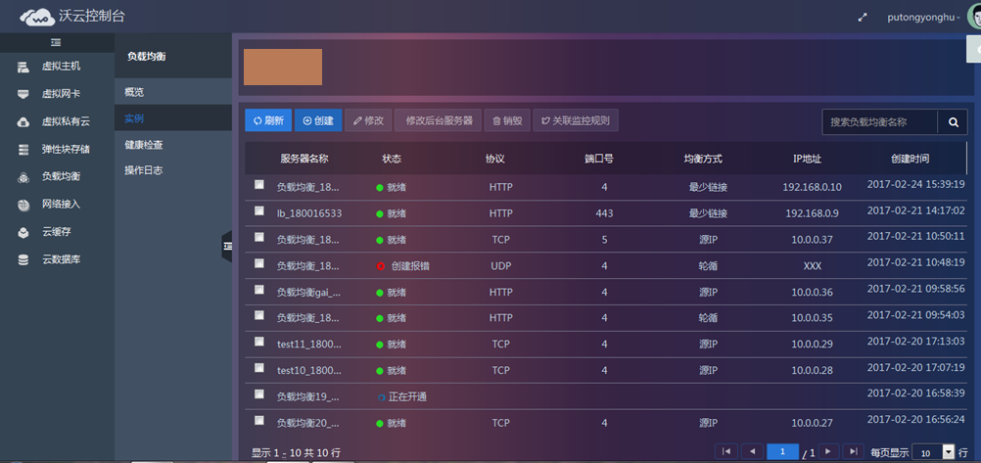
Horizon (门户)

Slide 14
Notes:
Nova

Slide 15
Nova (Compute)
计算资源的控制器（nova-api安装在管理节点）
OpenStack Compute API
vnc/vmrc
nova-api
(OS, EC2, Admin)
nova-console
cinder-api
cinder-scheduler
OpenStack Image API
nova-compute
nova-conductor
nova-cert / object store
不提供虚拟化功能，集成了主流的开源虚拟化技术（ nova-computer 安装在计算节点）
libvrt, XenAPI,etc
amqp
hypervisor
nova
database
Queue
nova-consoleauth
nova-volume/cinder
OpenStack Identity API
nova-scheduler
nova-network
volume provider
(iSCSI, etc)
cinder-volume
为虚拟机提供了一个高度可伸缩的管理框架（nova-scheduler）
Network Provider
Neutron Agent
Notes:
Nova is the most complicated and distributed component of OpenStack. A large number of processes cooperate to turn end user API requests into running virtual machines. Below is a list of these processes and their functions:
nova-api accepts and responds to end user compute API calls. It supports OpenStack Compute API, Amazon's EC2 API and a special Admin API (for privileged users to perform administrative actions). It also initiates most of the orchestration activities (such as running an instance) as well as enforces some policy (mostly quota checks).
nova-compute process is primarily a worker daemon that creates and terminates virtual machine instances via hypervisor's APIs (XenAPI for XenServer/XCP, libvirt for KVM or QEMU, VMwareAPI for VMware, etc.). The process by which it does so is fairly complex but the basics are simple: accept actions from the queue and then perform a series of system commands (like launching a KVM instance) to carry them out while updating state in the database.
nova-volume manages the creation, attaching and detaching of z volumes to compute instances (similar functionality to Amazon’s Elastic Block Storage). It can use volumes from a variety of providers such as iSCSI or Rados Block Device in Ceph. A new OpenStack project, Cinder, will eventually replace nova-volume functionality. In the Folsom release, nova-volume and the Block Storage service will have similar functionality.
The nova-network worker daemon is very similar to nova-compute and nova-volume. It accepts networking tasks from the queue and then performs tasks to manipulate the network (such as setting up bridging interfaces or changing iptables rules). This functionality is being migrated to Neutron, a separate OpenStack project. In the Folsom release, much of the functionality will be duplicated between nova-network and Neutron.
The nova-schedule process is conceptually the simplest piece of code in OpenStack Nova: it takes a virtual machine instance request from the queue and determines where it should run (specifically, which compute server host it should run on).
The queue provides a central hub for passing messages between daemons. This is usually implemented with RabbitMQ today, but could be any AMPQ message queue (such as Apache Qpid). New to the Folsom release is support for Zero MQ.
The SQL database stores most of the build-time and runtime state for a cloud infrastructure. This includes the instance types that are available for use, instances in use, networks available and projects. Theoretically, OpenStack Nova can support any database supported by SQL-Alchemy but the only databases currently being widely used are SQLite3 (only appropriate for test and development work), MySQL and PostgreSQL.
Nova also provides console services to allow end users to access their virtual instance's console through a proxy. This involves several daemons (nova-console, nova-novncproxy and nova-consoleauth).
Nova interacts with many other OpenStack services: Keystone for authentication, Glance for images and Horizon for web interface. The Glance interactions are central. The API process can upload and query Glance while nova-compute will download images for use in launching images.

Slide 16
Nova (Compute)
OpenStack计算部件Nova：
API Server（nova-api）
消息队列（rabbit-mq server）
运算工作站（nova-compute）
网络控制器（nova-network）
卷管理（nova-volume）
调度器（nova-scheduler）
基于计算沃云服务：
弹性云主机
弹性负载均衡
弹性扩展
自动化部署
……

Slide 17
Notes:
Swift

Slide 18
Swift (Object Storage 对象存储)
Client Access
OpenStack Object API
OpenStack Identity API
分布式对象存储服务
可提供虚机镜像存储
完全独立的一个服务模块
三层逻辑结构：Account/Container/Object（账户/容器/对象)
  账户：相当于租户，用来做顶层的隔离机制
  容器：类似文件夹或目录
  对象：由元数据和内容两部分组成
swift-proxy
account
container
object
account DB
container DB
object store
Notes:
The swift architecture is very distributed to prevent any single point of failure as well as to scale horizontally. It includes the following components:
Proxy server (swift-proxy-server) accepts incoming requests via the OpenStack Object API or just raw HTTP. It accepts files to upload, modifications to metadata or container creation. In addition, it will also serve files or container listing to web browsers. The proxy server may utilize an optional cache (usually deployed with memcache) to improve performance.
Account servers manage accounts defined with the object storage service.
Container servers manage a mapping of containers (i.e. folders) within the object store service.
Object servers manage actual objects (i.e. files) on the storage nodes.
There are also a number of periodic processes which run to perform housekeeping tasks on the large data store. The most important of these is the replication services, which ensures consistency and availability through the cluster. Other periodic processes include auditors, updaters and reapers.
Authentication is handled through configurable WSGI middleware (which will usually be Keystone).

Slide 19
Swift (Object Storage 对象存储)
Client Access
OpenStack Object API
OpenStack Identity API
海量对象存储
大文件（对象）存储
数据冗余管理
归档能力-----处理大数据集
为虚拟机和云应用提供数据容器
处理流媒体
对象安全存储
备份与归档
良好的可伸缩性
swift-proxy
account
container
object
account DB
container DB
object store

Slide 20
Notes:
Glance

Slide 21
Glance (Image Service 镜像)
独立模块，可将镜像存储到多种存储中，如AWS S3、Swift、HDFS……
快照管理
不能进行镜像的制作
OpenStack
Image API
glance-api
OpenStack
Identity API
Storage Interface(s)
glance-registry
glance database
Notes:
The Glance architecture has stayed relatively stable since the Cactus release. The biggest architectural change has been the addition of authentication, which was added in the Diablo release.
Glance has four main parts to it:
glance-api accepts Image API calls for image discovery, image retrieval and image storage.
glance-registry stores, processes and retrieves metadata about images (size, type, etc.).
A database to store the image metadata. Like Nova, you can choose your database depending on your preference (but most people use MySQL or SQLite).
A storage repository for the actual image files. In addition to Swift, Glance supports normal filesystems, RADOS block devices, Amazon S3 and HTTP.
There are also a number of periodic processes which run on Glance to support caching. The most important of these is the replication services, which ensures consistency and availability through the cluster. Other periodic processes include auditors, updaters and reapers.
As you can see from the diagram in the Conceptual Architecture section, Glance serves a central role to the overall IaaS picture.
It accepts API requests for images (or image metadata) from end users or Nova components and can store its disk files in the storage repository.
• Raw
• Machine (kernel/ramdisk outside of image, also known as AMI)
• VHD (Hyper-V)
• VDI (VirtualBox)
• qcow2 (Qemu/KVM)
• VMDK (VMware)
• OVF (VMware, others)

Slide 22
Openstack是一个动态的分布式系统，需要keystone将各个模块通过认证进行通信
Notes:
End users can interact through a common web interface (Horizon) or directly to each service through their API
All services authenticate through a common source (facilitated through keystone)
Individual services interact with each other through their public APIs (except where privileged administrator commands are necessary)
In the sections below, we'll delve into the architecture for each of the services.
OpenStack is a dynamic distributed system of distributed systems

Slide 23
Keystone (认证服务)
OpenStack Identity API
提供了用户信息管理和完成各个模块认证服务。
  用户信息管理：user/tenant基本信息，tenant管理
  认证服务：登录认证，各个组件API的权限控制
Keystone
(service & Admin APIs)
User | 住宾馆的人
Credentials | 身份证
Authentication | 认证你的身份证
Token | 房卡
Tenant | 宾馆
Service | 宾馆可以提供的服务类别，比如，饮食类，娱乐类
Endpoint | 具体的一种服务，比如吃烧烤，打羽毛球
Role | VIP 等级，VIP越高，享有越高的权限
token backend
(kvs, memcache)
policy backend
(rules, custom)
catalog backend
(kvs, sql, etc)
identity backend
(kvs, pam, sql)
Notes:
Keystone provides a single point of integration for OpenStack policy, catalog, token and authentication.
Keystone handles API requests as well as providing configurable catalog, policy, token and identity services.
Each Keystone function has a pluggable backend which allows different ways to use the particular service. Most support standard backends like LDAP or SQL, as well as Key Value Stores (KVS).
Most people will use this as a point of customization for their current authentication services.

Slide 24
Notes:
Neutron (Formerly Quantum)

Slide 25
Neutron (网络管理)
IP资源管理：DHCP
网络连接管理：实现网络虚拟化和NaaS，即虚拟网络连接和网络的访问控制
插件式（plugin）：主流厂家软硬件网络设备适配
OpenStack Network API
neutron–server
Neutron
agents
Queue
Neutron
Plugin(s)
Neutron database
OpenStack Identity API
Notes:
Neutron provides "network connectivity as a service" between interface devices managed by other OpenStack services (most likely Nova). The service works by allowing users to create their own networks and then attach interfaces to them. Like many of the OpenStack services, Neutron is highly configurable due to its plug-in architecture. These plug-ins accommodate different networking equipment and software. As such, the architecture and deployment can vary dramatically. In the above architecture, a simple Linux networking plug-in is shown.
neutron-server accepts API requests and then routes them to the appropriate Neutron plug-in for action.
Neutron plug-ins and agents perform the actual actions such as plugging and unplugging ports, creating networks or subnets and IP addressing. These plug-ins and agents differ depending on the vendor and technologies used in the particular cloud. Neutron ships with plug-ins and agents for: Cisco virtual and physical switches, NEC OpenFlow products, Open vSwitch, Linux bridging, the Ryu Network Operating System, and VMware NSX.
The common agents are L3 (layer 3), DHCP (dynamic host IP addressing) and the specific plug-in agent.
Most Neutron installations will also make use of a messaging queue to route information between the neutron-server and various agents as well as a database to store networking state for particular plug-ins.
Neutron will interact mainly with Nova, where it will provide networks and connectivity for its instances.

Slide 26
Neutron (网络管理)
Neutron 功能
提供 VLAN 的隔离
提供软件定义网络 SDN
支持第三方的 API 扩展
支持第三方的 Plugin 扩展
基于网络的沃云服务
网络接入：
路由\虚拟路由
网卡\虚拟网卡
带宽服务
虚拟私有云：
私有网络
局域网
……

Slide 27
Notes:
Cinder

Slide 28
Cinder (Block Storage)
OpenStack Block Storage API
类似AWS的EBS，提供持久化存储方案
Cinder-volume提供存储适配，各存储厂家和方案通过driver方式提供
通过消息机制实现存储的创建、挂载、回收、快照控制
cinder-api
OpenStack
Identity API
cinder-volume
Cinder database
volume
provider
(iSCSI, etc)
cinder-scheduler
Notes:
Cinder separates out the persistent block storage functionality that was previously part of OpenStack Compute (in the form of nova-volume) into its own service. The OpenStack Block Storage API allows for manipulation of volumes, volume types (similar to compute flavors) and volume snapshots.
cinder-api accepts API requests and routes them to cinder-volume for action.
cinder-volume acts upon the requests by reading or writing to the Cinder database to maintain state, interacting with other processes (like cinder-scheduler) through a message queue and directly upon block storage providing hardware or software. It can interact with a variety of storage providers through a driver architecture. Currently, there are drivers for IBM, SolidFire, NetApp, Linux iSCSI and other storage providers.
Much like nova-scheduler, the cinder-scheduler daemon picks the optimal block storage provider node to create the volume on.
Cinder deployments will also make use of a messaging queue to route information between the cinder processes as well as a database to store volume state.
Like Neutron, Cinder will mainly interact with Nova, providing volumes for its instances.

Slide 29
Cinder (Block Storage)
基本功能：
卷操作
卷-虚机操作
卷-快照操作
卷-镜像操作
基于存储的沃云服务
弹性块存储
高效块存储
SSD块存储
共享块存储
文件存储
云备份

Slide 30
Other projects : Telemetry, Heat, Trove
Notes:
Other projects: Telemetry, Heat, Trove

Slide 31
Telemetry (aka Ceilometer, Metering)
Push/Polling Inputs
主要的目标是监控和计量
通过REST接口存取收集数据，存储在数据库或者JSON/XML文件中
发布和告警功能
Telemetry Collector
Telemetry Agents
OpenStack
Identity API
Database
Telemetry API
Telemetry Data
Telemetry Evaluator
Alarm Queue
TelemetryNotifier
Telemetry notifications
Notes:
The Ceilometer project was started in 2012 with one simple goal in mind: to provide an infrastructure to collect any information needed regarding OpenStack projects. It was designed so that rating engines could use this single source to transform events into billable items which we label as “metering”.
As the project started to come to life, collecting an increasing number of metrics across multiple projects, the OpenStack community started to realize that a secondary goal could be added to Ceilometer: become a standard way to collect metric, regardless of the purpose of the collection. For example, Ceilometer can now publish information for monitoring, debugging and graphing tools in addition or in parallel to the metering backend. This effort is labeled as “multi-publisher”.
Most recently, as the Heat project started to come to life, it soon became clear that the OpenStack project needed a tool to watch for variations in key values in order to trigger various reactions. As Ceilometer already had the tooling to collect vast quantities of data, it seemed logical to add this as an extension of the Ceilometer project, which was tagged as “alarming”.

Slide 32
Heat (AutoScale)
Heat是云应用编程的脚本语言
Heat是OpenStackAPI的延伸
与Horizon集成，模板的上传，参数的添加等
Heat是云应用演进的引擎（Trove、Sahara都支持Heat）
支持AWS的Cloud Formation 模板(XML/yaml)
与监控结合，可实现自动扩展
HOT template
Heat Client for API Calls
OpenStack Identity API
Heat-API
Heat-engine
Ceilometer Alarms
Heat database
OS Services Nova, Neutron, Glance, etc.
Notes:
Heat implements an orchestration engine to launch multiple composite cloud applications based on templates in the form of text files that can be treated like code. A native Heat template format is evolving, but Heat also endeavors to provide compatibility with the AWS CloudFormation template format, so that many existing CloudFormation templates can be launched on OpenStack. Heat provides both an OpenStack-native ReST API and a CloudFormation-compatible Query API.
A Heat template describes the infrastructure for a cloud application in a text file that is readable and writable by humans, and can be checked into version control, diffed.
Infrastructure resources that can be described include: servers, floating ips, volumes, security groups, users, &c.
Heat also provides an autoscaling service that integrates with Ceilometer, so you can include a scaling group as a resource in a template.
Templates can also specify the relationships between resources (e.g. this volume is connected to this server). This enables Heat to call out to the OpenStack APIs to create all of your infrastructure in the correct order to completely launch your application.
Heat manages the whole lifecycle of the application - when you need to change your infrastructure, simply modify the template and use it to update your existing stack. Heat knows how to make the necessary changes. It will delete all of the resources when you are finished with the application, too.
Heat primarily manages infrastructure, but the templates integrate well with software configuration management tools such as Puppet and Chef.

Slide 33
Trove（数据库）
datastore管理
Instance管理
configuration管理
database管理
user管理
replication管理
backup管理
cluster管理
Trove-api
OpenStack
Identity API
Trove Task Mananger
Trove database
Message Queue
volume
provider
(iSCSI, etc)
Trove Conductor

Slide 34
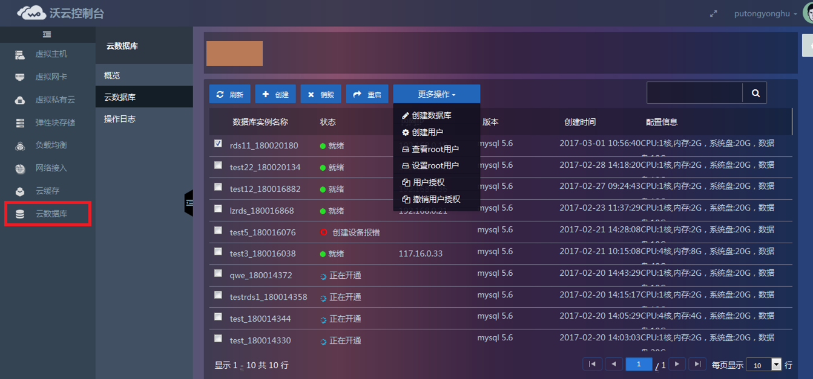
Trove（数据库）

Slide 35
Openstack给用户/开发者带来什么
开放：开源社区，无厂家锁定
平台性：提供私有云和公有云解决方案
成本：开源方案，遵守Apache协议，低CapEx
标准化：标准化的API（REST）北向接口，内部RPC（远程过程调用）
存储：开源方案， – Ceph, Swift
灵活性：模块化架构（每个模块可以独立部署），混合云解决方案（对接AWS、VMWare等）
易用性：开发语言Python脚本语言，OpenStack API
分层架构：API、逻辑处理、驱动适配（driver/Plugin）

Slide 36
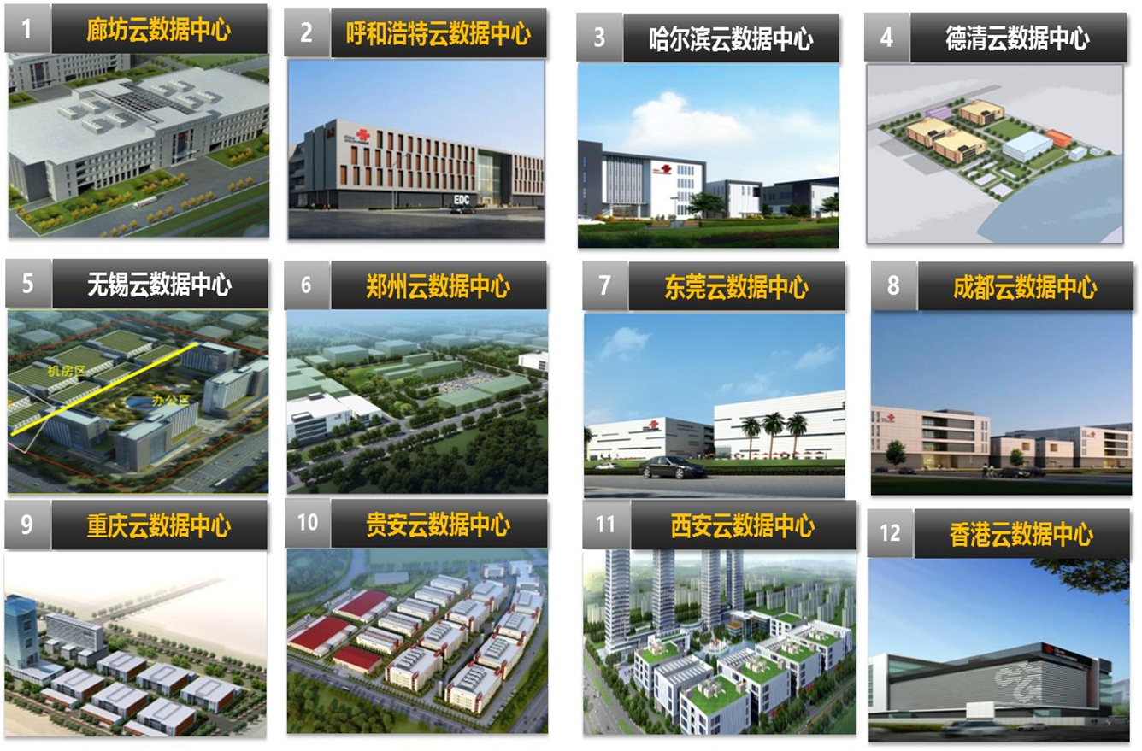
沃云数据中心
Notes:
（一）愿景
创新改变世界、让中国联通云计算和数据服务体验无处不在。
（二）使命
聚焦数据中心、互联网、云计算与数据服务领域，打造自主研发、价值经营、专业化一体化的核心能力，大力推进产业链协同合作，持续为客户创造最大价值，创新体制机制，成为“国际一流、国内领先”。
（三）战略
价值驱动、软件定义创新与服务领先。
实施公司发展战略，通过5-10年的努力，实现规模快速增长和效益快速提升，致力于成为“国际一流、国内领先”。

Slide 37
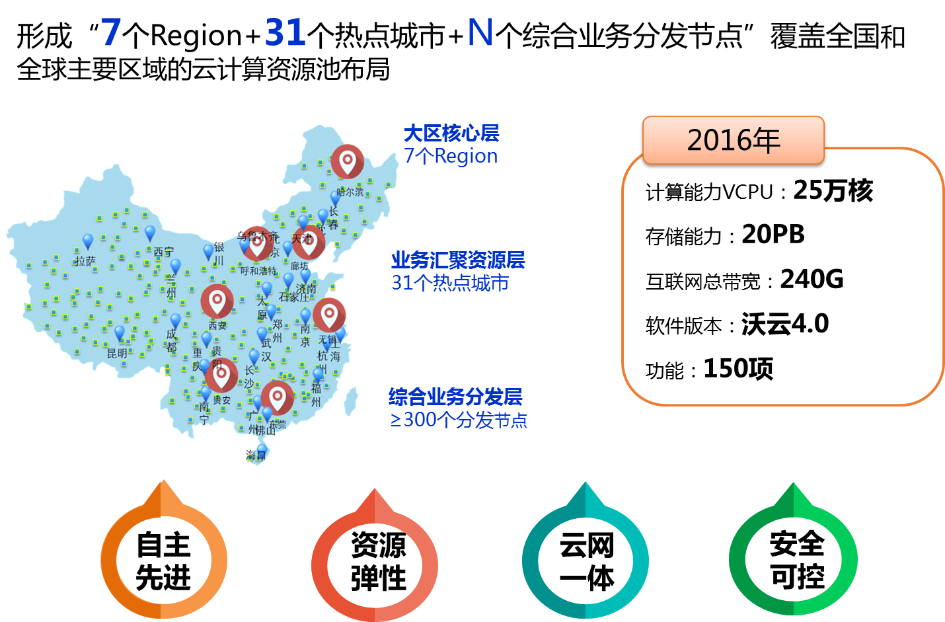
沃云公有云资源池
Notes:
（一）愿景
创新改变世界、让中国联通云计算和数据服务体验无处不在。
（二）使命
聚焦数据中心、互联网、云计算与数据服务领域，打造自主研发、价值经营、专业化一体化的核心能力，大力推进产业链协同合作，持续为客户创造最大价值，创新体制机制，成为“国际一流、国内领先”。
（三）战略
价值驱动、软件定义创新与服务领先。
实施公司发展战略，通过5-10年的努力，实现规模快速增长和效益快速提升，致力于成为“国际一流、国内领先”。

Slide 38
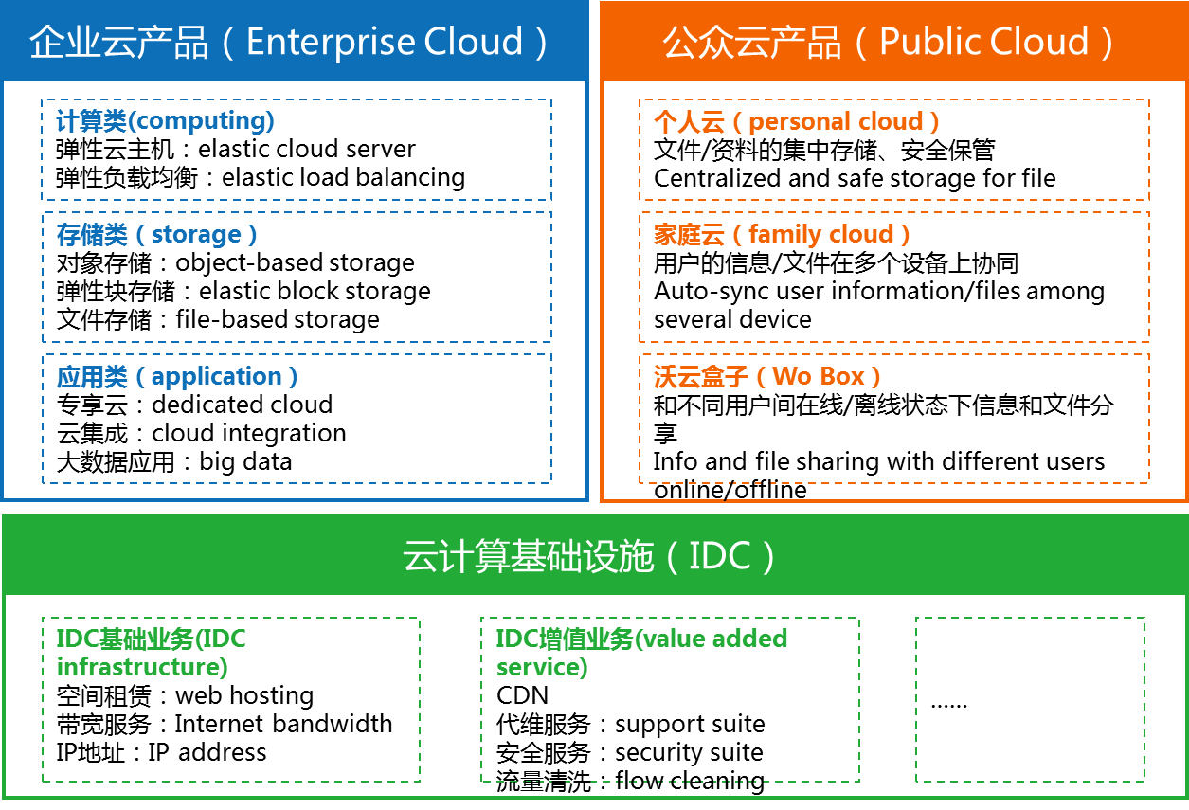
沃云产品线
Notes:
（一）愿景
创新改变世界、让中国联通云计算和数据服务体验无处不在。
（二）使命
聚焦数据中心、互联网、云计算与数据服务领域，打造自主研发、价值经营、专业化一体化的核心能力，大力推进产业链协同合作，持续为客户创造最大价值，创新体制机制，成为“国际一流、国内领先”。
（三）战略
价值驱动、软件定义创新与服务领先。
实施公司发展战略，通过5-10年的努力，实现规模快速增长和效益快速提升，致力于成为“国际一流、国内领先”。

Slide 39

沃云资质荣誉
Notes:
（一）愿景
创新改变世界、让中国联通云计算和数据服务体验无处不在。
（二）使命
聚焦数据中心、互联网、云计算与数据服务领域，打造自主研发、价值经营、专业化一体化的核心能力，大力推进产业链协同合作，持续为客户创造最大价值，创新体制机制，成为“国际一流、国内领先”。
（三）战略
价值驱动、软件定义创新与服务领先。
实施公司发展战略，通过5-10年的努力，实现规模快速增长和效益快速提升，致力于成为“国际一流、国内领先”。

Slide 40
公司的愿景、使命和战略
（一）愿景
创新改变世界、让中国联通云计算和数据服务体验无处不在。
（二）使命
聚焦数据中心、互联网、云计算与数据服务领域，打造自主研发、价值经营、 专业化一体化的核心能力，大力推进产业链协同合作，持续为客户创造最大价 值，创新体制机制，成为“国际一流、国内领先”。
（三）战略
价值驱动、软件定义创新与服务领先。
实施公司发展战略，通过5-10年的努力，实现规模快速增长和效益快速提升， 致力于成为“国际一流、国内领先”。

Slide 41
欢迎进入云的世界
只要你对云计算感兴趣，有探索精神，希望加入到云计算行列中来。
有一定的编程基础，熟悉C、C++ 、JAVA、Python等中任意一门语言。
不断学习新技术，团队合作精神，较强的沟通及协调能力，创新能力强。
计算机、通信、软件工程等相关专业——硕士研究生及以上
实习时间至少3个月，每周工作至少3天，保证每周5个工作日的优先
这些技能将是你的加分项：
熟悉主流云服务商的产品体系（计算类/存储类/网络类/安全类）
熟悉X86的虚拟化技术、存储虚拟化技术、网络虚拟化技术、安全虚拟化技术
熟悉OpenStack、Ceph、SDN等并具有二次开发经验

Slide 42

招聘详情
岗位：产品研发岗、产品经理岗、 系统运维支撑岗
校招简历投递链接：http://dwz.cn/lty11-1
校招流程：
网络申请——能力测评——专业面试——
身体检查——宣讲签约
实习简历投至：
hq-ysjhr@chinaunicom.cn
主题：实习+岗位+学校+专业+学历+姓名
校招二维码

Slide 43
谢 谢
联通云数据有限公司

