Slide 1
Coursera Capstone Project for IBM Data Science Specialization - Week 2
By
ARNAV ASHANK

Slide 2
Introduction
Background
New york city is the most populous city in U.S. and is home to many immigrant population in New York after. Furthermore, it is the largest metropolitan area in the world with 18 million people as of 2010 with an estimated population of 18,897,109 residents.
Being a metropolitan city, New york city is also home to many restaurants which serves wide variety of cuisines. Owing to significant number of Indian expatriate population, New york City and its nearby Suburbs have handful of Indian restaurant.
So, as a part of this project Indian restaurants in New york City will be listed, visualized.

Slide 3
introduction
Problem Description
By utilizing the New york City restaurants inspection data, Indian Restaurants in New york City and their risk category will be Analyzed. Secondly, a classsifier model will be built to predict the risk categories of resturants. Furthermore, using the foursqure API we will get the ratings of Indian Restaurants in New york City.
Target Audience
People looking to open new restaurants
Restaurants
Travelers who love Indian food

Slide 4
DATA
For this project we will use the following data :
1. New york City restaurants inspection data from 2016-2020
* Data source : https://data.cityofnewyork.us/api/views/43nn-pn8j/rows.csv?accessType=DOWNLOAD
* Description : This data set contains 386000 rows and 26 coulmns contains Restaurant Name, Street Name, violation descriptions along with their latitude and longitude.
2. Ratings of Indian resturants for selected locality in New York City
* Data source : Fourquare API
* Description : By using this api we will get all the ratings for Indian restaurants in selected neighborhood

Slide 5
Approach
Collect the New york City Restaurants Inspection data from https://data.cityofnewyork.us/api/views/43nn-pn8j/rows.csv?accessType=DOWNLOAD
Analyze the restaurants based on their risk category
Built a machine learning model for predicting the risk category the resturants are placed
Filter out all venues from the inspection data that are Indian Resturants.
Find rating , tips and like count for each Indian Resturants using FourSquare API.
Using rating for each resturant , we will sort that data.
Visualize the Ranking of neighborhoods using folium library(python)

Slide 6
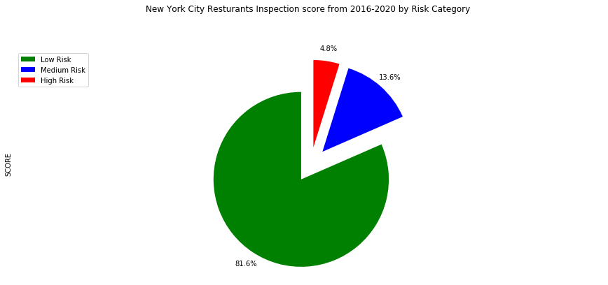
New York Inspections from 2016-2020

Slide 7
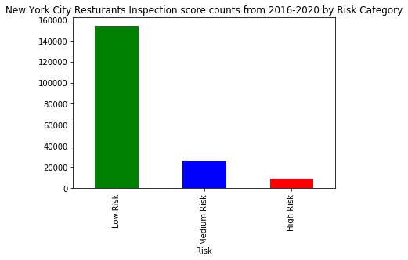
Inspections Counts from 2016-2020

Slide 8
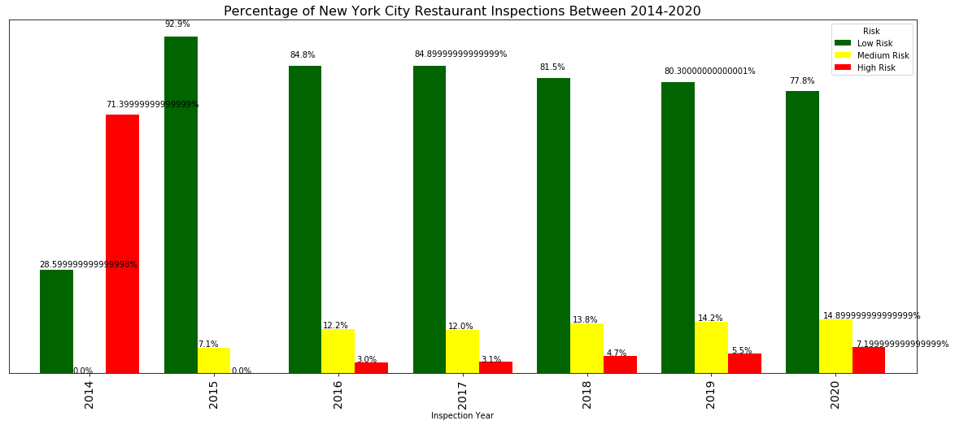
INSPECTIONS By Year

Slide 9
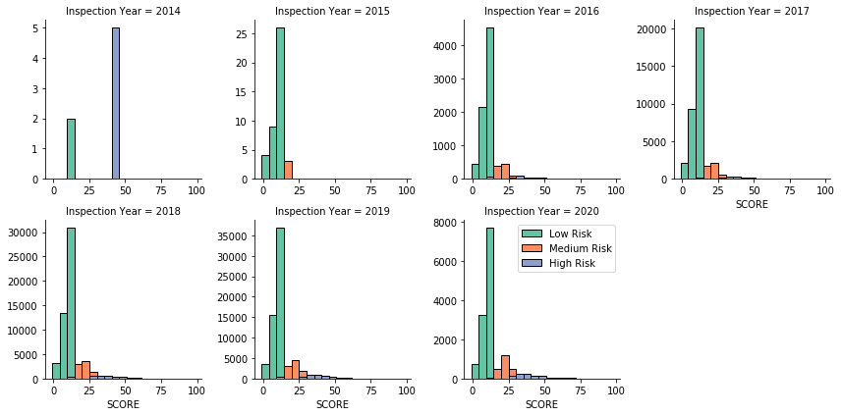
INSPECTIONS By Year

Slide 10
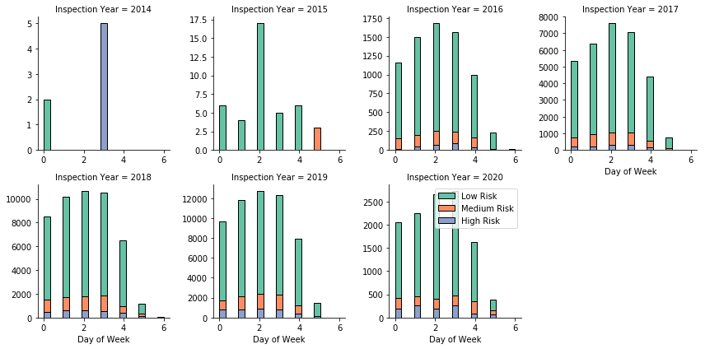
Overall inspection based on day of week

Slide 11
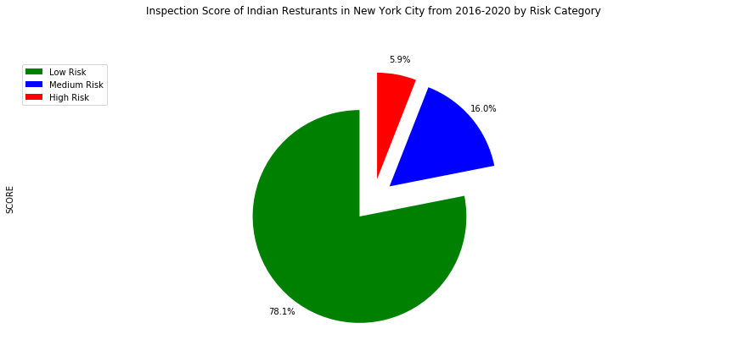
Indian Restaurants Inspections from 2016-2020

Slide 12
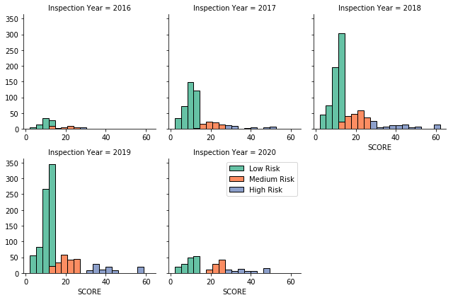
Indian Restaurants Inspections by year

Slide 13
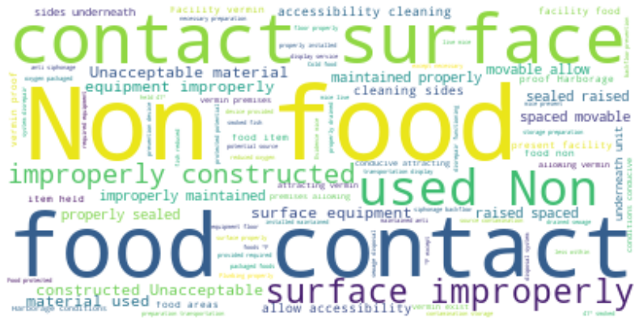
Word Cloud for Violation Description of Indian Restaurants from 2016-2020

Slide 14
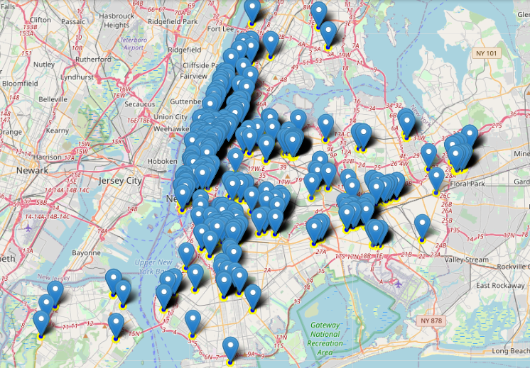
Indian Restaurants Visualizations

Slide 15
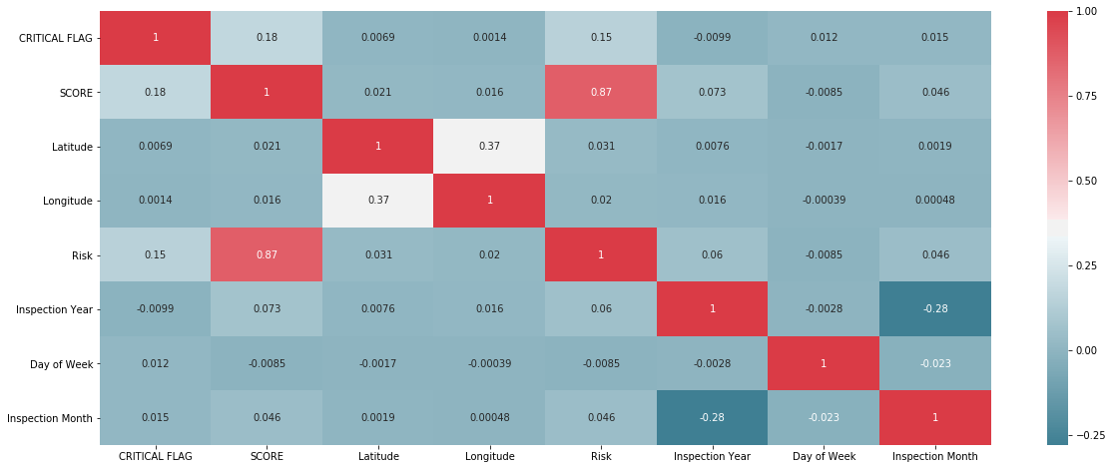
Feature Correlations

Slide 16
Machine Learning Results
Machine Learning Algorithm | Accuracy Score
Decision Tree Classifier | 1.0
Random Forest Classifier | 1.0

Slide 17
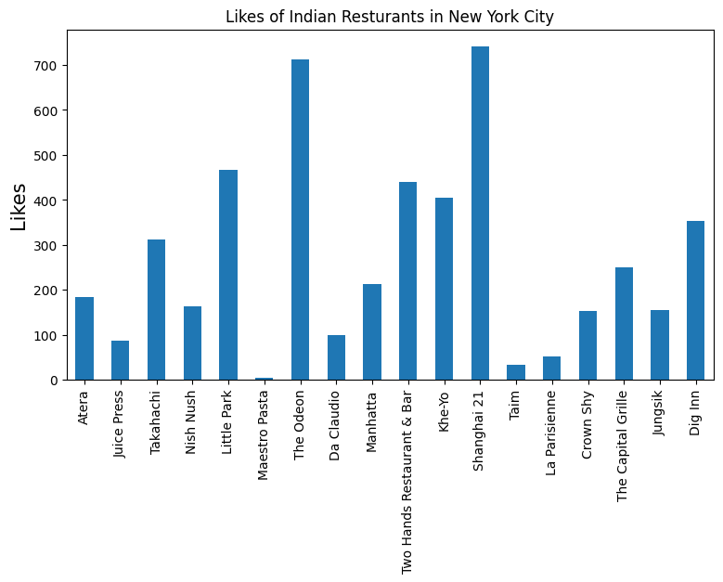
Likes received by the Indian Restaurants from FourSquare API

Slide 18
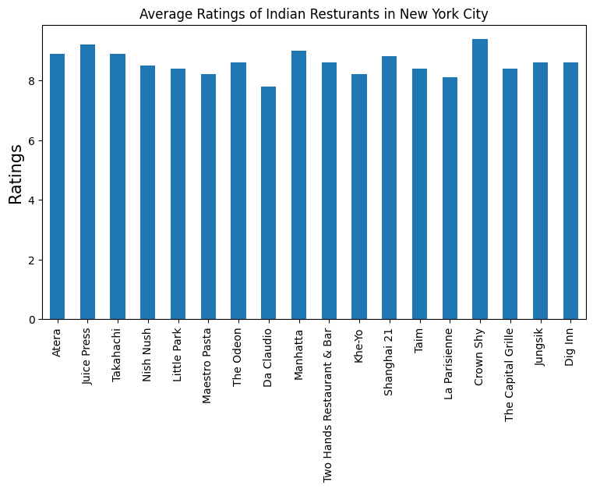
Average Ratings received by the Indian Restaurants from FourSquare API

Slide 19
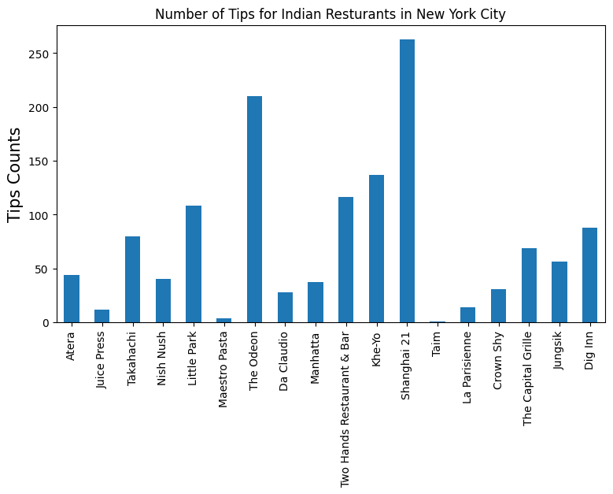
Number of Tips for the Indian Restaurants from FourSquare API

Slide 20
Conclusions
This project successfully completes my IBM Data Science Professional Certification Training. I had a steep learning curve during the course. I have really enjoyed doing all the lab excercises and the courses were really informative.
The following are the conclusions that I derive from this project:
New York has numerous Indian Restaurants out of which we have analyzed a few of them. Thus opening a restaurant in New York will be facing a tough competition in the beginning.
Of the Indian restaurants that are currently present in New York which we analyzed roughly 80% are placed in low risk category based on the inspection data from 2016-2020
A decision tree classifier model is built for classifying the restaurants into various risk categories and the model performs well for the given data set. This will help the restaurants in predicting their risk category for a given year.
The Indian restaurants in the New York were visualized using the folium map rendering library.
Using FourSquare API, the venue details for the Indian restaurants were analyzed and found that among all the restaurants in Shanghai 21 is the best place to dine.

Slide 21
Limitations and Future Work
The restaurants are ranked solely on the data provided by FourSquare API. If data on other demographics are available this can be improved.
The accuracy of location data depends on New York City Inspection Data and FourSquare API. Hence, need to be analyzed further as there are some ambiguous entries.
The machine learning model will be further improved as the model developed may be prone to over-fitting

