Slide 1

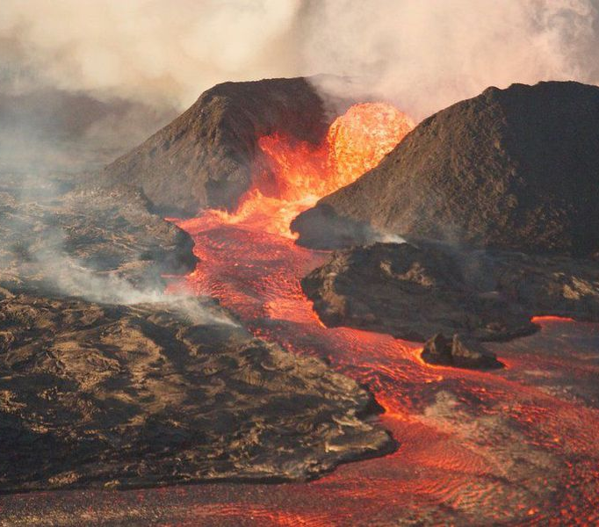
DATAVIZ Project 2
Visualizations of volcanic activity around the Earth
Notes:
SHAWNTELL

Slide 2
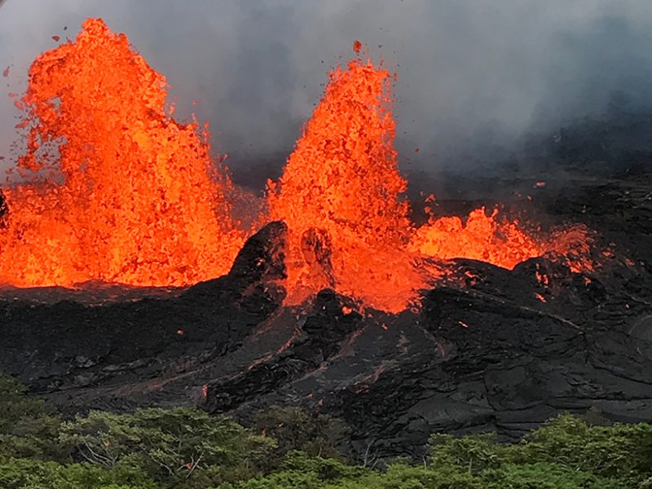
Team 2
Banu Nathan
Fleming Brathwaite
Dan Freda
Shawntell Manning
Notes:
SHAWNTELL

Slide 3
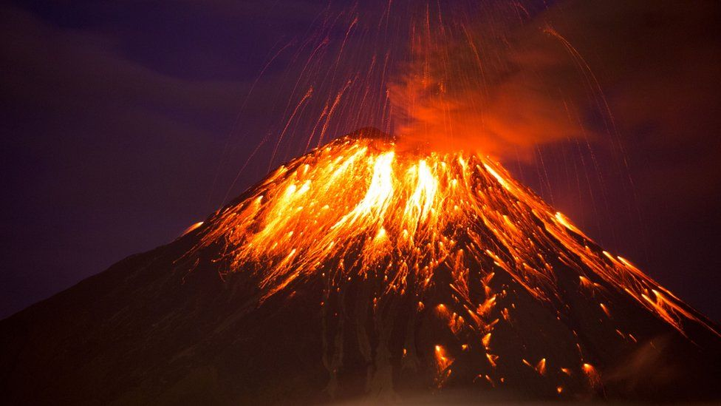

Theme
Interactive visualizations of global volcanic activity using a combination of web scraping and Leaflet or Plotly
Notes:
SHAWNTELL
We were inspired to choose the theme of global volcanic activity in light of the recent eruption of Mount Soufriere on the island of Saint Vincent in the Caribbean on April 9th. We were immediately able to find the data we needed to successfully carry out this project. However, one limitation we faced was access to real time data to create a true live interactive experience. So please keep in mind that the data we are using is reflective of our queries pulled over the past week.

Slide 4
references
Smithsonian Institution: Global Volcanism Program (Excel)
NOAA: Significant Volcanic Eruption Database (Json)
Oregon State University: Volcano World, Deadliest Eruption (webscraping)
GitHub.com: Fraxen/techtonic plates (Json)
Data Sources
Global Volcanism Program, 2013. Volcanoes of the World, v. 4.9.4 (17 Mar 2021). Venzke, E (ed.). Smithsonian Institution. Downloaded 23 Apr 2021. https://doi.org/10.5479/si.GVP.VOTW4-2013.
National Geophysical Data Center / World Data Service (NGDC/WDS): NCEI/WDS Global Significant Earthquake Database. NOAA National Centers for Environmental Information. doi:10.7289/V5TD9V7K
Oregon State University Volcanic World: http://volcano.oregonstate.edu/deadliest-eruption
GitHub.com: Fraxen / Techtonic Plates: https://github.com/fraxen/tectonicplates
Notes:
Data Sources & Description of data types:
Smithsonian Institution: Global Volcanism Program
Site: https://volcano.si.edu/search_volcano.cfm
File Type: Excel
"Volcanoes of the World" is a database describing the physical characteristics of Holocene volcanoes and their eruptions. This search returns a list which may be filtered based on a volcano name, volcano type, features, evidence of recent activity, location (set using a map), country, rock types, population within various distance ranges, or the availability of images. Name and country searches will also return subfeature names and synonyms; using other filters will result in only primary volcano names being returned. A standard set of fields is shown on the screen display, but full results with additional content may be downloaded into an Excel spreadsheet.
NOAA: Significant Volcanic Eruption Database
Site: https://public.opendatasoft.com/explore/dataset/significant-volcanic-eruption-database/information/
File Type: Json
The Significant Volcanic Eruption Database is a global listing of over 500 significant eruptions which includes information on the latitude, longitude, elevation, type of volcano, and last known eruption. A significant eruption is classified as one that meets at least one of the following criteria: caused fatalities, caused moderate damage (approximately $1 million or more), with a Volcanic Explosivity Index (VEI) of 6 or larger, caused a tsunami, or was associated with a major earthquake.
Oregon State University / Volcano World / Deadliest Eruption
Site: http://volcano.oregonstate.edu/deadliest-eruption
File Type: Web scraping
The list contains eruptions with more than 500 known human fatalities. These are the most deadly eruptions known. Other eruptions have been as big or bigger than these, but no one lived nearby to be threatened (for example the Valley of 10,000 Smokes eruption in Alaska in 1912). The Mt. St. Helens eruption in 1980 in Washington state was a far less dangerous eruption than these, only 61 humans died, although thousands of deer and other animals perished.
GitHub.com/Fraxen/techtonic plates (Json)
GitHub.com: Fraxen / Techtonic Plates: https://github.com/fraxen/tectonicplates

Slide 5
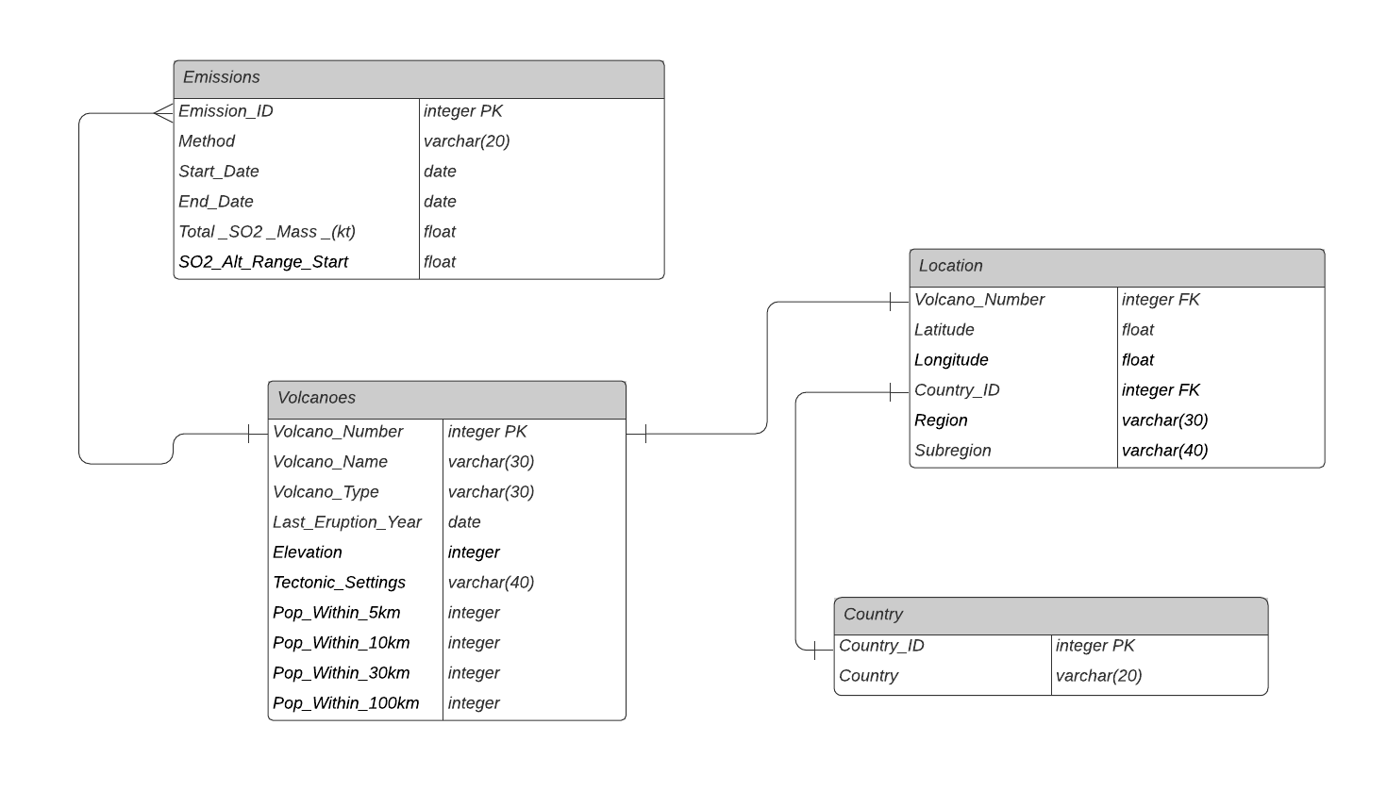
Data munging techniques
List Counts:
Emissions - 360
Locations – 118
Volcanoes – 118
Country - 33
Global Volcanism Program, 2013. Volcanoes of the World, v. 4.9.4 (17 Mar 2021). Venzke, E (ed.). Smithsonian Institution. Downloaded 23 Apr 2021. https://doi.org/10.5479/si.GVP.VOTW4-2013.
Notes:
FLEMING:
From the Smithsonian data source, there were two files which we retrieved queries delivered with Excel files. We generated two queries: one based on volcanic emissions and the other based on geographic data.
We munged these two lists into three separate table to normalize them for import into PostgreSQL. We encountered some challenges with importing the location table with latitude and longitude as combined foreign keys, so we split them into two tables so we could relate them as foreign keys from distinct tables.
Then we converted the csv files to a json for querying in pandas.

Slide 6
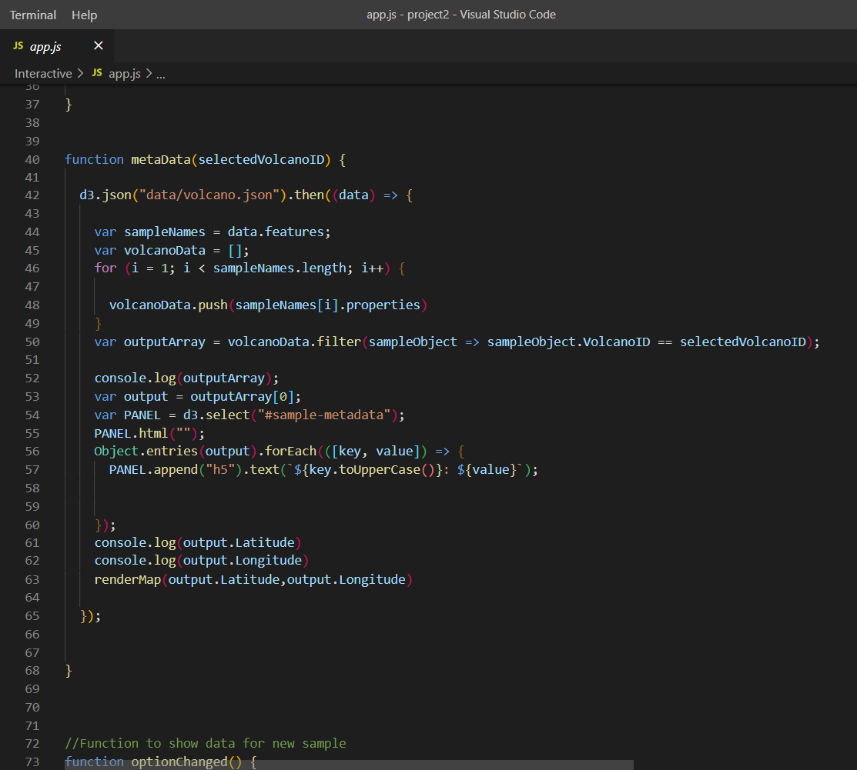
Coding approach
To create our visualization, we used a Python Flask–powered API, HTML/CSS, JavaScript, Beautiful Soup, MongoDB and PostgreSQL.
Notes:
BANU & DAN
To create our visualization, we used a Python Flask–powered API, HTML/CSS, JavaScript, Beautiful Soup, MongoDB and PostgreSQL.

Slide 7
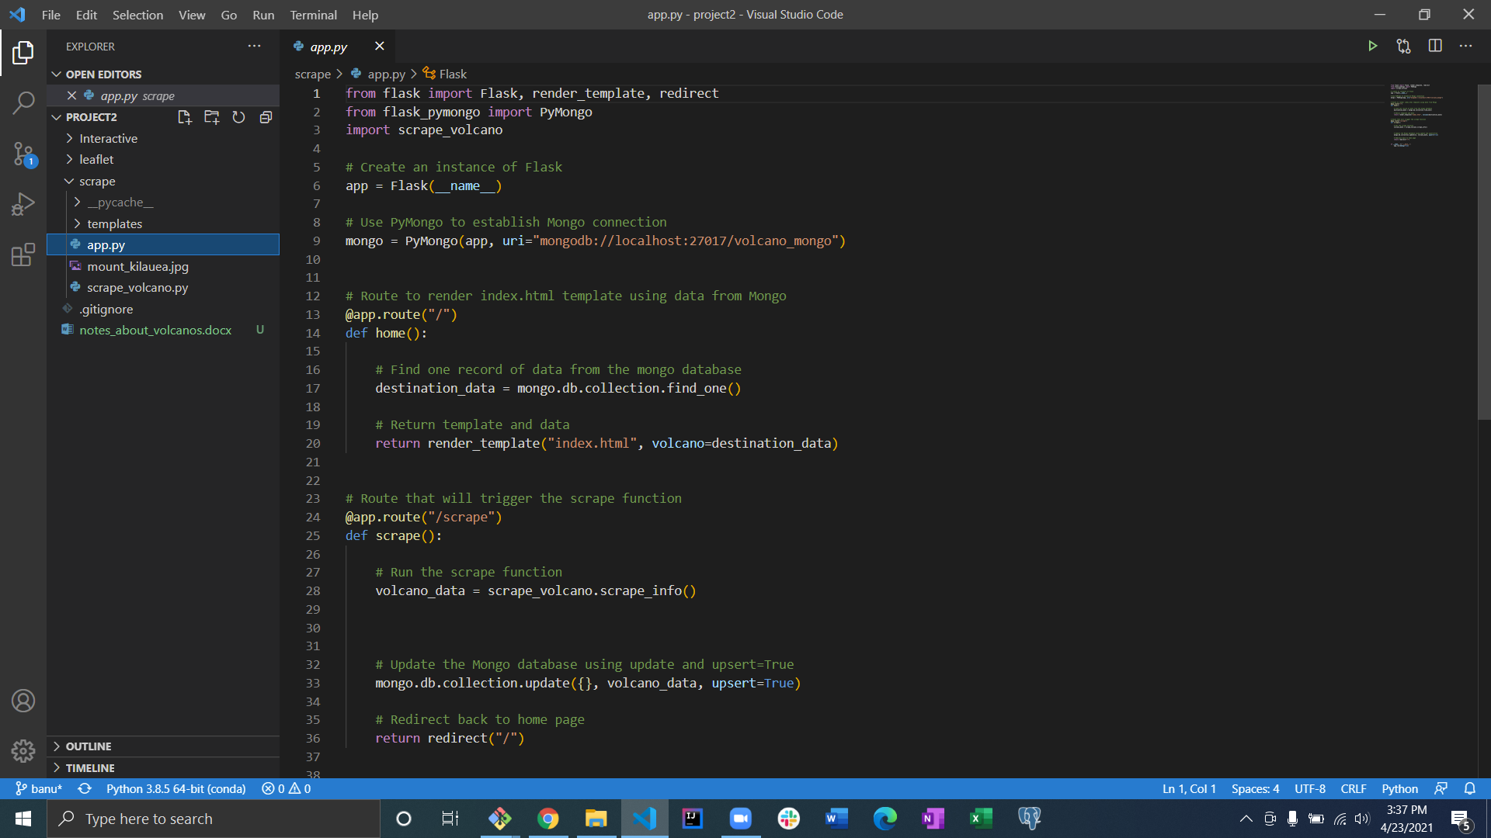
Webscrape code
Notes:
DAN

Slide 8
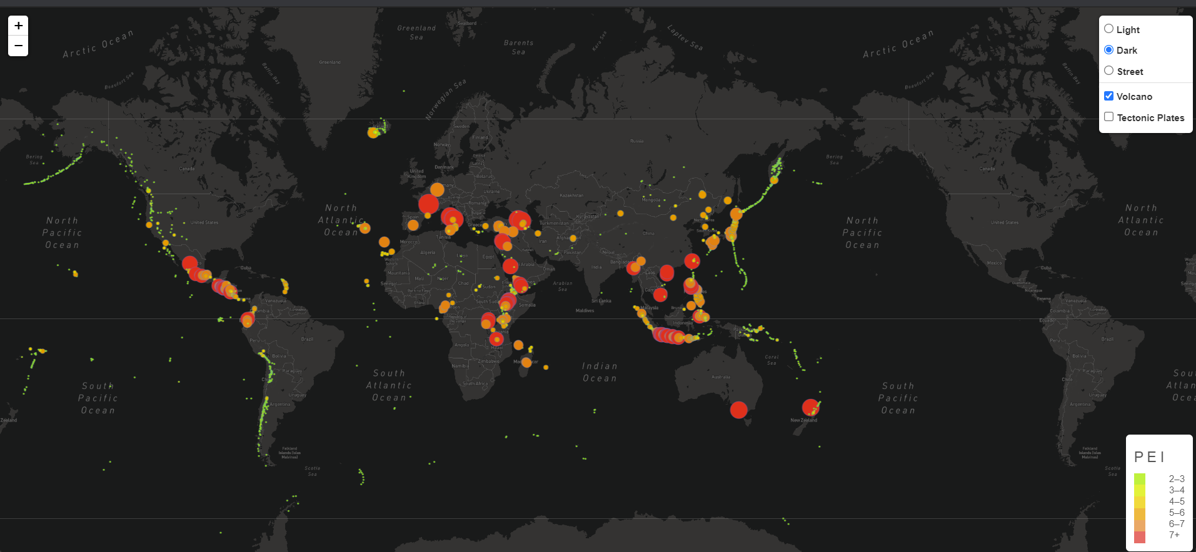
Final visualization
Notes:
DAN:
Your final visualization should ideally include at least three views.
Project must include some level of user-driven interaction (e.g., menus, dropdowns, textboxes).

Slide 9
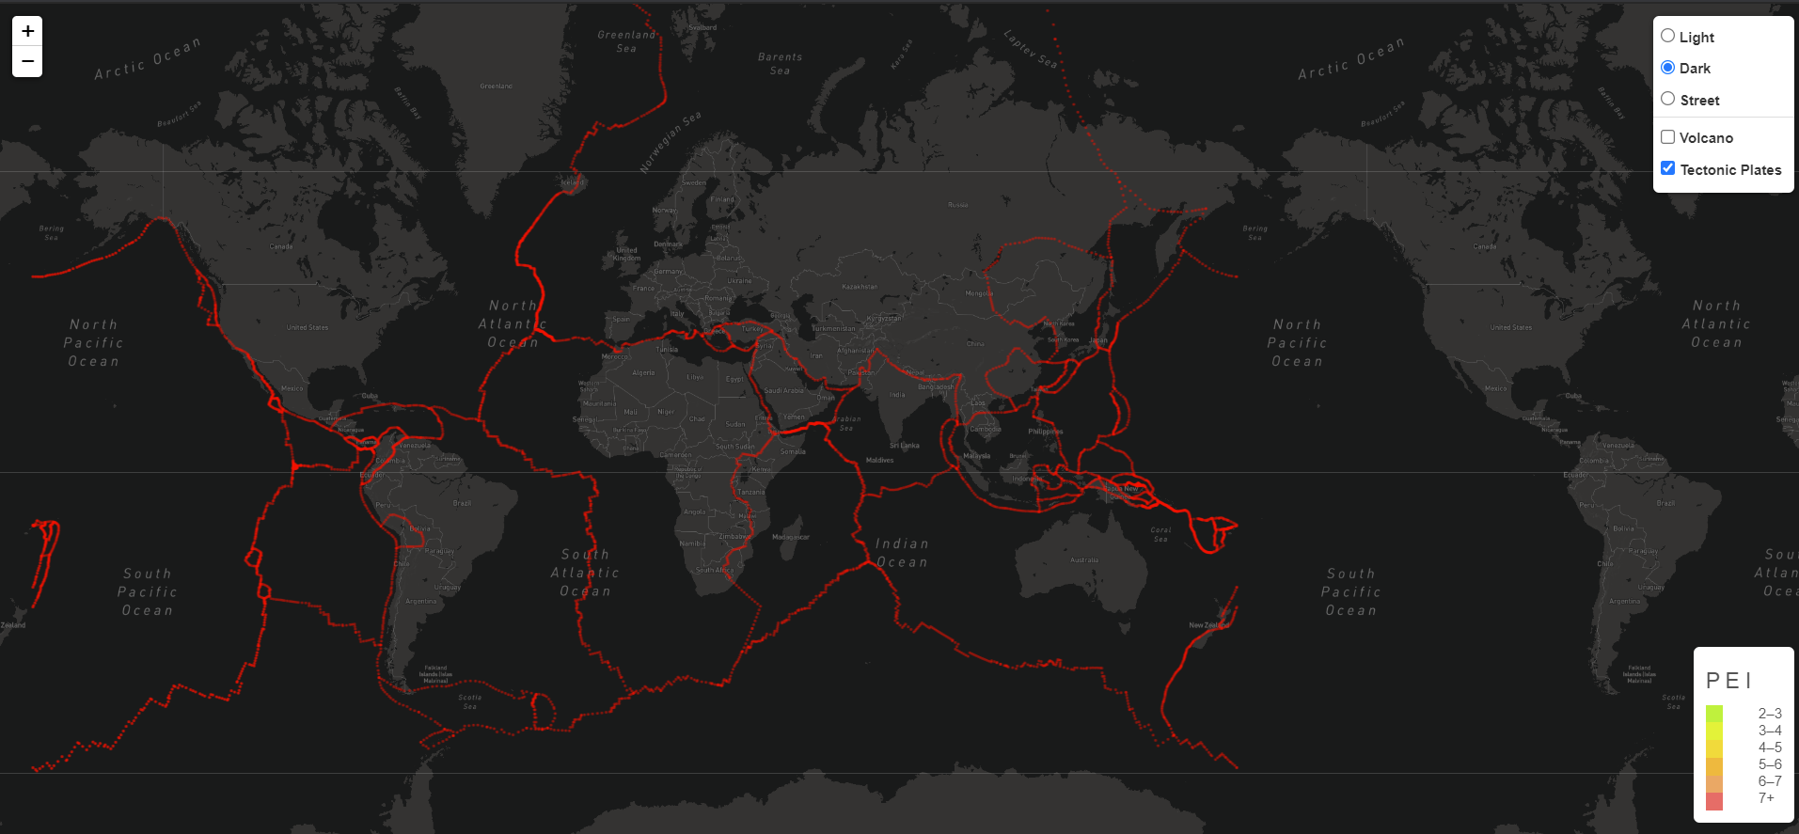
Tectonic plate view
Notes:
DAN

Slide 10
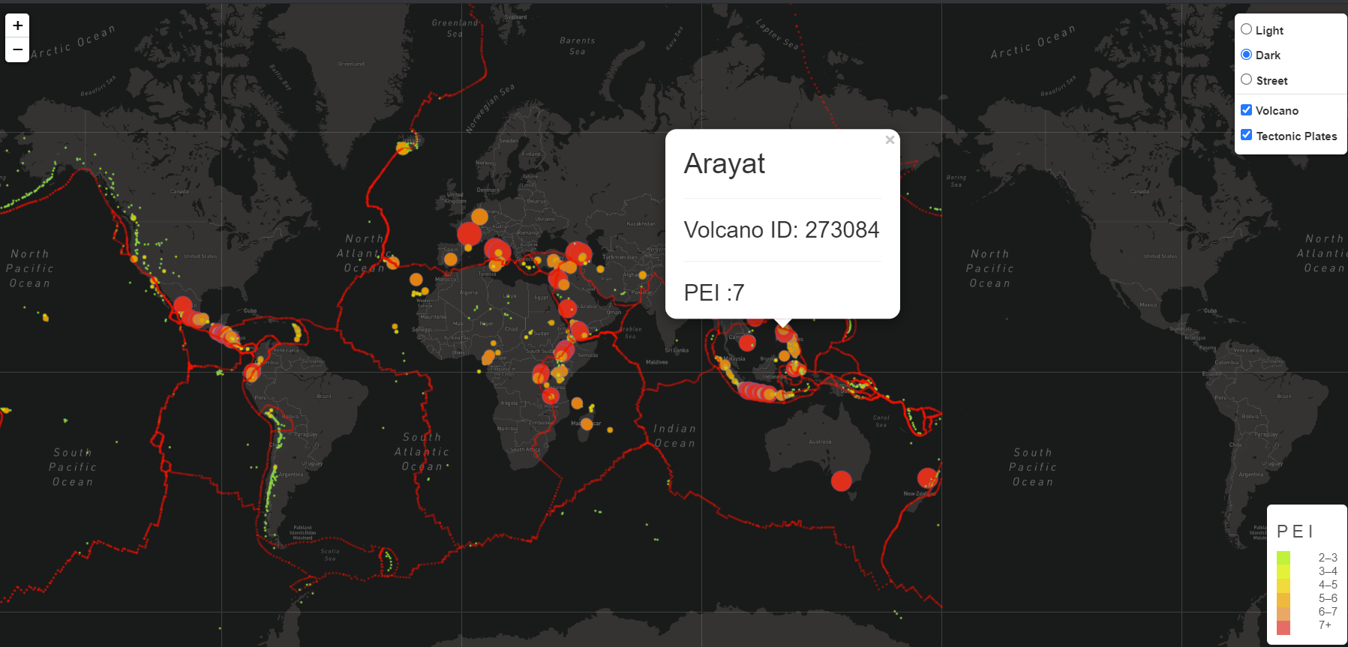
Marker view
Notes:
DAN

Slide 11
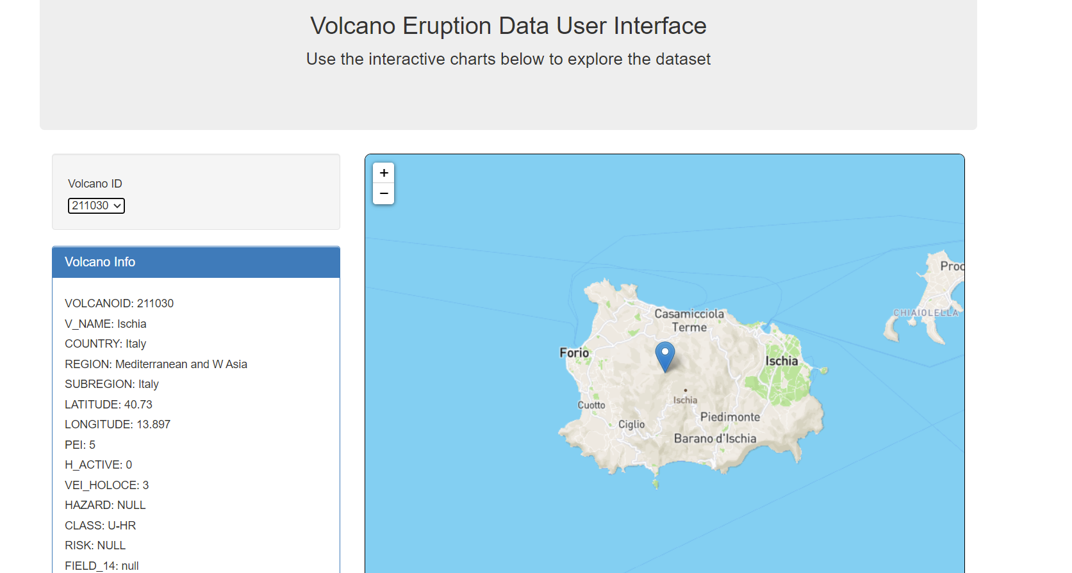
Interactive Query
Notes:
DAN

Slide 12
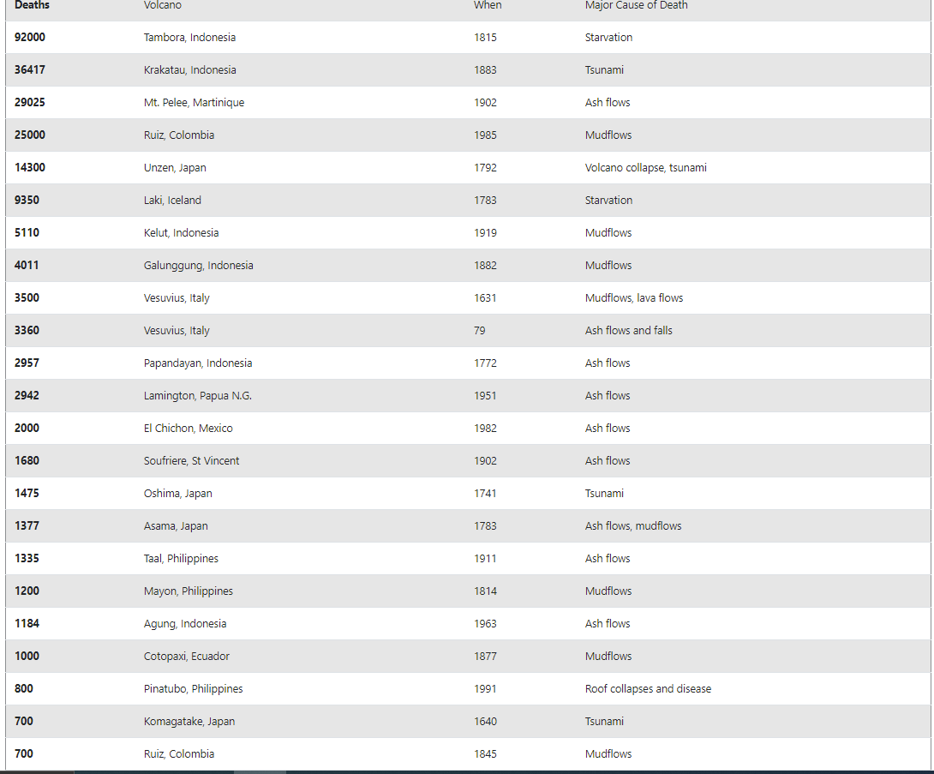
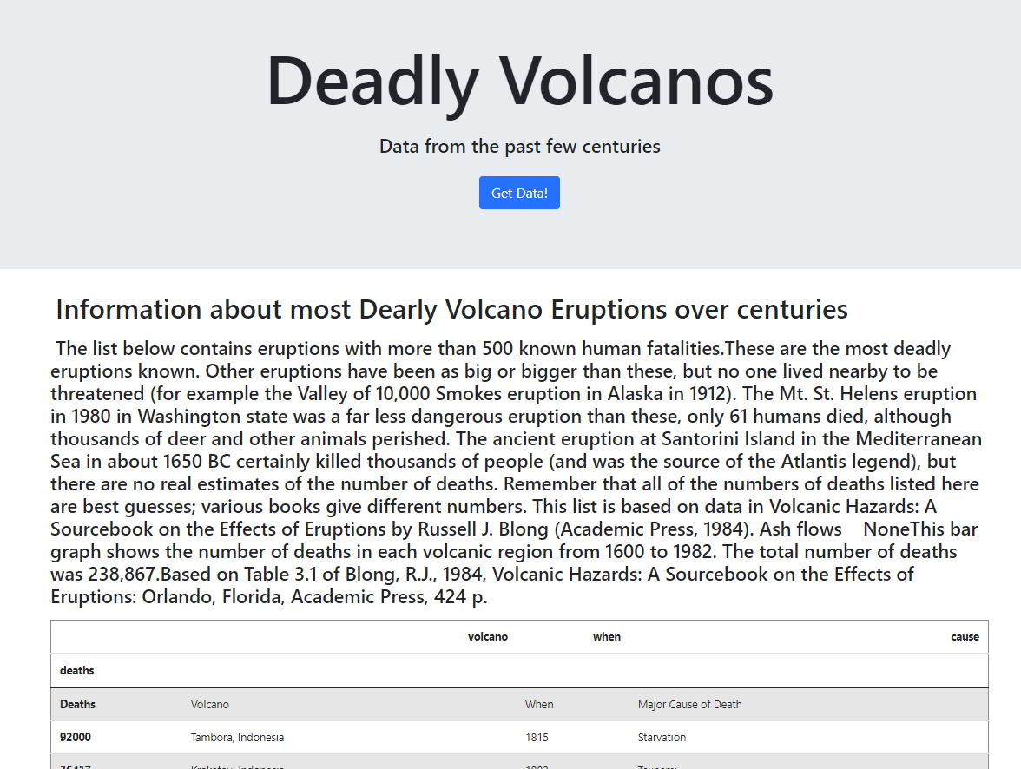
webscraping
Notes:
DAN

Slide 13
DEMO

Slide 14
QUESTIONS

