Slide 1
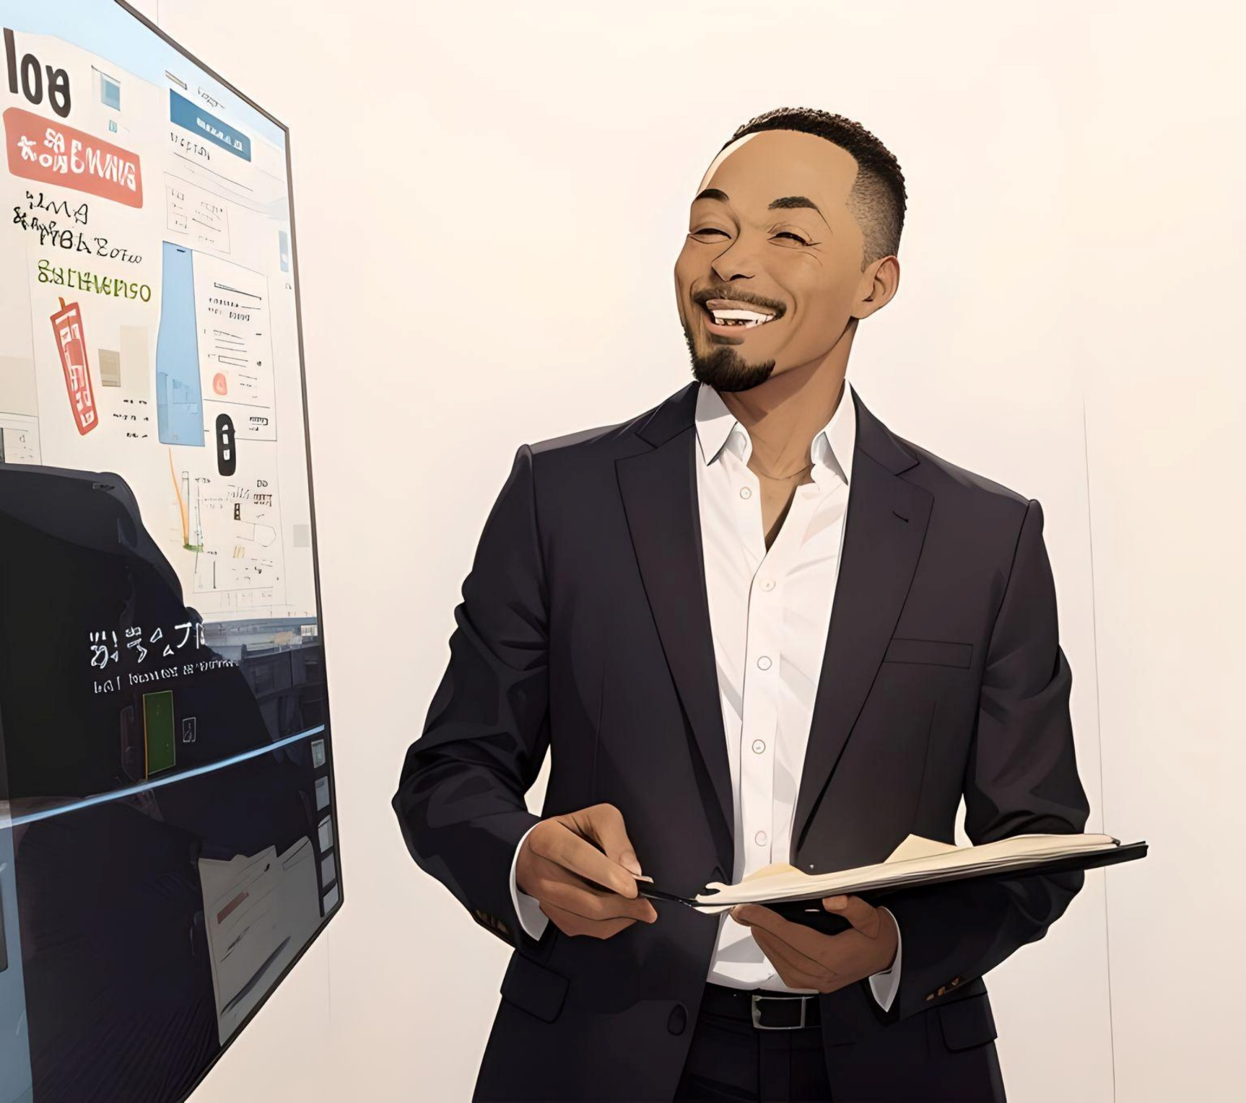
TalentRise
Unleashing Organization’s Growth
Through Right Talent
By team ‘The AI-nsteins’

Slide 2
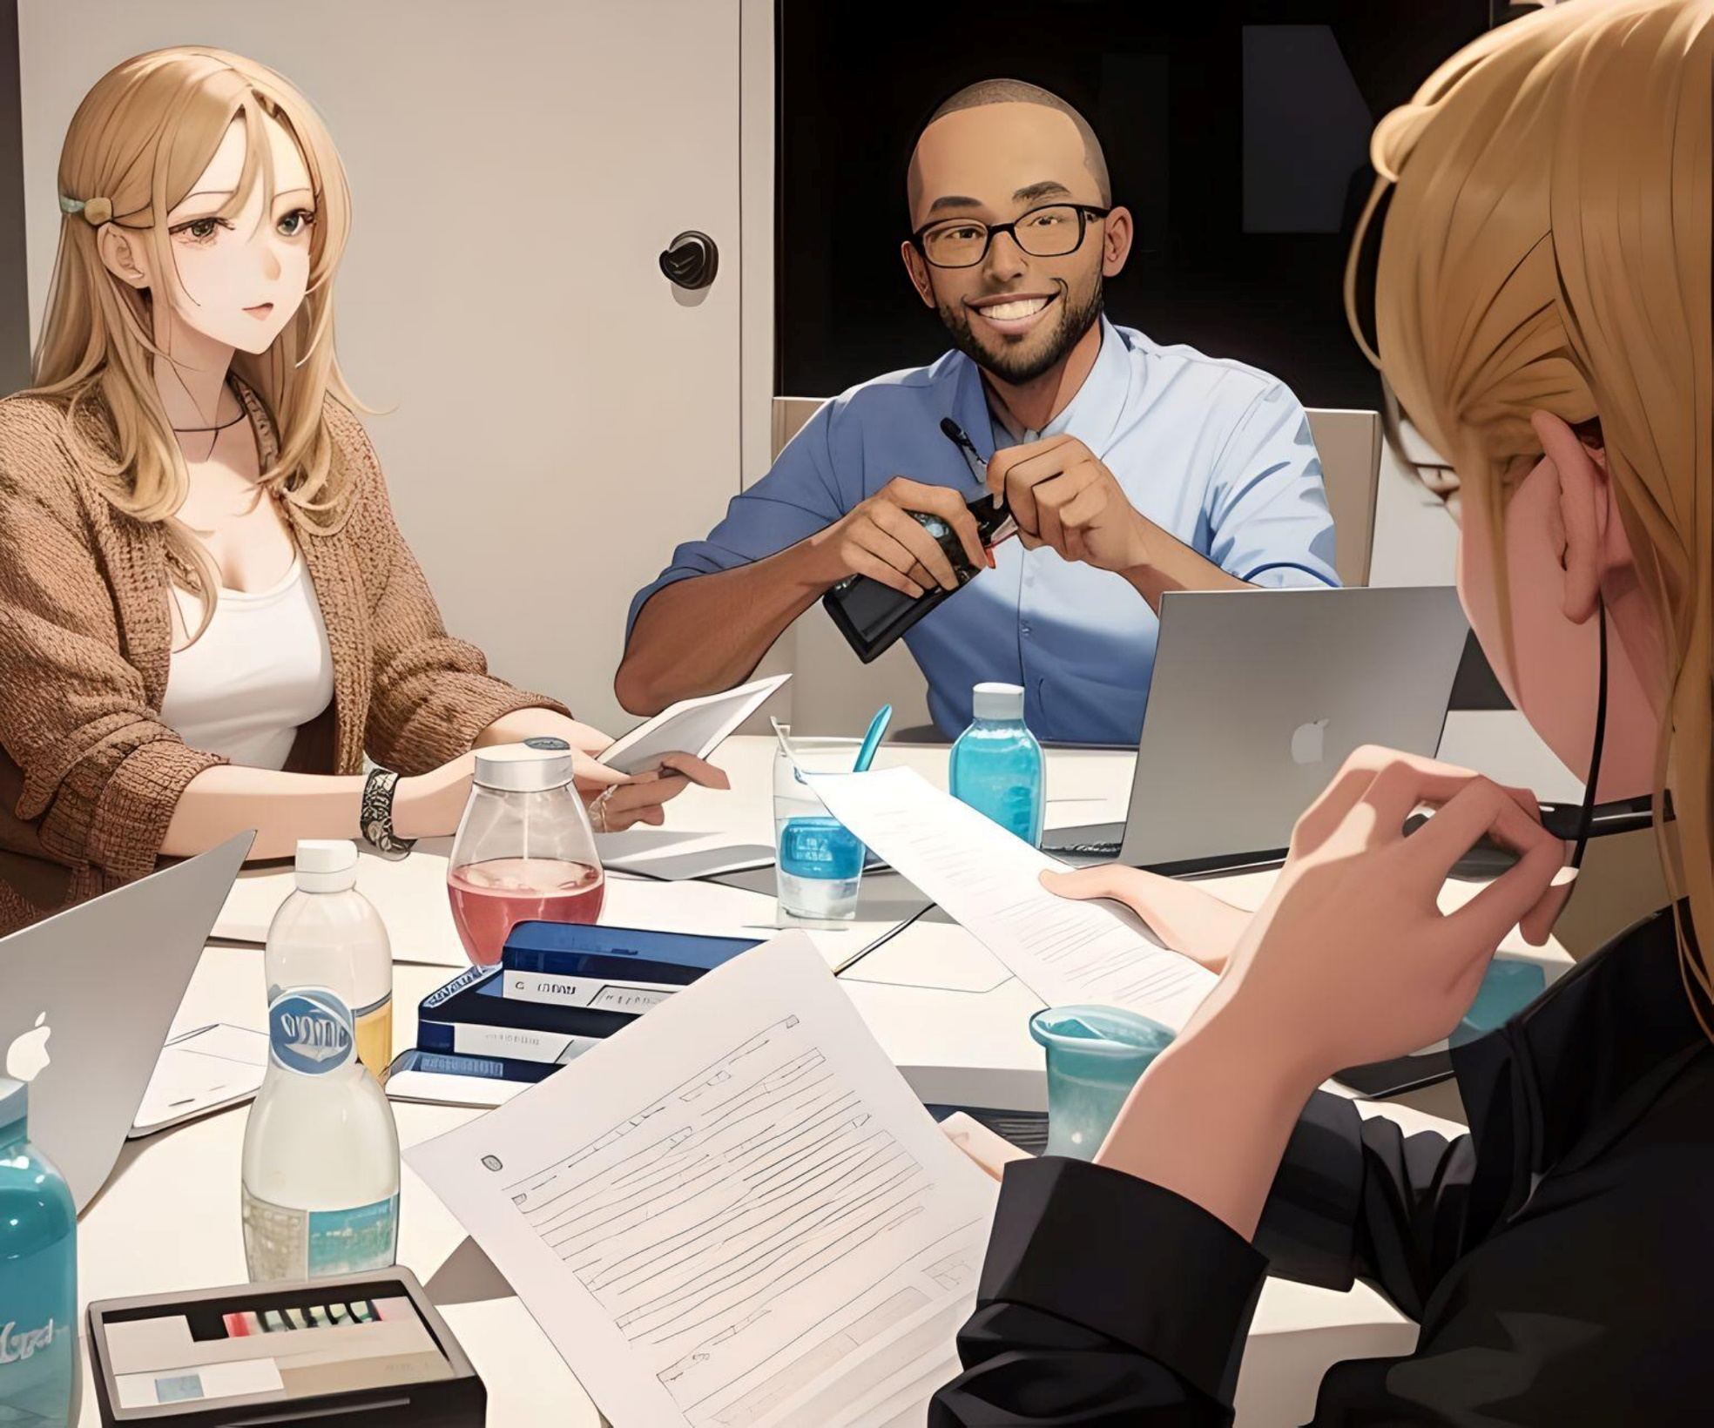
UNDERSTANDING TALENT MANAGEMENT
Talent management is more than just filling positions; it is about finding and retaining the right talent both outside and within the organization to help fuel its long-term growth and sustainability objectives.
Traditional tools and manual processes cannot provide the edge that HR needs to cope up with rapidly evolving Talent market and to keep the best talent in the organization engaged and inspired.

Slide 3
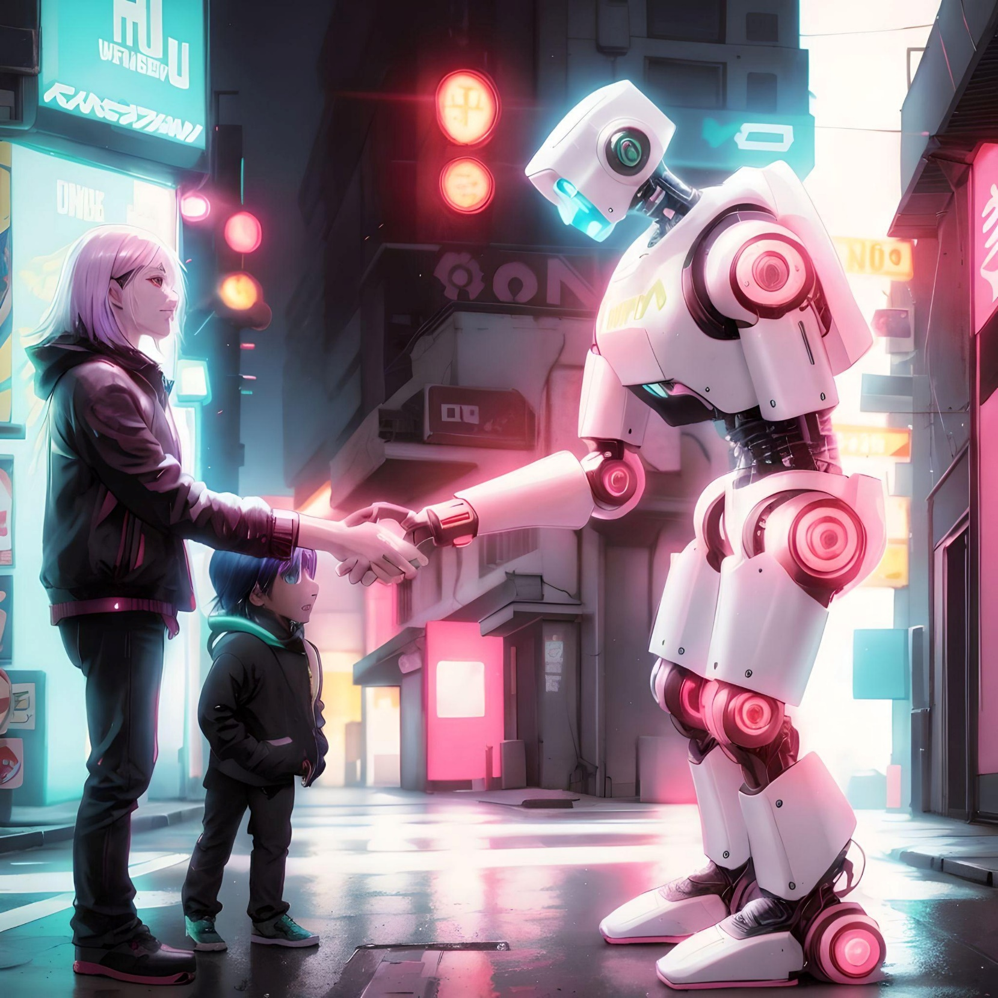
INTRODUCING TALENTRISE
An intuitive GenAI-powered solution that elevates HR through automation of various tedious processes involved in talent acquisition such as-
Resume Shortlisting.
Interview Questions preparation
Job Description and various other documents generation.
To colleagues it provides a personalized growth plan to help them –
Meet their Career aspirations.
Find right job opportunities within the organization.

Slide 4





Benefits Of TalentRise
Operational Excellence
Automate & optimize Talent Management processes to create capacity for strategic workforce planning & execution
Focus on Goals
Colleagues always have their career goals in sight and take control of their growth in the organization
Simple & Straightforward
Simplify and standardize HR processes to achieve predictable outcomes helping the organization maintain sustainable growth
Realize Workforce Potential
Create a fungible workforce that can thrive in rapidly changing & challenging environments

Slide 5












Tech Stack & Architecture
UI
React with TypeScript
Material UI
Prompt >>
<< Response
UI
Backend
Python REST APIs
Python REST API
Uvicorn Server
Azure OpenAI Integration
Application
Server
Azure GenAI
Azure Services APIs
Azure OpenAI Service
Azure Cognitive Search
Azure Blob Storage
gpt 4.0
DevOps
Azure DevOps Pipeline
NodeJS build
Docker container
Documents
Azure Blob
Storage
Index
Azure Cognitive
Search

Slide 6

Future Possibilities
Docufy
(AI-Powered Documents
Generator)
Talent Hound
(Resume Shortlisting
With Explainability)
Hire Wise
(AI-Powered Interview Questions
Generator)
Job Match
(Internal Mobility Assistant)

Slide 7
Demo

Slide 8

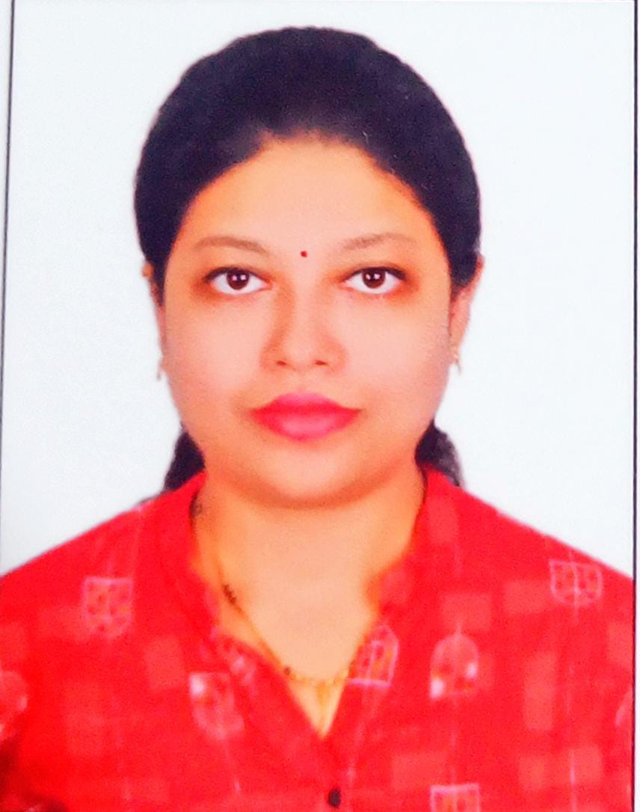
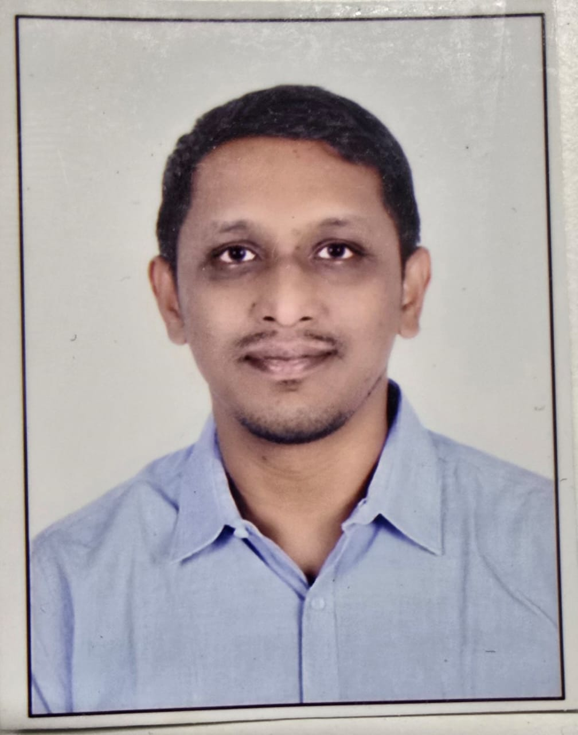
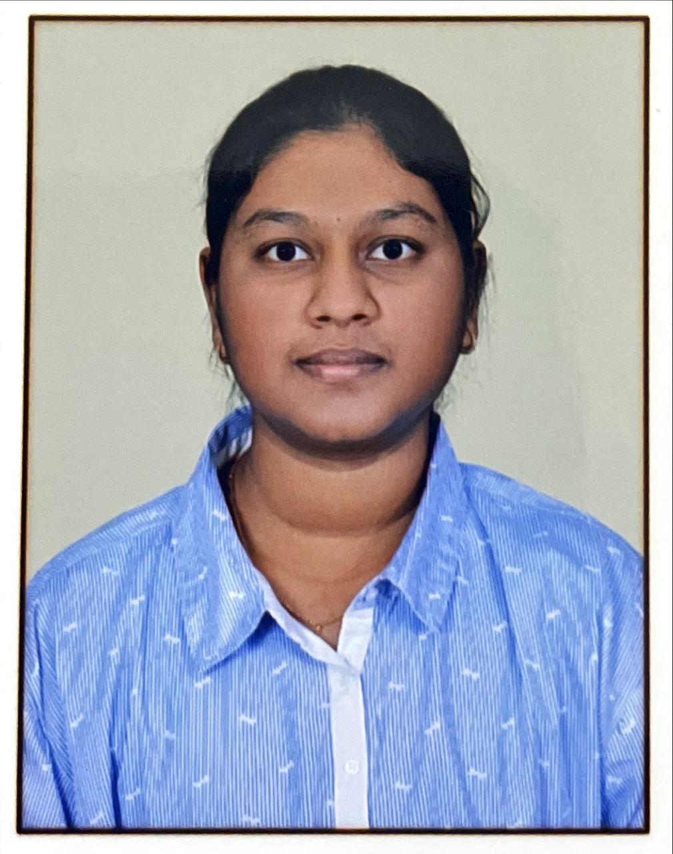
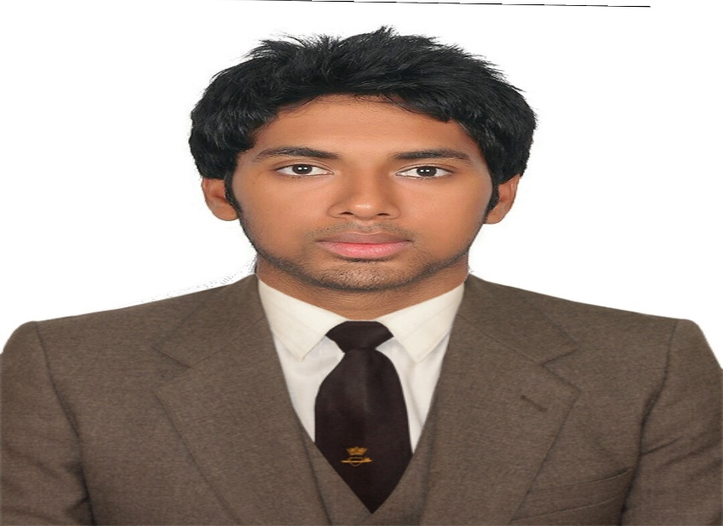
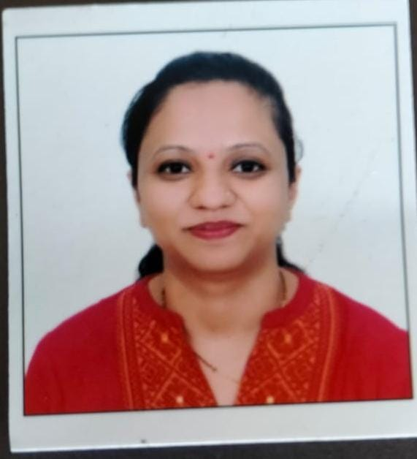
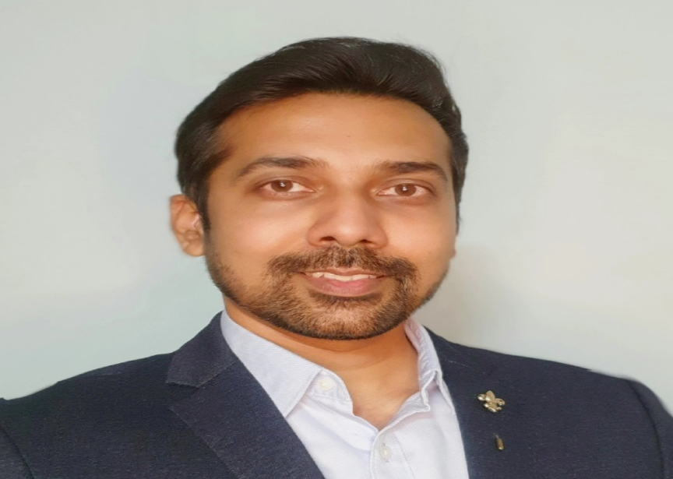

Meet The AI-nsteins
Antariksh Guha
Priyanka Dekate
Sujoy Guha
Ishitaa Gangadhara
Full-stack Developer / Architect
Data Engineer
Full-stack Developer
Creative Content Creator
Nitish Kishore
Pallavi Nath
Anupam Sharma
Arushi Shukla
Full-stack Developer
Data Engineer
Debugger / Problem Solver
Quality Control

Slide 9

Thanks!
Do you have any questions?

