Slide 1
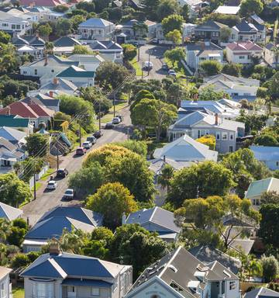
IBM PROFESSIONAL DATASCIENCE CERTIFICATE Rent and House prices in Auckland
Asha Rajagopal
June 2020

Slide 2
Introduction/Business Problem
Houses are one of the basic essentials. When you move in to a new place, the first thing that you look for is where to rent/buy a house within the limited budget.
This project aims to get an understanding on the relationship between rent/house price in Auckland region of New Zealand and the most popular amenities nearby and thus choose an apt location to rent/buy a house.
Business Problem : Where would be an ideal location to rent/buy a house in Auckland?
Target Audience: The target audience of this study would be people looking for renting a house in Auckland as well as those who look forward to buy a house.

Slide 3
Data
The list of suburbs of Auckland region (through web scraping)
The latest (for the year 2020) average rent and house price for 3 bedroom houses in Auckland region (through web scraping)
The latitude and longitude data for each suburb using Geocode package of Python
The most popular venues of each suburb: The FourSquare API returns the popular venues in a suburb or location based on the foot traffic.

Slide 4
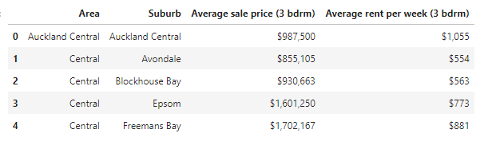
Data Wrangling and Cleaning
The list of suburbs, rent and house prices are scraped from web pages using BeautifulSoup package in Python and converted to a data frame.
Unnecessary columns are dropped and an Area column is added to the dataset. The dataset after scraping and cleaning looks as follows:

Slide 5
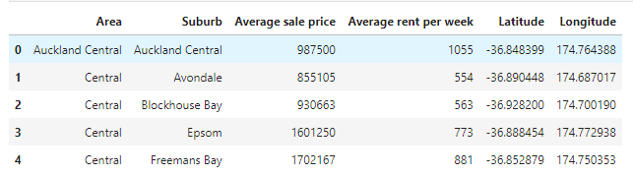
The columns are renamed, formatted and latitude , longitude data is pulled using Geocode package in Python. These data are then appended to our dataset.
The final dataset ready for Visualization and Analysis looks as below.

Slide 6
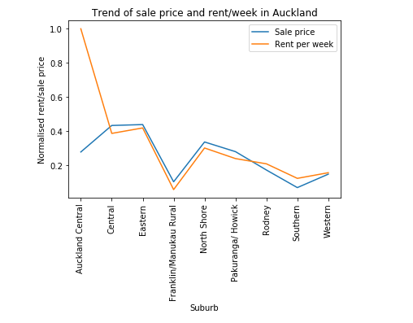
Data Visualization
Once we have data ready to work on, we will just visualize the trends in rent and house prices in Auckland. For this, we had to normalise the rent and house price using min-max method. The rent/sale price is analysed for each suburb. And there seems to be a high correlation between the both.

Slide 7
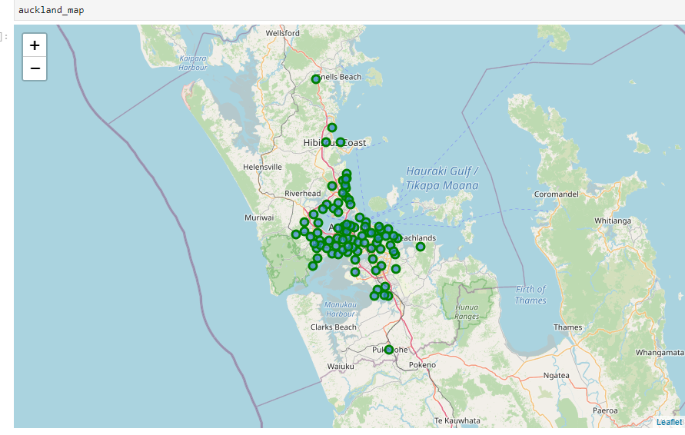
The Auckland region and the suburbs are visualised using Folium package in Python. This gives us an idea on how the suburbs are distributed geographically.

Slide 8
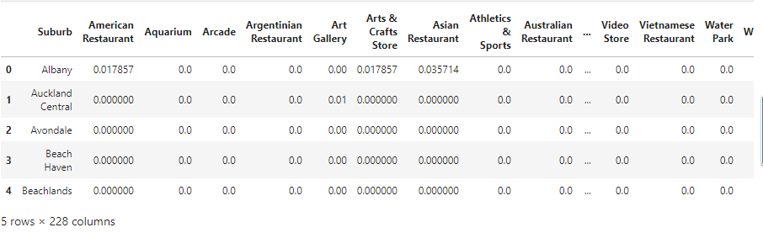
The Foursquare API is then used to retrieve the most common venues in each suburb.
This data is collected using API queries and the result json data is the converted to dataframe with the required columns
The dataset then undergoes transformations using one-hot encoding method. This helps us to get the categories of venues. And this data is used to get frequency of venue categories in each suburb.

Slide 9
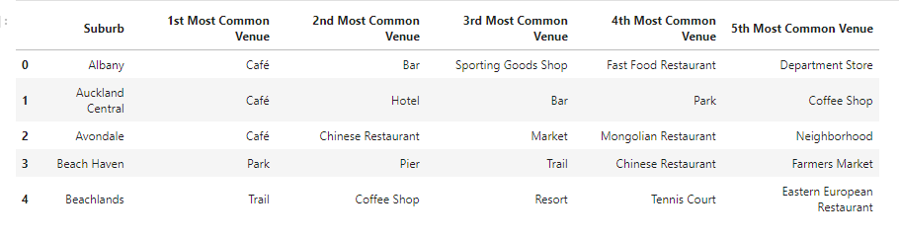
This dataset can also be used to retrieve top 5 venues in each suburb

Slide 10
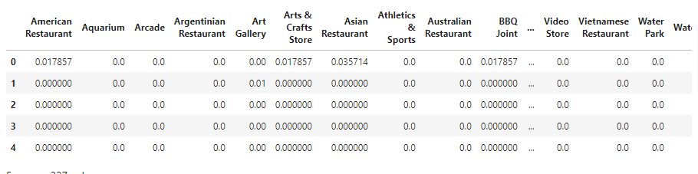
Data Analysis
The dataset is made ready for Data Analysis – to cluster the suburbs in Auckland region based on the nearby venues.
K-Means clustering algorithm is used to cluster the suburbs. Since we focus identifying the groups of suburbs with similar rent or house prices
The dataset on which analysis/clustering is performed is a shown below.

Slide 11
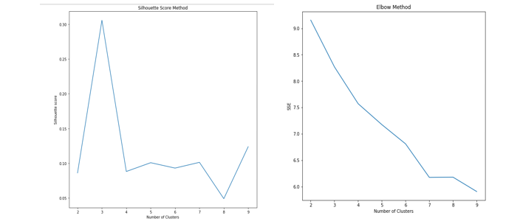
The best or optimum value of k is found out using elbow method and silhouette score method. The graphs for these two methods are then plotted.
It is evident that the optimum value of k=3. So we proceed to cluster the suburbs into 3 clusters

Slide 12
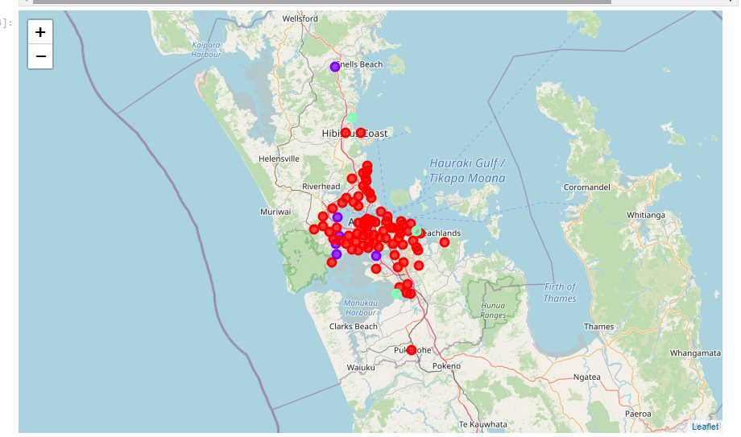
Results and Discussion
The map of Auckland after clustering looks as below

Slide 13
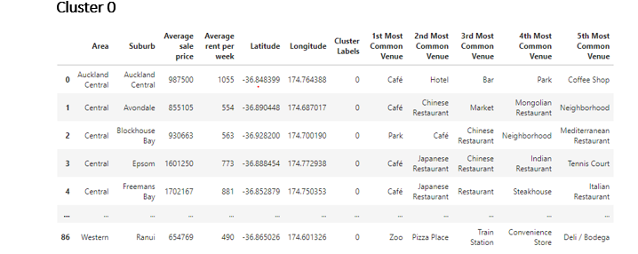
The most common venue in this cluster is café and parks. Suburbs in Central and Auckland Central area falls in this cluster.
This cluster also has a variety of shops and the average rent per week is NZD 620 and average sale price of house is NZD 1,007,300.
This cluster has the highest rent and house price. There are public transport venues like train station among the most common venues.

Slide 14
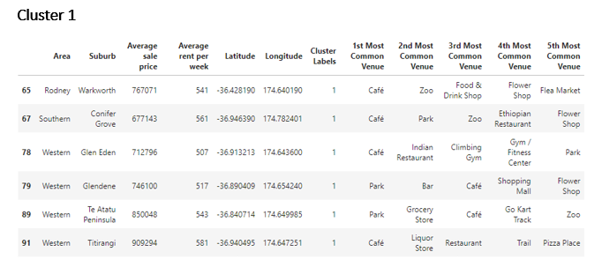
This cluster has lesser suburbs than cluster 0.
The most common venues on the cluster are once again café and parks. Western suburbs are the major percentage of this cluster.
The average rent per week is NZD 541 and house sale price is NZD 777,075

Slide 15
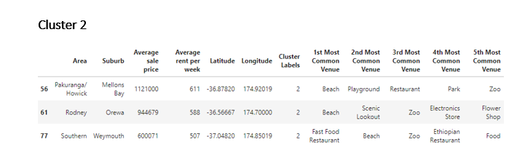
This cluster has beaches and restaurants among the most common venues.
It has mix of north, south and western areas. But looks like more kids friendly and picnic oriented areas.
The average rent per week is NZD 568 and Sale price is NZD 888,583.

Slide 16
Analysing the map and the resultant dataset,
It is hard to predict a specific are for renting/buying a house based on just the nearby venues. But based on the clustering we performed, Cluster 1 would be ideal for the ones who would enjoy the closeness to city and at the same time would love to stay away from the rush of city life.
Cluster 2 would suit the ones looking for a peaceful retired life and Cluster 0 looks like more suitable for the ones who loves city life and are ready to be spoiled for choices.

Slide 17
Conclusion
Buying or renting a house in a new place depends on various factors. Amenities available nearby are just one of those criteria.
This study would help those who are looking to buy or rent a house in Auckland region to get an idea on the nearby amenities or venue and a general idea on pricing of houses.
And the study can be further extended by including more features like distance from city, schools etc and using more data.

