Slide 1
Cyclistic
Asha Ramanujam

Slide 2

Outline
Background
Business task
Summary
Analysis
Conclusion
Appendix

Slide 3
Background

Slide 4

Cyclistic
Bike-share company in Chicago : 5,800 bicycles and 600 docking stations
Maximize annual membership
Goal : design a new marketing strategy to convert casual riders into annual members

Slide 5
Business Task
How do annual members and casual riders use Cyclistic bikes differently?

Slide 6
Summary

Slide 7
Summary
Casual and annual members vary in the following metrics while using bikes:
Trip duration
Stations and routes
Day for starting the trip
Trip duration with day of trip
Trip duration with month of start
Popular stations and routes

Slide 8
Analysis

Slide 9
Data used
User type | Annual | Casual
Number of trips | 2937360 | 880631
Average trip duration (minutes) | 14.3278 | 57.01802
Maximum trip duration(minutes) | 150943.9 | 177200.4
Day for which maximum trips | Tuesday | Saturday
Station from where maximum trips start | Canal St & Adams St | Streeter Dr & Grand Ave
 | Clinton St & Madison St | Lake Shore Dr & Monroe St
 | Clinton St & Washington Blvd | Millennium Park
Station where maximum trips end | Clinton St & Washington Blvd | Streeter Dr & Grand Ave
 | Canal St & Adams St | Lake Shore Dr & Monroe St
 | Clinton St & Madison St | Millennium Park
Routes with maximum trips | Canal St & Adams St to Michigan Ave & Washington St | Lake Shore Dr & Monroe St to Streeter Dr & Grand Ave
 | Michigan Ave & Washington St to Clinton St & Washington Blvd | Streeter Dr & Grand Ave to Streeter Dr & Grand Ave
 | Columbus Dr & Randolph St to Clinton St & Washington Blvd | Lake Shore Dr & Monroe St to Lake Shore Dr & Monroe St
Q1,Q2,Q3, and Q4 data of 2019 used
2 types of customers : annual and casual

Slide 10
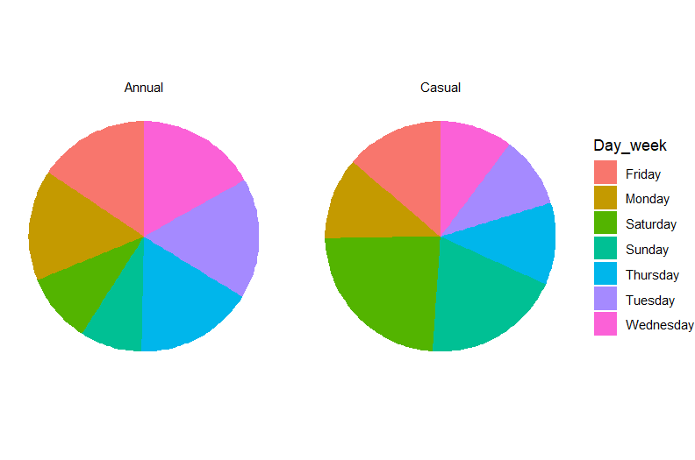
Start time : Day of the week
We investigate the hour of the day in which different consumers start their trip
Saturday: Day for start for maximum number of trips for casual riders
Annual riders trips are more evenly distributed across days with Tuesday being the day for maximum trips started

Slide 11
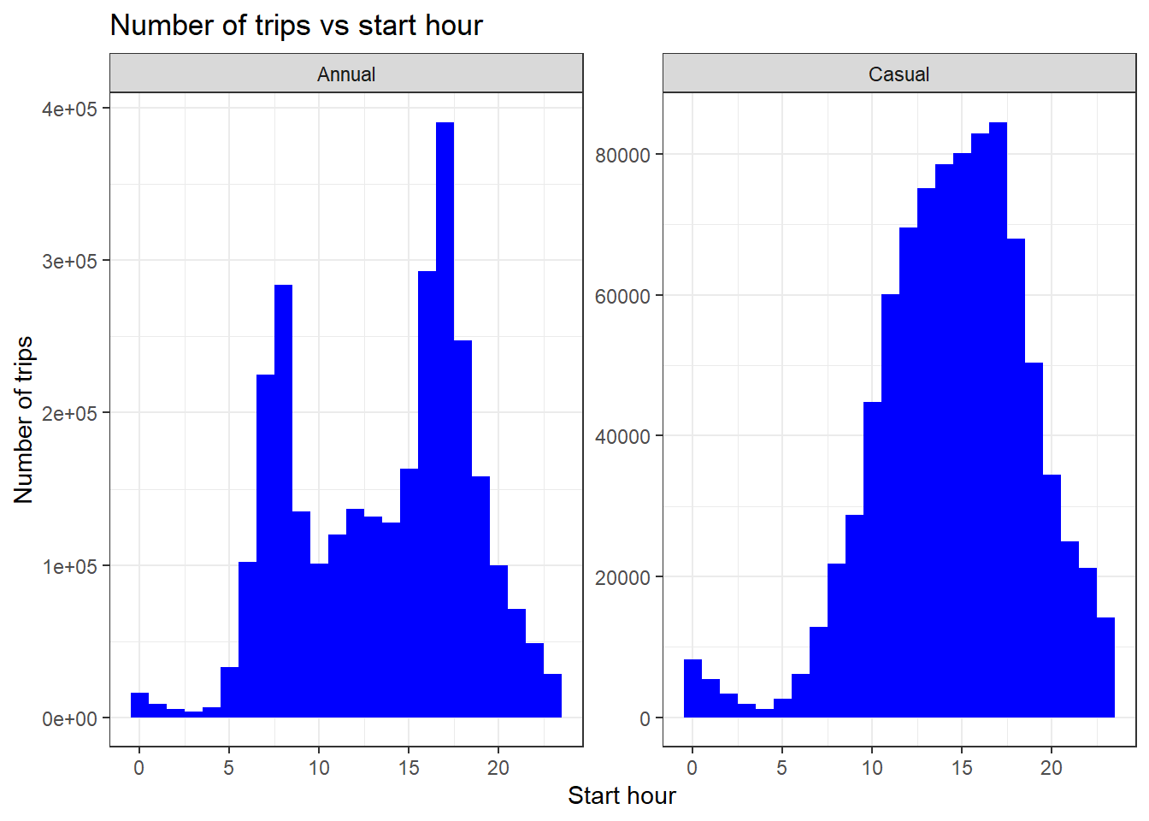
Start time : Hour of the day
We investigate the hour of the day in which different consumers start their trip
While most trips by casual riders start in hours 9:00 am – 7:00 pm and , most trips by annual riders start in hours 4pm-7pm and 7am-9am.

Slide 12
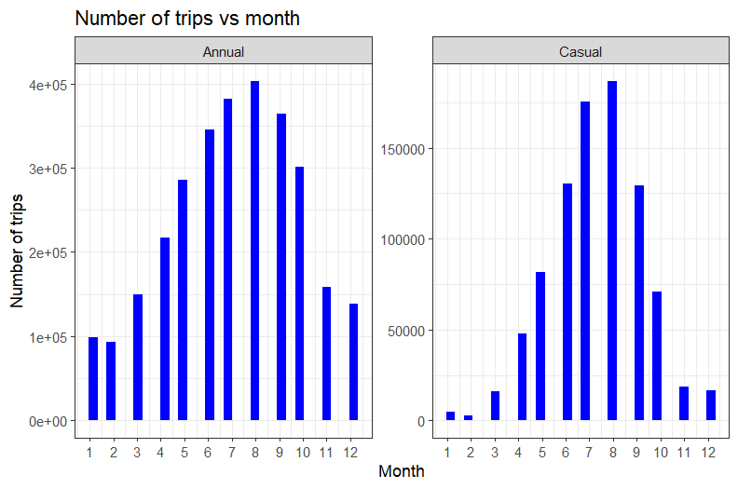
Start time : Month of the year
We investigate the month in which different consumers start their trip
The most dominant months for trips for both annual and casual riders is August followed by July

Slide 13
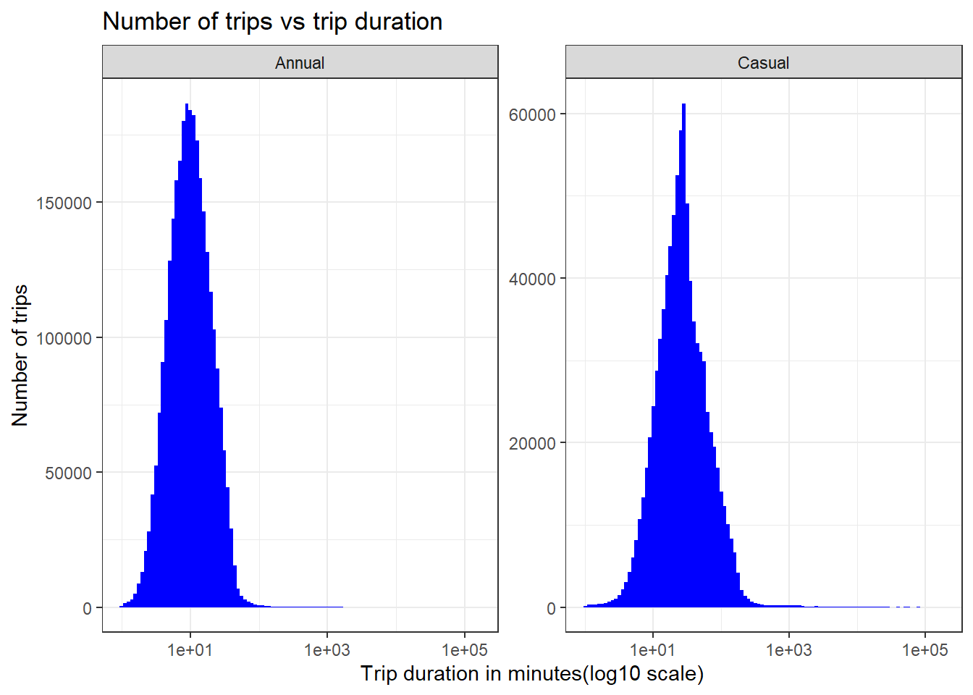
Trip duration
We investigate trip duration for the annual and casual riders.
Trip duration for casual members peaks in between 26 to 29 minutes
Trip duration for annual members peaks in between 8.4 to 9.5 minutes

Slide 14
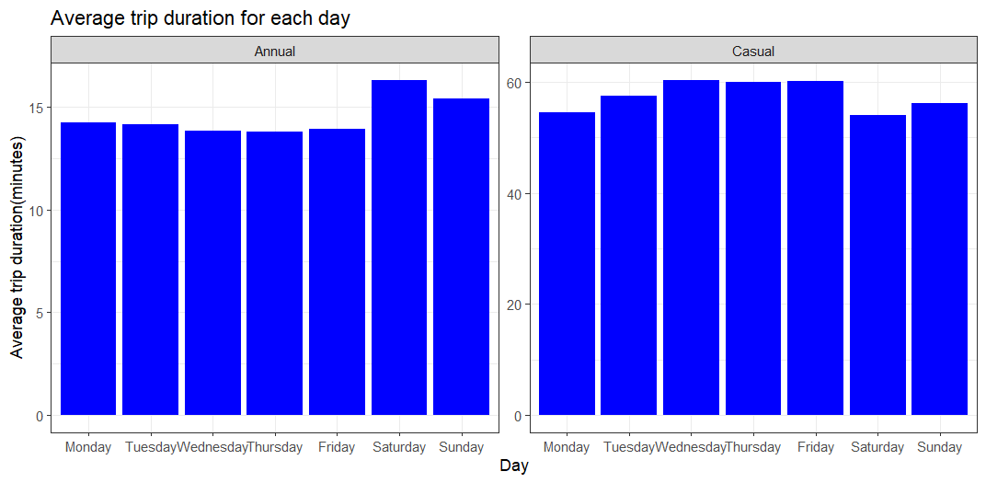
Trip duration for each day
We investigate trip duration for the annual and casual riders on different days.
Annual members take the most duration on average for trips starting on Saturday
Casual members take the most duration on average for trips starting on Wednesday, Thursday and Friday
The average trip durations do not vary much between days

Slide 15
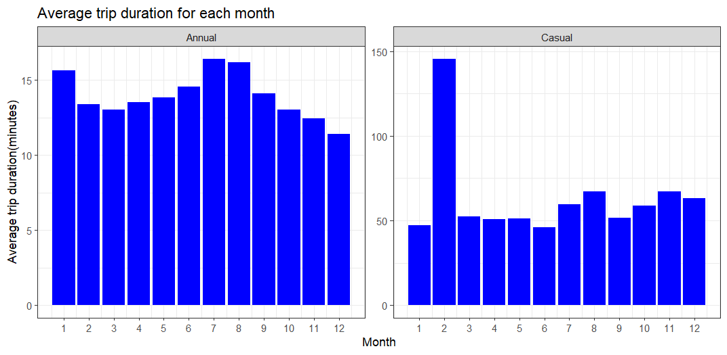
Trip duration for each month
We investigate trip duration for the annual and casual riders on different months.
Annual members take the most duration on average for trips starting in July
While casual members take the most duration on average for trips starting in February, the number of trips in February is very small making it an outlier. The next most time taken by casual members are on trips started in August and November

Slide 16
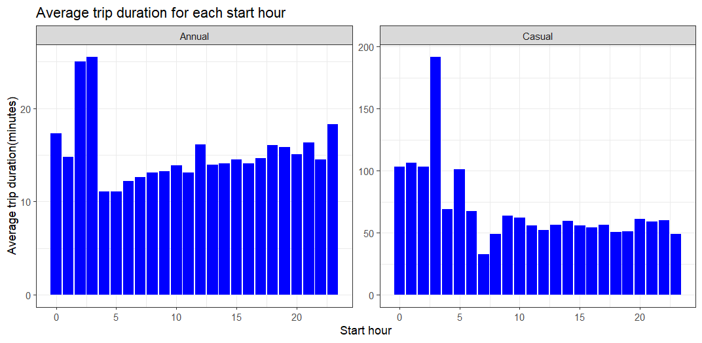
Trip duration for each start hour
We investigate trip duration for the annual and casual riders with respect to the hour at which the trips are started.
While annual members take the most duration on average for trips starting in 2am – 4 am, the number of trips is very small. The next most time taken by annual members are on trips started at 12 am, 12 pm and 11 pm
While casual members take the most duration on average for trips starting at 4am , the number of trips is very small making it an outlier.

Slide 17
Conclusions

Slide 18
Conclusions
Trip rides from annual members were more than the rides from casual members
Casual members on average had a larger trip duration than annual members
Annual members had their maximum trips started on Tuesday while casual members had their maximum trips started on Saturday
Casual riders start their trip mostly in hours 10:00 am – 5:00 pm while the annual riders start their trip mostly in hours 4pm-6pm and 7am-8am

Slide 19
Conclusions
The most dominant months for trips for both annual and casual riders is August followed by July
Trip duration for casual members peaks in between 26 to 29 minutes and peaks in between 8.4 to 9.5 minutes for annual members
Annual members take the most duration on average for trips starting on Saturday while casual members take the most duration on average for trips starting on Wednesday, Thursday, and Friday

Slide 20

Thank You! Any Questions?

Slide 21
Appendix
Data source : https://divvy-tripdata.s3.amazonaws.com/index.html

