Slide 1
Software Requirement Specification
By:
Krptonites Team
Tanvi
Rajesh Dobhal
Asha Revalia

Slide 2
INTRODUCTION
Defination:
This app would help all tourists to easily check-in to a hotel in the city of their visit.
All details regarding the approved hotels, restaurants, air catering units, time share.
Purpose:
These days whenever we enter a new city we are curious to know everything about
it. The information available on the internet is vast but may not always be credible,
updated and specific to our needs.

Slide 3
Overview Of The Project
Tourists can plan their trip though this app.
According to location Tourists can hire approved service providers.
Can get information about the climate condition/ Rainfall pattern of their planned area.
Can get information about all India and State-wise details on Number of Persons Arrested under Different IPC Crimes by Sex.

Slide 4
Data Referrence:
http://data.gov.in/dataset/approved-hotels-restaurants-air-catering-units-time-share- resortsapartments-convention-centr
The above link will tell all the approved Hotels/Restaurants/Air Catering Units/Time Share
Resorts/Apartments/Convention Centre/Bed & Breakfast as on 12.03.2013
http://data.gov.in/dataset/district-rainfall-normal-mm-monthly-seasonal-and-annual-data-period-1951-2000
The above link tell district rainfall normal(in mm) monthly,seasonal and annual
http://data.gov.in/dataset/approved-service-providers-adventure-tour-operators-domestic-tour-operators-inbound-tour-ope
The above link tells the approved service providers (adventure tour operators, domestic
tour operators,inbound tour operators,tourist transport operators and travel agents)
http://data.gov.in/dataset/all-india-and-state-wise-number-persons-arrested-under-different-ipc-crimes-sex
The above link tells the all India and state-wise details on number of persons
arrested under different IPC crimes by sex

Slide 5
Overall discription:
Product Prespective:
User will select city from the dropdown list of Cities in India where users can plan their trip.
User can select from the list of hotels.
Hotel Link, check in link, hotel rating, hotel contact will be displayed.
Areas Crime rate, Climatic condition, best Tour operator options will be available.
Corresponding result will be displayed for the button pressed.

Slide 6
User Interface
User I/P:
City name.
Preferred hotel from dropdown list.
Output from app:
Climatic condition.
Crime rate.
Tour operator information.

Slide 7
Software Interface:
HTML : For the web designing page HTML5 will be used.
CSS: For styling and colouring of scheme CSS will be used.
Python: For backend Scripting and to read in all the data files, and generate
JSON files.
Java Script: To provide levels of interactivity to web pages that are not
achievable with simple HTML.
JQUERY: JQuery is a multi-browser java Script library designed to simplify
the client-side scripting of HTML.
JSON: JSON is a language which uses java script syntax for describing data
objects.

Slide 8
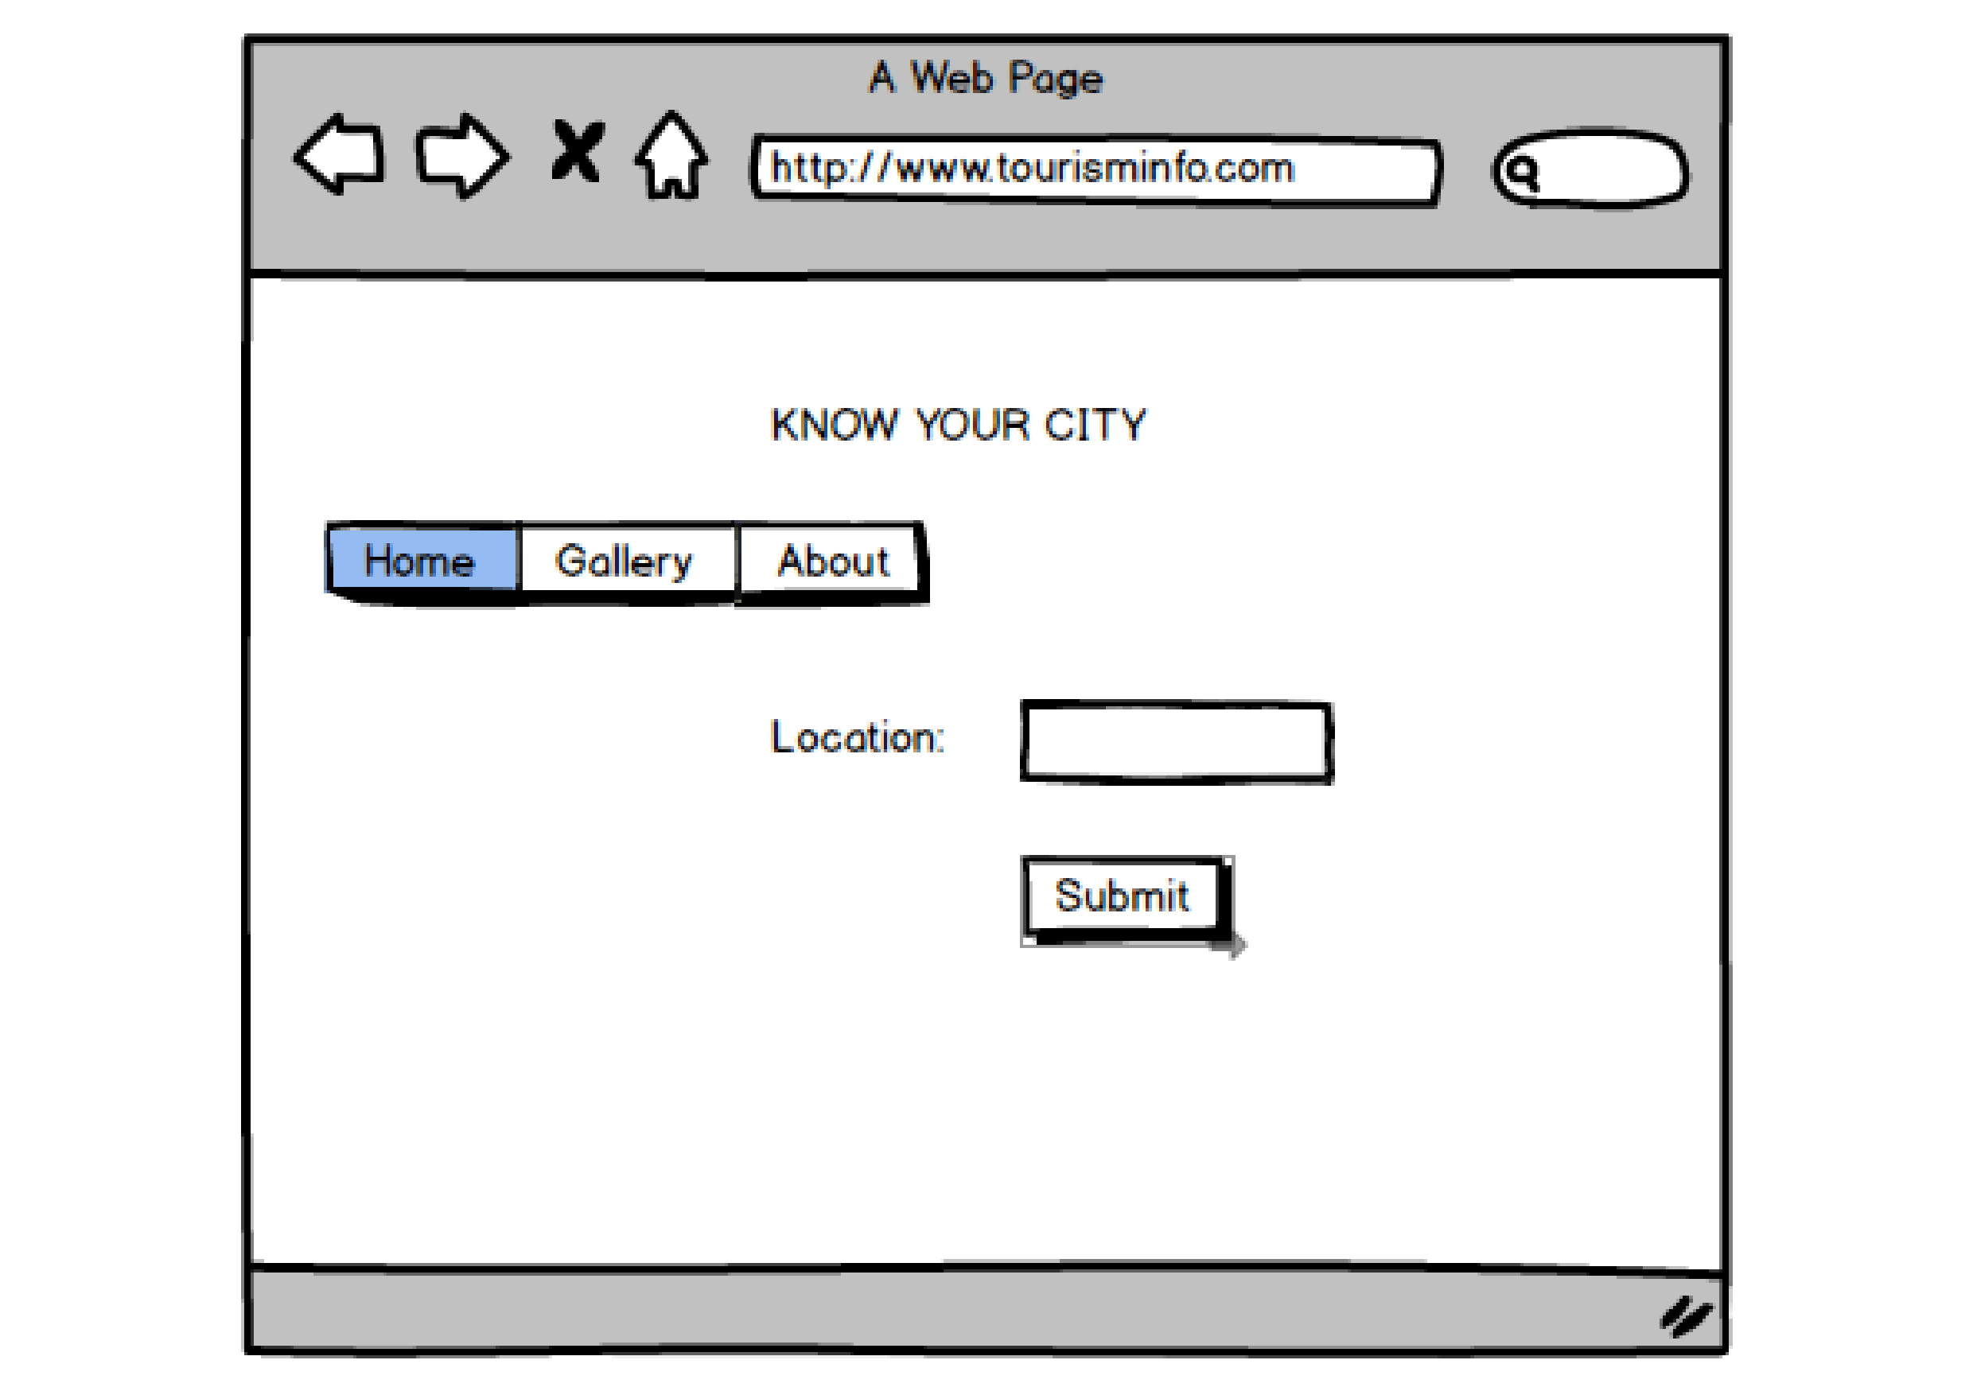
First Page:
In this page user enter location where he is planning to travel.
On pressing submit button location list will be displayed.
How List Of Location Will Be Displayed?
We are creating JSON file where all the Locations will be stored.

Slide 9
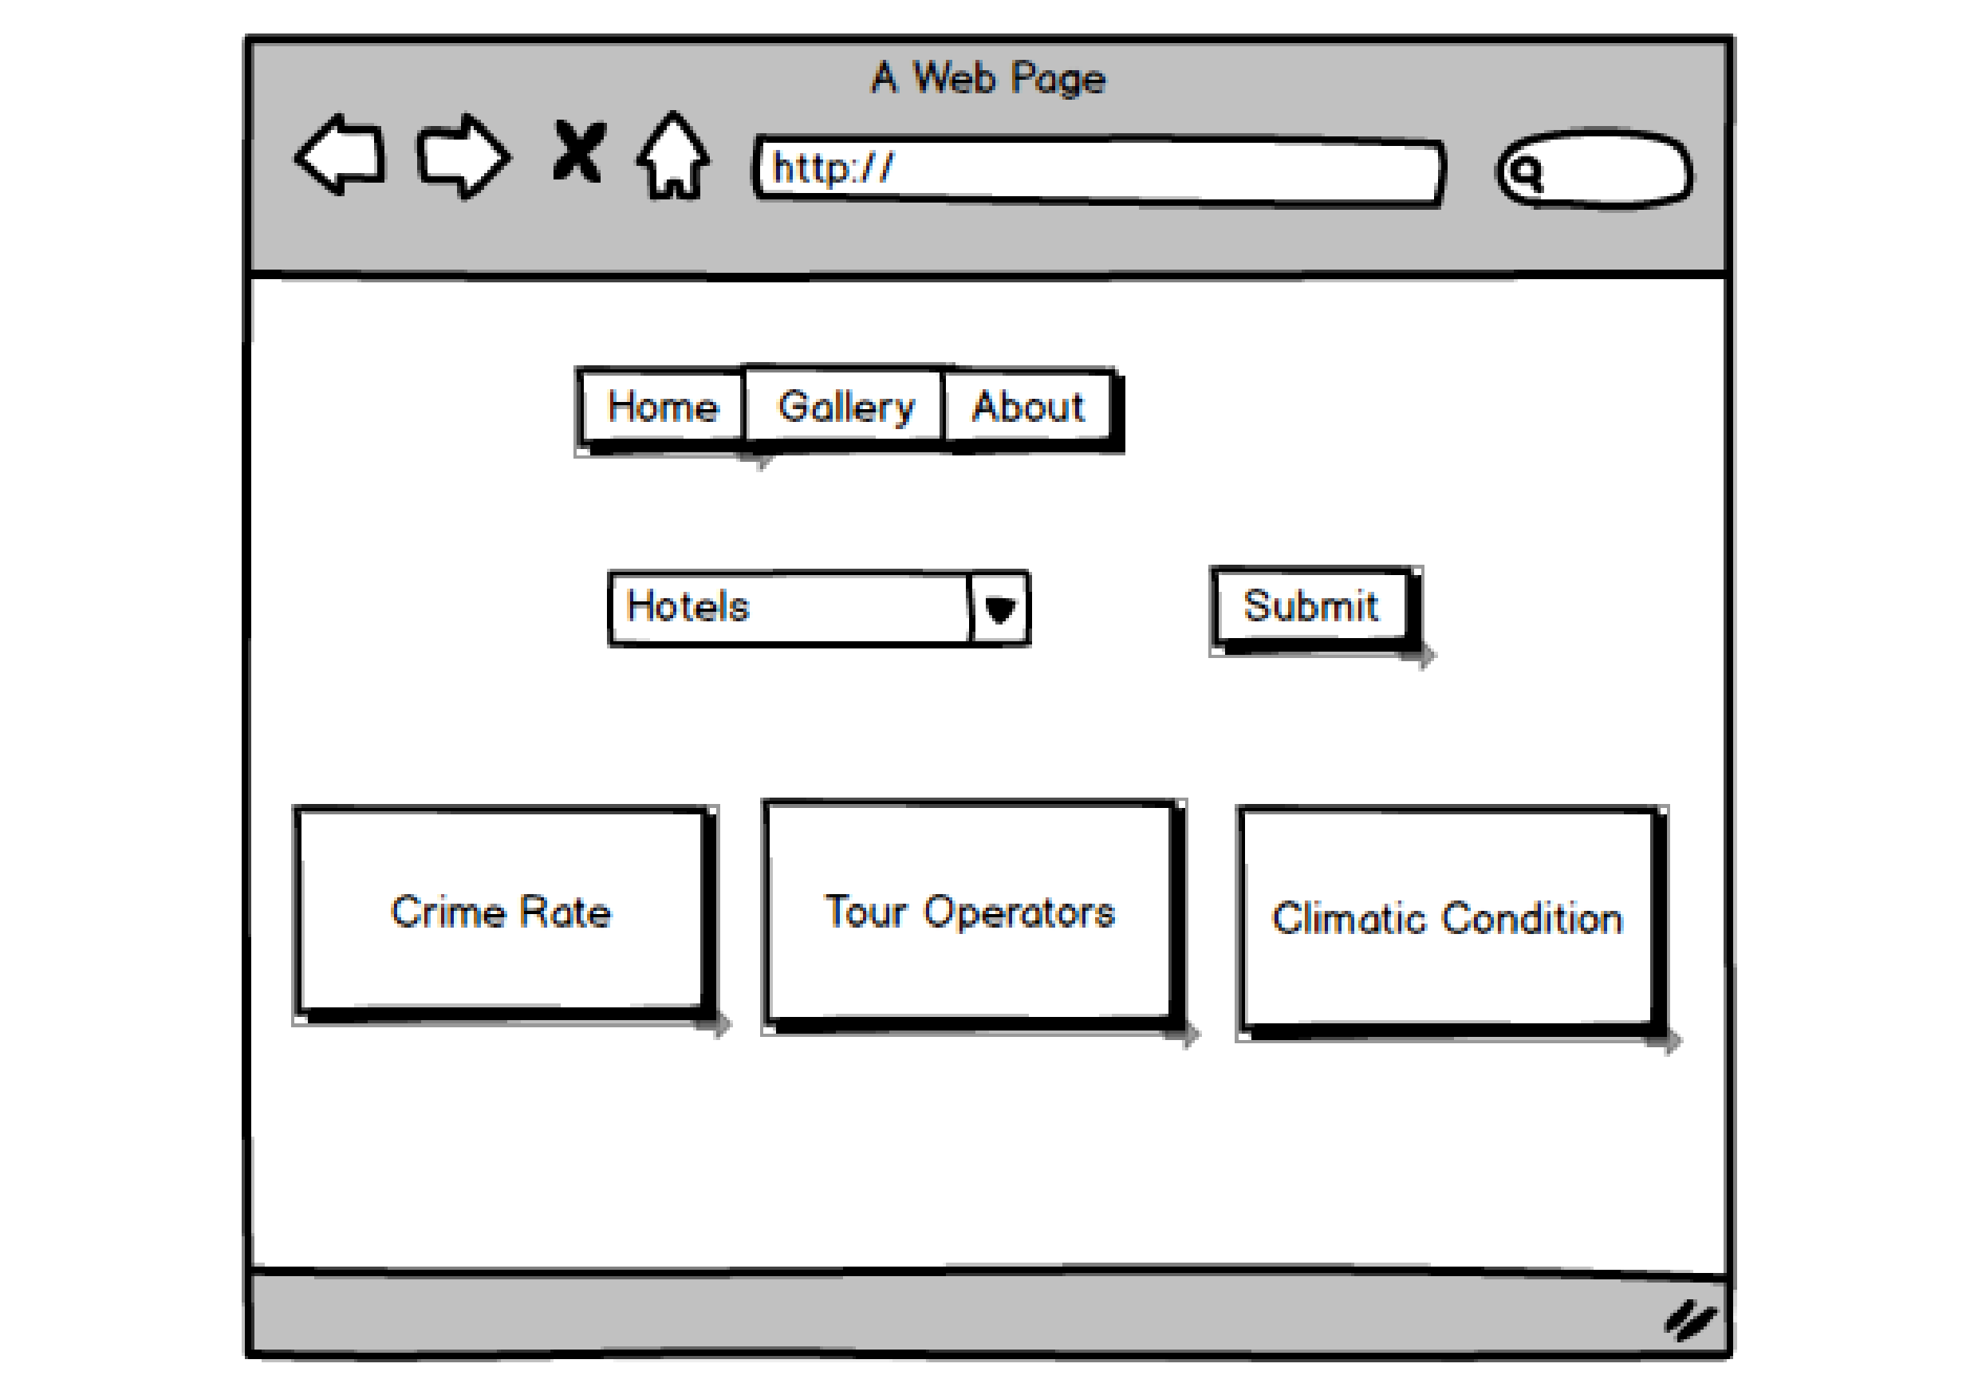
Second Page:
Corresponding location hotel name will be come under the dropdown list of hotels.
On submitting hotel info will be displayed.
Even location crime rate, its tour operators and climatic condition will be available on this page.

Slide 10
We will be converting Excel file into JSON files using python script
JSON files are as following:
Hotels.json : names of hotels loction-wise.
Hotel_info.json : Contains all information of hotels(array).
Crime.json : Information of crime location-wise.
Climate.json : Information of climatic condition location-wise.
Tour.json : Information of tour operators location-wise.
HTML and Java script, to load the json files, and display them in the page.
Use jquery's functions to fetch data and to update on the page.

Slide 11
Third, Fourth Fifth and sixth Pages contain the information of corresponding hotel_info, location crime rate, tour guide information, climatic condition.
Hotel_info page have information of a hotel which is selected. It contains check-in detail, hotel rating, email, contact details etc.

