Slide 1

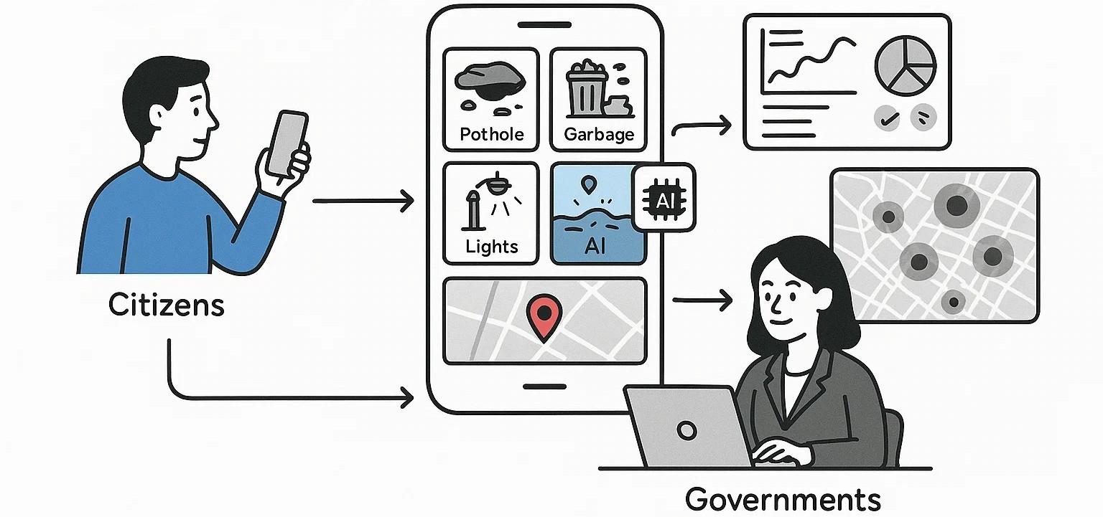
CIVIC ISSUES REPORTING SYSTEM
A crowdsourced web platform for reporting civic issues (potholes, garbage, lights, waterlogging) with geo-tagged media. AI classifies, prioritizes, and routes reports to authorities. Citizens track progress, validate others’ reports, and get live updates, while governments use dashboards, heatmaps, and analytics.
How It Helps:
- Real-time reporting speeds up issue detection.
- AI ensures urgent cases get priority.
- Transparent status builds accountability.
- Community validation cuts duplicates/fakes.
Innovation & Uniqueness:
- Crowdsourced + AI-powered governance.
- Geo-visuals to identify hotspots.
- Blockchain-ready transparency.
- Gamified citizen engagement.
- IoT integration for auto-reporting.
YOUTH CODER HACK 2025

Slide 2
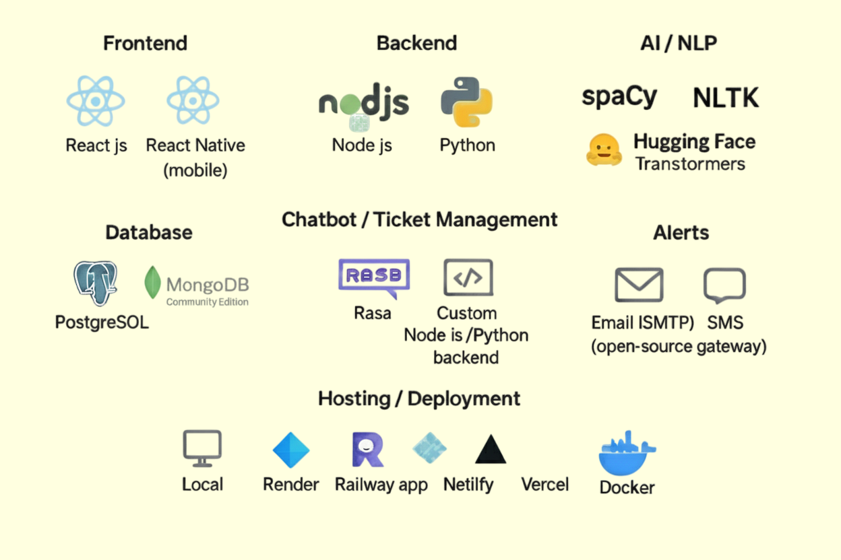
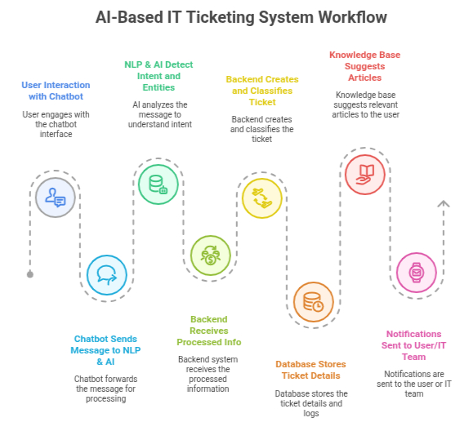
APPROACH
YOUTH CODER HACK 2025

Slide 3
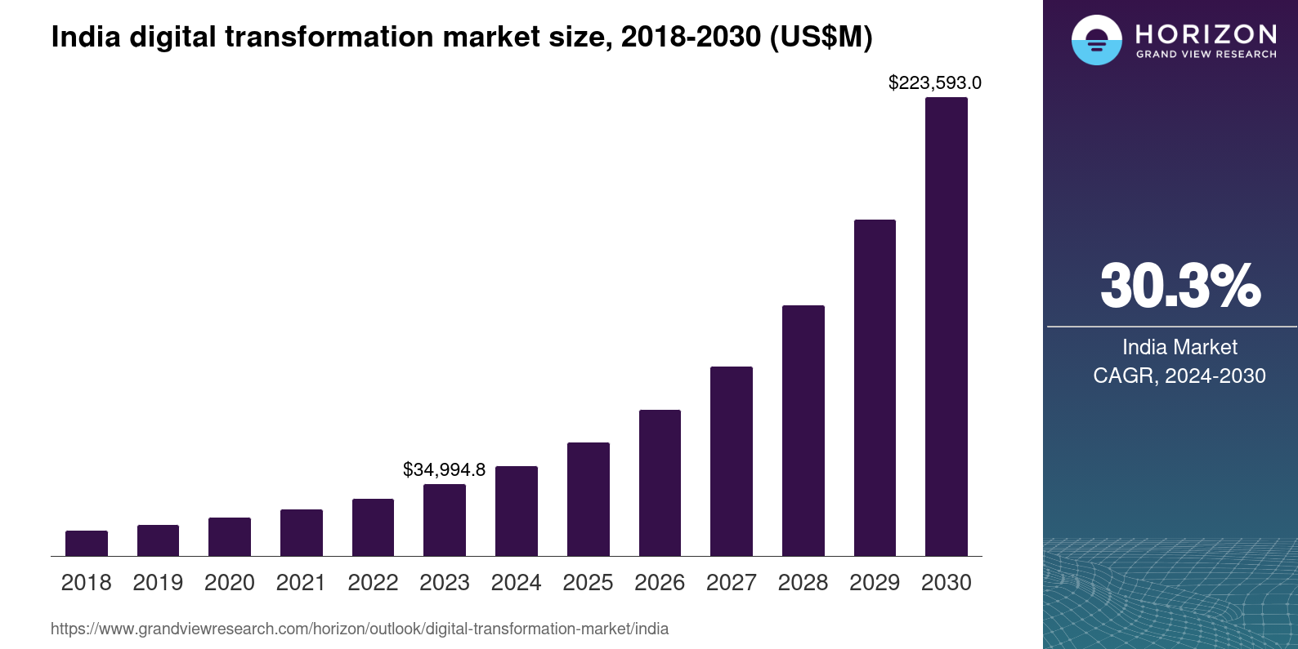
FEASIBILITY AND VIABILITY
Feasibility of the Idea :
Digital Foundation
Government Support
Market Opportunity
Potential challenges and risks :
Digital Divide Exclusion
Cybersecurity Threats
User Adoption Crisis
Strategies for overcoming these challenges :
Digital Inclusion Bridge
Cybersecurity (Zero - trust Architecture , OWASP MASVS)
User Adoption (Simplified Registration, Multi-Channel Accessibility , Continuous Improvement)
YOUTH CODER HACK 2025

Slide 4

BENEFITS
Potential impact on the target audience :
Drives democratic participation by equipping citizens with multi-channel reporting tools and public accountability mechanisms, giving them a direct and traceable voice in municipal operations
Benefits of the solution :
Social :
Civic Responsibility , Social Cohesion , Accountability
Economic :
Municipal Operation Efficiency , Urban Development ,
Revenue Enhancement
Environment :
Waste Management , Eco Water Management ,
Sustainable Environment
YOUTH CODER HACK 2025

