Slide 1


Data Visualisation: Empowering Business with Effective Insights
Gain insights into leveraging data visualisations as a tool for making informed business decisions.
Software used: Excel, Tableau

Slide 2
Questions of interest to the CEO
Which region is generating the highest revenue, and which region is generating the lowest?
What is the monthly trend of revenue, which months have faced the biggest increase/decrease?
Which months generated the most revenue? Is there a seasonality in sales?
Who are the top customers and how much do they contribute to the total revenue? Is the business dependent on these customers or is the customer base diversified?

Slide 3
Questions of interest to the CMO
What is the percentage of customers who are repeating their orders? Are they ordering the same products or different?
For the repeat customers, how long does it take for them to place the next order after being delivered the previous one?
What revenue is being generated from the customers who have ordered more than once?
Who are the customers that have repeated the most? How much are they contributing to revenue?

Slide 4
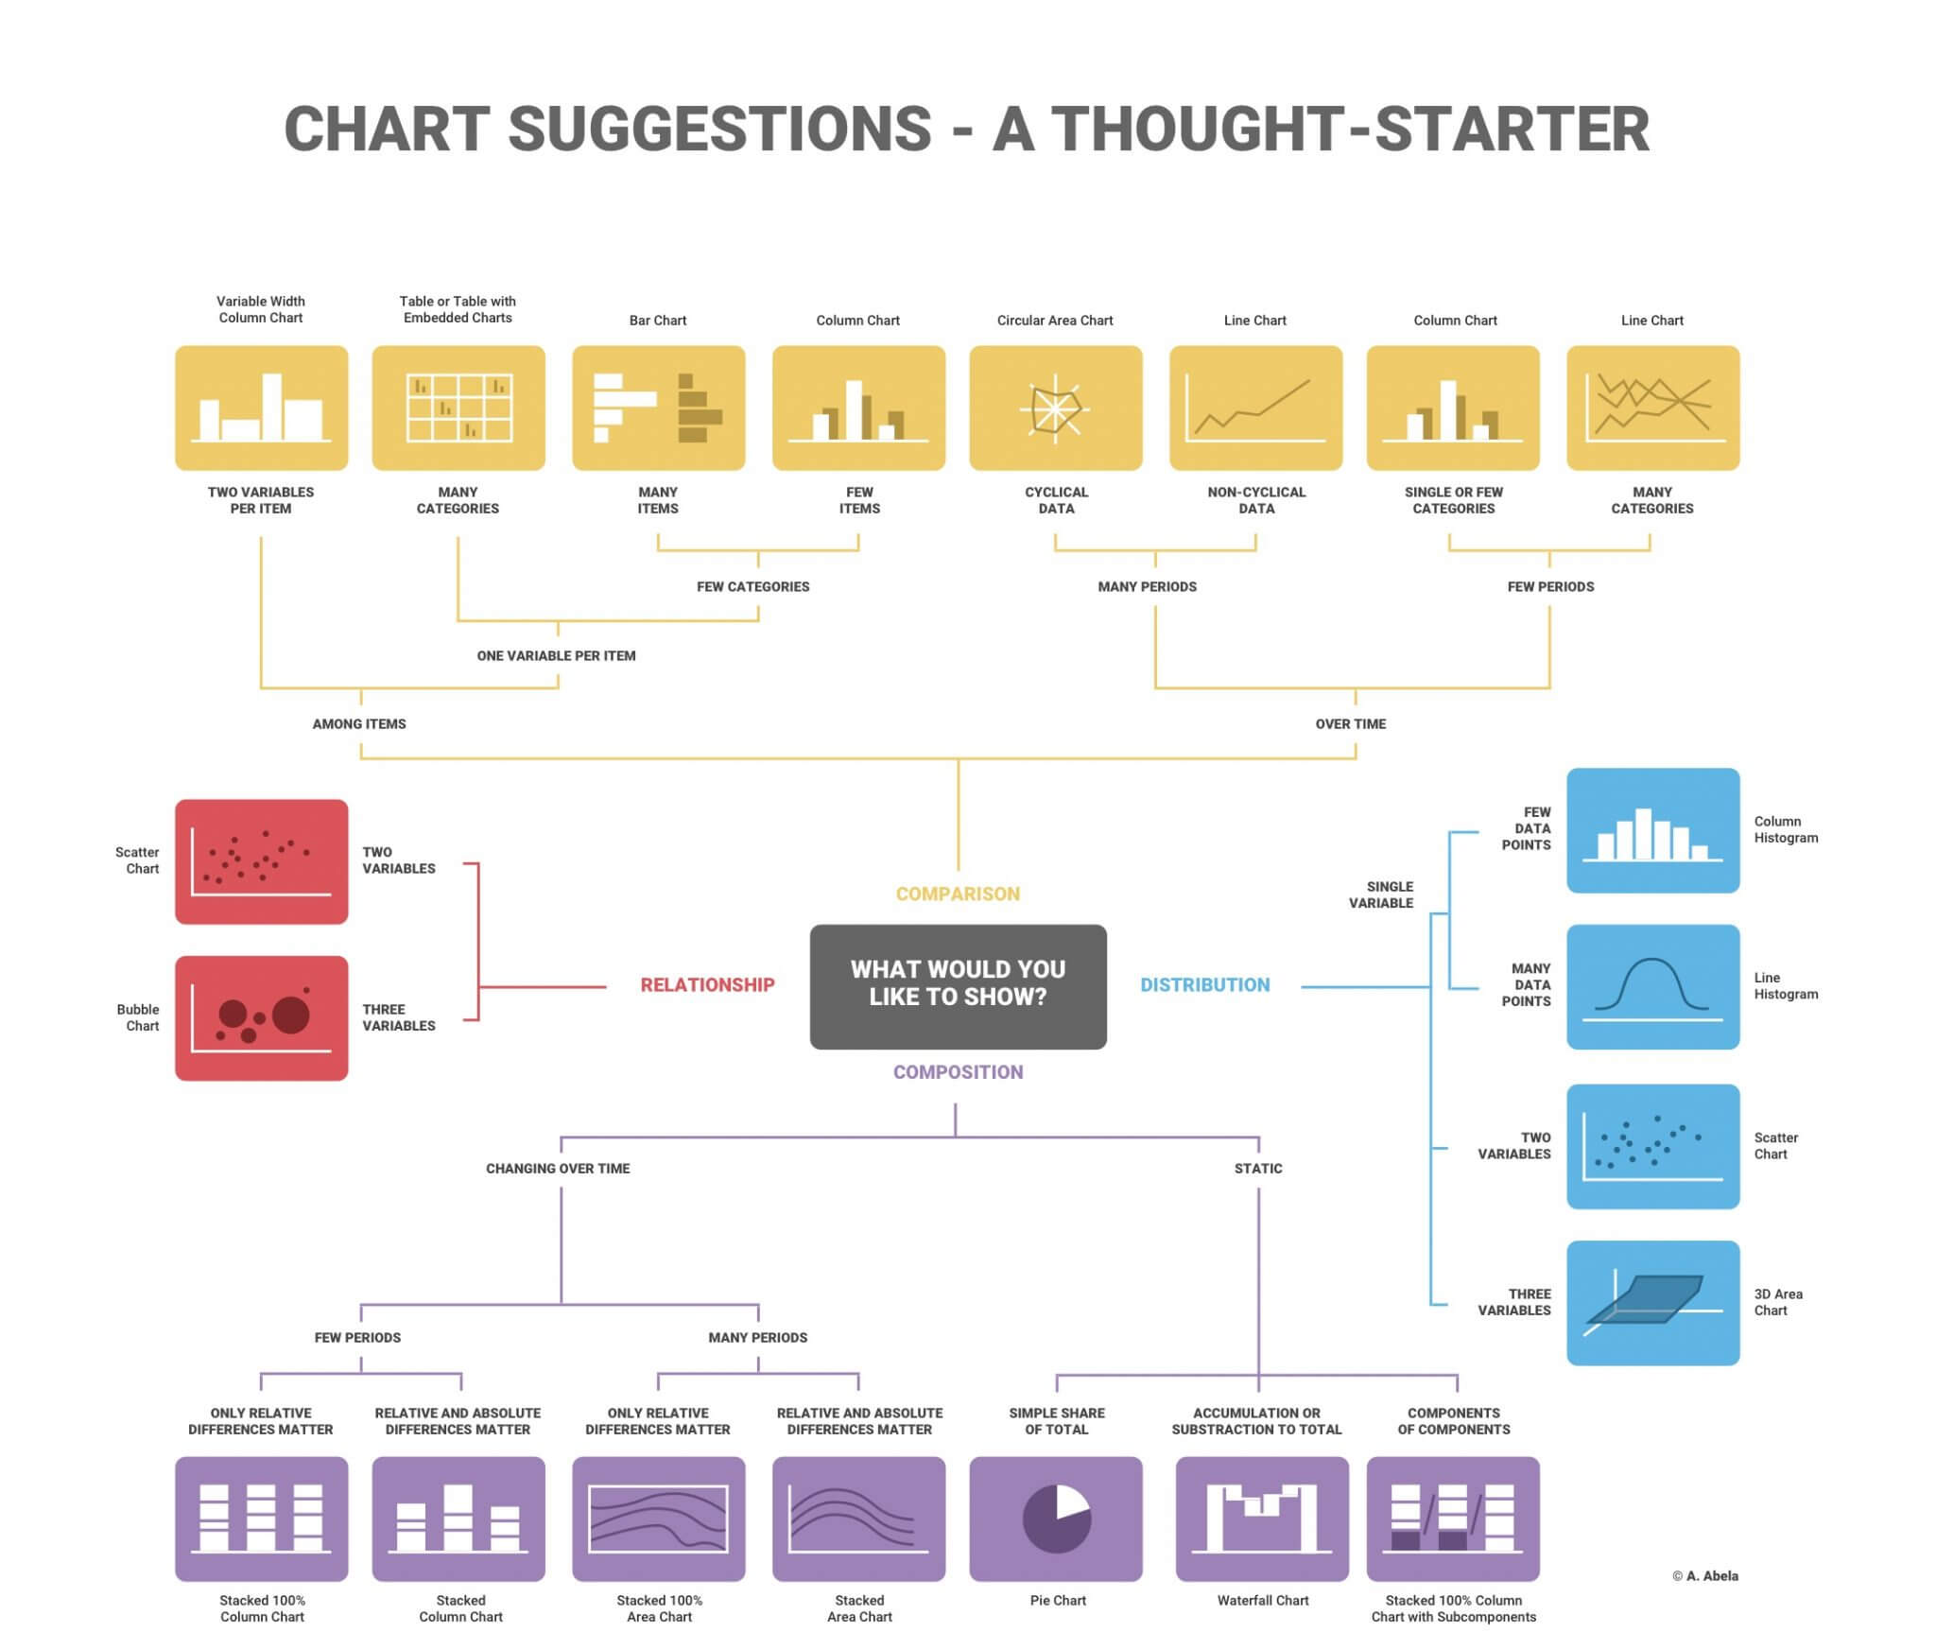
Choosing the Right Visuals

Slide 5
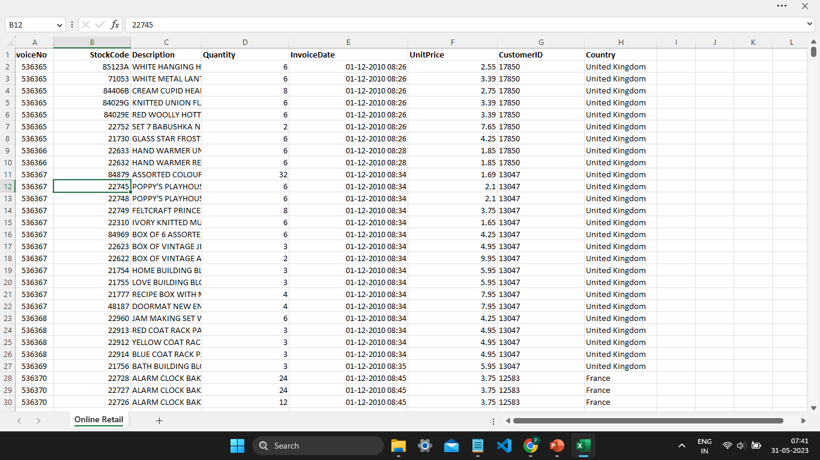
Glimpse of Data

Slide 6
Data processing
After loading the data, I removed the records having quantities less than 1
Removed records having unit price less than 0
Showing visualization of Sales for year 2011

Slide 7
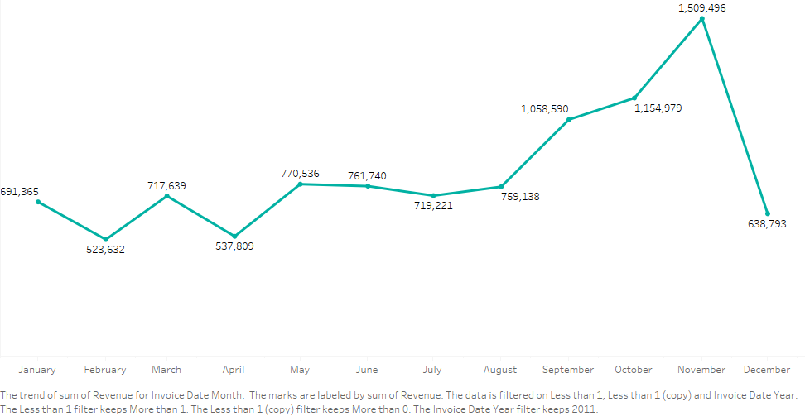
The CEO of the retail store is interested to view the time series of the revenue data for the year 2011 only.
The first visual demonstrates that the first eight months' sales were quite stable, with an average of $685k in earnings each month. The revenue rises by 40% over the prior month in September, marking the beginning of the revenue boom. This pattern persisted up until November, when it rose to 1.5 million USD, the greatest amount of the whole year. Unfortunately, since the data for December is lacking, no inferences can be made from it. This data demonstrates how seasonality, which typically occurs in the last four months of the year, has an influence on retail store sales.

Slide 8
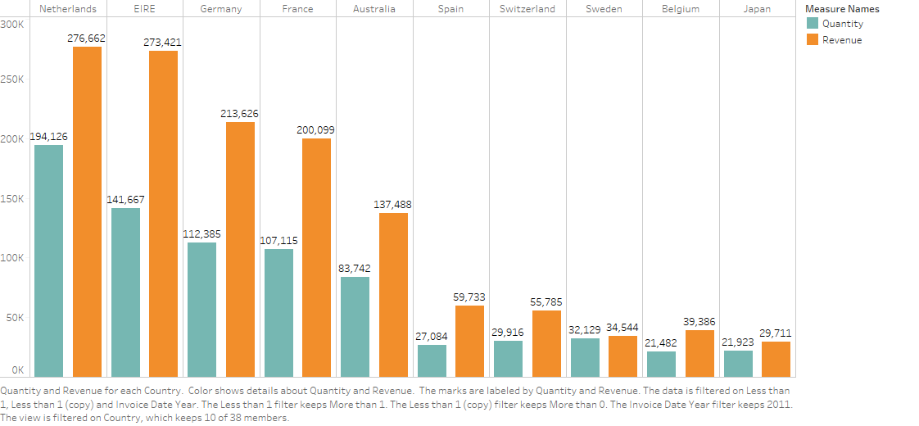
The CMO is interested in viewing the top 10 countries which are generating the highest revenue. Also show quantity sold along with the revenue generated.
The second graph shows the top ten nations in terms of growth potential. The UK is not included in these figures since it already has a high demand and I believe that CMO is more interested in countries where demand may increase. The Netherlands, Ireland, Germany, France, and Sweden are among the countries with the greatest levels of unit sales and income, according to the statistics. Belgium and Japan should also receive greater attention because the disparity between quantity and revenue is not very great.

Slide 9
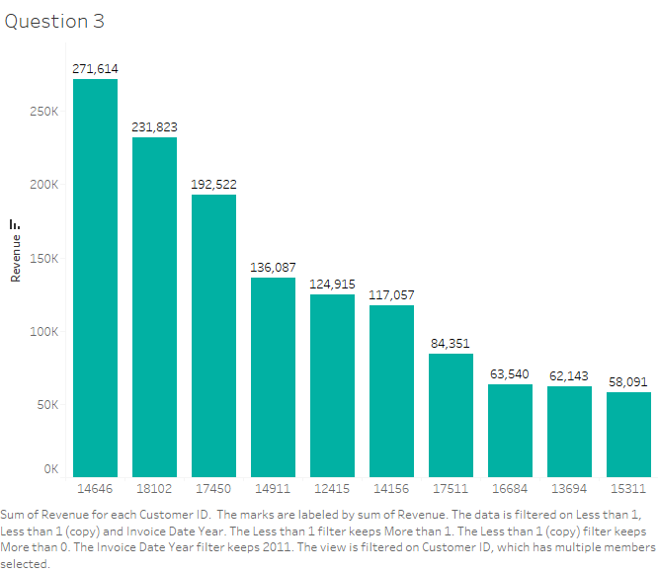
The CMO of the online retail store wants to view the information on the top 10 customers by revenue.
The top 10 consumers who have made the most purchases from the business have been the subject of the third study. According to the statistics, there is little variation in the purchases made by the top 10 clients. The fact that the highest revenue-producing client only spent 17% more than the second-highest demonstrates that the company does not rely solely on a small number of consumers to generate income.

Slide 10
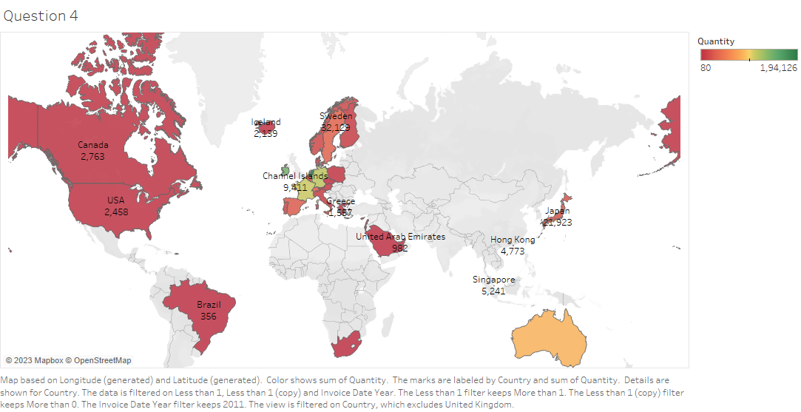

Slide 11
The CEO is looking to gain insights on the demand for their products. He wants to look at all countries and see which regions have the greatest demand for their products.
The map graphic concludes by comparing the places that have produced the greatest money to those that have not. Apart from the UK, it is clear that nations like the Netherlands, Ireland, Germany, France, and Australia generate significant income, and the business should invest more in these nations to boost product demand. The map also reveals that just a small percentage of sales occur in the American region and that the majority occur in the European zone. Along with Russia, there is no market for the items in Africa or Asia. Sales revenues and profitability might increase with the implementation of a fresh strategy focused on these areas.

Slide 12
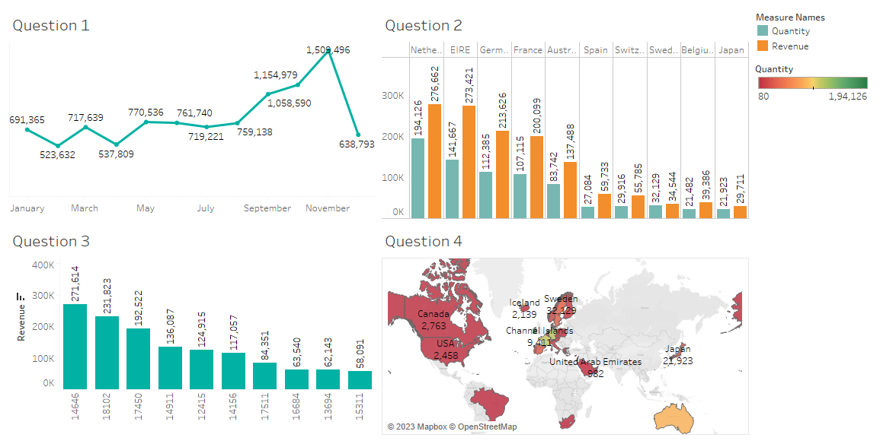

Slide 13


Slide 14
Thanks so much for your time. If you have any questions about the analysis or would like to see anything additional after you’ve had time to digest this information, I’d be happy to develop that for you.

