Slide 1
Does wal-mart have an affect on obesity?
Shawn Bandy, Tony Bui, Vincent Larouche and
Matt Pinchback
Notes:
Alternative title? : Walmart and other determinants of obesity

Slide 2
Motivation – Geography of Obesity
Keep your eye on the South.

Slide 3
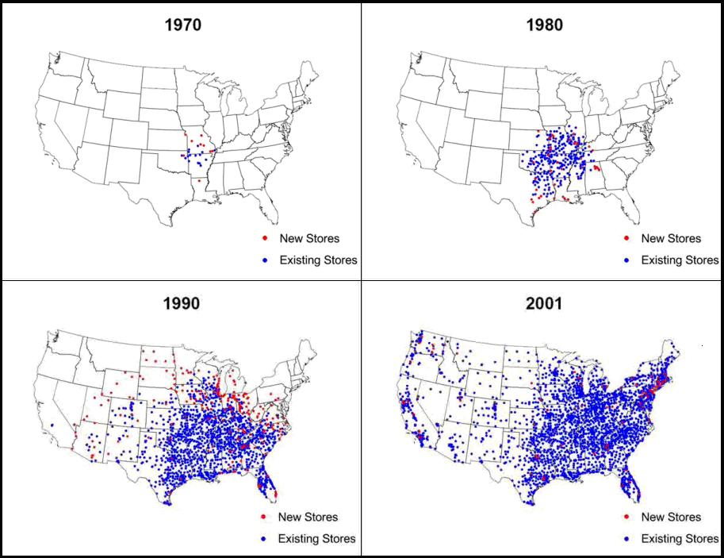
Motivation – Geography Of Obesity

Slide 4
Introduction
Obesity has been on the rise for the past 50 years.
Even more significantly in from 1990 to 2010.
In 2010, 35.7% of U.S. adults were obese.
Obesity rate was only 12% in 1990 and 23% in 2005.
Obesity is been linked to:
High blood pressure
Diabetes
Stroke
Heart Disease
Notes:
Heart Disease of course being the number 1 disease in the nation.
Obesity leads to more than 100,000 deaths per year and roughly $117 billion in medical expenditures per year, according to the U.S. Department of Heath and Human Services.

Slide 5
Introduction
Wal-Mart was originally established in 1962 and has significantly grown since the late 1980’s.
The first Wal-Mart Supercenter was established in 1988.
With the number of Wal-Mart Supercenter’s growing along with the obesity rate the question remains:
Does Wal-Mart have an affect on the obesity rate in the U.S?
Notes:
The supercenter, first of it’s kind to add full-service grocery store, according to walmartstores.com/aboutus.
There are currently 2,705 Supercenters, including the one in downtown Long Beach and at the Long Beach town center.
And if Wal-Mart’s do have an affect on obesity, at what rate.

Slide 6
OLS Model
PCT_OBESE = β₀ + β₁(WM_PER_TENTHOU) - β₂(WM_PER_SQ) - β₃(PCI) - β₃(MEDIAN_HOUSE_INC) + β₄(PCT_POVERTY) - β₅(PCT_UNEMPLOY) + β₅(PCT_FARM_JOBS) + β₆(TRAVEL_TIME_WORK) – β₇(PCT_UNINSURED) - β₈ (PCT_HS) – β₉(PCT_COLLEGE) + β₁₀(PCT_FASTFOOD) + β₁₁(PCT_DRINKING) + β₁₂(PCT_SMOKING) – β₁₃(PCT_UNDER_5) + β₁₄(PCT_UNDER_18) – β₁₅(PCT_OVER_65) – β₁₆(PCT_FEMALE) – β₁₆(PCT_BLACK) – β₁₇(PCT_AMIND) – β₁₈(PCT_ASIAN) + β₁₉(PCT_PACISLAND) + β₂₀(PCT_HISPANIC) – β₂₁(PCT_FOREIGN_BORN) + u
Controlling for Other Obesity Risk Factors
Age, Race and Gender
Income, Employment and Education
Diet and Health

Slide 7
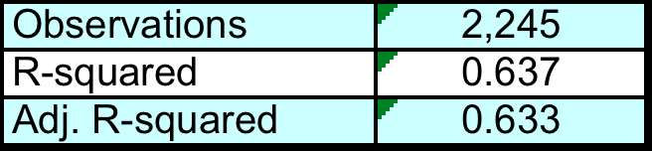
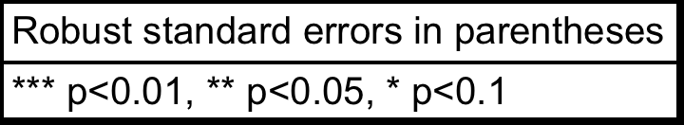
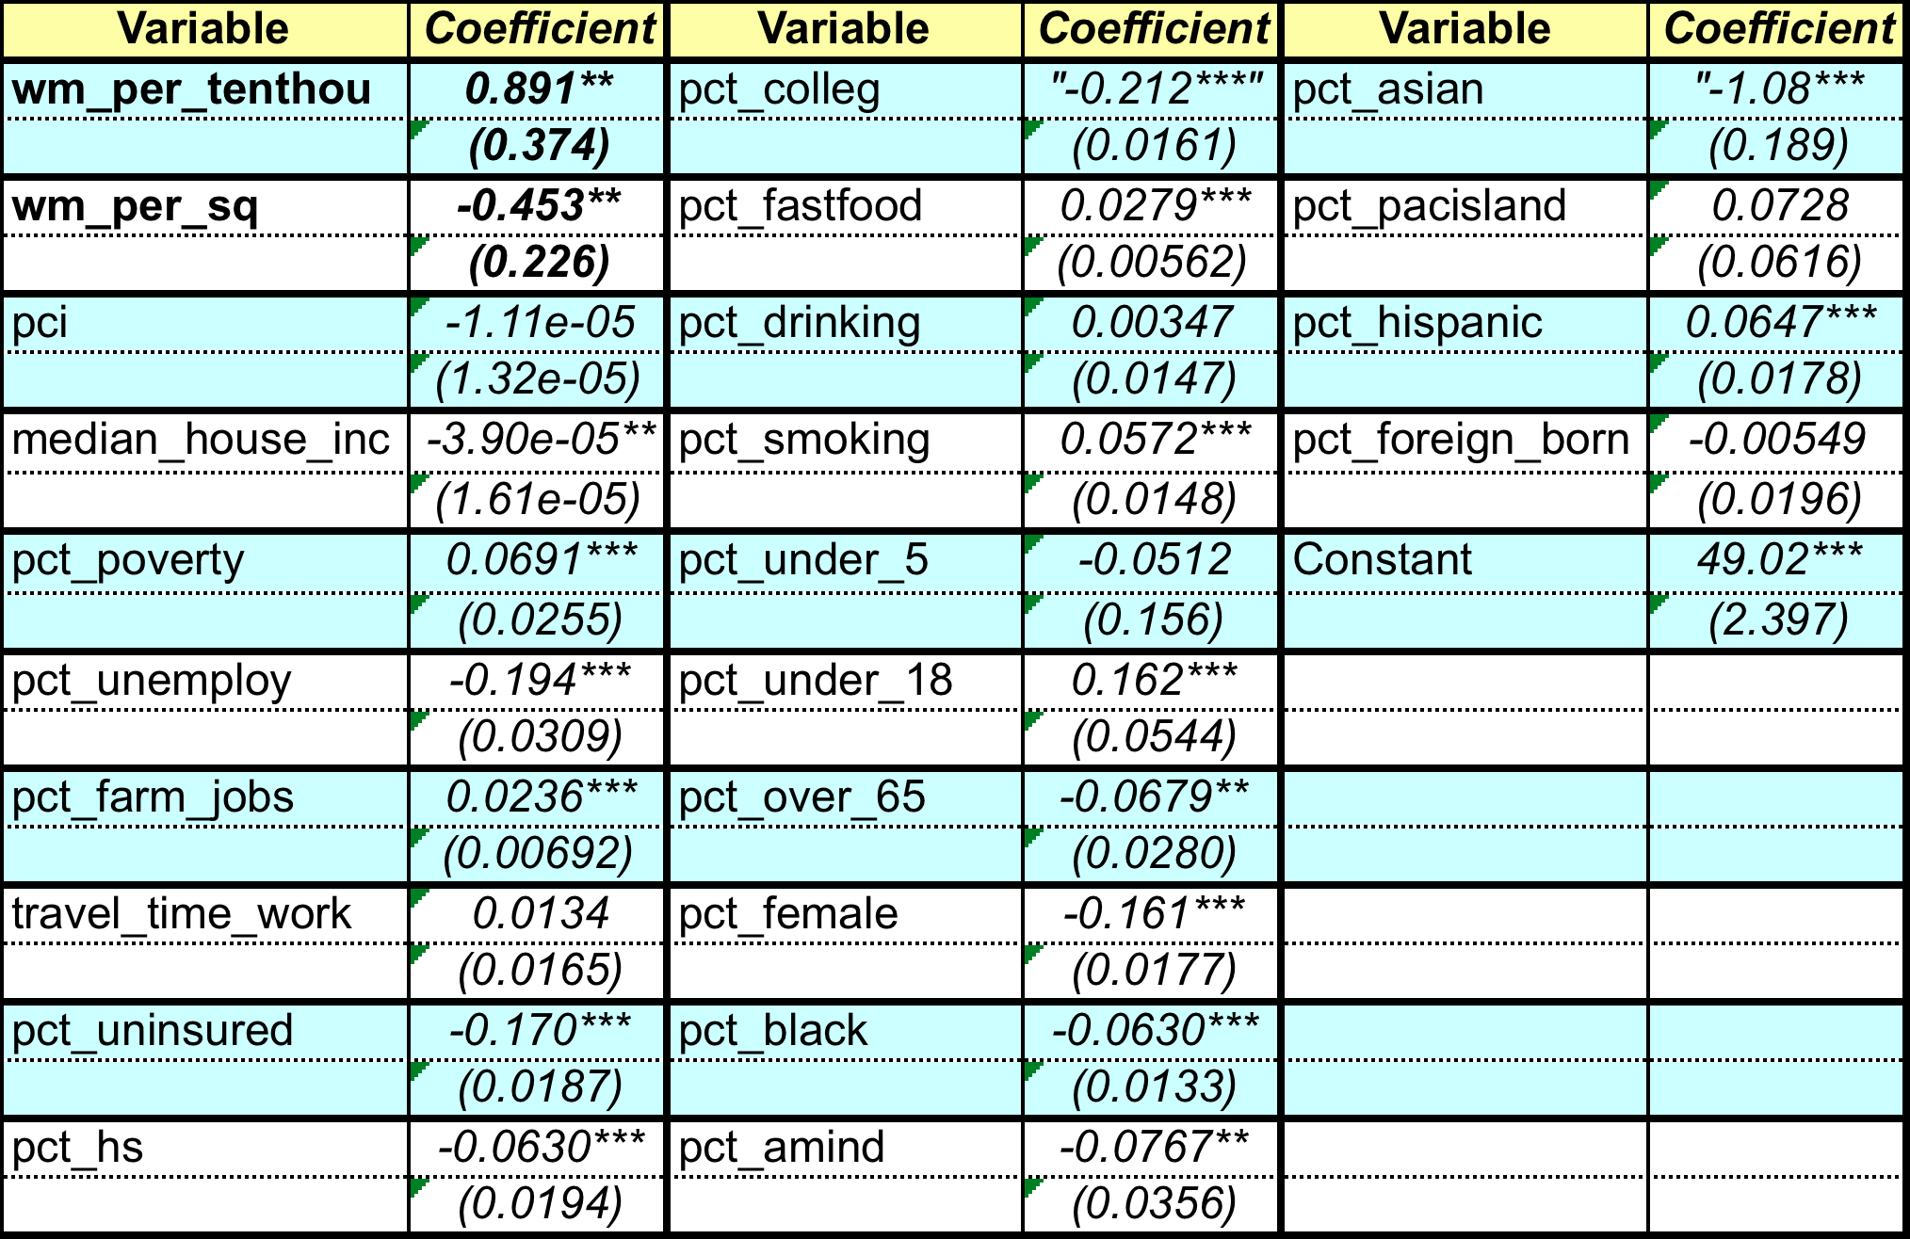
Regression Results

Slide 8
Key Results
Effects of Wal-Mart Stores on Obesity
Wal-Mart stores per 10,000 people
Statistically significant
For each additional Wal-Mart store, there is 0.89% increase in percentage of obese in the county but a 0.45% decreasing marginal return.

Slide 9
Other Results
What we would expect…
Significant factors for obesity:
Income/Poverty – Higher income -> Lower Obesity
Education – More education -> Lower Obesity
Availability of Fast Food – More fast food -> Higher Obesity
Health Factors (drinking, smoking, insurance)
Ethnic Factors – Varies but is significant.

Slide 10
Model Weaknesses
Goodness of Fit
R2 and Adj. R2
Heteroskedasticity
Breusch-Pagan test: χ2 = 20.21
Robust standard errors
Multicollinearity
4 Variables with VIF > 10
Pct_hispanic, pct_female, pct_foreign_born, median_house_inc
Mean VIF is 5.90

Slide 11
Interpretation
After controlling for income, education, ethnic and health factors, the concentration of Wal-Mart stores in a county still has a statistically significant impact on obesity.
But what does that mean?

Slide 12
“Supersizing Supercenters”?
From Courtemanche & Carden, 2008:
Additional Supercenter Stores increase obesity by 2.4 percentage points and BMI by 0.25 units
Explains 11% of the rise in obesity since the late 1980s.
Lower prices do not offset increased medical costs.

Slide 13
“Supersizing Supercenters”
“I think the most obvious story is that Wal-Mart lowers the price of foods, and a lot of the foods it has big price advantages on are the processed, inner-aisle types of food that aren’t that good for you.” --Courtmanche, Forbes, January 2011
“Wal-Mart is not evil.”

Slide 14
Next Steps
Improve geographical data – e.g. from county level to relative driving distances
Differentiate between store types --Supercenters, Express, Neighborhood Markets)
Explore the impact Wal-Mart stores have on local retail ecologies – Farmers Markets, Fast Food, Produce Stands, Backyard Gardens
Pin a dollar figure on lost income and increased medical costs due to the “Wal-Mart Effect”

