Slide 1
Research Introduction
M1 Kazuya Okamura
2024/07/25

Slide 2
Introduction
Joint research with JRI (日本総研) researcher
  Same as M1 Suto
Research Theme:
  Deep Randomized Time Warping for Action Recognition ^{[1]}
  Mechanism of Randomized Time Warping versus Attention Module ^{[2]} (not yet published)
  ↓
  Application based on RTW method

Slide 3
Overview of methods
Randomized Time Warping (RTW)
An extension method of DTW (Dynamic Time Warping)
Time elastic (TE) features:
  Random sampling of input sequences while preserving temporal features
Input sequence
TE features
…

Slide 4
Randomized Time Warping (RTW)
Applying PCA to a set of TE features, measured by canonical angles, is more effective than DTW
Set of TE features
PCA
Seq. 1
Seq. 2

Slide 5
Randomized Time Warping (RTW)
Advantage
By random sampling, TE features can be represented at local and global scales
RTW can be interpreted as focusing on highly similar features among multiple TE features
  → It can be regarded as a self-attention mechanism
Furthermore, subspace representations can be generated stably even with small amounts of data
→ In small sample sizes, it is superior to self-attention mechanism
Notes:
ランダムサンプリングにより、特徴量を局所的なスケールと大域的なスケールを表すことができる
RTWは、複数のTE特徴の中から、類似度の高い特徴に注目していると解釈でき、自己注意機構と見なすことができる
さらに、部分空間表現は、少量のデータでも安定して生成できる。そのため、サンプルサイズが小さい場合、自己注意機構より優れている

Slide 6
Overview of methods
Deep Randomized Time Warping for Action Recognition ^{[1]}
  Extracted from 2D/3D CNN and converted to TE features through RTW
  Therefore, it can be applied to various CNN architectures
Mechanism of Randomized Time Warping versus Attention Module ^{[2]}
  Spatial Transformer + RTW
  RTW performs as well as or better than a self-attention mechanism
Notes:
2D/3D CNNから抽出され、RTWを通してTE特徴に変換する
そのため、様々なCNNアーキテクチャに適用できる
RTWが自己注意機構と同等かそれ以上の性能を持つ

Slide 7
Future work
Reproduce the Transformer+RTW program and verify that it works properly on supercomputer
Consider applications based on RTW method (not just video recognition)
  To other targets
    Sign language recognition
    etc...

Slide 8
Progress
Verify Transformer+RTW program on supercomputer
Done
  Verification of GPU training behavior using previous research programs
  Dataset preparation (Something-Something V2)

Slide 9
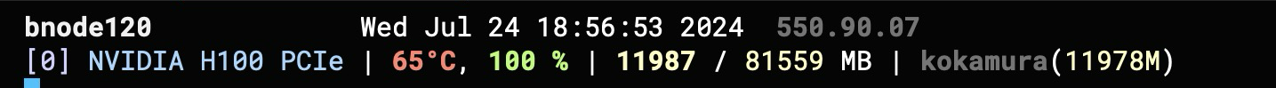
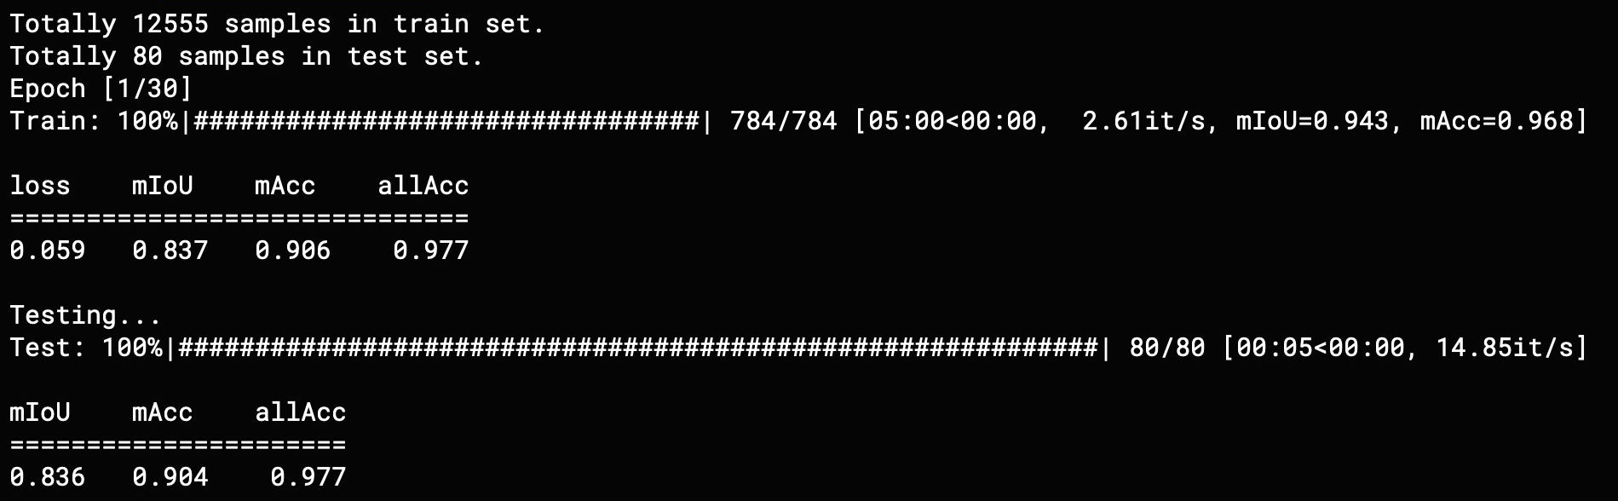
Verification of GPU training behavior
Whether GPU-based learning is possible
Whether the learning is progressing correctly
  Using PSPNet (Pyramid Scene Parsing Network)

Slide 10
Verification of GPU training behavior
PSPNet
Training speed
GPU / Computer | Training speed
NVIDIA RTX2060 (6GB) on laptop computer | 30m /epoch
NVIDIA H100 (80GB) on supercomputer | 4-5m /epoch
Dataset
12,555 images in total
Hyperparameter
Batch size : 16
Input image : 473x473

Slide 11
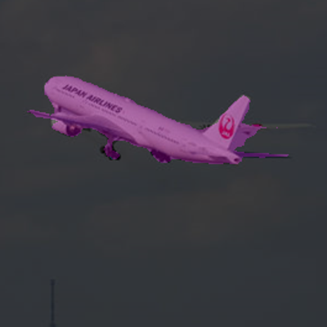
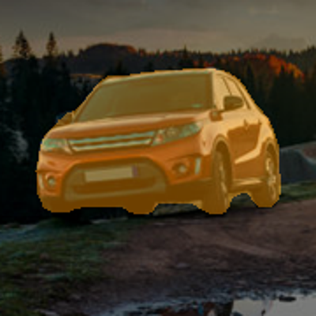
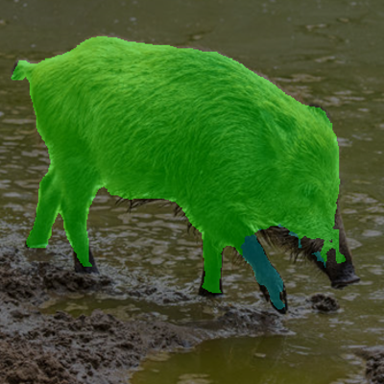
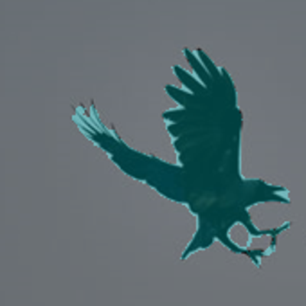
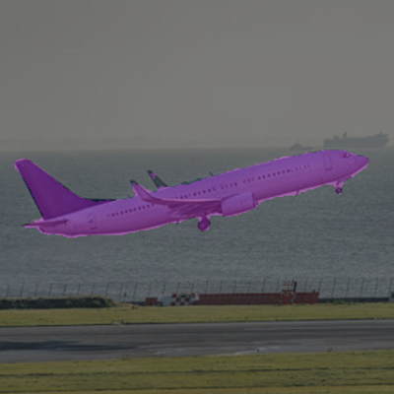
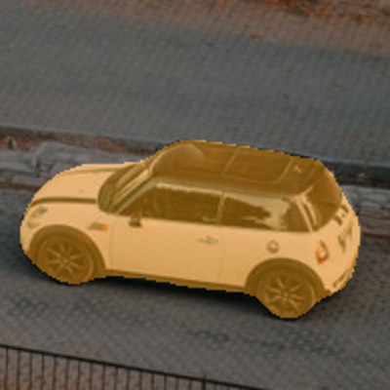
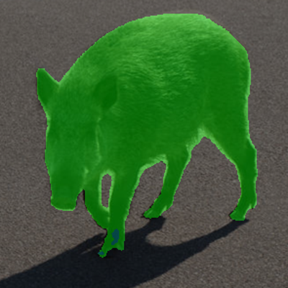
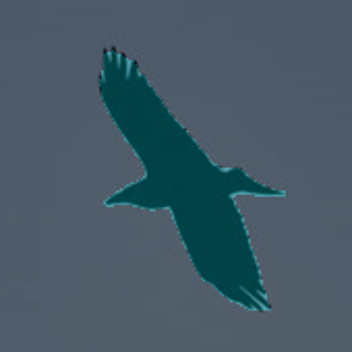
Verification of GPU training behavior
PSPNet
  Results of 5 epoch
airplane
car
boar
crow

Slide 12
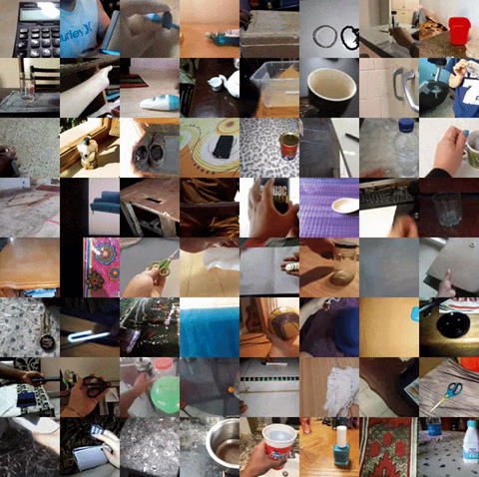
Dataset preparation
Something-Something V2
  Moving objects dataset
Dataset details
Total number of videos | 220,847
Training Set | 168,913
Validation Set | 24,777
Test Set (w/o labels) | 27,157
Labels | 174
Quality | 100px
FPS | 12
Extract frames from videos
Resize images
※ https://developer.qualcomm.com/software/ai-datasets/something-something

Slide 13
Progress
Verify Transformer+RTW program on supercomputer
Done
  Verification of GPU training behavior with the PyTorch program (using previous research programs)
  Dataset preparation (Something-Something V2)
Next
  Reproduce Transformer+RTW program and experiment to obtain similar results.
  Consider application methods
  Revise paper on research at previous school
personal

Slide 14
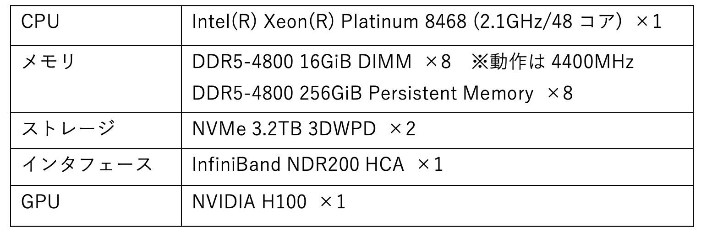
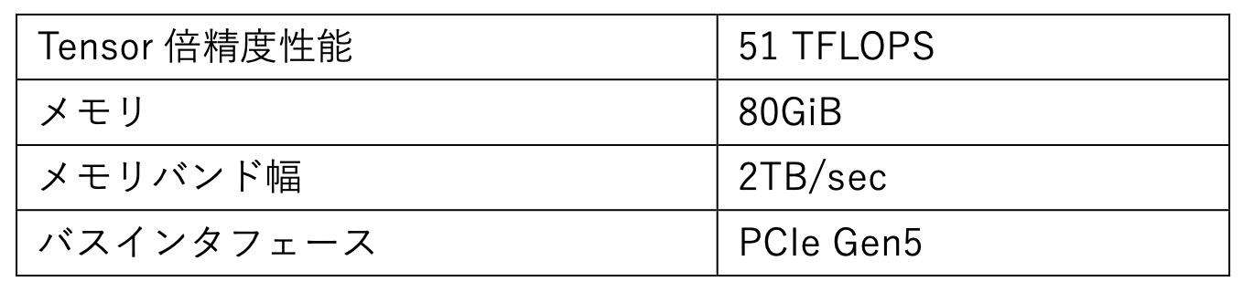
Supercomputer Specs (Pegasus)
▼ NVIDIA H100

