Slide 1
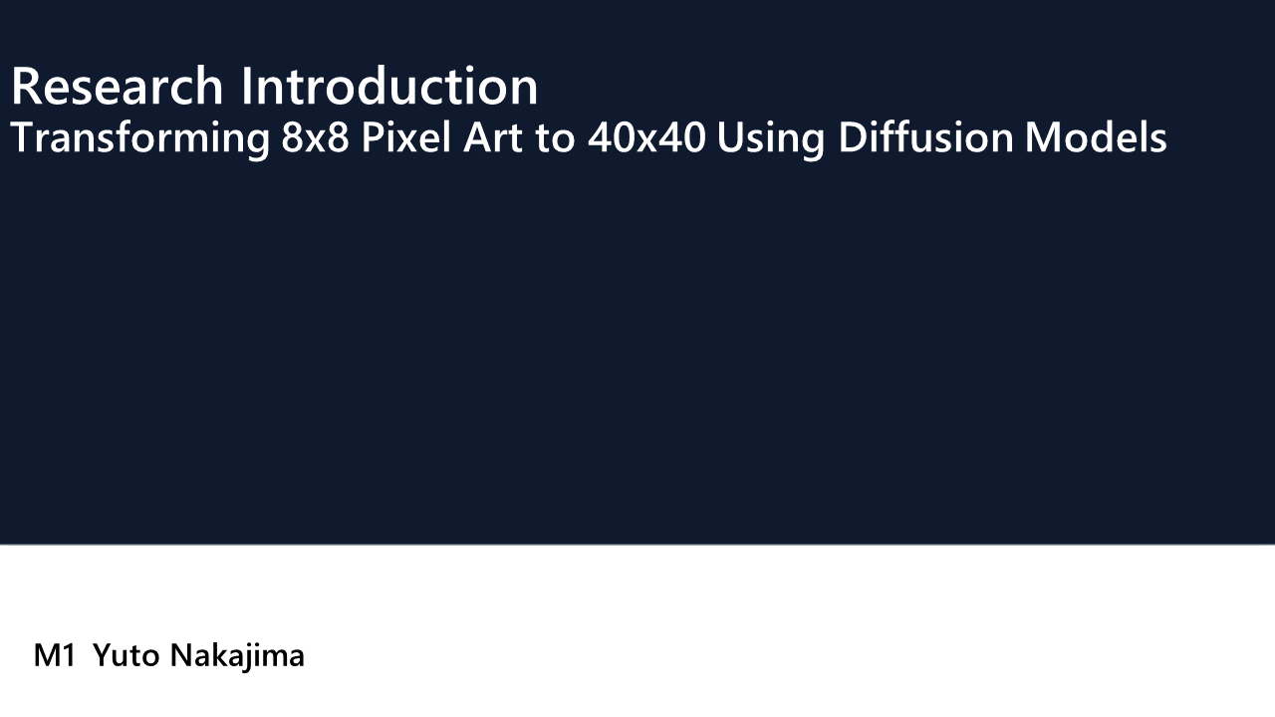

Slide 2
Introduction
In recent years, image generation using Diffusion Models has attracted significant attention.
These models typically use text or images as input.
Using text as input for image generation:
there can be discrepancies between the generated image and the intended image.
Using images as input:
It is possible to generate images that closely match the desired result.
However, it is difficult to prepare appropriate input images.

Slide 3

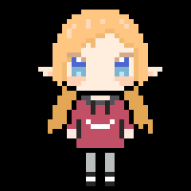
Introduction
In this study, we propose a method for image generation using 8x8 pixel art, which can be easily created by anyone, as input.
Specifically, we aim to generate 40x40 pixel art.
input
target

Slide 4
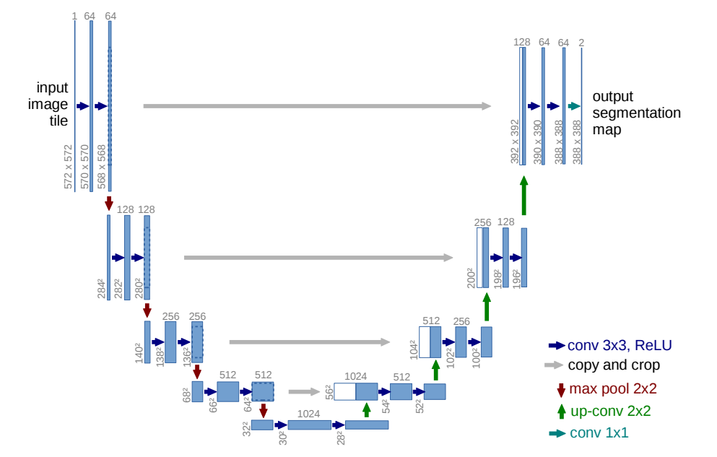
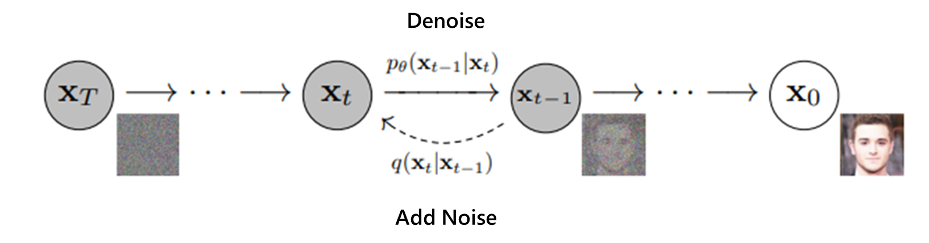
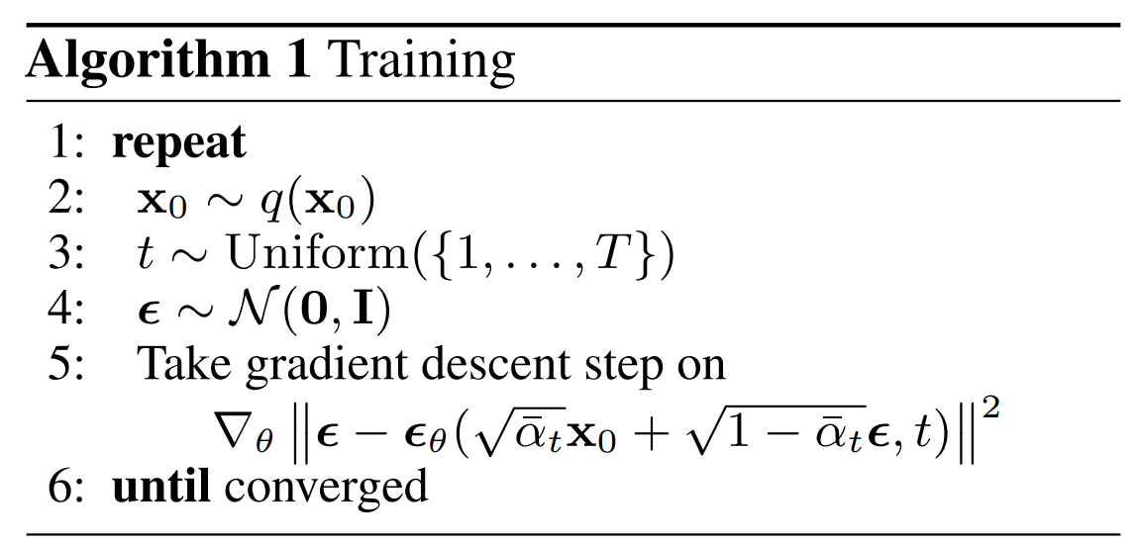
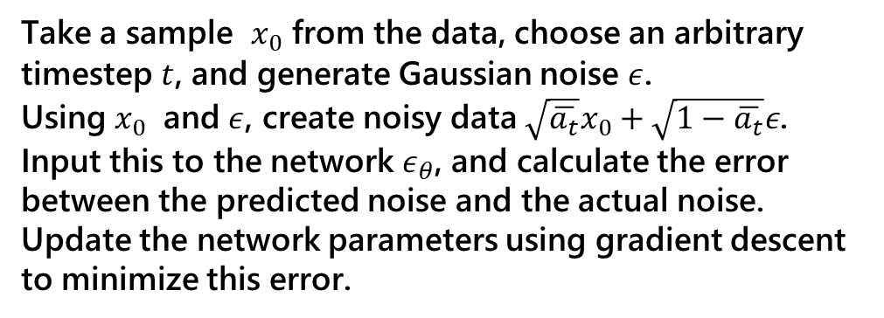
Method
DiffusionModel(DDPM)
Take a sample ​ $x_{0}$ from the data, choose an arbitrary timestep $t$, and generate Gaussian noise $ε$.
Using $x_{0}$​ and $ε$, create noisy data $\sqrt{\overline{a_{t}}}x_{0}+\sqrt{1−\overline{a_{t}}}ε$.
Input this to the network ​$ε_{θ}$, and calculate the error between the predicted noise and the actual noise. Update the network parameters using gradient descent to minimize this error.
Notes:
データからサンプル $x_{0}$ を取得し、任意のタイムステップ t を選び、ガウスノイズ ϵを生成します。
$x_{0}$ ​ と ϵを使って、ノイズ付加データ $\sqrt{\overline{a_{t}}}x_{0}+\sqrt{1−\overline{a_{t}}}ε$ を作成します。
これをネットワーク ϵθ​ に入力し、予測されたノイズと実際のノイズとの誤差を計算します。
勾配降下法を用いてこの誤差を最小化するようにネットワークのパラメータを更新します。
このアルゴリズムは、ノイズ除去の精度を最大化するために対数尤度を最大化する方向でモデルを学習させるプロセスを示しています。

Slide 5

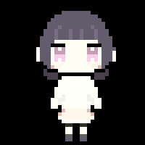
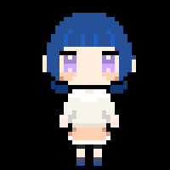

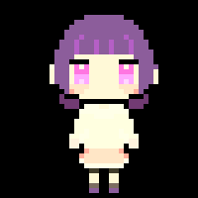
Dataset
Prepared a training dataset of 50 images.
To expand the dataset, I performed ColorTransfer.
To prevent the influence of the background, I used only the ab components in the Lab color space.
The method used is the common approach of matching the input colors to the target by using the standard deviation of the ab components.
The number of images after expansion is 2500.
Dataset URL
https://drive.google.com/drive/folders/1SwHgpKcFisSWCM86BH8WNrzXkEgH4_40?usp=sharing
input
target
output

Slide 6
Preliminary Experiment
Since we are generating relatively small images, specifically 40×40 pixels,
it may not be necessary to use as many channels as those employed in existing models.
Compare the models
Pix2Pix
Diffusion Model
Diffusion Model with reduced channels

Slide 7
Preliminary Experiment
Train Diffusion models and Pix2Pix
Train Condition
No. | 1 | 2 | 3 | 4
Model | Diffusion | Diffusion | Diffusion | Pix2Pix
Train | 50set | 2500set | 2500set | 2500set
Validation | 1set | 1set | 1set | 1set
Unet Channel | 64,128,256,512 | 64,128,256,512 | 64,64,64,64 | 64,128,256
Batch size | 8 | 8 | 8 | 8
Epoch | 1000 | 1000 | 1000 | 1000

Slide 8
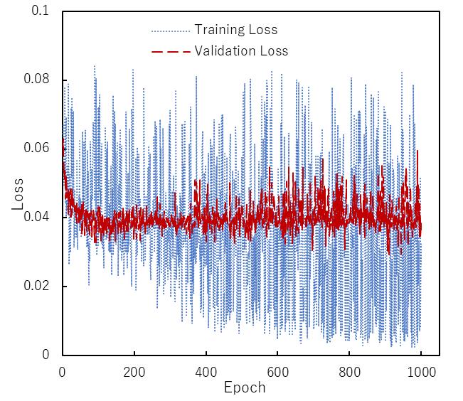
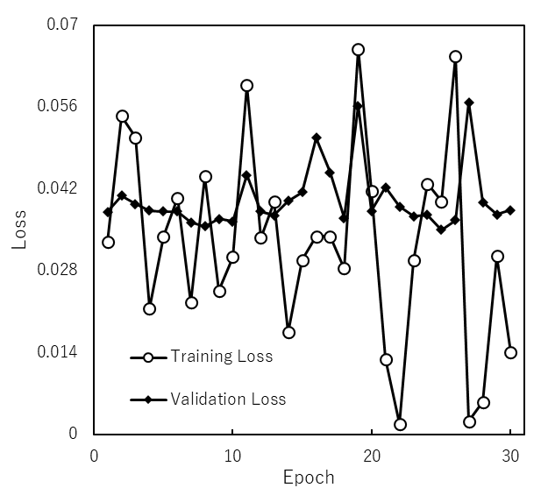
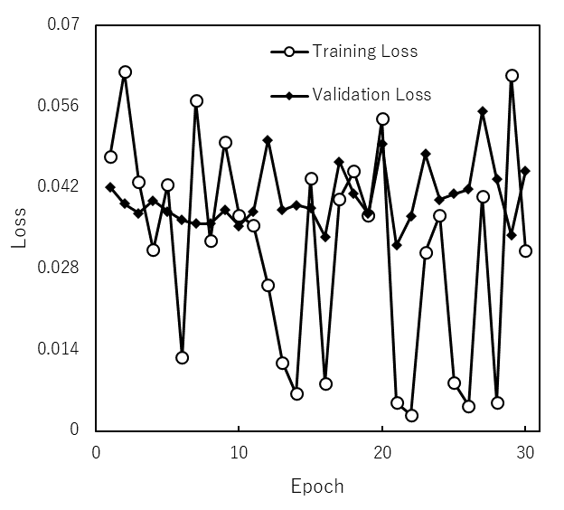
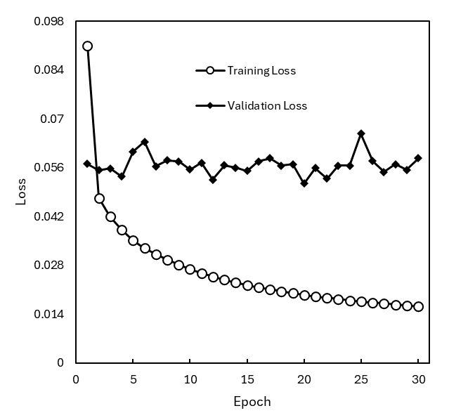
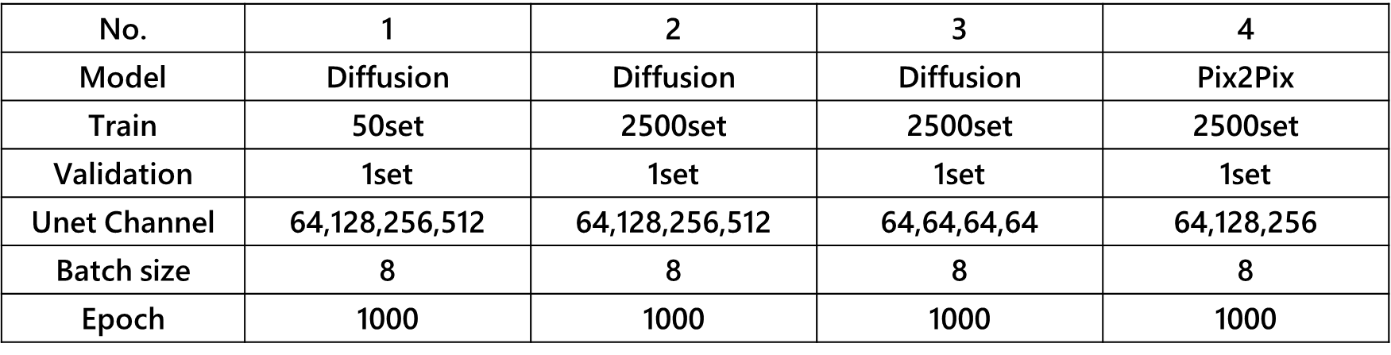
Result
1
2
3
4
7

Slide 9
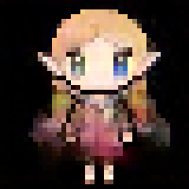
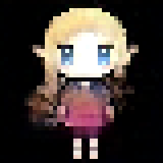
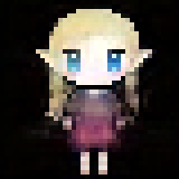
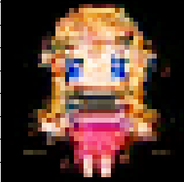
Result
input
target
Output
Diffusion
pix2pix
1
2
3
4

Slide 10
Future Work
Dataset Expansion
increase the number of pixel art of people.
expand to other types of pixel art.
Model Parameter Optimization
Vision Transformer for Denoise Network

