Slide 1
Aim
Identify and investigate(hopefully) associations between clinical phenotypes and genotypes using network analysis.
  Clinical phenotypes: ICD 9/10, demographic, treatment from EHR/Warehouse
  Clinical genotypes: CPD data (whole data, not just clinically reported)
  Analysis: Read in data and form networks based upon relevant centrality scores (may want to look at gradients of centrality)
  Visualization: A tool that can calculate these networks and be configurable to display on the fly various network types

Slide 2
Topics
EPIC EHR vs. PENN IS initiatives
Formatting/retrieval/use of PENN data
Network analysis
Future directions/update

Slide 3
EPIC EHR vs. PENN IS
PENN IS
  Data lake
    It is basically an ambiguous term for an uncontrolled data warehouse
EPIC
Data Model
Viz
Mess
Analysis
Viz
Mess
HL7
Analysis

Slide 4
EPIC EHR vs. PENN IS
EPIC seems to be the clear choice, why?
  The “data lake” currently only has EPIC clarity data, and while it will be built upon… it is an unfinished product.
  The data lake, while providing access to more data, is less controlled.
    I can learn HL7, can I learn all of the formatting nightmares associated that could be lurking in the lake?
  EPIC does not require an additional data model step, the data comes out as such. Does require “honest broker?”
    OBX|4|NM|26464-8^Leukocytes [#/volume] in Blood^LN^^^^^^Leukocytes [#/volume] in Blood||105600|{cells}/uL^cells per/microliter^UCUM|Angeles^CA^90067^^B|2343242^Knowsalot^Phil^^^Dr.^^^&2.16.840.1.113883.3.72.5.30.1&ISO^L^^^DNOBX|5|NM|26515-7^Platelets [#/volume] in Blood^LN^^^^^^Platelets [#/volume] in Blood
Why not?
  Learning HL7 (and the ORM) seems like it is going to be awful… I should at least take a look at the data in clarity to see if maybe this is easier?

Slide 5
CPD Data
In test cases the filmaker data is horrible
  Ideally we would use p.change as that is the most logical to use for network analysis, but it did not go well in round 1.
options:
  1) fix all of the manually entered p.changes
  2) figure out how to fix the singular representation:
    Chr1, 1234, 5678, *, -ATGC
  3) unarchive and grab all VCFs
To create a data store, or to not create a data store?
  Many groups want this data, if I can curate, annotate and store it could be really useful…essentially any project I undertake in the near future will require the correction of CPD data

Slide 6
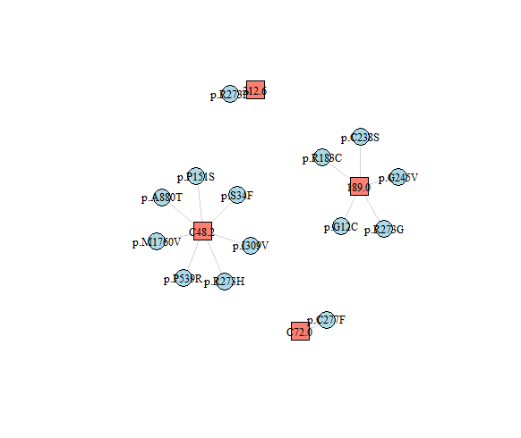
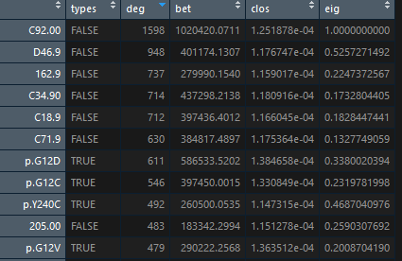
PheWAS/Network analysis
Previous work:
  Used a language (d3) to read json and display in html using dummy values
  Babak requests: Try the same thing in igraph
Current work:
  Pulled reported clinical data into igraph and mapped (ICD vs p.change/gene)
  Used a bipartite graph as the did in Verma, et. al.
  Used igraph to calculate different centrality

Slide 7
Future work
100% owe you an aims paper by mid-august.
Keep playing/learning network analysis (perhaps take a course)
Learn Epic?
Parse CPD data

Slide 8
Citations
ICD mapper – R: https://cran.r-project.org/web/packages/icd/vignettes/introduction.html
Verma et al: https://www.ncbi.nlm.nih.gov/pubmed/30598166
Bipartite networks: https://rpubs.com/pjmurphy/317838
Force directed (not what im using) : https://bl.ocks.org/vasturiano/02affe306ce445e423f992faeea13521
Super cool tutorial: https://mrpandey.github.io/d3graphTheory/unit.html
Ritchie et al: https://www.nature.com/articles/nbt.2749

