Slide 1

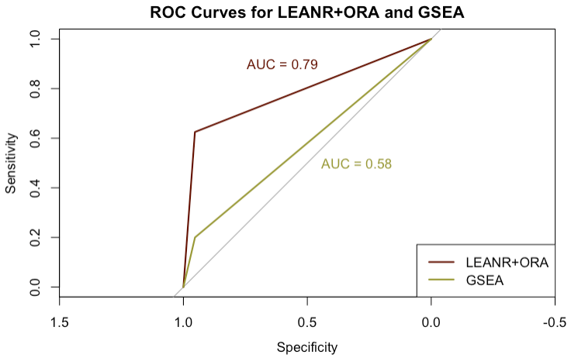
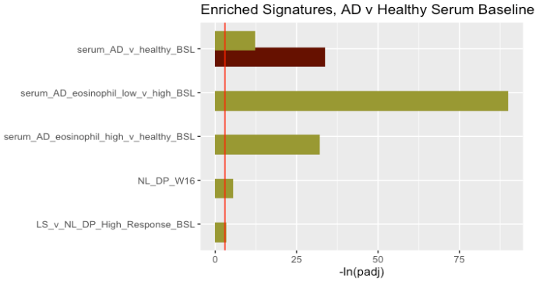

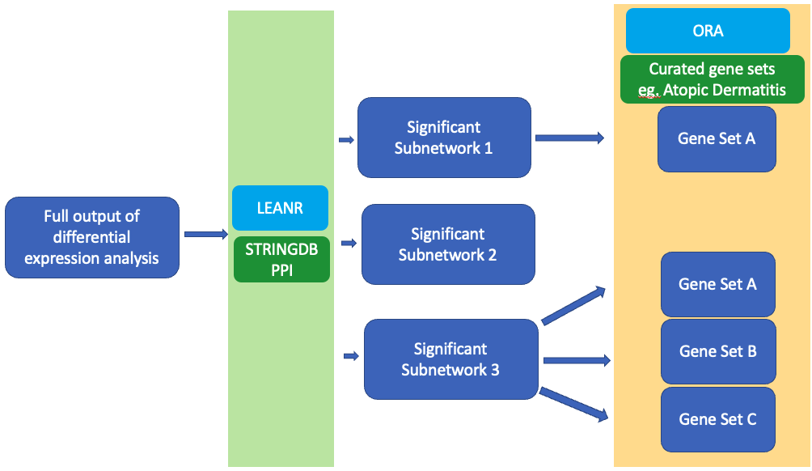
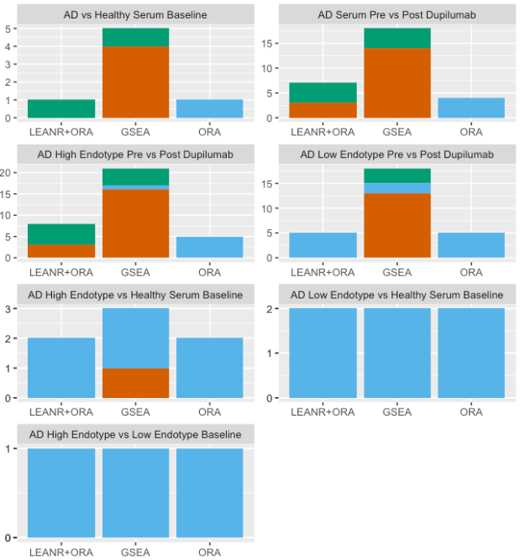

North America
Signature Matching Using a Graph Networks Approach
Ashley Morrison(Boston University),
Manisha Brahmachary(Sanofi,Brigdewater), Inoncent Agueusop (Sanofi,Frankfurt)
introduction
data analysis
results
Signature matching is a common bioinformatic technique that quantitatively matches samples to gene sets that share a common biological annotation which can then provide molecular evidence of the association of biological pathways with diseases. We present LEANR+ORA as a potential method for signature matching using a graph networks approach.
The output of each pipelines was compared across seven separate differential expression analysis (Table 1) (Figure 2). The number of true positives (TP) compared to false negatives (FN) and false positives (FP) was found for each method (Figure 3). Performance was measured using Receiver-Operator-Characteristic (ROC) analysis comparing true positive rates and false positive rates of the pathway analysis results against the AD gene set list (pROC R package) (Figure 4) (5).
LEANR+ORA had a higher rate of true positives and a lower rate of false positives than GSEA or ORA (Figure 3) (Figure 4). No method was able to detect signatures from the Mobus low endotype. GSEA frequently called biologically unrelated signatures as significant (Figure 2), and ORA alone was unable to detect gene sets in any of the conditions (Figure 2) (Figure 3).
methods
Figure 4
LEANR+ORA uses a modified version of the Local Enrichment ANalysis (LEAN) method, which implements pathway topology to find enriched protein subnetworks for signature matching (1). LEAN+ORA consists of three steps (Figure 1):
Differential expression analysis (DEA) is conducted on a transcriptomic/proteomic expression dataset.
The full list of output markers and the associated p-values are overlayed onto a protein-protein interaction network (2) and the LEANR R package used to statistically calculate enrichment of local subnetworks (1).
Significantly enriched subnetworks are individually tested for gene set enrichment using ORA (fora from FGSEA R package) (3).
Table 1. Analysis Conducted
AD vs Healthy Serum at Baseline
AD Serum Pre vs Post Dupilumab Treatment
AD High Endotype Pre vs Post Dupilumab Treatment
AD Low Endotype Pre vs Post Dupilumab Treatment
AD High Endotype vs Healthy Serum at Baseline
AD Low Endotype vs Healthy Serum at Baseline
AD High Endotype vs Low Endotype at Baseline
Figure 2
ROC curves and AUC for LEANR+ORA and GSEA. ROC for ORA could not be calculated as the pipeline was unable to detect any gene sets.
***
conclusion
LEANR+ORA more consistently identified biologically relevant gene sets than GSEA or ORA. It was unable to detect the Mobus low endotype, but this is likely because this group was defined by its limited transcriptional dysregulation in comparison to the Mobus high endotype. The integration of protein- protein interaction data in LEANR+ORA can provide better clarity into the complexity of biological systems, though continued testing of the pipeline on proteomics datasets is needed.
Figure 1
Comparison of enrichment p-values when analyzing gene set enrichment of serum from AD vs healthy patients at baseline. Biologically relevant gene sets (true positives) marked by “***”. The red line indicates the log transformed 0.05 adjusted p-value cutoff
Figure 3
Signatures tested for enrichment came from a curated list of 33 AD related gene sets. LEANR+ORA was benchmarked against GSEA (fgsea from the FGSEA R package, using log2fc values from DEA) and ORA (fora from the FGSEA R package, using the entire list of differentially expressed proteins) (3). All methods were run on data from Mobus et al. (2022) (4) which identified atopic dermatitis (AD endotypes on serum from AD patients (n=60 at baseline, n=49 pre/post Dupilumab treatment) and healthy controls (n=43).
references
Gwinner, Frederik, et al. “Network-Based Analysis of Omics Data: The LEAN Method | Bioinformatics | Oxford Academic.” OUP Academic, Oxford University Press, 6 Dec. 2016
Szklarczyk, Damian, et al. “STRING Database in 2023: Protein–Protein Association Networks and Functional Enrichment Analyses for Any Sequenced Genome of Interest | Nucleic Acids Research | Oxford Academic.” OUP Academic, Oxford University Press, 12 Nov. 2022
Korotkevich, Gennady, et al. “Fast Gene Set Enrichment Analysis | BioRxiv.” BioRxiv, bioRxiv
Möbus L, et al. Blood transcriptome profiling identifies 2 candidate endotypes of atopic dermatitis. J Allergy Clin Immunol. 2022 Aug;150(2):385-395.
Xavier Robin, et al. pROC: an open-source package for R and S+ to analyze and compare ROC curves. BMC Bioinformatics, 12, p. 77.
Count of true positives, false negatives, and false positives for each method when tested for enrichment against the curated list of AD gene sets.

