Slide 1
Mobile price ANALYSIS
Ashutosh Shukla

Slide 2



Business Problem Definition
Determining the different factors that contribute to Mobile Price.
How a company launching a mobile phone would determine the mobile phones price.

Slide 3

Dataset Overview
Price
Battery Capacity
Screen Size
Resolution
Processor
RAM(MB)
Internal Storage(GB)
Rear Camera
Front Camera
Number of SIMs
Dataset had 35 Features

Slide 4
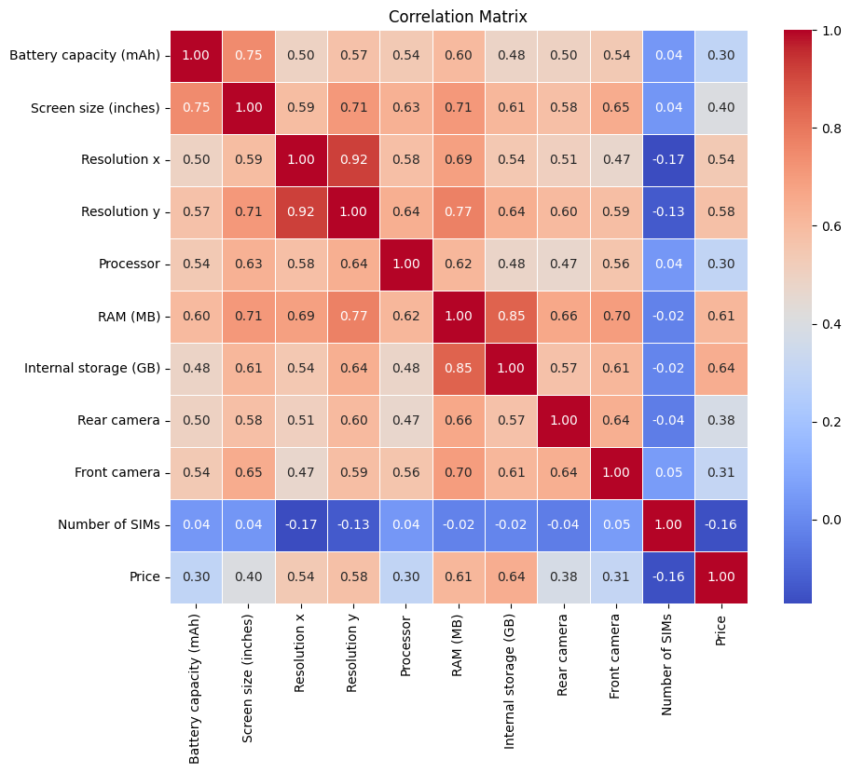
Correlation Heat MAP

Slide 5
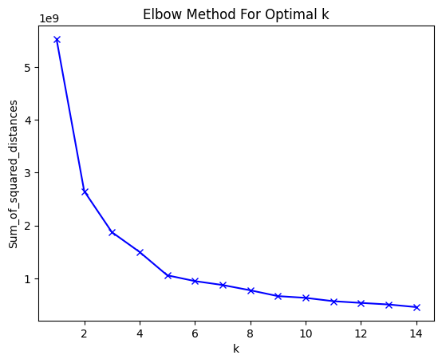
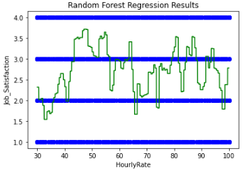
ELBOW METHOD

Slide 6
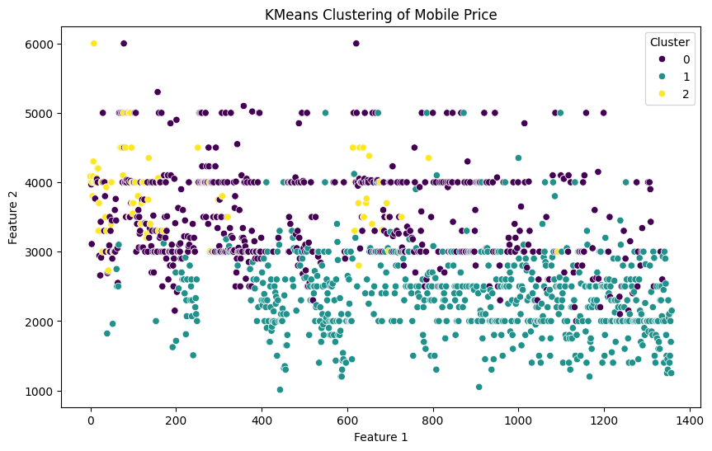
Linear Regression CLUSTERING and f1 score accuracy
Accuracy(F1 SCORE) 0.02

Slide 7
Random Forest Model
MAE: 4530.669148030211
MSE: 86488417.52384362
RMSE: 9299.914920247584

Slide 8


Conclusion
Based off the correlation heat map Resolution, RAM(MB) and Memory(GB) are the most strongly correlated with Price. So these features should be considered more significantly when setting the price for a mobile phone.

