Slide 1
Predicting diabetic readmissions

Slide 2
The Problem:
What factors of a diabetic’s health profile are most likely to predict that a patient will have at least 1 readmission for any acute care admission and can be researched in the next 2 years to explore alternative care and treatment options to prevent readmission?
Notes:
After the Affordable Care Act, acute care readmissions have significantly impacted
hospital financials. Diabetics in particular are prone to readmission as the disease affects so
much of the body and complicates care. With healthcare moving to a pay-for-performance
model, providers often do not get compensated for the readmission and total compensation is
decreased when they occur. In addition to the obvious patient safety and quality of life concerns,
preventing readmissions can also protect a hospital’s revenue.

Slide 3
The Solution:
Extend the first admission
Notes:
My proposed solution is to take greater care to fully resolve the problem causing each admission, including ordering additional labs and medication reconciliations.

Slide 4
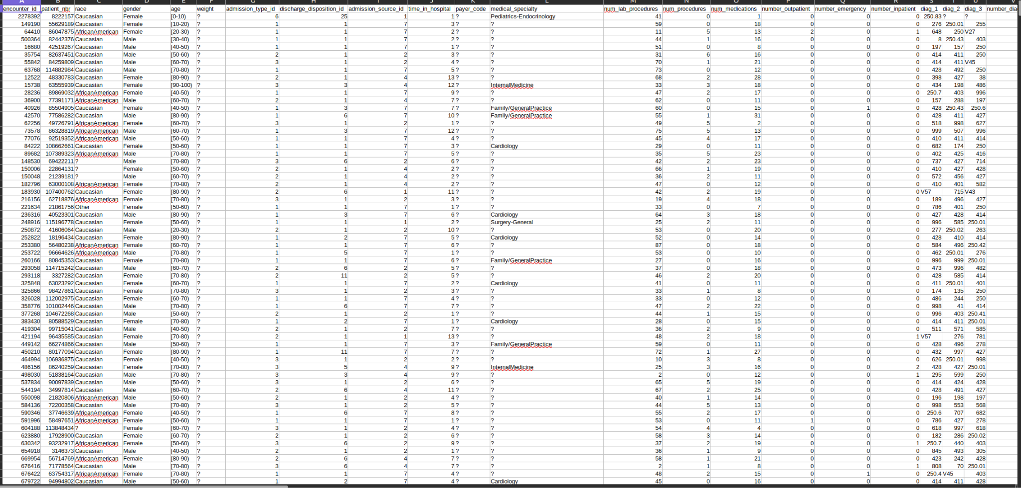
The Data
Data Source: http://archive.ics.uci.edu/dataset/296/diabetes+130-us+hospitals+for+years+1999-2008
Notes:
The original data was 101,766 observations and 50 features collected by Cerner in their HealthFacts database from 130 US hospitals between 1999 and 2008.

Slide 5
Data Wrangling
Be selective of what features are used
Discard cloudy observations
Combine features into hierarchical relationships where appropriate
Handle outliers
Target Variable: Readmitted
Goal is to provide clean, actionable data.
Notes:
As part of data cleaning, several features were dropped including patient weight, payor,
medical specialty of the admitting clinician and many features describing patient prescriptions.
These had constant, near constant or missing values. Admission and discharge type and
source codes were also combined into larger hierarchical categories. Outliers in other features
were handled by deletion, or transformation. The final shape of the data set was 101,727 rows
and 38 columns.

Slide 6
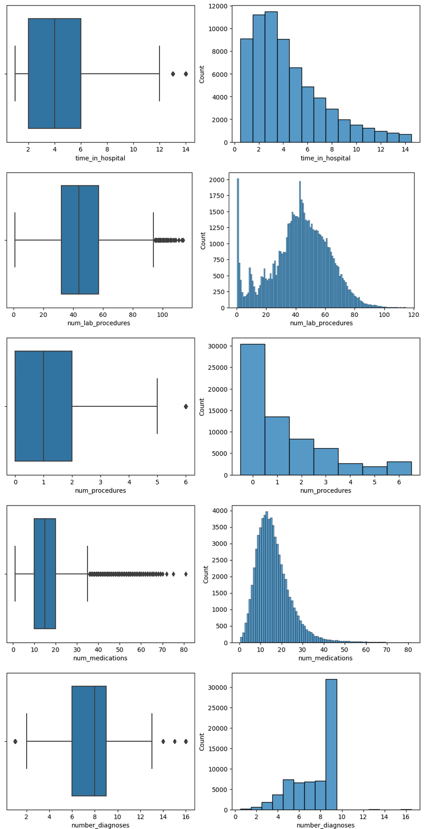
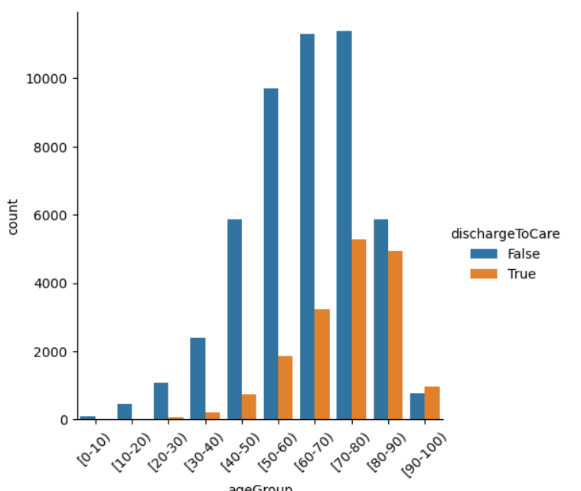
Exploratory
Data Analysis
Notes:
Corrections to the data were made to account for racial and age biases as well has developing new features based on combinations of feature values. For example, groups of diagnoses were created based on how often they were found in the same observation and medications were grouped by pharmacy class.

Slide 7
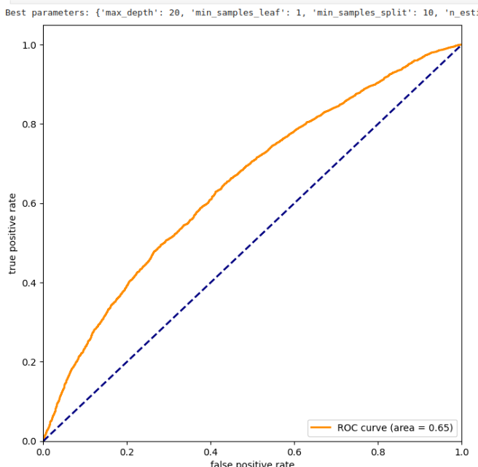
Metric Selection
Model Selection
Logistic Regression
Random Forest Classifier
Naive Bayes Classifier
AUC selected as success metric

Slide 8
Hyperparameter Tuning
Best random forest parameters
20 levels deep
At least 10 samples per split
200 total trees built and tested
Grid Search Cross Validation
Notes:
All models tested were done with 5-fold cross validation in grid search, testing common values for common parameters.

Slide 9
Takeaways
Random forest was best model
Number of lab procedures, medications and inpatient days had the strongest influence
Diagnoses were not important
Race and gender were not important

Slide 10
Future Research
Separate between type 1 and type 2 diabetics
Additional models including neural nets and boosted classifiers
Clinical input on medications and diagnoses clustering

Slide 11
Thank You!
Hospitals contributing data to HealthFacts
Strack, et al. for compiling and modeling the data
Springboard for providing a platform to build additional skills

