Slide 1
AGENTIC CODING / 2026
Agents
at work.
Agentic coding and building agents to automate real workflows.

Slide 2
AGENDA
01
How we got here.
02
Why agents now.
03
What an agent is.
04
OpenClaw, in your pocket.
05
How to build one.
02 / 42

Slide 3
01
How
did software start writing itself?
03 / 42

Slide 4

2010s
Stack
Overflow.
Humans copy snippets between tabs.
HOW ——
04 / 42

Slide 5
2021
Autocomplete
learns to code.
Copilot ships. The IDE starts to predict.
HOW ——
05 / 42

Slide 6

2022-2023
Copy.
Paste.
Pray.
ChatGPT writes the snippet. The human is the runtime.
HOW ——
06 / 42

Slide 7
2023-2024
Chat with
your repo.
LLMs read code, explain it, refactor it.
HOW ——
07 / 42

Slide 8
2025-TODAY
It writes,
runs, ships.
Agents take goals, not keystrokes.
HOW ——
08 / 42

Slide 9
02
Why
does any of this matter?
09 / 42

Slide 10
70%
of knowledge work is repeatable.
Tickets, reports, reviews, follow-ups, glue code.
WHY ——
10 / 42

Slide 11
10×
less typing. Same output.
You describe the goal. The agent does the keystrokes.
WHY ——
11 / 42

Slide 12
0
context switches.
Work stays in one place. The agent goes to the tools.
WHY ——
12 / 42

Slide 13
03
What
is an agent, actually?
13 / 42

Slide 14
An agent
plans. acts. checks. retries.
A loop with judgment, not just a prompt.
WHAT ——
14 / 42

Slide 15
THE LOOP
GOAL
TOOLS
CHECK
→
→
What you want
How it acts
Did it work
Then it loops until done.
WHAT ——
15 / 42

Slide 16
THE SHIFT
SCRIPT
AGENT
Step. Step. Step.
Goal. Decide. Verify.
Breaks the moment reality drifts.
Adapts when the world changes.
Brittle becomes resilient.
WHAT ——
16 / 42

Slide 17
WORKFLOWS TO AUTOMATE
Code.
Ops.
Research.
Reports.
WHAT ——
17 / 42

Slide 18
THE TOOLBOX
Claude Code
Superpowers
OpenClaw
gstack
Agents SDK
LangGraph
MCP
Pick one. The shape is the same.
WHAT ——
18 / 42

Slide 19
THE TOOLBOX
Claude Code
Superpowers
OpenClaw
gstack
Agents SDK
MCP
Pick one. The shape is the same.
WHAT ——
18 / 42

Slide 20
SUPERPOWERS
A plugin
of skills. of habits. of taste.
Drop-in expertise the agent already knows how to use.
WHAT ——
19 / 42

Slide 21
SUPERPOWERS / 01
You have skills.
Search them.
Use them.
A startup rule injected at boot. The bootstrap that kicks it off.
WHAT ——
20 / 42

Slide 22
SUPERPOWERS / 02 —— THE PLAYBOOKS
TDD.
Debug.
Brainstorm.
Plan.
Worktrees.
Review.
Reusable SKILL.md files. Drop-in expertise.
WHAT ——
21 / 42

Slide 23
SUPERPOWERS / 03 —— THE FLOW
Brainstorm.
Plan.
Worktree.
Test. Code. Review.
Ship.
The agent does not code first. It clarifies, plans, isolates, tests, reviews, finishes.
WHAT ——
22 / 42

Slide 24
SUPERPOWERS / 04 —— TDD IS MANDATORY
RED
→
GREEN
→
REFACTOR
Failing test first
Minimal code to pass
Clean. Then commit.
Write the failure. Watch it fail. Then make it pass.
WHAT ——
23 / 42

Slide 25
CLAUDE CODE / 01
An agent
in your terminal.
Reads your code. Edits files. Runs commands. Ships PRs.
WHAT ——
24 / 42

Slide 26
CLAUDE CODE / 02 —— WHAT IT GIVES YOU
Read.
Edit.
Run.
Recall.
Files. Diffs. Shell. Memory. The agent's hands.
WHAT ——
25 / 42

Slide 27
CLAUDE CODE / 03 —— EXTENSIBLE
Bring your skills.
Bring your tools.
Bring your team.
Plugins, MCPs, subagents, hooks. The shape bends to you.
WHAT ——
26 / 42

Slide 28
THE PRIMITIVES
Skills.
Subagents.
Slash commands.
Hooks.
27 / 42

Slide 29
PRIMITIVES / 01 —— SKILLS
A skill
is a folder. of know-how(instructions).
A SKILL.md the agent reads before doing the job.
WHAT ——
28 / 42

Slide 30
PRIMITIVES / 02 —— SUBAGENTS
Spawn a helper.
Hand it a task.
Get a report.
Parallel work. Fresh context. Less noise in the main thread.
WHAT ——
29 / 42

Slide 31
PRIMITIVES / 03 —— SLASH COMMANDS
/review.
/plan.
/ship.
Frozen prompts. One keystroke. Reusable workflows.
WHAT ——
30 / 42

Slide 32
PRIMITIVES / 04 —— HOOKS
PRE-HOOKS
POST-HOOKS
BEFORE
→
DURING
→
AFTER
Gate the action
Watch it run
React to it
Scripts that run on the agent's lifecycle. Guardrails, telemetry, glue.
WHAT ——
31 / 42

Slide 33
PROJECTS
PROJECTS
WHAT ——
32 / 42

Slide 34
PROJECTS
DEMO
WHAT ——
32 / 42

Slide 35

04
OpenClaw
an agent in your pocket.
33 / 42

Slide 36
OPENCLAW / 01
A personal agent
you run yourself.
MIT-licensed. Local-first. Markdown memory on disk.
WHAT ——
34 / 42

Slide 37
OPENCLAW / 02 —— YOU TEXT IT
WhatsApp.
Telegram.
Slack.
iMessage.
The channel you already use becomes the command line.
WHAT ——
35 / 42

Slide 38
OPENCLAW / 03 —— YOUR DAY, AUTOMATED
01
Morning brief.
bills, calendar, mail
02
Triage your messages.
WhatsApp, Slack
03
Drive a browser.
log in, download
04
Run the shell.
scripts, files
05
Manage the calendar.
schedule, follow up
WHAT ——
36 / 42

Slide 39
OPENCLAW / 04 —— BRING YOUR OWN BRAIN
Anthropic.
OpenAI. Google(Gemini).
Or local. Ollama.
Your hardware. Your model. Your rules.
WHAT ——
37 / 42

Slide 40
OPENCLAW / 04 —— BRING YOUR OWN BRAIN
MY RECOMMENDATION
Your hardware. Your model. Your rules.
WHAT ——
37 / 42

Slide 41
BUILD ONE
01
Pick a workflow you do weekly.
10 min
02
Give it tools and a goal.
1 hr
03
Let it loop. Watch. Iterate.
ongoing
WHAT ——
38 / 42

Slide 42
THE HARD PART
Context.
Tools.
Trust.
WHAT ——
39 / 42

Slide 43
THE PRINCIPLE
Small agents.
Sharp tools.
Tight loops.
WHAT ——
40 / 42

Slide 44
WHAT'S NEXT
Fewer apps.
More agents.
Same goals.
WHAT ——
41 / 42

Slide 45
?
AGENTIC CODING

Slide 46
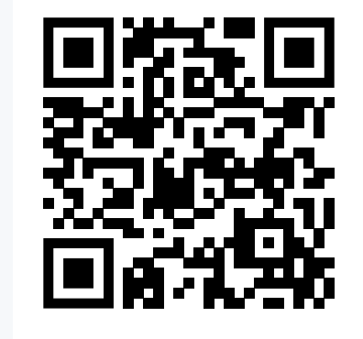
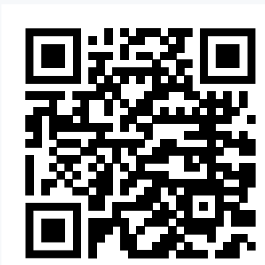
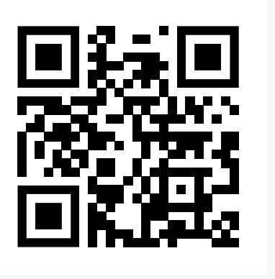
SOCIALS
ASH
DISCORD
KESHAV

