Slide 1
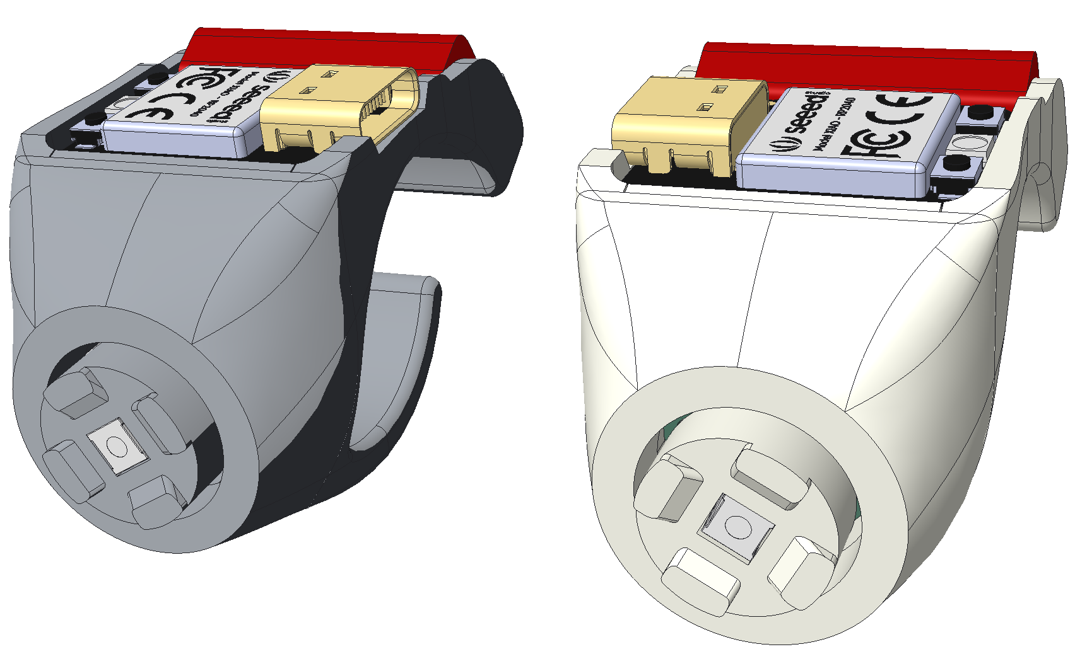
Left Hand Ring
Right Hand Ring
scroll up
left click
scroll up
left click
right click
deep sleep
reset
scroll down
right click
scroll down
deep sleep
reset

Slide 2
deep sleep
reset
deep sleep
reset
Y axis
X axis
Y axis
X axis
X axis
left mouse
click
Y axis
X axis
Y axis
left mouse
click

