Slide 1
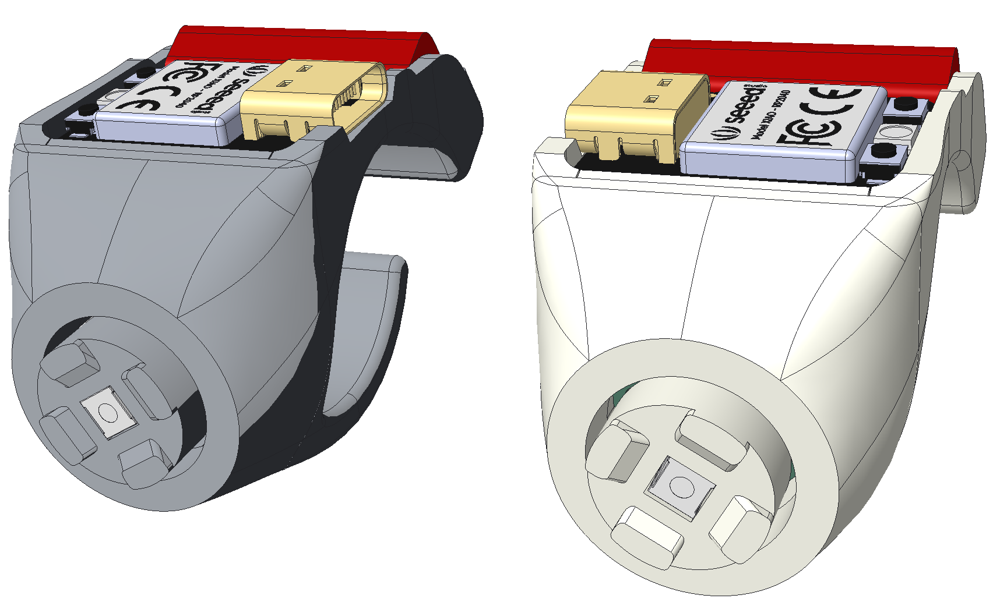
Left Ring
Right Ring
scroll up
left click
scroll up
left click
right click
scroll down
deep sleep
reset
right click
scroll down
deep sleep
reset

