Slide 1
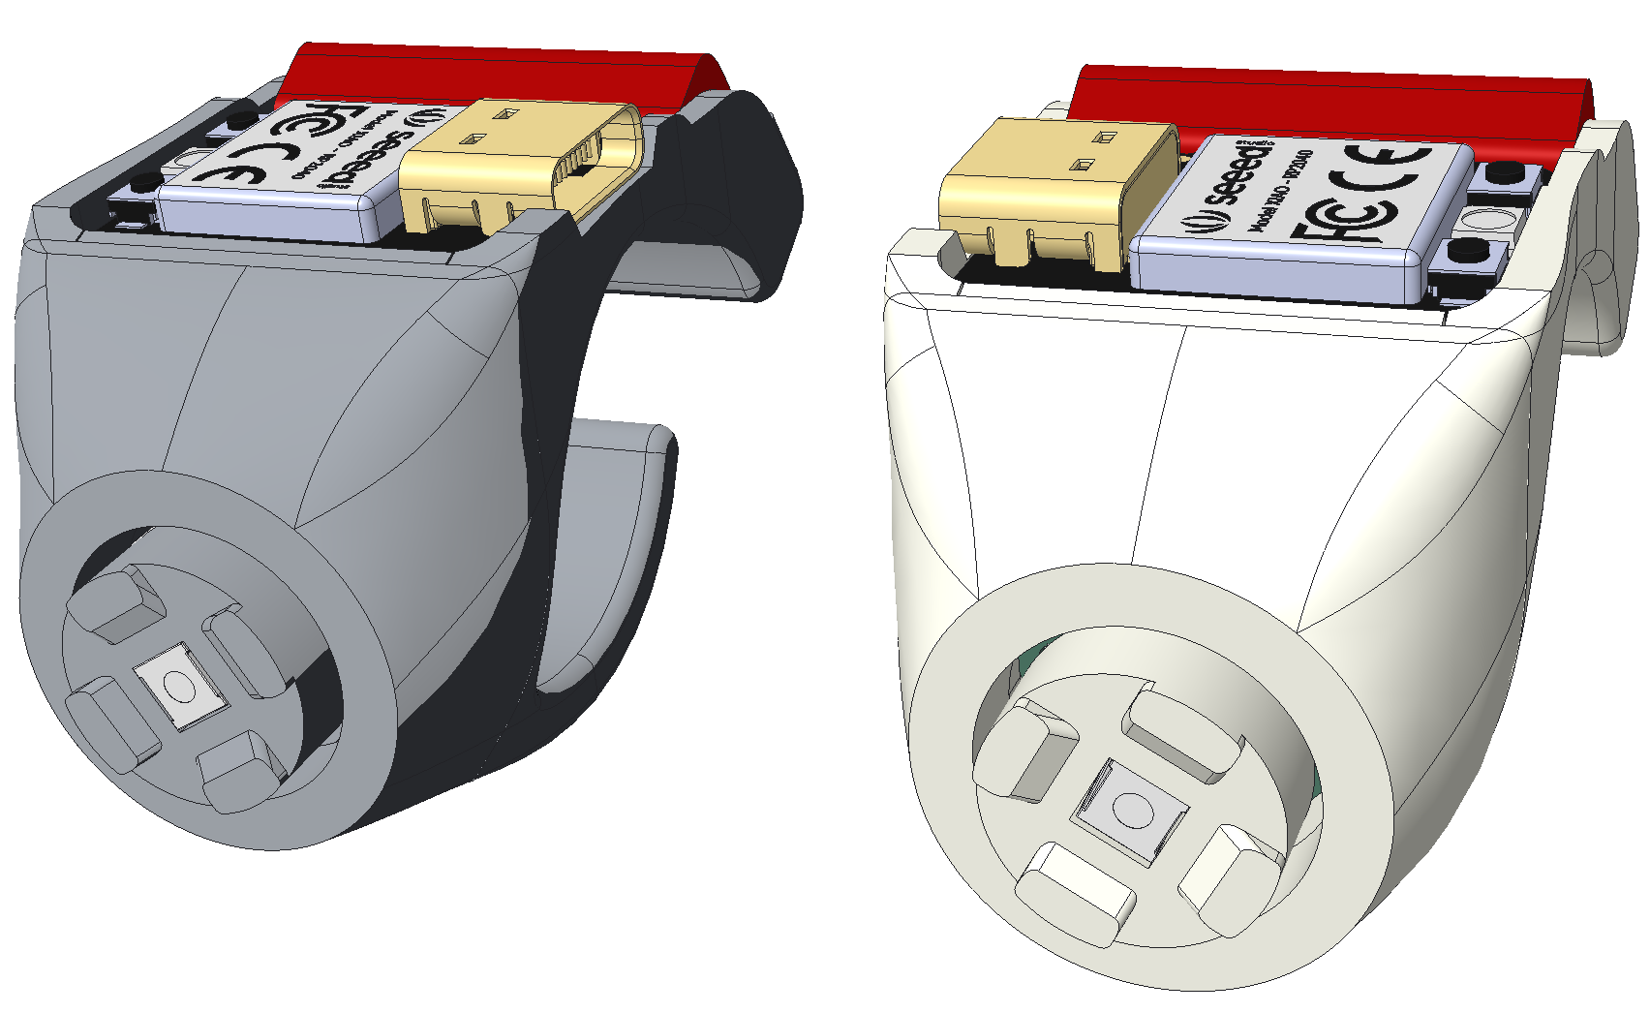
Left Hand Ring
Right Hand Ring
scroll up
left click
scroll up
left click
right click
deep sleep
reset
scroll down
right click
scroll down
deep sleep
reset

