Slide 1
Is Sentiment of Corporate Announcements A Good Predictor Of A Share Price Change? The Case of Using FinBERT On A Dataset of Joint Venture Announcements
Prepared by: Svetlana Ashchepkova
Supervised by: Anastasia Uspenskaya
Netology, 2021

Slide 2
Problem statement and research question
Problem: finding the relation between the tonality of corporate announcements and the share price changes
Research question: can tonality of corporate announcements serve as a share price predictor?

Slide 3
Dataset and experimental design
Dataset: 50 announcements about joint venture creation (US-based and US-listed companies, different transactions, different industries), manually pre-processed to remove titles and regulatory disclosures
Experiments: Comparison of several groups within a dataset (using non-parametric tests). Classification problem

Slide 4
Model for tonality assessment
FinBERT:
A finance domain specific BERT model trained on a large financial communication corpora of 4.9 billion tokens, including corporate reports, earnings conference call, transcripts and analyst reports
Higher accuracy compared to generic BERT models
Pre-trained and fine-tuned model

Slide 5
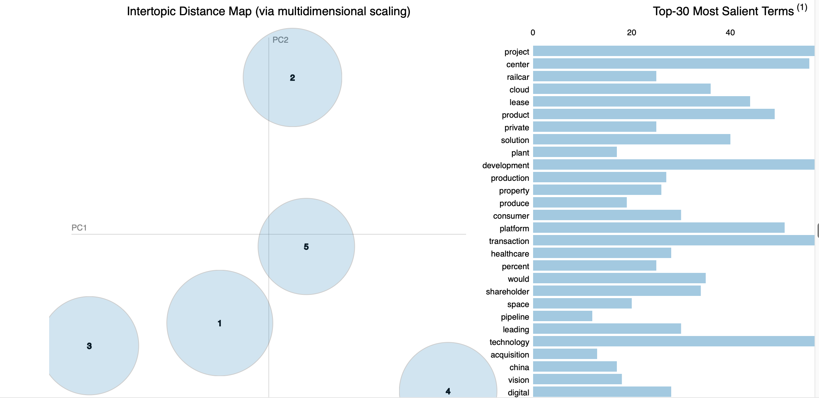
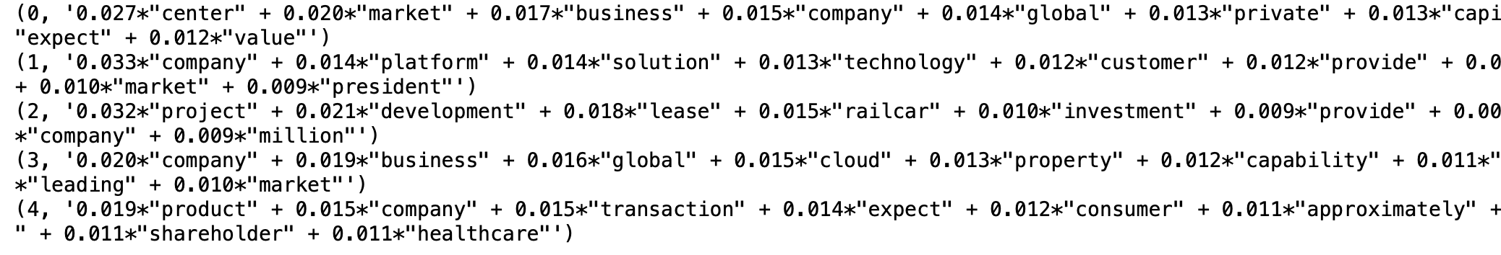
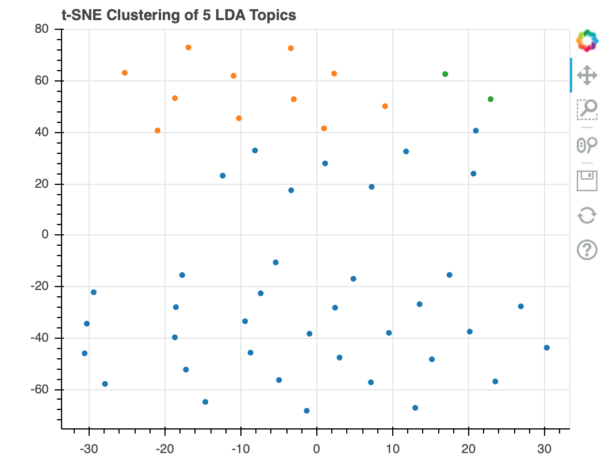
Feature creation
Creating a Dominant Topic feature using the LDA model (5 topics)

Slide 6
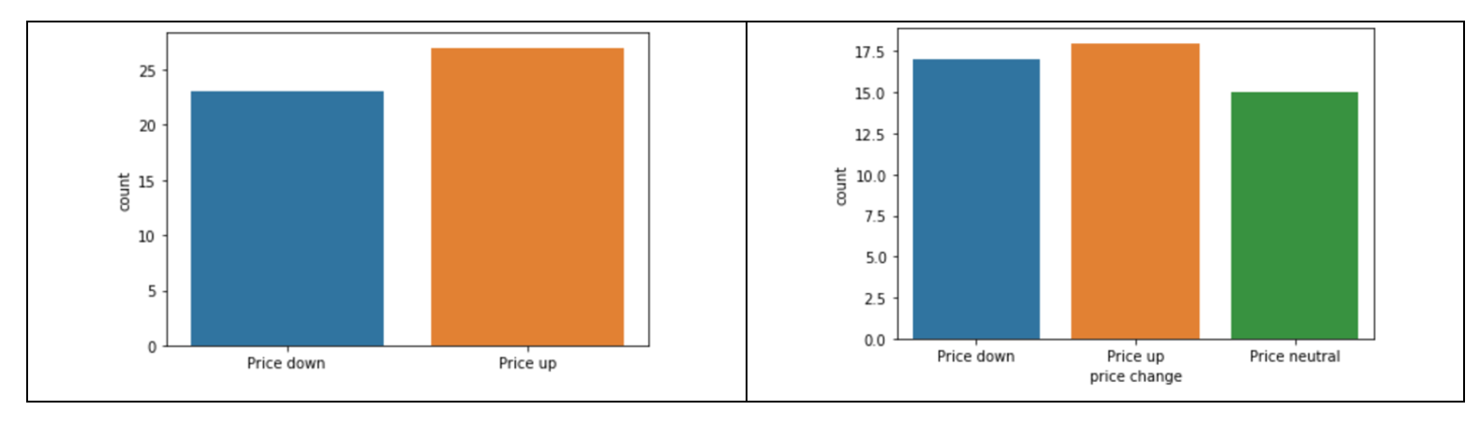
Experiment 1. Difference Between Groups
Two tests: Mann-Whitney and Kruskal-Wallace
In both tests, p-value was significantly above 0.05 pointing to likely absence of statistically significant difference in share price change following the announcement

Slide 7
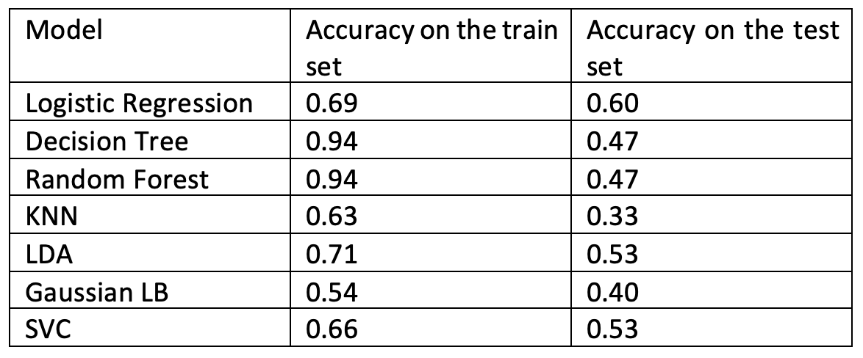
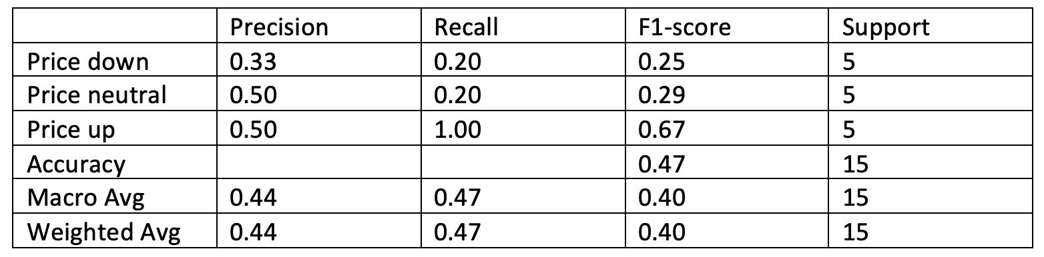
Experiment 2. Classification

Slide 8
Limitations of FinBERT
Limitation of FinBERT Text Analytics
1. It is a large model, so fine-tuning the whole model requires significant time and computing power.
2. The model fails to do math in which the figure is higher where there are no indicative words like ‘higher’
3. It fails to distinguish neutral statements about a given situation
4. It fails to identify if the situation is a positive outlook or an objective observation
Source: https://nu-pie.com/how-can-finbert-help-you-get-a-jump-on-your-competitors/

