Slide 1
Zomato Restaurant Reviews Teal Rabbits
Ashley Drayton, Babette Blanquet, Benedict Nathaniel, Erica Wearne

Slide 2
Zomato Restaurant Reviews Teal Rabbits Hypothesis, Questions and Overall Findings
Hypothesis:
Melbourne is the cultural epicentre of Australia and renowned for the quality and diversity of its food.
Melbourne has the best restaurants amongst the five largest cities in Australia.
Question:
Does Melbourne really have the best restaurants in Australia based on price, ratings and diversity of cuisines?
Findings:
Melbourne has the highest rated restaurants however it comes at a higher price.

Slide 3
Zomato Restaurant Reviews Teal Rabbits The Data Exploration
We used Zomato API to gather the data.
Our dataset included 500 restaurants
Top 100 restaurants of Melbourne, Sydney, Brisbane, Adelaide, Perth
Challenges
Finalising the API enquiry
The limitation of 100 restaurants maximum per call.
We were wanting 1000 restaurants per city.
Biases
By choosing only the five cities, this excluded possibly excellent restaurants in rural areas of Australia.
We were interested in the best restaurants where most Australians live.

Slide 4
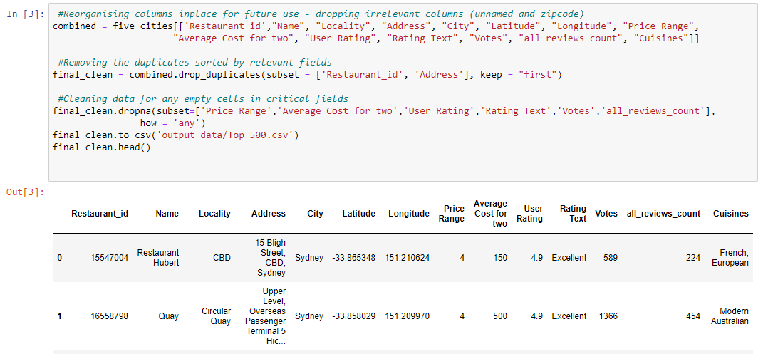
Zomato Restaurant Reviews Teal Rabbits Data Clean-Up
Initial clean
Cleaning of top 500 restaurants
Creation of CSV of the top 500 restaurants

Slide 5
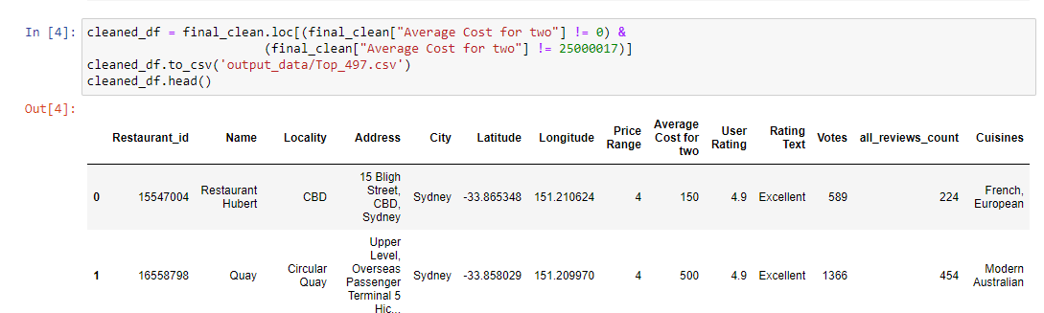
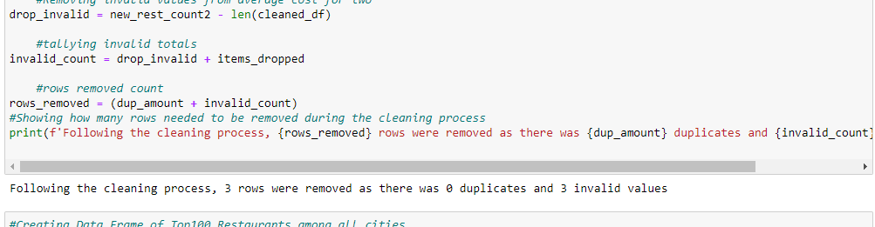
Zomato Restaurant Reviews Teal Rabbits Data Clean-Up
Clean of incorrect cells (Average cost for 2) → Creation of CSV containing the top 497 restaurants
Calculation of the removed rows during the cleaning process

Slide 6
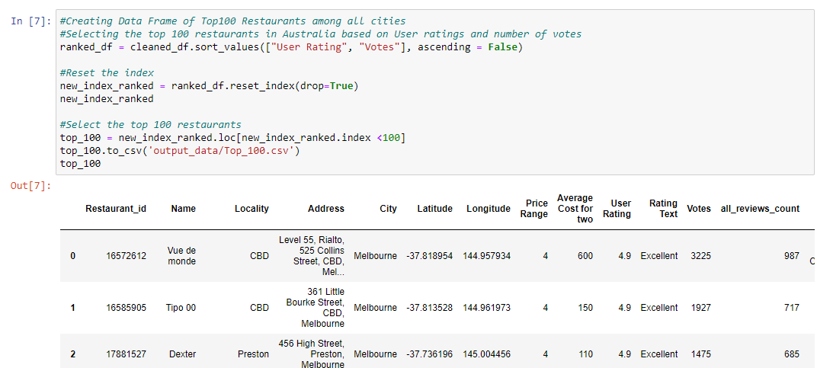
Zomato Restaurant Reviews Teal Rabbits Data Clean-Up
Obtained top 100 restaurants based on user ratings
Where user ratings were tied, total votes were considered

Slide 7
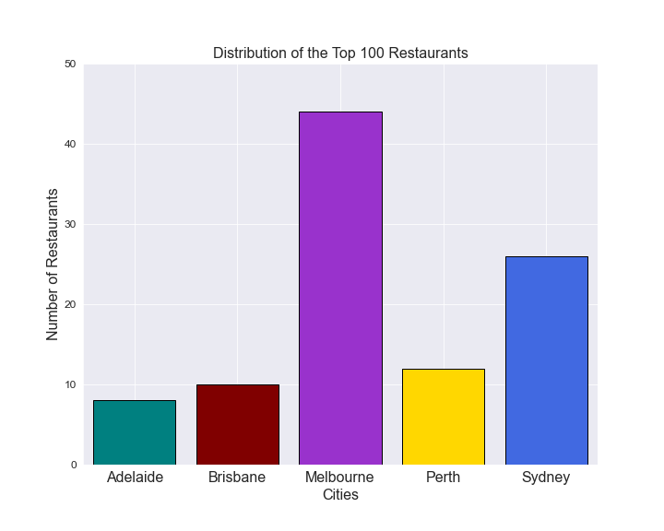
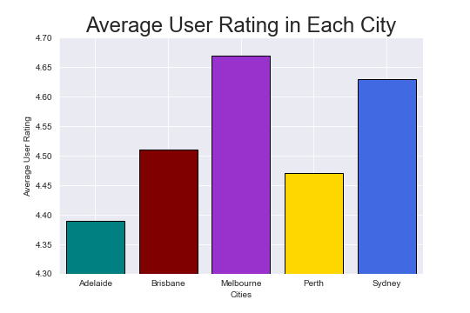
Zomato Restaurant Reviews Teal Rabbits Restaurant Distribution and Average User Rating
When doing the comparison of the top 500 restaurants however, Melbourne is ahead on average user ratings and equal with Sydney on median user rating.
44% of the Top 100 Restaurants are in Melbourne.

Slide 8
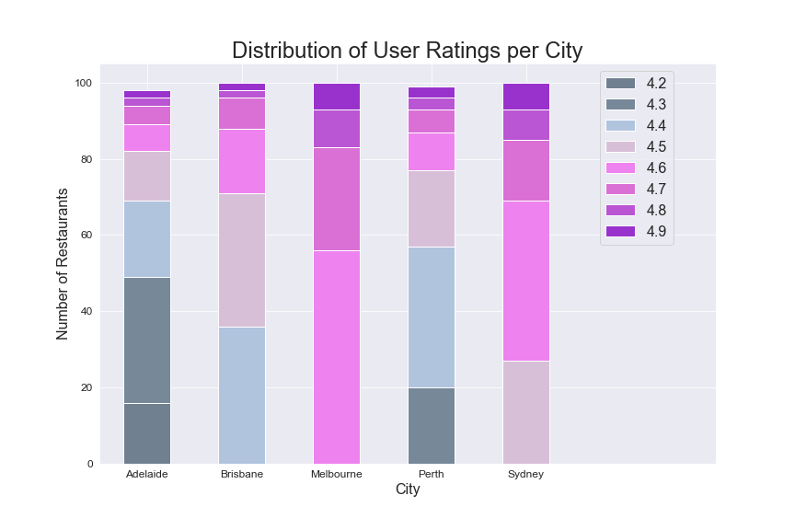
Zomato Restaurant Reviews Teal Rabbits User ratings across top 500 restaurants in each city
Melbourne and Sydney have a slightly higher ratings than other cities.
The Top 100 restaurants in Melbourne have a rating >= 4.6

Slide 9
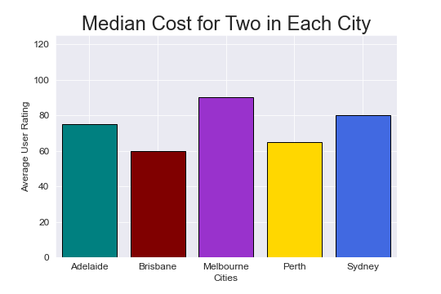
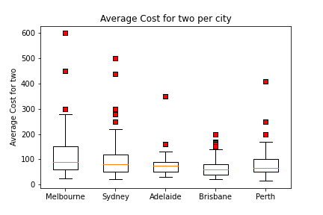
Zomato Restaurant Reviews Teal Rabbits Cost Comparison Across the Cities
Melbourne is significantly more expensive than in any other city
Melbourne outlying restaurants don’t explain the high average cost

Slide 10
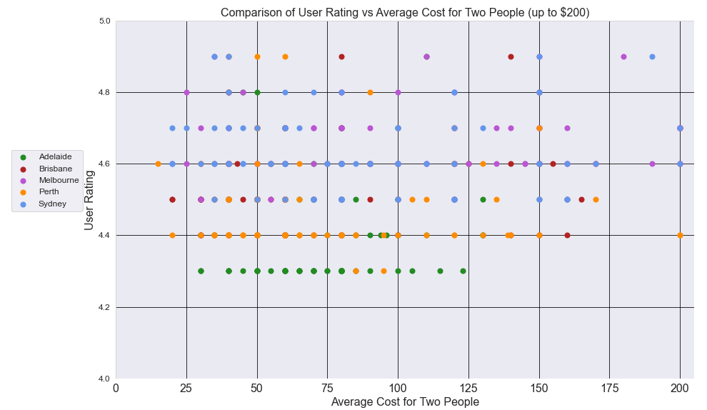
Zomato Restaurant Reviews Teal Rabbits Affordability vs Quality
There is no correlation between user rating and the average cost for two people.

Slide 11
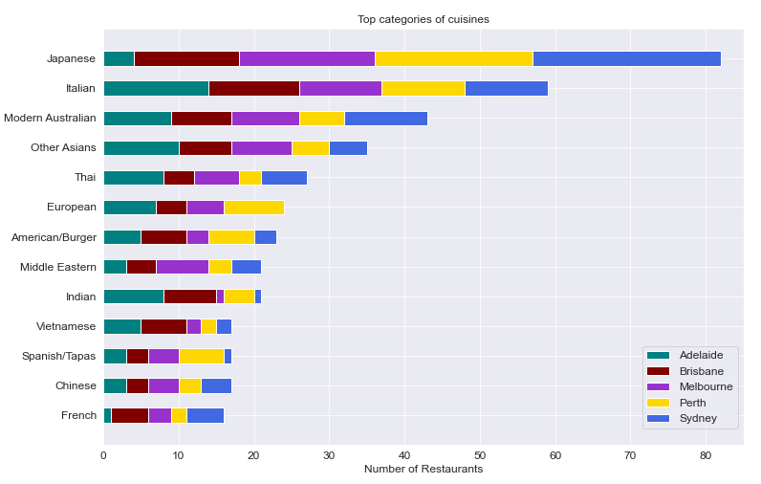
Zomato Restaurant Reviews Teal Rabbits Cuisines and cities
The Japanese and Italian cuisines are the most represented among the top restaurants.
The variety of cuisines is roughly the same across all cities.

Slide 12
Zomato Restaurant Reviews Teal Rabbits Summary and Conclusion
Summary
44% of the Top 100 restaurants are located in Melbourne
Melbourne’s average cost for two people is significantly higher than other city in Australia, topping Sydney by $20 and other cities by $40.
The top 500 restaurant list paints a better picture in the aspects we’re observing, affordability also increases as we expand our list to top 500 restaurants.
Generally, cuisines are evenly diverse across the 5 cities.
Conclusion
Melbourne has the highest rated restaurants however it comes at a higher price.

Slide 13
Zomato Restaurant Reviews Teal Rabbits Challenges
Challenges
Higher average cost in Melbourne’s top restaurants can be potentially skewed by factors such as the dining scene, target demographics, paid marketing, etc. Zomato IS after all for-profit.
Top 100 doesn’t adequately represent the dining scene in Australia – heavily favoured by Melbourne.
Zomato categorisation includes multiple terms that may convolute the data exploration process, may cause categorical disparity.
Broad vs specific categorisation.
What we took is a “snapshot”, not accurately representing the thousands of other restaurants in those cities.
If we had 2 more weeks..
We would look at a larger number of restaurants and assess grouping more thoroughly.
Look at other APIs and do further validation - perhaps more public ones such as Google Maps and Foursquare APIs.

Slide 14

Questions

