Slide 1
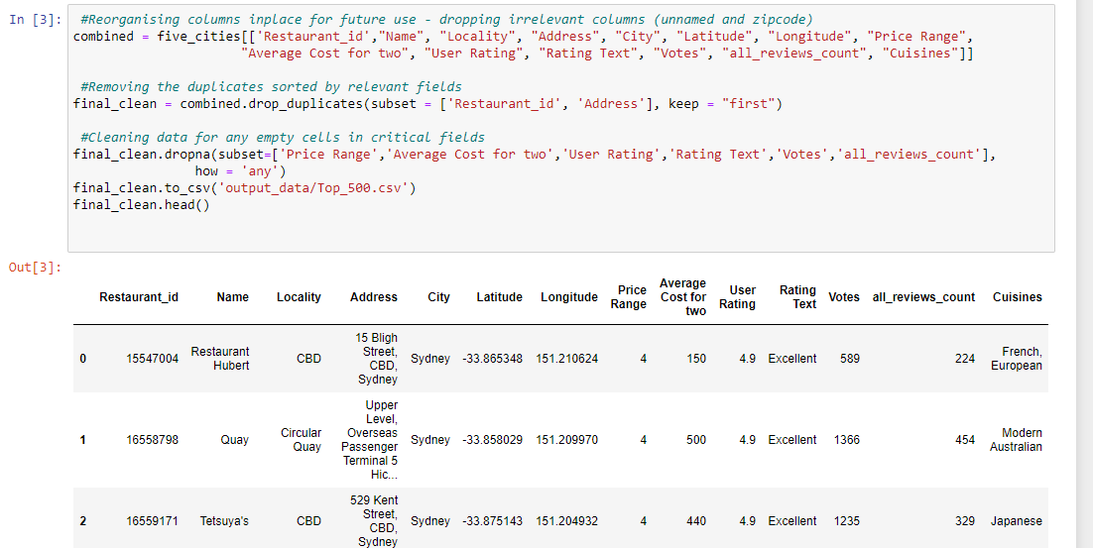
Data Clean-up
Initial Clean → Creation of top 500 csv

Slide 2
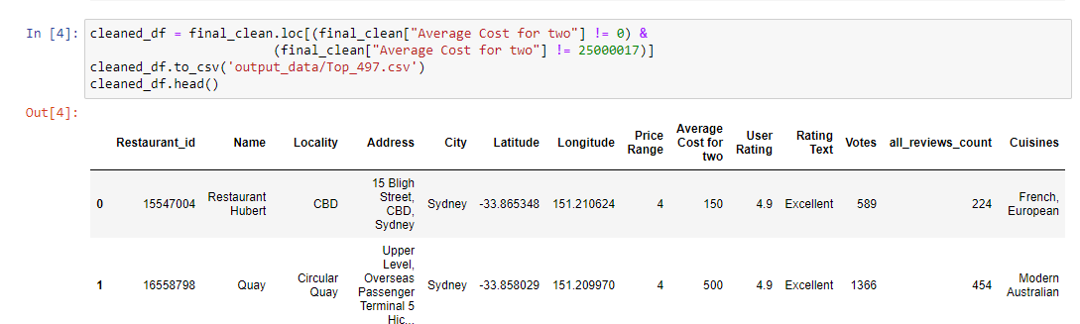
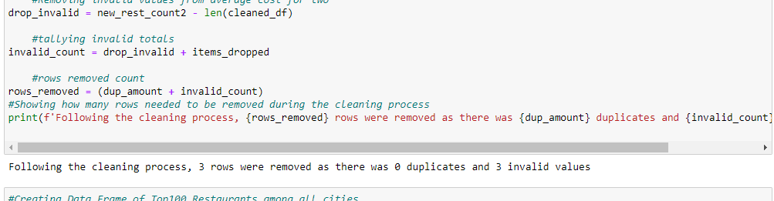
Data Clean-up
Clean of incorrect cells (Average cost for 2) → Creation of top 497 csv
Calculation of the removed rows during cleaning process

Slide 3
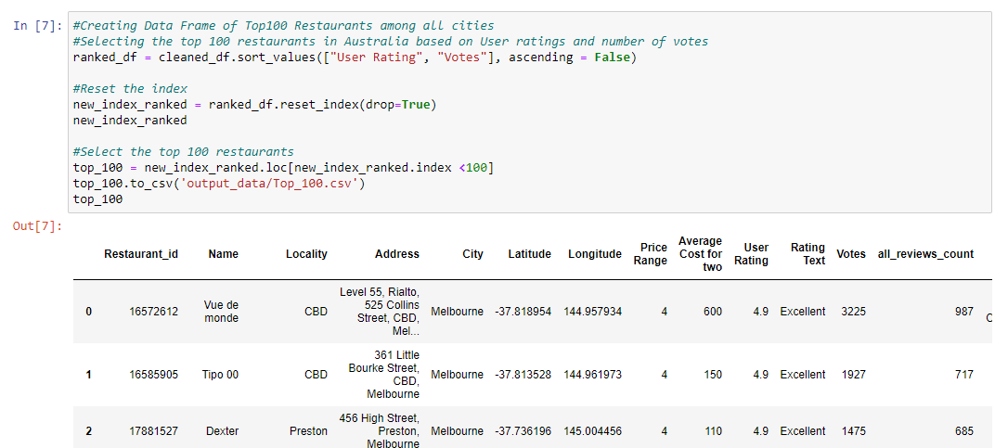
Data Clean-up
Obtaining the top 100 restaurants based off User ratings (then total votes if tied)

