Slide 1
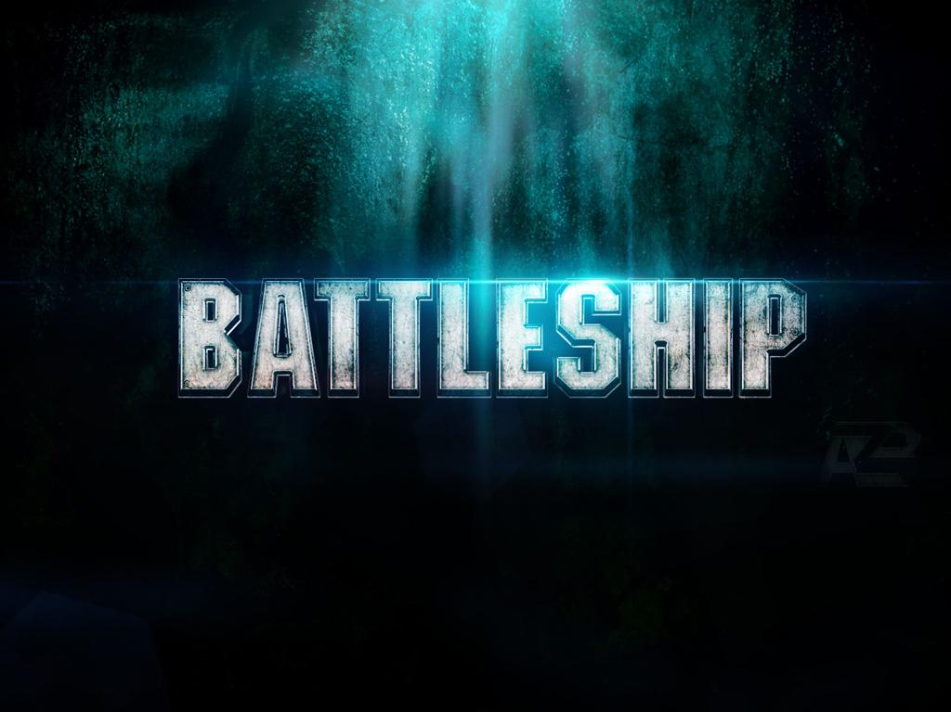
By: Miguel Martínez && Eduardo Pérez

Slide 2

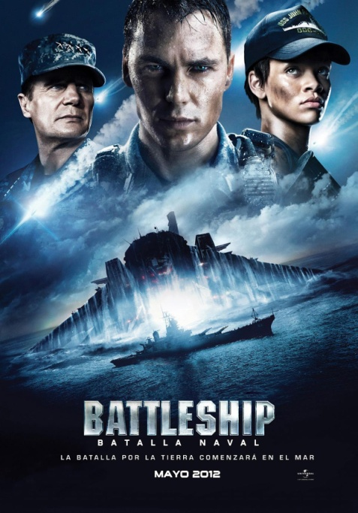
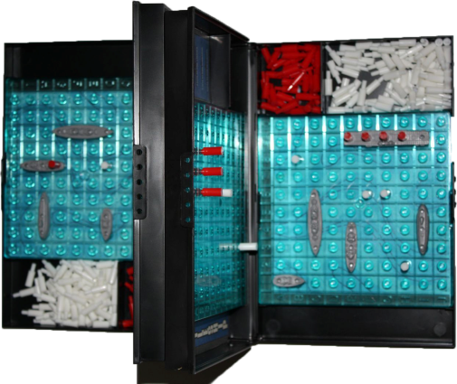
What is BattleShip?
BattlesShip is a guessing game for two players.
It was published by Milton Bradley Company in 1931 as the pad-and-pencil game "Broadsides, the Game of Naval Strategy”
And as a board game in 1967.
The 2012 film Battleship is an American science fiction action movie inspired by the board game.

Slide 3
Objectives
Build the game with similar mechanics
Allow for PvP combat to play online
Do all this in Java!

Slide 4

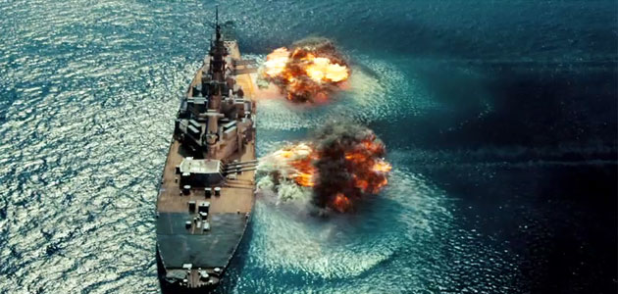
Future updates will include…
4 player matches
Gold shots that allow to know in which direction is the closest ship.
Rapid cannon fire – Fire up to 5 shots at a time.
Save high scores for each player
…

Slide 5
Program tree
Battleship.java
SetUp.java
BSThread.java
Player.java
CommunicationMechanics.java
Ship.java

Slide 6
Program tree (cont.)
Class definitions:
Player -> holds all of the player's information, such as his Board with the location of his ships, the enemy board, the places he has already bombed, etc
Ship -> Ship class that holds the information of each ship, such as the coordinates of all of his positions, and the methods to operate with these coordinates
BSThread -> Starts SetUp with new thread
CommunicationMechanics -> allows for communication among the players
SetUp -> Starts server and allows for remote & local connections through port 7777
Battleship -> Where the game and its mechanics are implemented

Slide 7
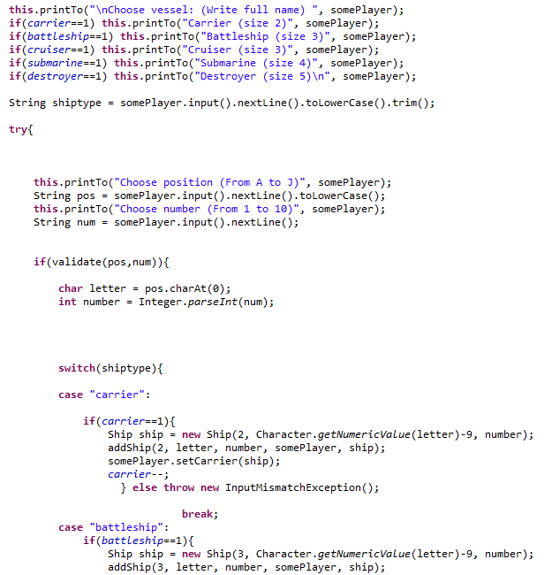
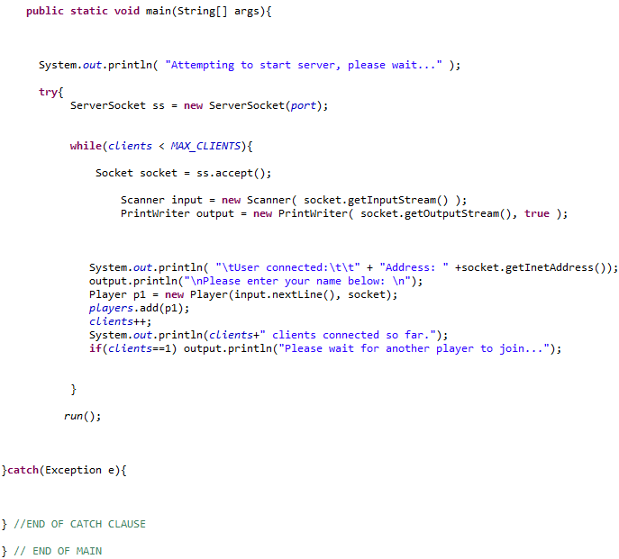
Code
Let’s take a look at the code!
Note: The code will be made public in case you want to try out yourself, or see its implementation. Check the Projects section in theskyfall.com for the download link and more.

Slide 8
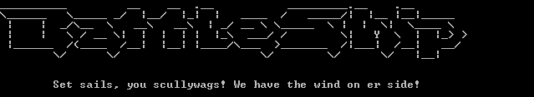
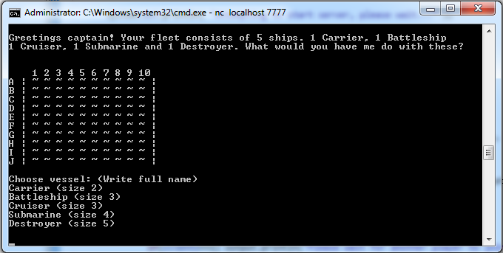
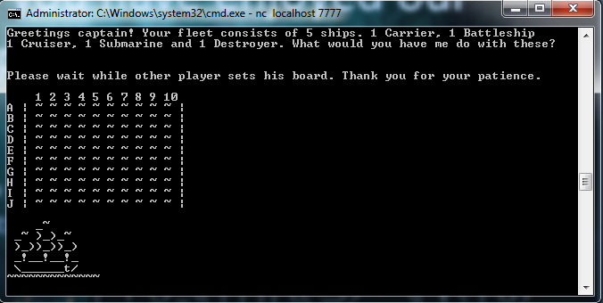
We hope you have enjoyed our presentation!
Last minute thought:
We are always open to suggestions, if you have any idea that could help make it better, share it with us!
Thanks a lot for your attention!

Slide 9
THANK YOU!

