Slide 1
The History of Women in Tech
Sarah Dutkiewicz
sarah@cletechconsulting.com
Notes:
Presented at Strangeloop – September 19, 2013
Over 15 years ago, only woman in some of my engineering courses and only female and computer engineering in my diff eq class. Where were the women?
While sitting in a Solaris lab on campus, wondering if there were many women in tech and what their contributions were.
These are just some of the many inspirational women in tech that we all can learn from.

Slide 2
Learning More About These Women in Tech
Ada Lovelace
The Ladies of the ENIAC
Grace Murray Hopper
Barbara Liskov
Frances Allen
Mary Lou Jepsen

Slide 3
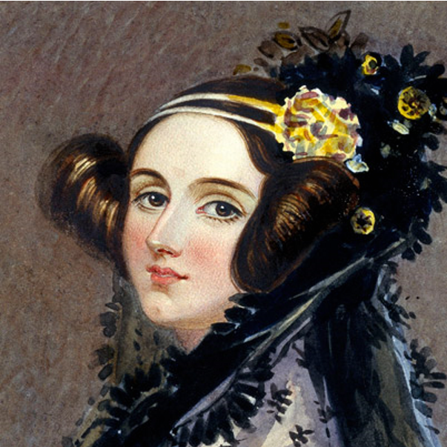
Augusta Ada Byron, Lady Lovelace (1815-1852)
Daughter of Lord Byron, raised by Lady Byron
Raised in hopes of not becoming a poet
Focused studies in maths and science
1828 – Flying Machine

Slide 4
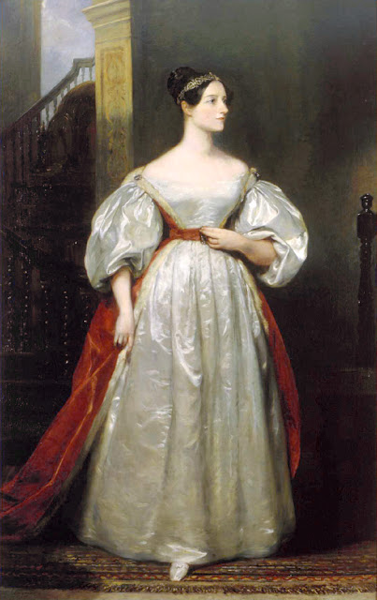
If you can’t give me poetry, can’t you give me “poetical science”?
Ada Byron, Lady Lovelace – to her mom
Notes:
Source: http://cs-www.cs.yale.edu/homes/tap/Files/ada-bio.html

Slide 5
Math
+ Imagination
+ Metaphors
Magic

Slide 6
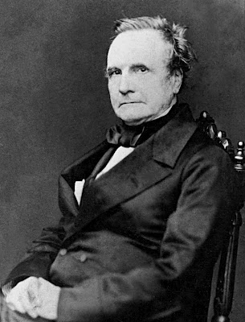
Early Mentoring
Met her mentor – Charles Babbage - through Mary Somerville (s Scottish mathematician & astronomer( at the age of 17
Mentor was mathematician, philosopher, inventor, and mechanical engineer
Ada had a life outside of this
Wife to Earl of Lovelace
Mom to 3 kids under 8
Notes:
Image and notes from http://www.historyandwomen.com/2012/09/augusta-ada-byron-countess-of-lovelace.html

Slide 7
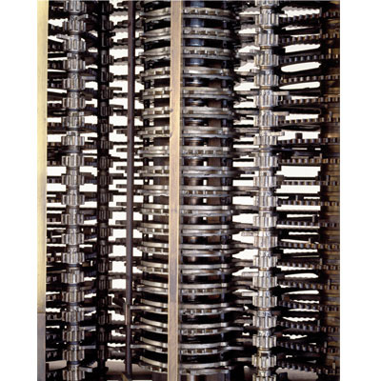
1843 – Predictions for the Analytical Engine
Compose complex music
Produce graphics
Practical & scientific use

Slide 8
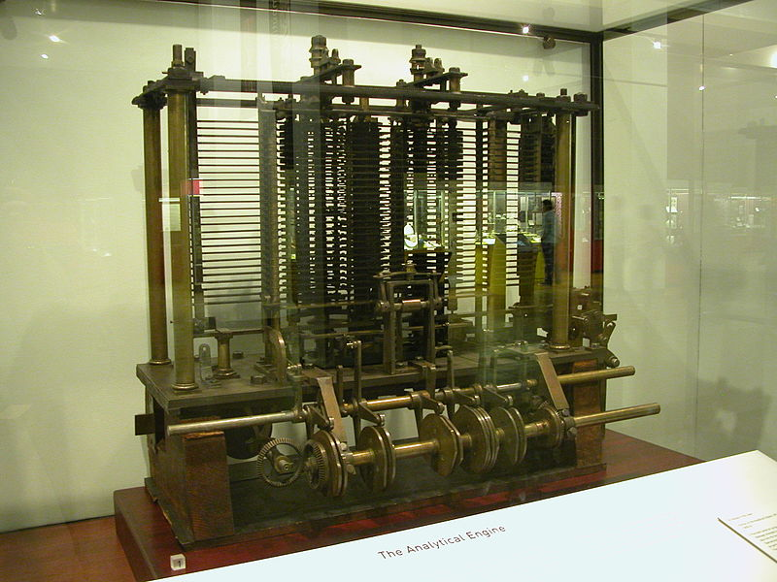
Ada & The Analytical Engine
She documented her mentor’s Analytical Engine and included the first program – how to calculate a sequence of Bernoulli numbers with the Engine.
First individual to conjure a computer algorithm
1843 – Published in English science journal as A.A. L. on how codes can be created to handle letters, numbers, and symbols.
Notes:
Analytical engine image taken from: http://www.computerhistory.org/babbage/engines/

Slide 9
Lessons from Ada
Follow your passion. Her poetical science eventually led her to success.
Moms can work while maintaining a social life and a career.
Choose a mentor who you’re interested in learning from and feed off of and into their energy.

Slide 10
The Original Ladies of the ENIAC
Notes:
Fran Bilas: http://en.wikipedia.org/wiki/Fran_Bilas
Ruth Teitelbaum: http://en.wikipedia.org/wiki/Ruth_Teitelbaum

Slide 11
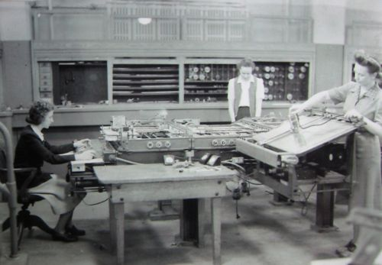
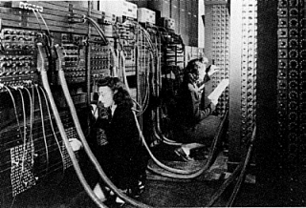
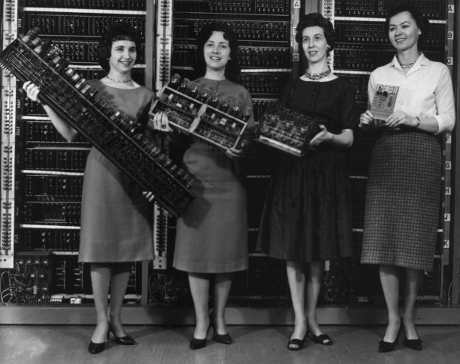
Some of the Women of the ENIAC
Notes:
ENIAC First Four from the US Army: http://ftp.arl.army.mil/ftp/historic-computers/jpeg/first_four.jpg

Slide 12
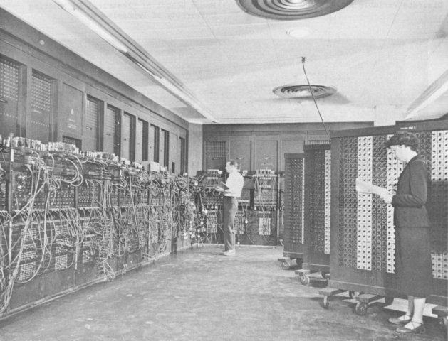
Notes:
Images available from http://ftp.arl.army.mil/~mike/comphist/

Slide 13

Kathleen “Kay” McNulty Mauchly Antonelli
one the six original programmers of the ENIAC
degree in mathematics
started with ballistics trajectories and happened into the ENIAC
worked on BINAC and UNIVAC I software design
eventually would marry one of the ENIAC co-inventors

Slide 14
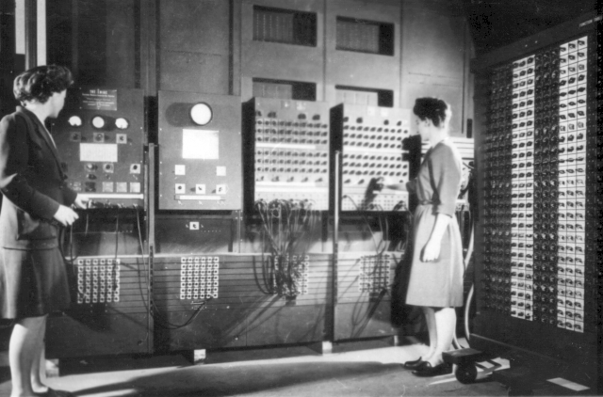
(Betty) Jean Jennings Bartik
responsible for administering the Master Programmer, central program of the ENIAC
helped transform ENIAC into something easier to work with and able to handle more sophisticated problems
moved on to BINAC and UNIVAC I

Slide 15
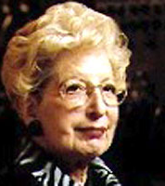
Marlyn Wescoff Meltzer
one of the first group of ENIAC programmers
originally hired by Moore School of Engineering for weather calculations
eventually moved on to ballistic trajectories

Slide 16
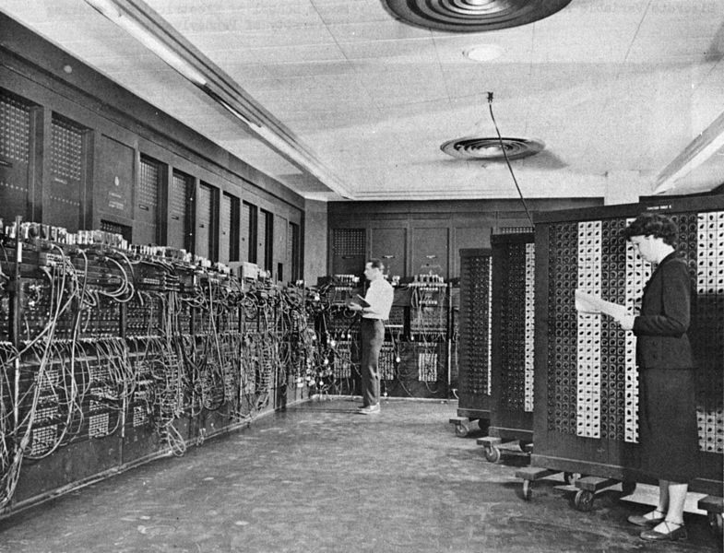
Frances Elizabeth (Betty) Snyder Holberton
responsible for administering the Master Programmer, central program of the ENIAC
part of the UNIVAC I code team
part of the COBOL Committee
worked on developing standards for FORTRAN

Slide 17
Frances Bilas Spence
majored in math, minored in physics
originally worked on ballistics trajectories
one of the first ENIAC computer programmers

Slide 18
Ruth Lichterman Teitelbaum
B Sc in Math
one of the first ENIAC computer programmers
followed the ENIAC and taught the next generation how to program it

Slide 19
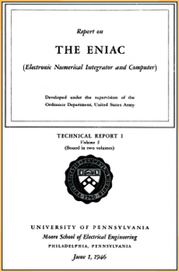
Adele Goldstein
initially trained some of the original programmers in calculating firing table trajectories
wrote the documentation for the ENIAC
created the Report on the ENIAC

Slide 20
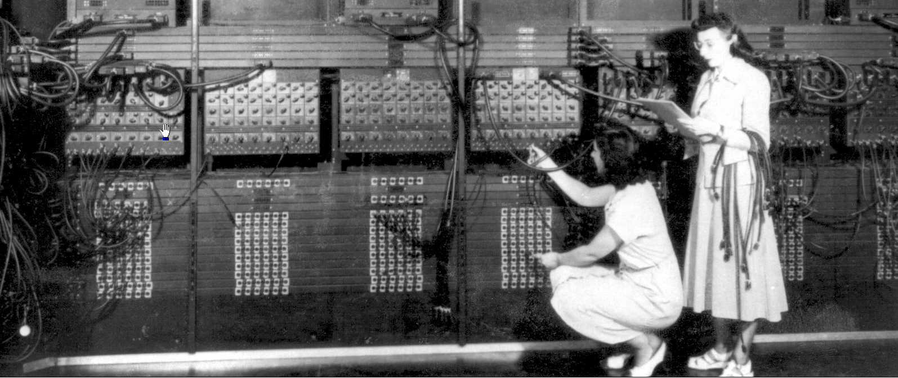
Notes:
Gloria Ruth Gordon Bolotsky and Ester Gerston at work, taken from http://www.columbia.edu/cu/computinghistory/eniac.html

Slide 21
Where a calculator on the ENIAC is equipped with 18,000 vacuum tubes and weighs 30 tons, computers in the future may have only 1,000 vacuum tubes and perhaps weigh 1.5 tons.
Popular Mechanics, March 1949

Slide 22
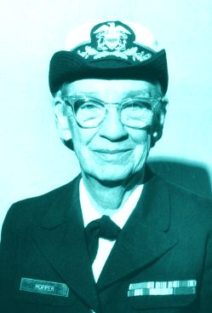
Admiral Grace Murray Hopper (1906 – 1992)
Enjoyed tearing things apart to learn how they worked
B.A. in Math & Physics, M.A. & Ph. D. in Mathematics
Began teaching maths in 1931
Family of military traditions, led her to Navy WAVES (Women Accepted for Voluntary Emergency Service) in 1943
Commissioned as lieutenant 6 months later

Slide 23
We’ve always done it that way.

Slide 24
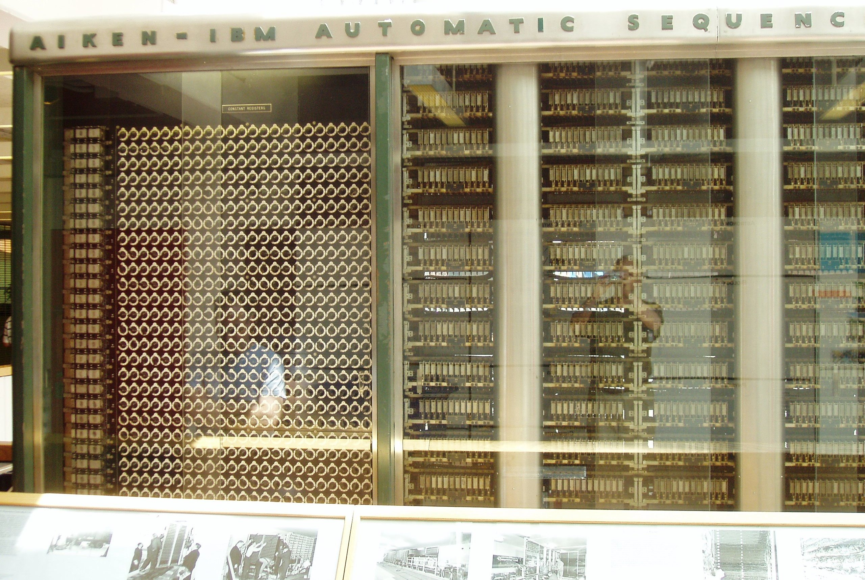
The Trail of Success
Starting computing coefficients of arc tangents with an electromechanical Mark I
500-page Manual of Operations for the Automatic Sequence-Controlled Calculator
Eventually moved on to Mark II & Mark III

Slide 25
The Quest for Programmer-Friendly & Application-Friendly Tools
Bringing the computer to a much wider audience
Notes:
From Harvard to Eckert-Mauchl;y, Remington-Rand, Sperry-Rand, and Univac

Slide 26
The Power of Collaboration
Reduced errors
Less tedium
Less duplication of effort
Notes:
Encouraged collecting and sharing portions of programs

Slide 27
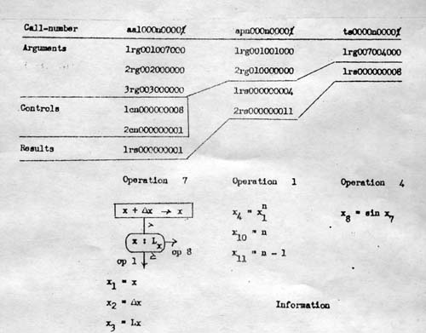
The Compiler
Mnemonics transformed into binary code instructions
A-O series was first – allowing specification of call numbers to programming routines stored on magnetic tape. One could then call those numbers to access the routine.
Notes:
Image taken from http://www.cbi.umn.edu/iterations/norberg.html

Slide 28
Reaching Out to Non-Scientific Reaches
Opening the world through development of programming languages

Slide 29
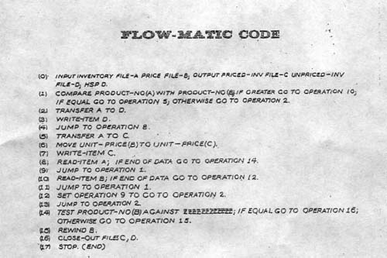
FLOW-MATIC
Translate language used for automatic billing and payroll calculation
UNIVAC I & II understood 20 English statements
1952 – published her first compiler paper
Notes:
Image taken from http://www.cbi.umn.edu/iterations/norberg.html

Slide 30
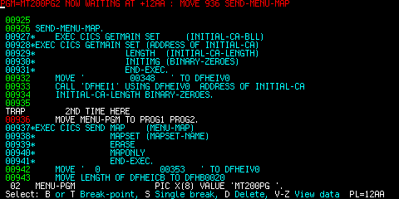
COBOL Language Design
Greatly influenced by FLOW-MATIC
Defined by the CODASYL (Conference on Data Systems Languages) Executive Committee and CODASYL Short Range Committee
First specs in 1959
Push for standardizing COBOL

Slide 31
Language Validation
Started with COBOL
Moved on to other programming languages
Led to national and international standards

Slide 32
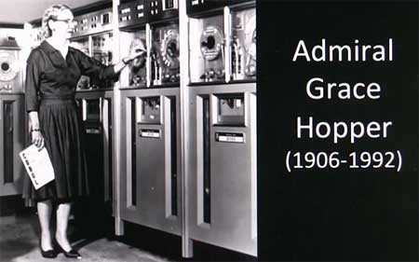
More on Admiral Hopper
While working for companies, also taught for the United States Naval Reserve
Adventures in military, business, academia, and private industry
“Retired” from the business world in 1971
Would go on to work into her 80s
Notes:
Image taken from http://realestatewebtrainer.files.wordpress.com/2012/03/admiralgracehopperwithunivaccomputer.jpg

Slide 33
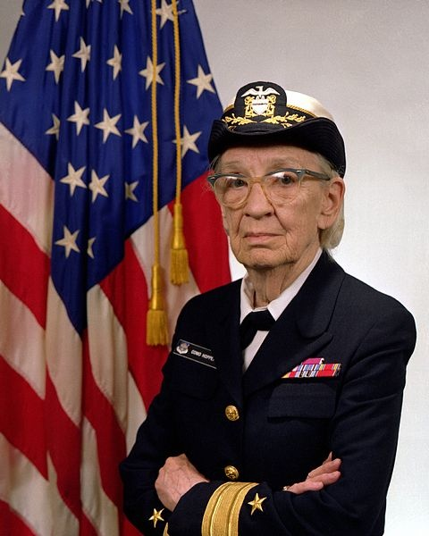
Military Pride
Promoted to commodore in 1983
2 years later, when titles merged, she became an Admiral
Retired from the Navy in 1986
Buried with full Naval honors in 1992

Slide 34
Some of Her Awards
1969 – Computer Science Man-of-the-Year Award, Data Processing Management Association
1971 – Sperry created an award in her name
1973 – first American and first woman Distinguished Fellow of the British Computer Society

Slide 35
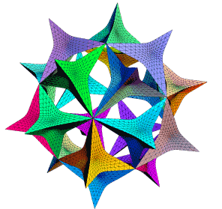
Her Influences
Subroutines
Formula translation
Relative addressing
Linking loader
Code optimization
Symbolic manipulation – as seen in Maple & Mathematica

Slide 36
Lessons from Admiral Hopper
Just because “we’ve always done it that way” doesn’t mean it’s right. Don’t be afraid to challenge those words.
Programming works well as a team task, especially when collaboration happens.
By bringing it down to plain English, computing is no longer just for programmers and mathematicians. It’s more approachable by non-technical people.

Slide 37
SOLID Principle
Single Responsibility
Open/Closed
Liskov Substitution
Interface Segregation
Dependency Inversion

Slide 38
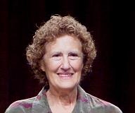
Barbara Liskov (1939-)
First woman to get a PhD from the computer science department at Stanford in 1968
Worked in computer design and operating systems
ACM A.M. Turing Award winner for her work in languages
Created Venus Computer – supported construction of complex software
Up to 16 teletypes
Users connected to virtual machines

Slide 39
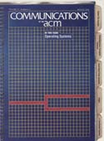
CLU & Argus Languages
Created by Liskov’s MIT group
CLU
Modular programming
Data abstraction
Polymorphism
Argus
Distributed applications
Nested transactions
Notes:
Distributed programming in Argus, March 1988

Slide 40
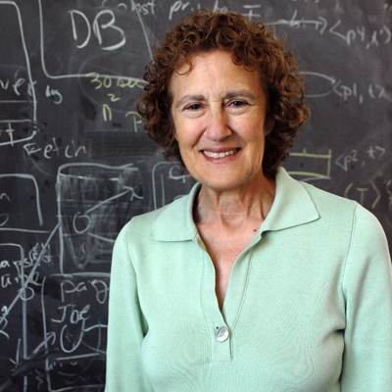
Other Focuses of Liskov’s Work
Object-oriented database systems
Garbage collection
Caching
Persistence
Recovery
Fault tolerance
Security
Geographic routing

Slide 41
… revered in the MIT community for her role as scholar, mentor, and leader. Her pioneering research has made her one of the world’s leading authorities on computer language and system design.
- Susan Hockfield, MIT President

Slide 42
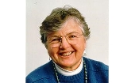
Frances Allen (1932-)
Optimized compilers and worked in parallelization
Worked with the NSA on programming languages and security codes intelligence
In 1989, became the first female IBM fellow
Also in 1989, became the first female IBM Academy president
In 2006, received the A. M. Turing Award for fundamentally improving the performance of programs in solving problems and accelerating the use of high performance computing

Slide 43
Published works
1966 – “Program Optimization”
1970 – “Control Flow Analysis” and “A Basis for Program Optimization”
1971 – (with John Cocke)- “A Catalog of Optimizing Transformations”
1973 & 1974 – interprocedural data flow analysis
1976 – (with John Cocke) – analysis strategy for optimizing compilers

Slide 44
FORTRAN in Parallel
PTRAN – execute FORTRAN in parallel
New parallelism detection schemes

Slide 45


Mary Lou Jepsen (1965-)
Bachelors in Studio Art & Electrical Engineering
Masters in Holography
Ph D in Optical Sciences
Head of the Display Division, Google X Lab
Founder of Pixel Qi – low-cost, low-power LCD screens
Co-founder of One Laptop per Child

Slide 46
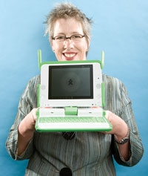
One Laptop Per Child
Deployments in over 50 other countries
More than 25 languages
Every child in Uruguay
Laptop with sunlight-readable display
Ultra-low power management system
XO Laptop – lowest-power and most environmentally friendly

Slide 47
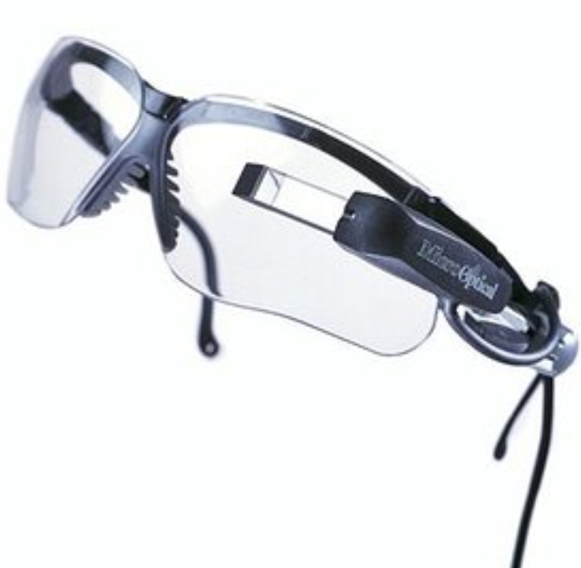
Jepsen’s Contributions Can Be Seen In…
Head-mounted display
HDTV
Projector
Holographic video systems

Slide 48
Other Women in Tech

Slide 49
More Women in Tech
Meg Whitman – chief officer at some well-known tech companies (DreamWorks, P&G, Hasbro, eBay, and now HP)
Padmasree Warrior – CTO of Cisco, former CTO of Motorola
Anita Borg – bringing more non-technical women in design, more women scientists, and promote this growth
Erna Schneider – invented computerized switching system for telephones
Jean E. Sammet - FORMAC programming language for symbolic manipulation of math formulas

Slide 50
Lessons to Carry Forward

Slide 51
Choose a mentor who you’re interested in learning from and feed off of and into their energy.
Based on Ada’s experiences with Charles Babbage and his Analytical Engine

Slide 52
Be open-minded with your career. You never know where your adventures will take you.
Based on the adventures of the women of the ENIAC

Slide 53
Make tech more approachable by translating it into plain English.
Based on Grace Hopper’s strive to reach the non-technical and business realms

Slide 54
Challenge “We’ve always done it that way”
Based on Grace Hopper’s experiences

