Slide 1
The Trouble with Types
Martin Odersky
EPFL and Typesafe

Slide 2
Types
Everyone has an opinion on them
Industry:
Used to be the norm (C/C++, Java).
Today split about evenly with dynamic.
Academia:
Static types are more common.

Slide 3
Static: Points in Favor
More efficient
Better tooling
Fewer tests needed
Better documentation
Safety net for maintenance
Notes:
tooling: completion, hyperlinking, find references, refactorings

Slide 4
Dynamic: Points in Favor
Simpler languages
Fewer puzzling compiler errors
No boilerplate
Easier for exploration
No type-imposed limits to expressiveness

Slide 5
What is Good Design?
− Clear
− Correct
− Minimal
− The opposite of “random”
Great designs are often discovered, not invented.
Notes:
Guy Steele: Schene was discovered.

Slide 6
Elements Of Great Designs:
Patterns
&
Constraints

Slide 7
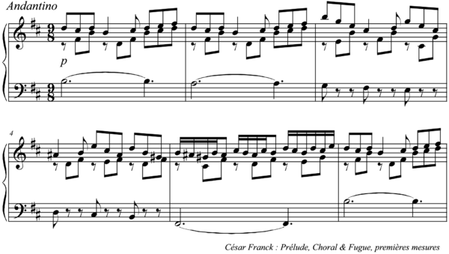
Example: Bach Fugues

Slide 8
What Is A Good Language for Design?
One that helps discovering great designs.

Slide 9
What Is A Good Language for Design?
One that helps discovering great designs.
Patterns → Abstractions
Constraints → Types

Slide 10
Example
Functional Collections
And their generalizations, e.g. monads, applicatives
Powerful patterns made safe by types.

Slide 11
But...
Type systems are hairy.
Otherwise there would not be so many different ones.
I'm not against types, but I don't know of any type systems that aren't a complete pain, so I still like dynamic typing [Alan Kay]

Slide 12
Type Systems Landscape
static
C
OCaml
Haskell
Java
C#
Scala
Typescript
Dart
dynamic
Assembly
JS
Ruby
Python, Clojure
weak
strong

Slide 13
Static Type Systems
detailed
Haskell OCaml
“Type it to the max”
Scala
Eiffel
F#
“Cutting corners”
Typescript
Dart
C#
Java 5+
C
Go
“My way or the highway”
coarse
Java 4
Pascal
weak
strong

Slide 14
(1) My Way or the Highway
detailed
Haskell OCaml
Scala
F#
Typescript
Dart
C#
Java 5+
C
Go
coarse
Java 4
weak
strong

Slide 15
My Way or The Highway
Simple type systems
No generics
Not that extensible by users
→ Simpler tooling
Highly normative

Slide 16
(3) Type it to the Max
detailed
Haskell OCaml
Scala
F#
Typescript
Dart
C#
Java 5+
C
Go
coarse
Java 4
weak
strong

Slide 17
Type it to the Max
Rich* language to write types
Type combination forms, including generics.
Type systems often inspired by logic.
* Often, turing complete

Slide 18
Type it to the Max
Where dynamic languages had the upper hand:
No type-imposed limits to expressiveness
→ Rich type system + escape hatches such as casts
No boilerplate
→ Type Inference
Easier for exploration
→ Bottom type Nothing, ???

Slide 19
Making Good Use of Nothing
def f(x: Int) = ???

Slide 20
Making Good Use of Nothing
def f(x: Int): Nothing = ???
if (x < 0) ??? else f(x)

Slide 21
Other Strengths of Dynamic
Simpler languages
− Rich types add complexity
Fewer puzzling compiler errors

Slide 22
5862.scala:36: error: type mismatch;
found : scala.collection.mutable.Iterable[_ >: (MapReduceJob.this.DataSource, scala.collection.mutable.Set[test.TaggedMapper[_, _, _]]) with test.TaggedMapper[_$1,_$2,_$3] forSome { type _$1; type _$2; type _$3 } <: Object] with scala.collection.mutable.Builder[(MapReduceJob.this.DataSource, scala.collection.mutable.Set[test.TaggedMapper[_, _, _]]) with test.TaggedMapper[_$1,_$2,_$3] forSome { type _$1; type _$2; type _$3 },scala.collection.mutable.Iterable[_ >: (MapReduceJob.this.DataSource, scala.collection.mutable.Set[test.TaggedMapper[_, _, _]]) with test.TaggedMapper[_$1,_$2,_$3] forSome { type _$1; type _$2; type _$3 } <: Object] with scala.collection.mutable.Builder[(MapReduceJob.this.DataSource, scala.collection.mutable.Set[test.TaggedMapper[_, _, _]]) with test.TaggedMapper[_$1,_$2,_$3] forSome { type _$1; type _$2; type _$3 },scala.collection.mutable.Iterable[_ >: (MapReduceJob.this.DataSource, scala.collection.mutable.Set[test.TaggedMapper[_, _, _]]) with test.TaggedMapper[_$1,_$2,_$3] forSome { type _$1; type _$2; type _$3 } <: Object] with scala.collection.mutable.Builder[(MapReduceJob.this.DataSource, scala.collection.mutable.Set[test.TaggedMapper[_, _, _]]) with test.TaggedMapper[_$1,_$2,_$3] forSome { type _$1; type _$2; type _$3 },scala.collection.mutable.Iterable[_ >: (MapReduceJob.this.DataSource, scala.collection.mutable.Set[test.TaggedMapper[_, _, _]]) with test.TaggedMapper[_$1,_$2,_$3] forSome { type _$1; type _$2; type _$3 } <: Object] with scala.collection.mutable.Builder[(MapReduceJob.this.DataSource, scala.collection.mutable.Set[test.TaggedMapper[_, _, _]])
and so on for another 200 lines
Need a Type Debugger!

Slide 23
(3) Cutting Corners
detailed
Haskell OCaml
Scala
F#
Typescript
Dart
C#
Java 5+
C
Go
coarse
Java 4
weak
strong
Notes:
Types are hard let’s go shopping

Slide 24
Cutting Corners
Appeal to user’s intuitions (covariant generics).
Employee are Persons
So functions from Employees to Employers are also functions from Persons to Employers, right?
Embrace unsoundness.
Easy, and superficially simple.
But, fundamentally, a hack.
Can we build great designs on false theories?

Slide 25
Precision
Soundness
Simplicity
Take Any Two?

Slide 26
Abstractions
Two fundamental forms
Parameters (positional, functional)
Abstract Members (name-based, object-oriented)

Slide 27
Abstractions
Two fundamental forms
Parameters (positional, functional)
Abstract Members (name-based, modular)

Slide 28
Types in Scala
scala.collection.BitSet Named Type
Channel with Logged Compound Type
Channel { def close(): Unit } Refined Type
List[String] Parameterized
List[T] forSome { type T } Existential Type
List Higher-Kinded
Modular
Functional

Slide 29
Orthogonal Design
Exists T
Functional
T[ _ ]
T[U]
Named
T { ... }
T with U
Modular

Slide 30
Non-Orthogonal Design
More Features
Fewer combinations
Named’
Exists T
T[ _ ]
T[U]’
Functional
Named
T { ... }
T with U
T[U]
Modular

Slide 31
Too Many Combinations?
Exists T
?
Functional
T[ _ ]
T[U]
Named
T { ... }
T with U
Modular

Slide 32
Projections Reduce Dimensionality
Exists T
Functional
T[ _ ]
T[U]
Named
T { ... }
T with U
Modular

Slide 33
Projections Help Remove Features
Exists T
Functional
T[ _ ]
T[U]
Named
T { ... }
T with U
Modular

Slide 34
Dot and Dotty
DOT: Calculus for Dependent Object Types
Dotty: A Scala-Like Language with DOT as its core

Slide 35
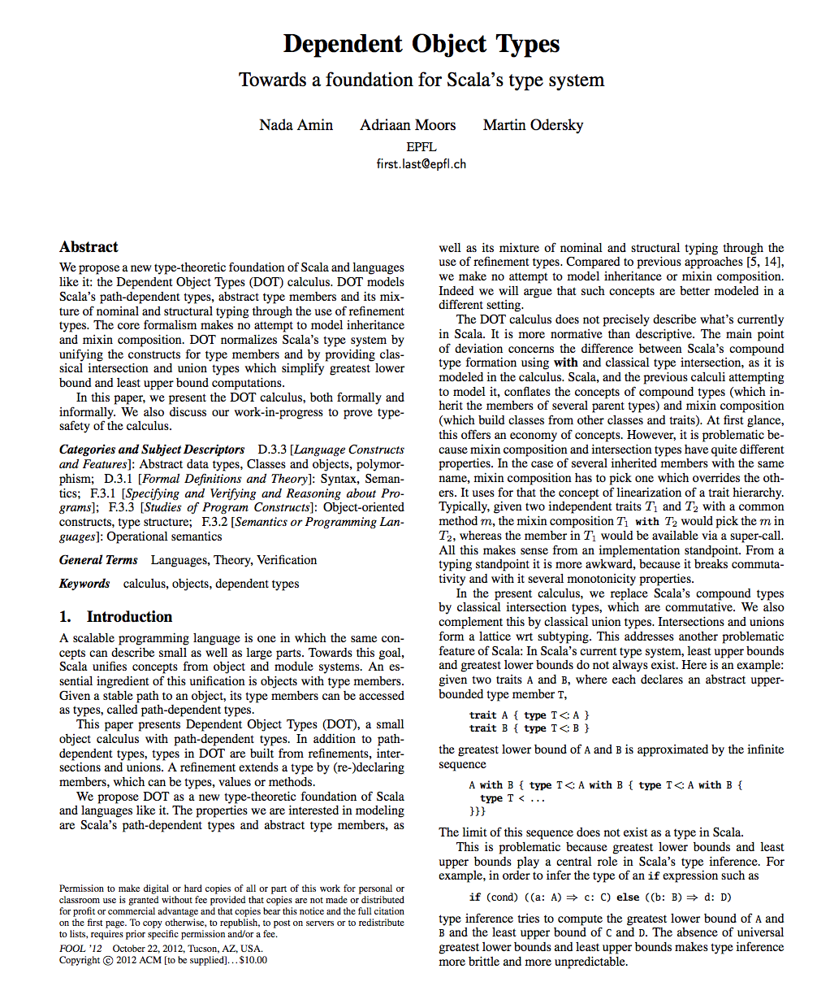
[FOOL 2012]

Slide 36
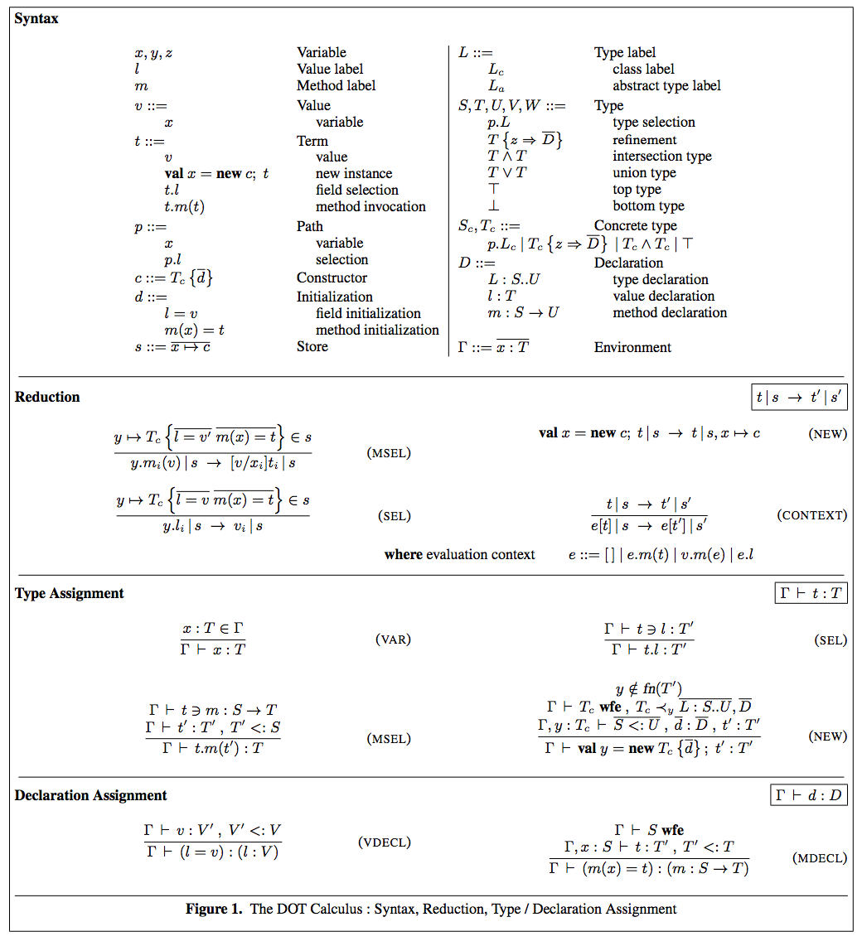

Slide 37
Types in Dotty
scala.collection.BitSet Named Type
Channel & Logged Intersection Type
Channel { def close(): Unit } Refined Type
( List[String] Parameterized )
List[T] forSome { tpe T } Existential Type
List Higher-Kinded

Slide 38
Modelling Generics
class Set[T] { ... } → class Set { type $T }
Set[String] → Set { type $T = String }
class List[+T] { ... } → class List { type $T }List[String] → List { type $T <: String }
Parameters → Abstract members
Arguments → Refinements

Slide 39
Making Parameters Public
class Set[type Elem] {...} class Set { type Elem ...}
Set[String] Set { type Elem = String }
class List[type +Elem] {...} class List { type Elem ...}List[String] List { type Elem <: String }
Analogous to “val” parameters:
class C(val fld: Int) class C { val fld: Int }

Slide 40
Expressing Existentials
What is the type of Lists with arbitrary element type?
Previously: List[_]
List[T] forSome { type T }
Now: List
(Types can have abstract members)

Slide 41
Expressing Higher-Kinded
What is the type of List constructors?
Previously: List
Now: List
Can always instantiate later:
type X = List
X { type T = String }
X[String]

Slide 42
In a Nutshell
In this system,
Existential = Higher-kinded
In fact, both are just types with abstract members.
We do not distinguish between types and type constructors.

Slide 43
Native Meets and Joins
The horrible type error message came from a computed join of two types.
Problem: In Scala, the least upper bound of two types can be infinitely large.
Adding native & and | types fixes that.

Slide 44
Will this Be Scala?
Hopefully. Depends on how compatible we can make it.
Note: SIP 18 already forces you to flag usages of existentials and higher-kinded types in Scala.
This should give you a some indication how much effort would be needed to convert.

Slide 45
The Essence of Scala
Harness the power of naming
A simple language struggling to get out

Slide 46
Types Are Trouble
Tooling
Error messages
Conceptual complexity
Scope for misuse
But I believe they are worth it,
because they can lead to great designs.

Slide 47
Supplementary Slides

Slide 48
DOT
expr.member
Type = path.TypeName
| Type { Defs }
| ...
Def = val x: Type = Expr
| def f(y: Type): Type = Expr
| type T <: Type
>:
=
extends

Slide 49
Subtyping
Fundamental relation:
T1 <: T2
T1 is a subtype of T2.
Comes in many guises:
Implementation matches Interface Type class extension
Signature ascription

