Slide 1

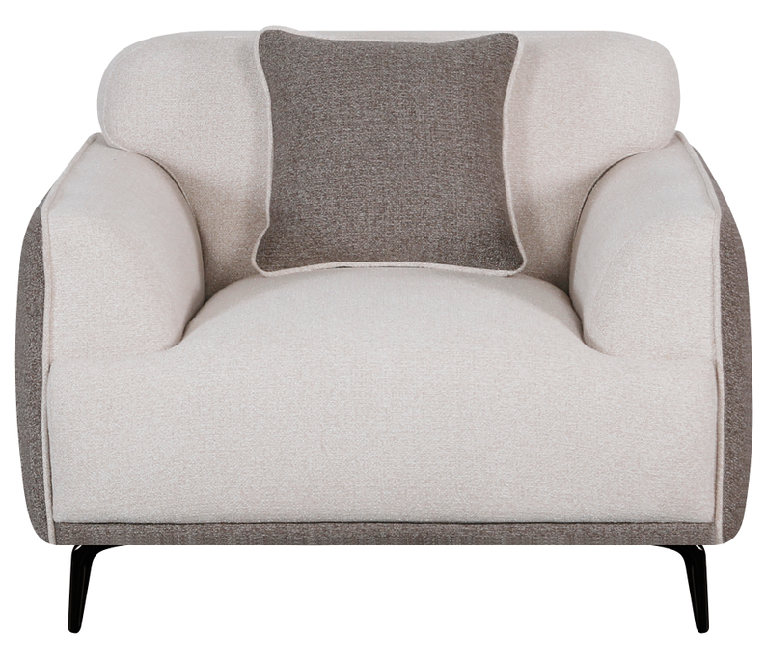
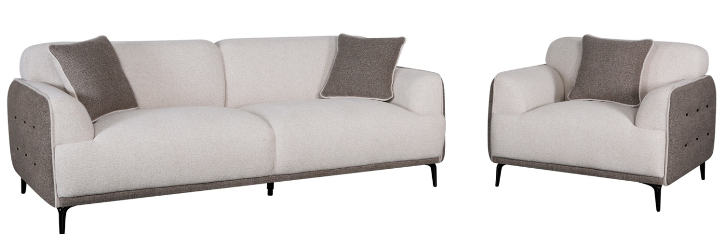
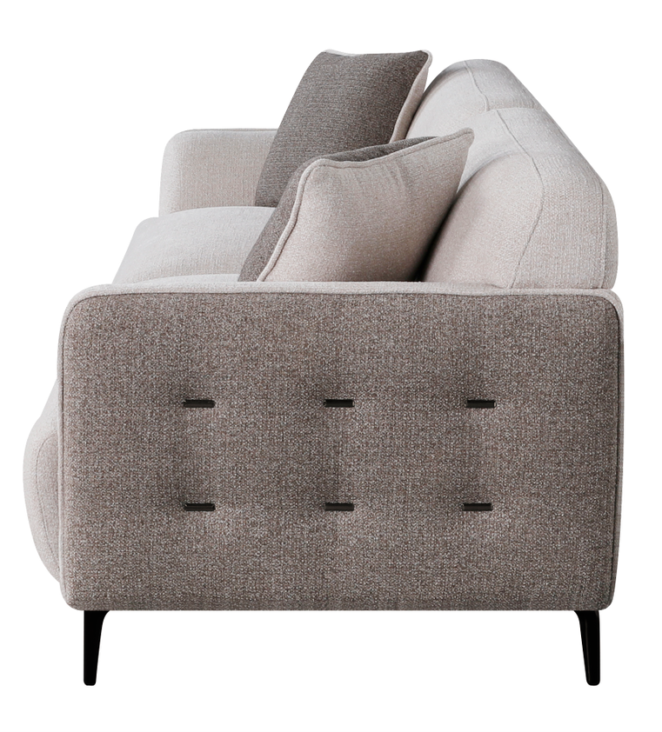
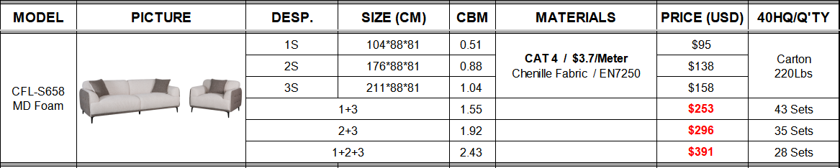
Feature:
The above quotation includes the decorative cushions.
Seat cushions made with 28KG/m³ medium-density foam + Pocket springs.
Metal button decoration on the armrests.
Metal leg.

