Slide 1
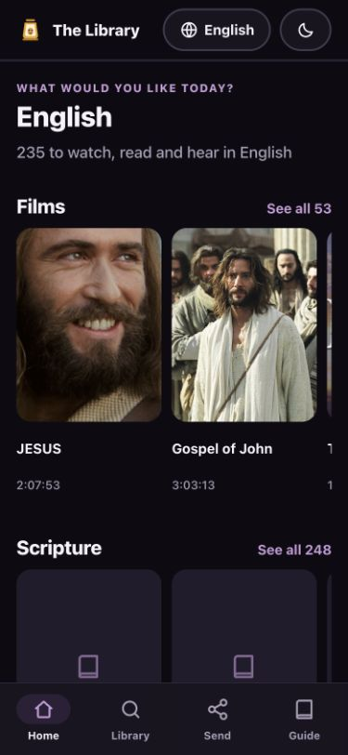
BibleTransfer123
Larry's guide to the updated library
Find, watch, save, download several items, and email one-language libraries.
Updated September 2026
Notes:
Screenshot captured from the current BibleTransfer123 build on September 24, 2026.

Slide 2
BibleTransfer123
02
START
What is new in this version?
▪
The library now lists 1,192 resources across nine library languages.
▪
Several films, audio recordings, or PDFs can be downloaded together.
▪
A language-only link can be prepared for email in two taps.
▪
Mandarin and Cantonese card items now open online when Wi-Fi is available.
The original card still works offline with the files packed on it.
Larry's updated step-by-step guide

Slide 3
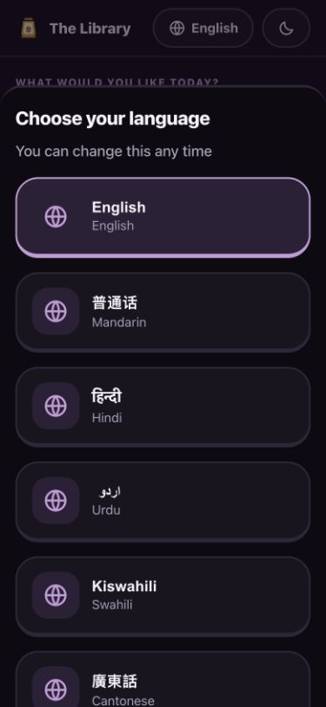
BibleTransfer123
03
FIRST
Your language
▪
Tap the language name at the top of the screen.
▪
Tap the language you want. The menus change to match it.
You can change this again at any time.
Larry's updated step-by-step guide

Slide 4
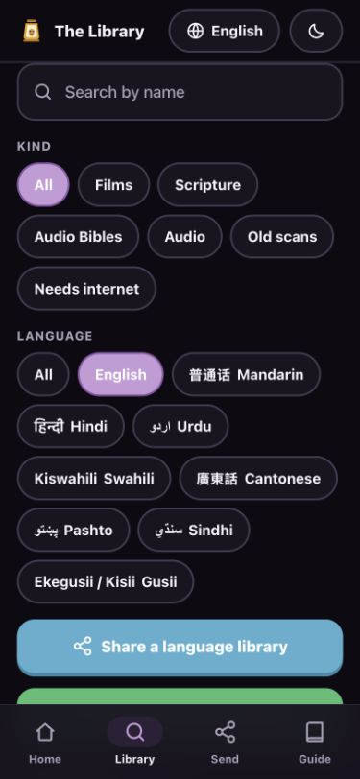
BibleTransfer123
04
FIND
The full library
▪
Tap Library at the bottom of the screen.
▪
The page shows everything available in the chosen language.
Films, Scripture, audio Bibles, recordings, and old scans are grouped by kind.
Larry's updated step-by-step guide

Slide 5
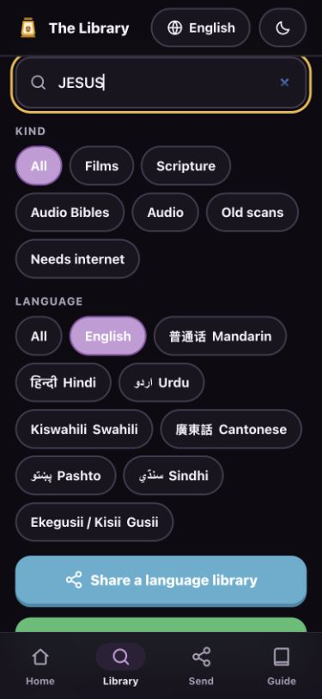
BibleTransfer123
05
FIND
Search and filters
▪
Type one or two words in the search box.
▪
Use Films, Scripture, Audio, or another kind to narrow the list.
▪
Tap the matching title to open it.
This example searches for JESUS.
Larry's updated step-by-step guide

Slide 6
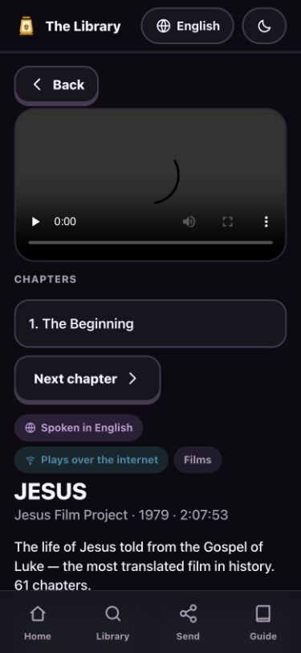
BibleTransfer123
06
WATCH
Playback over Wi-Fi
▪
Tap the play button in the video.
▪
For a long film, pick a chapter or tap Next chapter.
▪
“Plays over the internet” means the phone needs Wi-Fi or mobile data.
Larry's updated step-by-step guide

Slide 7
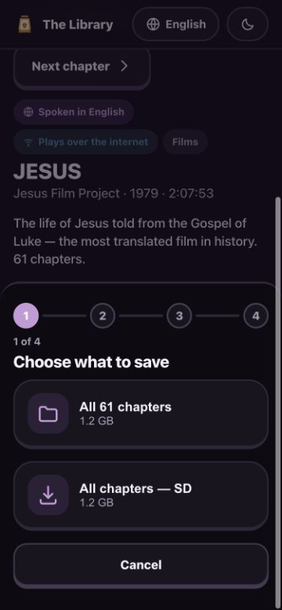
BibleTransfer123
07
SAVE
Saving one item
▪
Tap Save to my phone on the item page.
▪
Choose the smaller SD version when space or signal is limited.
▪
Wait until the download finishes before leaving the page.
Larry's updated step-by-step guide

Slide 8
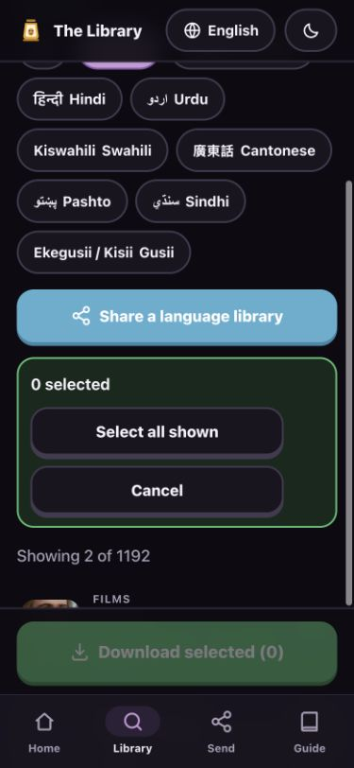
BibleTransfer123
08
SAVE SEVERAL
Starting a batch download
▪
Search or filter the library first.
▪
Tap Download several things.
▪
Tap Select all shown, or tap individual items.
Larry's updated step-by-step guide

Slide 9
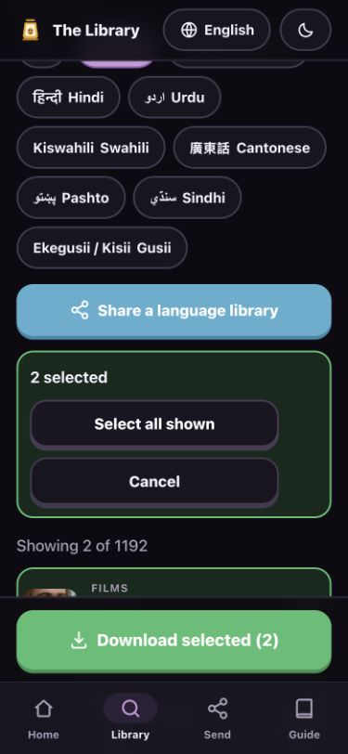
BibleTransfer123
09
SAVE SEVERAL
The selected items
▪
A green outline shows each selected item.
▪
Check the number beside “selected.”
▪
Tap Download selected at the bottom.
Larry's updated step-by-step guide

Slide 10
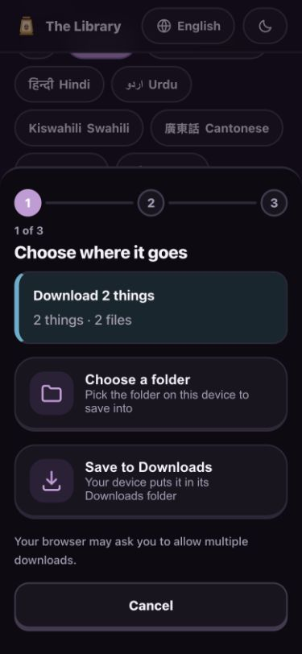
BibleTransfer123
10
SAVE SEVERAL
Where the downloads go
▪
Tap Save to Downloads for the simplest choice.
▪
The browser may ask permission to download several files. Allow it.
▪
Open the Files app, then Downloads, to find them later.
Larry's updated step-by-step guide

Slide 11
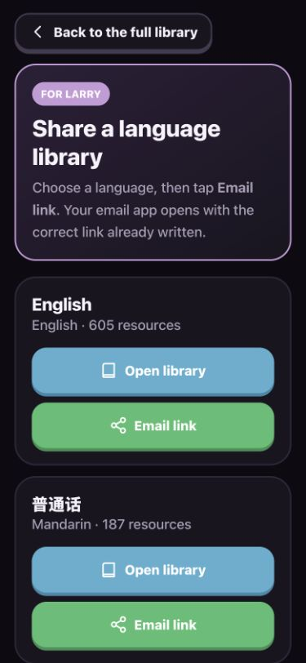
BibleTransfer123
11
EMAIL SHARING
Language links for email
▪
From Library, tap Share a language library.
▪
Find the language you want to send.
▪
Tap Email link. The email opens with the correct link already written.
Larry's updated step-by-step guide

Slide 12
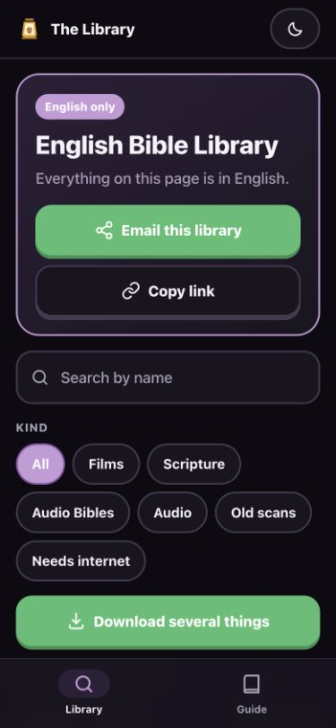
BibleTransfer123
12
EMAIL SHARING
Sharing from a language page
▪
If a language page is already open, tap Email this library.
▪
Add the person's email address and send the prepared message.
▪
Copy link is the backup when you want to paste the link yourself.
Larry's updated step-by-step guide

Slide 13
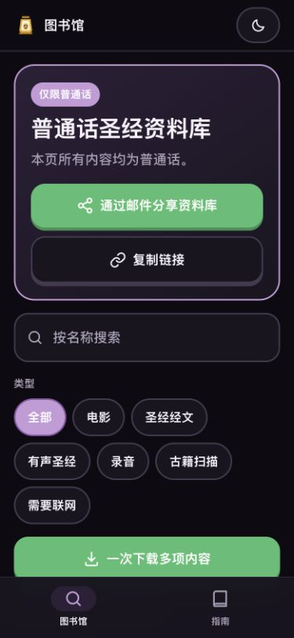
BibleTransfer123
13
EMAIL SHARING
What the recipient sees
▪
The link opens only the language you chose.
▪
The full library and other language buttons stay hidden.
▪
The menus appear in that language when a translation is available.
Larry's updated step-by-step guide

Slide 14
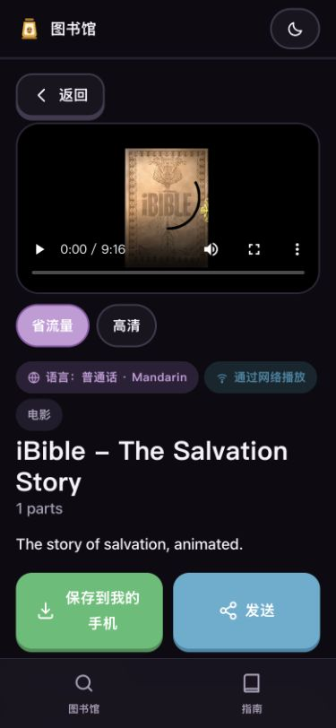
BibleTransfer123
14
NEW ONLINE ACCESS
Card items now work with Wi-Fi
▪
Mandarin and Cantonese films, audio, Bibles, and scans can now open online.
▪
Tap play, read, or listen just like the other items.
▪
Tap the green save button to keep a copy on the phone.
Larry's updated step-by-step guide

Slide 15
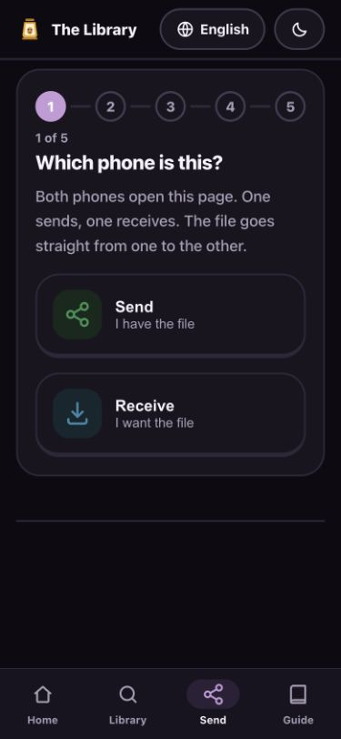
BibleTransfer123
15
NEARBY SHARING
Two phones on the same page
▪
Open Send on both phones.
▪
On the phone with the file, tap Send.
▪
On the other phone, tap Receive.
The file moves straight from one phone to the other.
Larry's updated step-by-step guide

Slide 16
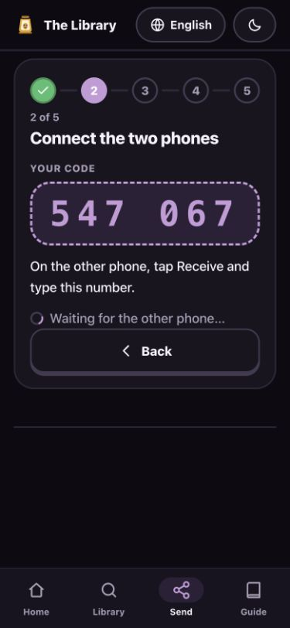
BibleTransfer123
16
NEARBY SHARING
The six-digit code
▪
The sending phone shows a six-digit code.
▪
Type the same code on the receiving phone.
▪
Wait for the phones to connect, then choose the file.
The number in this picture is only an example.
Larry's updated step-by-step guide

Slide 17
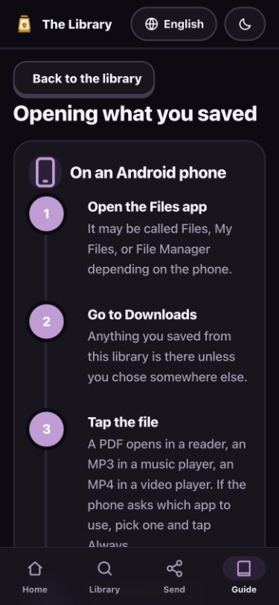
BibleTransfer123
17
HELP
The built-in Guide
▪
Tap Guide at the bottom whenever you get stuck.
▪
It explains where downloads go on Android, iPhone, and computers.
▪
It also explains VillageServer Wi-Fi and common problems.
Larry's updated step-by-step guide

Slide 18
BibleTransfer123
18
REMEMBER
Wi-Fi and packed cards
WITH WI-FI
FROM A PACKED CARD
Films can stream.
PDFs can open.
Publisher links can work.
Included files work offline.
Saving uses the local copy.
Keep every folder name unchanged.
Before travel, save the important files and open each one once.
Larry's updated step-by-step guide

Slide 19
BibleTransfer123
19
KEEP NEARBY
Larry's quick checklist
1
Choose the language
2
Open Library and find the item
3
Watch, read, listen, or save
4
For email: Share a language library, then Email link
5
For nearby: Send, choose a role, then use the code
When in doubt, tap Guide at the bottom of the screen.
Larry's updated step-by-step guide

