Slide 1
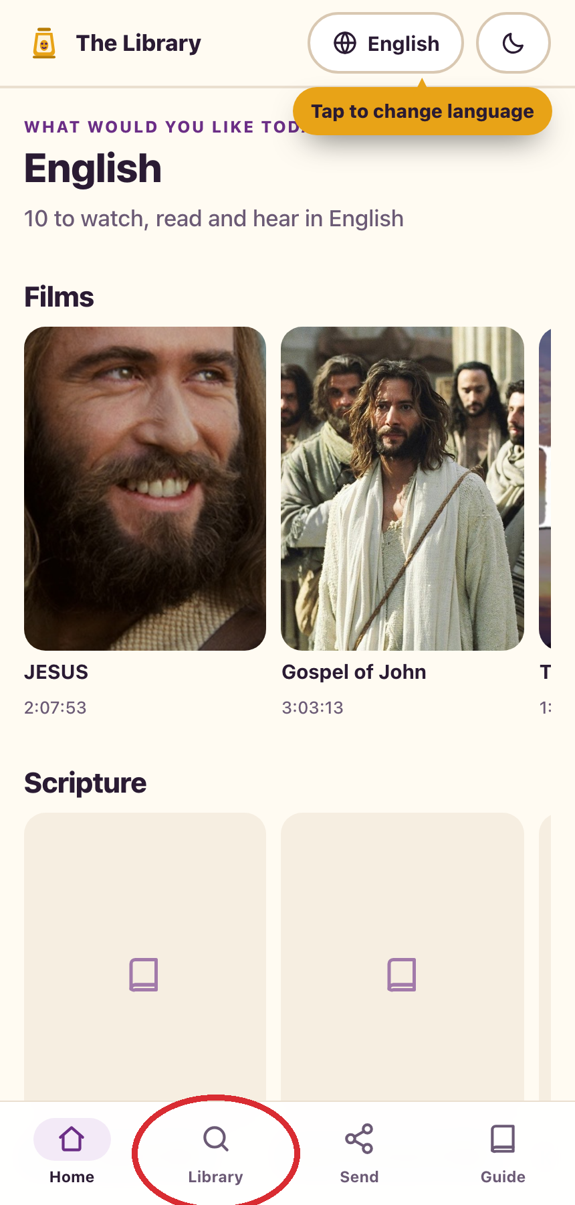
BibleTransfer123
01
START
The Library, made simple
Find a film, Bible text, or audio recording.
Save what you want on your phone.
Send a saved file to another person.
The red circle on each page shows what to tap.
Larry’s step-by-step guide
Notes:
Screenshots captured from the current local BibleTransfer123 app on 17 September 2026. Example pairing codes change each time.

Slide 2
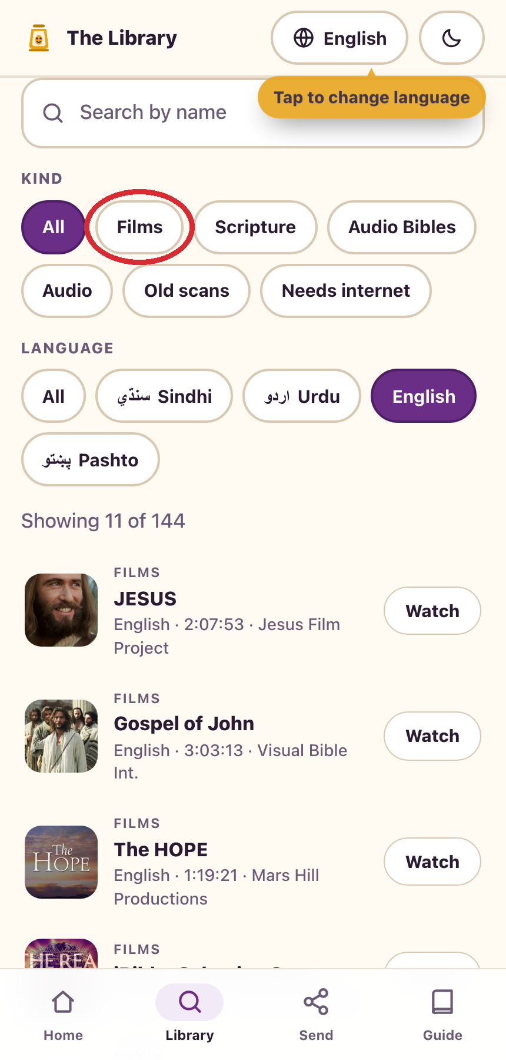
BibleTransfer123
02
EXPLORE
What is in the library?
Films, Bible texts, spoken audio, and old scans.
Choose English, Urdu, Sindhi, or Pashto.
Tap a title to watch, listen, or read.
On the website, media streams over the internet. A prepared card can hold selected files for offline use.
Larry’s step-by-step guide
Notes:
Screenshots captured from the current local BibleTransfer123 app on 17 September 2026. Example pairing codes change each time.

Slide 3
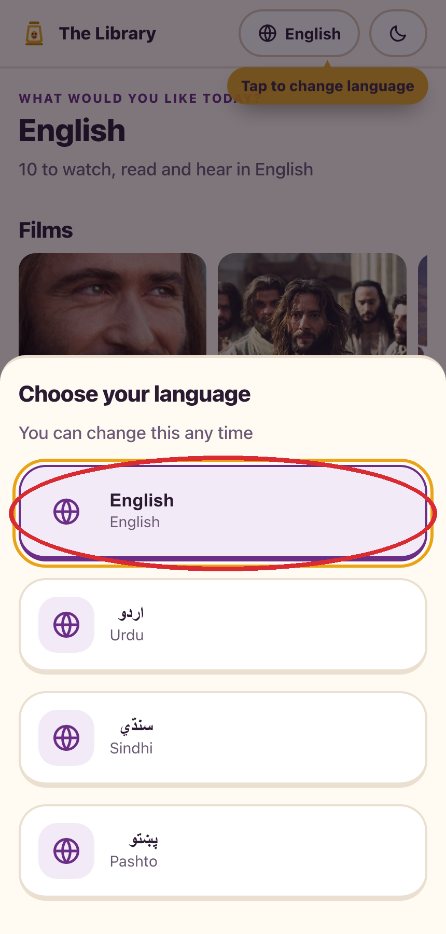
BibleTransfer123
03
EXPLORE
Choose your language
On the first screen, tap the language you want.
You can change it later at the top of the page.
The choice also changes which language of media appears first.
Larry’s step-by-step guide
Notes:
Screenshots captured from the current local BibleTransfer123 app on 17 September 2026. Example pairing codes change each time.

Slide 4
BibleTransfer123
04
EXPLORE
Open the Library
Tap Library at the bottom of the screen.
The Library shows everything in your chosen language.
Use the category buttons if you want only films, audio, or Bible text.
Larry’s step-by-step guide
Notes:
Screenshots captured from the current local BibleTransfer123 app on 17 September 2026. Example pairing codes change each time.

Slide 5
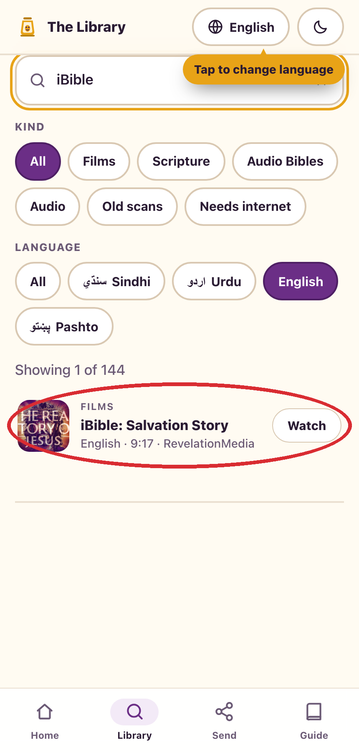
BibleTransfer123
05
EXPLORE
Find something to open
Type a name in the search box.
Tap the matching result.
This example uses the short film “iBible: Salvation Story.”
Larry’s step-by-step guide
Notes:
Screenshots captured from the current local BibleTransfer123 app on 17 September 2026. Example pairing codes change each time.

Slide 6
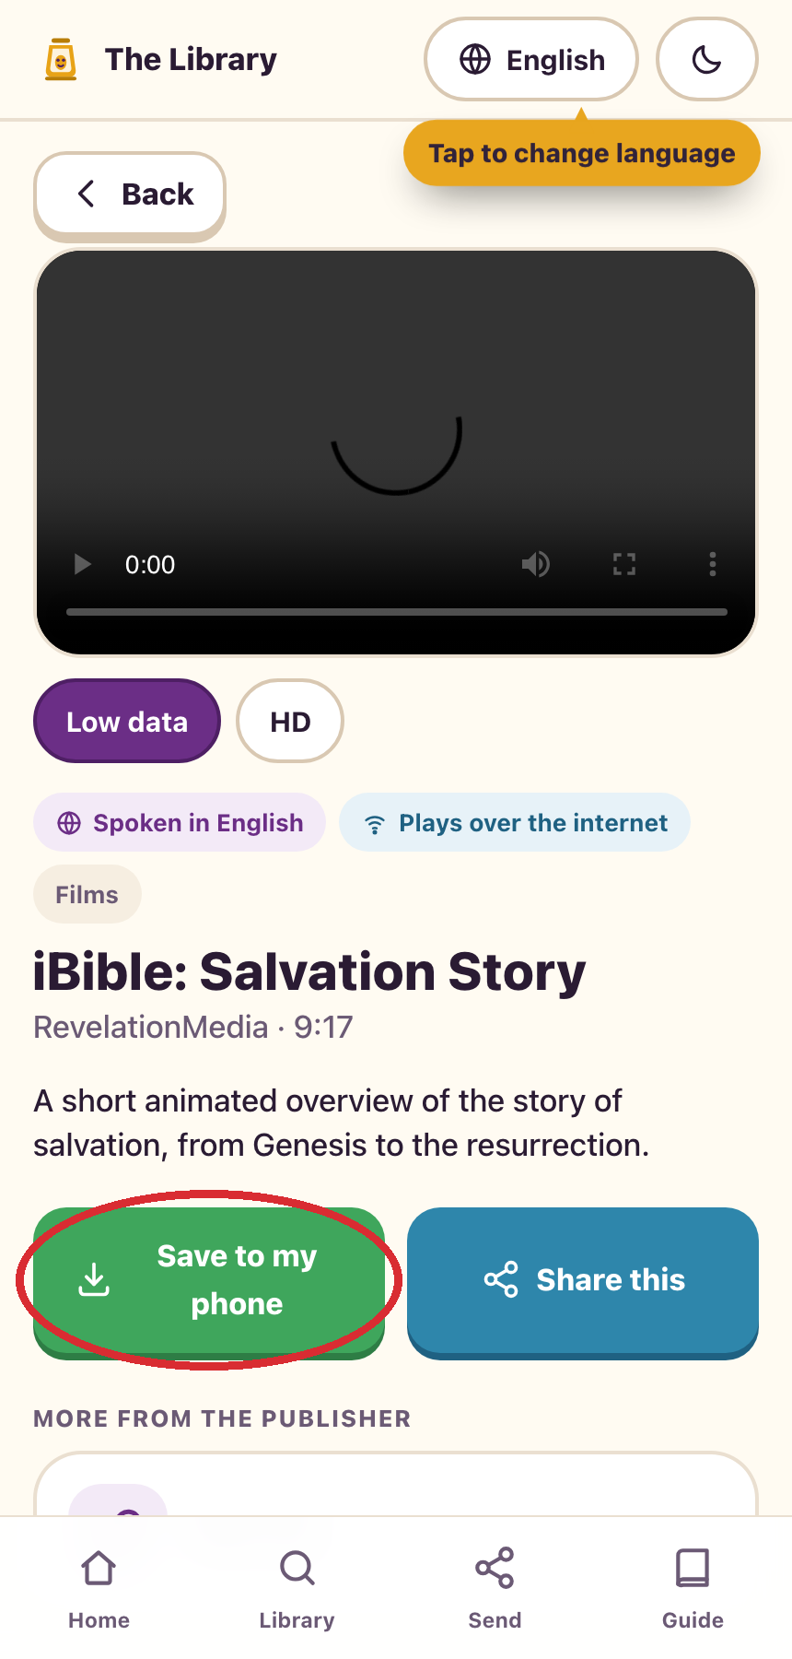
BibleTransfer123
06
SAVE
Keep a film on your phone
Open the film and tap Save to my phone.
You can also watch it on this page.
The website needs an internet connection to stream or save media.
Larry’s step-by-step guide
Notes:
Screenshots captured from the current local BibleTransfer123 app on 17 September 2026. Example pairing codes change each time.

Slide 7
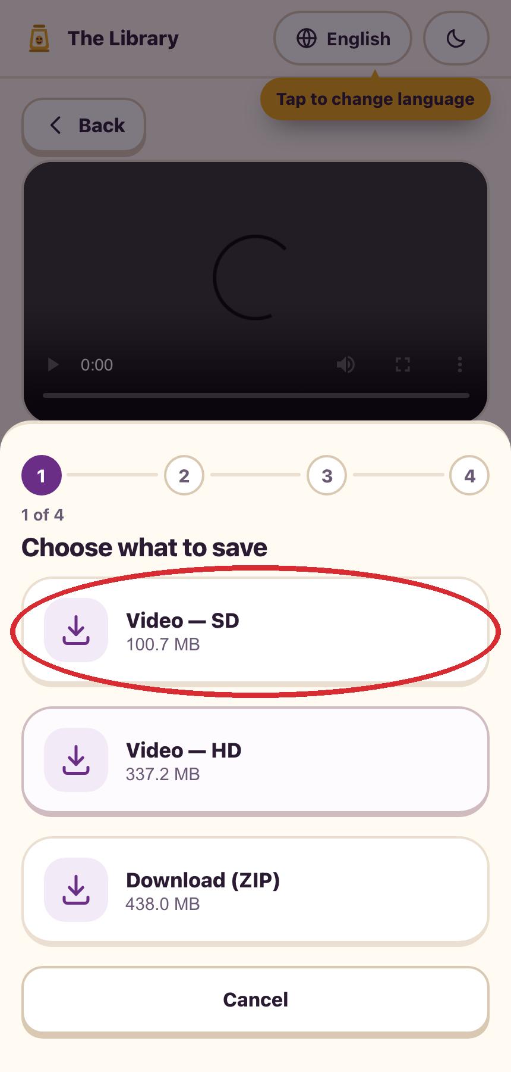
BibleTransfer123
07
SAVE
Choose the smaller video
Tap Video — SD.
The smaller file is easier to save and share.
In this example, SD is about 101 MB.
Larry’s step-by-step guide
Notes:
Screenshots captured from the current local BibleTransfer123 app on 17 September 2026. Example pairing codes change each time.

Slide 8
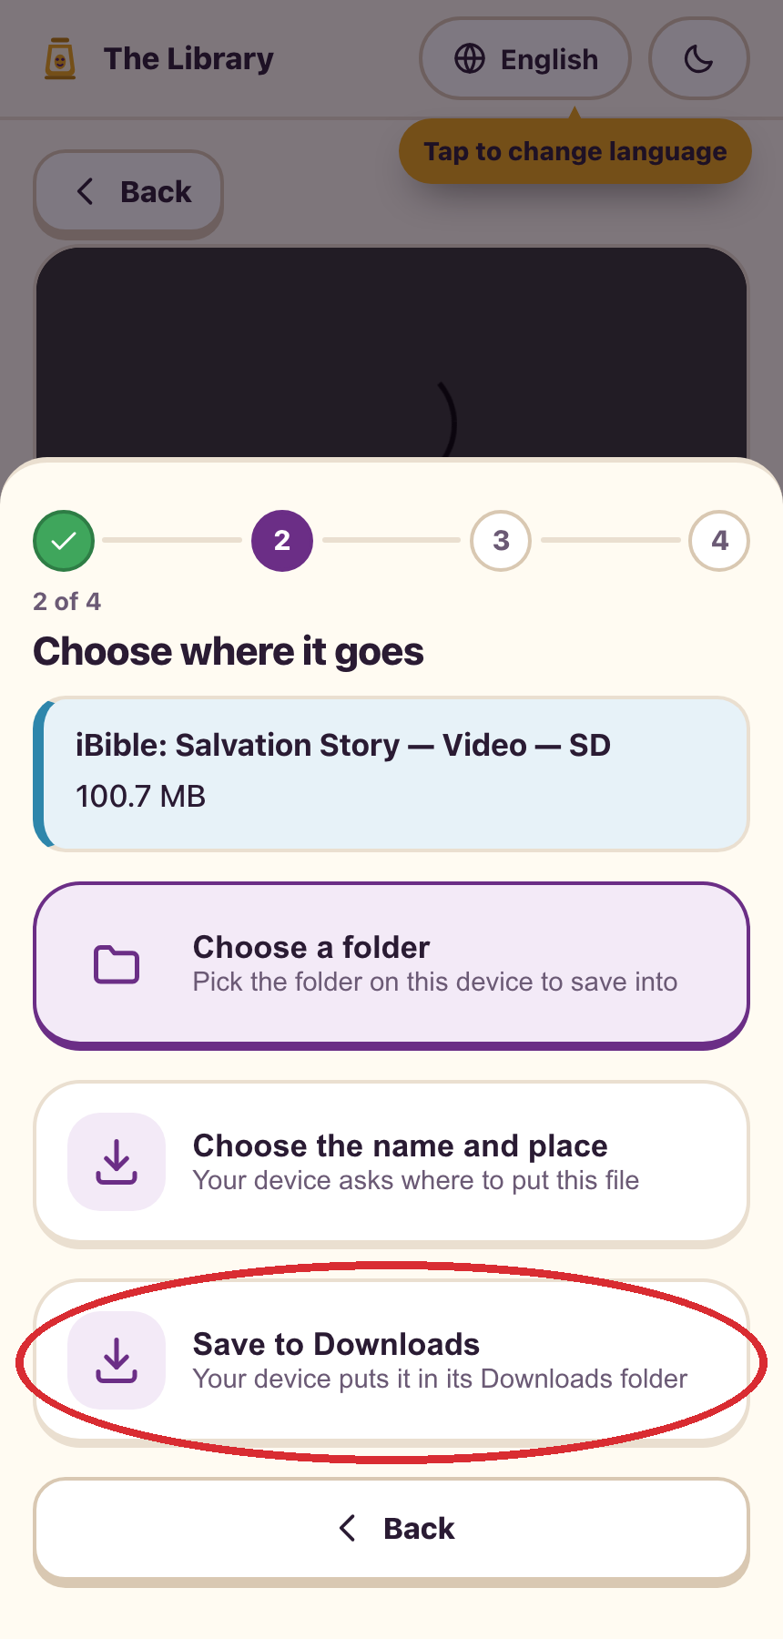
BibleTransfer123
08
SAVE
Save it to Downloads
Tap Save to Downloads.
Wait for the saving step to finish.
If your phone asks where to put the file, choose Downloads.
Larry’s step-by-step guide
Notes:
Screenshots captured from the current local BibleTransfer123 app on 17 September 2026. Example pairing codes change each time.

Slide 9
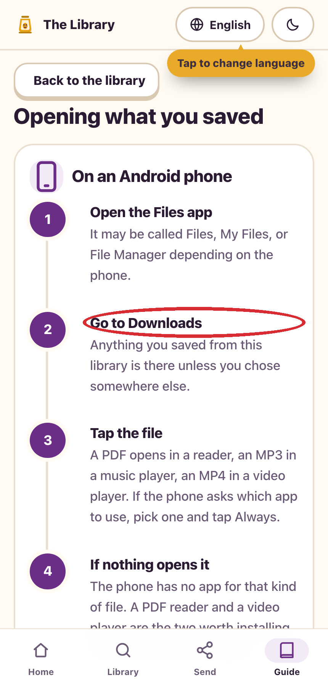
BibleTransfer123
09
SAVE
Find the saved file
Open your phone’s Files app.
Look in Downloads, then tap the file.
On an iPhone, use Files. On Android, it may be called Files or My Files.
Larry’s step-by-step guide
Notes:
Screenshots captured from the current local BibleTransfer123 app on 17 September 2026. Example pairing codes change each time.

Slide 10
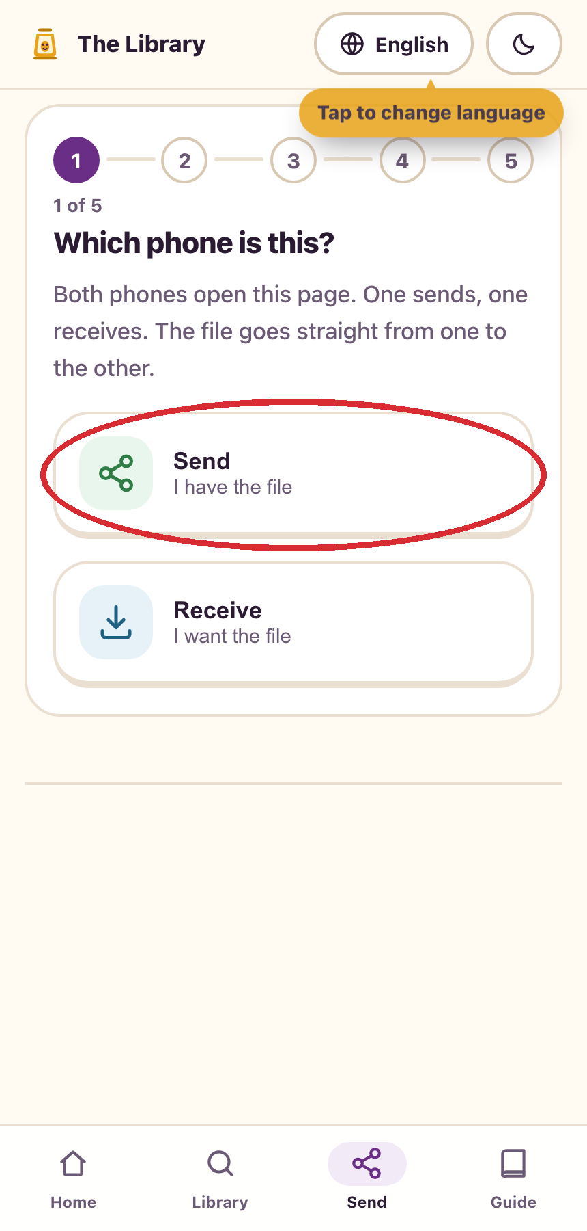
BibleTransfer123
10
SEND
Start on both phones
Open the same BibleTransfer123 address on both phones.
Tap Send at the bottom. On the phone with the file, tap Send.
On the other phone, tap Receive.
Larry’s step-by-step guide
Notes:
Screenshots captured from the current local BibleTransfer123 app on 17 September 2026. Example pairing codes change each time.

Slide 11
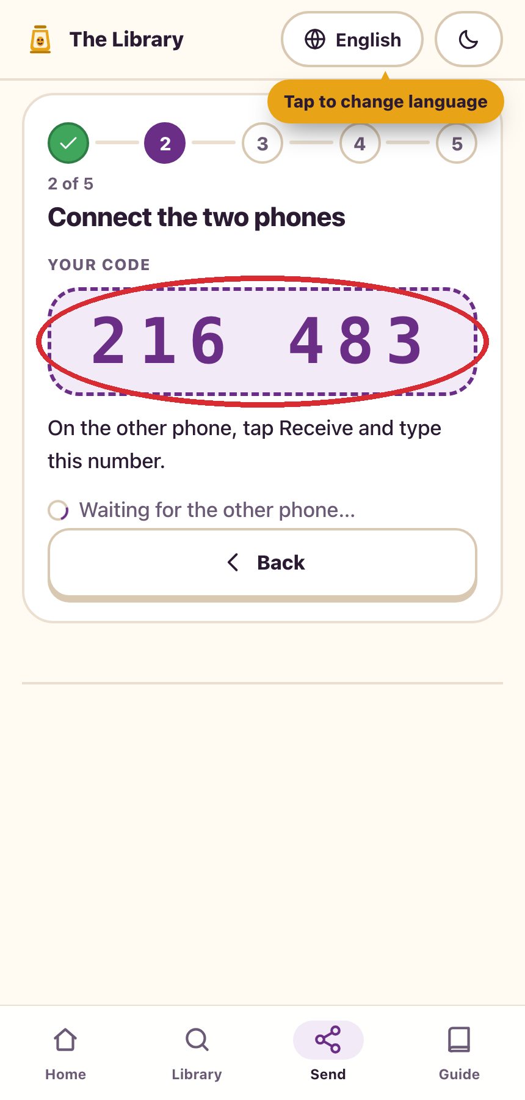
BibleTransfer123
11
SEND
Read the six-digit code
The sending phone shows a six-digit code.
Tell the other person that code.
The number in this picture is only an example. Yours will be different.
Larry’s step-by-step guide
Notes:
Screenshots captured from the current local BibleTransfer123 app on 17 September 2026. Example pairing codes change each time.

Slide 12
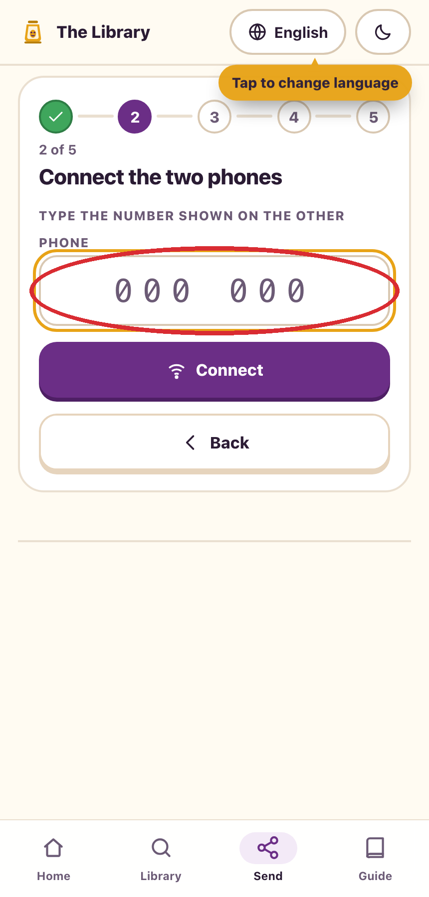
BibleTransfer123
12
SEND
Connect the receiving phone
On the other phone, tap Receive.
Type the six digits shown on the sending phone.
Wait for the phones to connect.
Larry’s step-by-step guide
Notes:
Screenshots captured from the current local BibleTransfer123 app on 17 September 2026. Example pairing codes change each time.

Slide 13
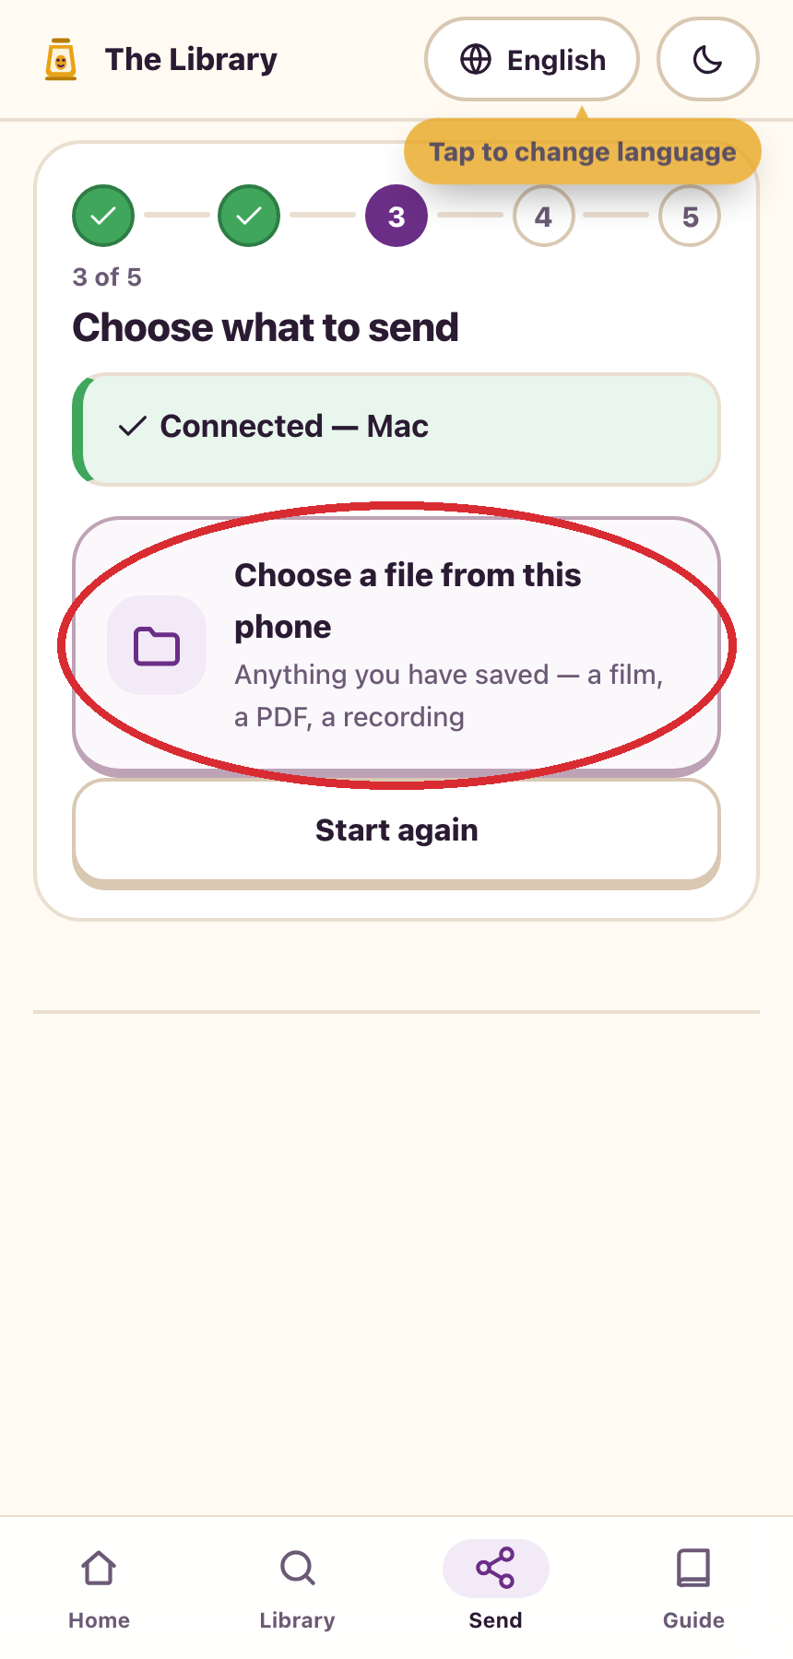
BibleTransfer123
13
SEND
Choose the file
On the sending phone, tap Choose a file from this phone.
Pick the file you saved earlier.
The connected device name may be different from the example shown.
Larry’s step-by-step guide
Notes:
Screenshots captured from the current local BibleTransfer123 app on 17 September 2026. Example pairing codes change each time.

Slide 14
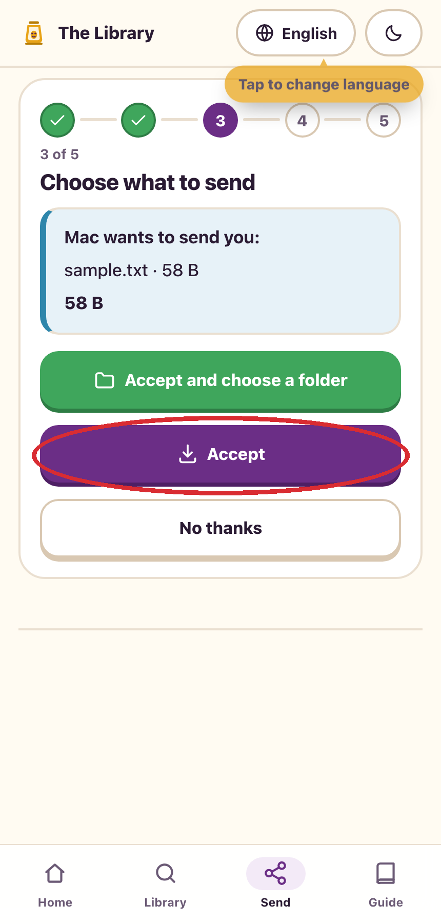
BibleTransfer123
14
SEND
Accept on the other phone
Check the file name on the receiving phone.
Tap Accept. Wait for the transfer to finish.
A folder choice may also appear on some devices.
Larry’s step-by-step guide
Notes:
Screenshots captured from the current local BibleTransfer123 app on 17 September 2026. Example pairing codes change each time.

Slide 15
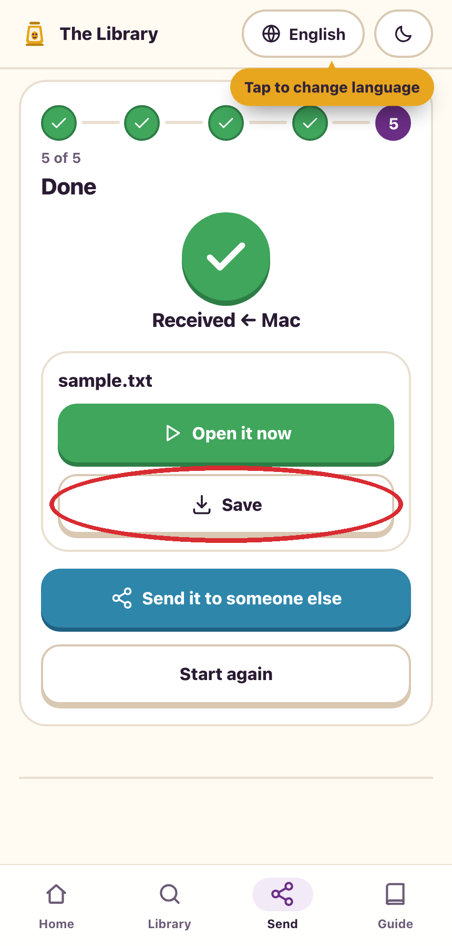
BibleTransfer123
15
SEND
Save and check the copy
On the receiving phone, tap Save.
Open the saved file once to check it works.
The sample file in this picture was used only to demonstrate the steps.
Larry’s step-by-step guide
Notes:
Screenshots captured from the current local BibleTransfer123 app on 17 September 2026. Example pairing codes change each time.

Slide 16
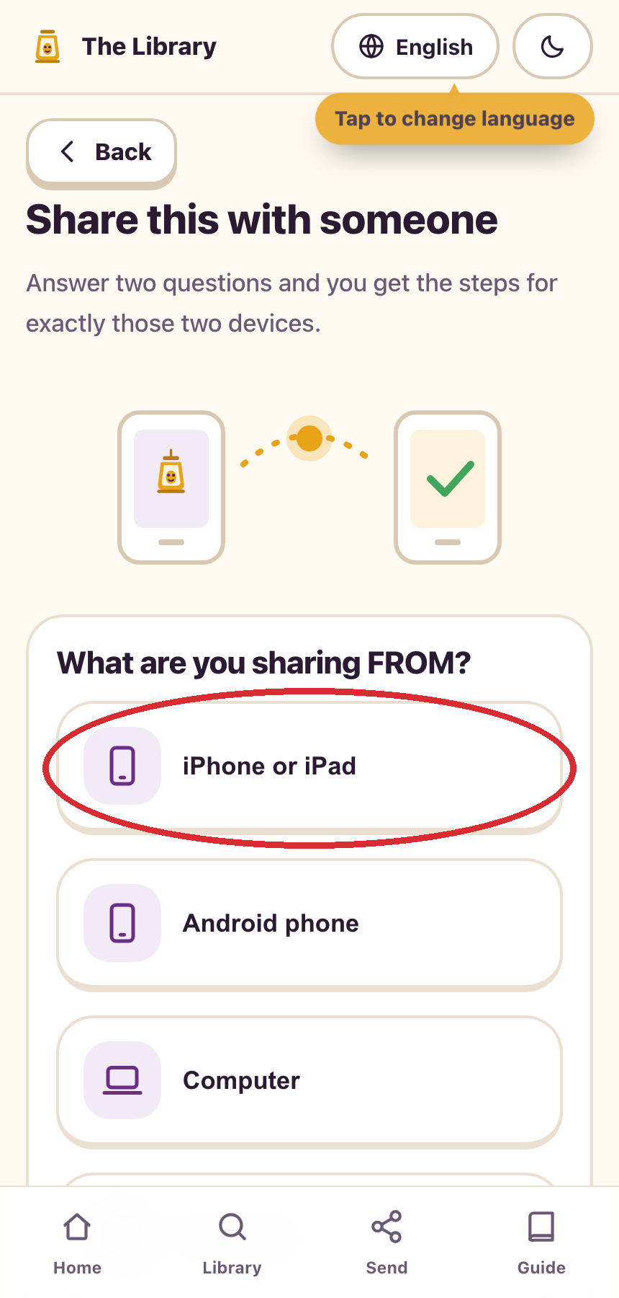
BibleTransfer123
16
MORE WAYS
For other device combinations
Open the Guide and choose the sharing instructions.
Pick the device you are sending FROM.
The guide covers phones, computers, and a microSD card.
Larry’s step-by-step guide
Notes:
Screenshots captured from the current local BibleTransfer123 app on 17 September 2026. Example pairing codes change each time.

Slide 17
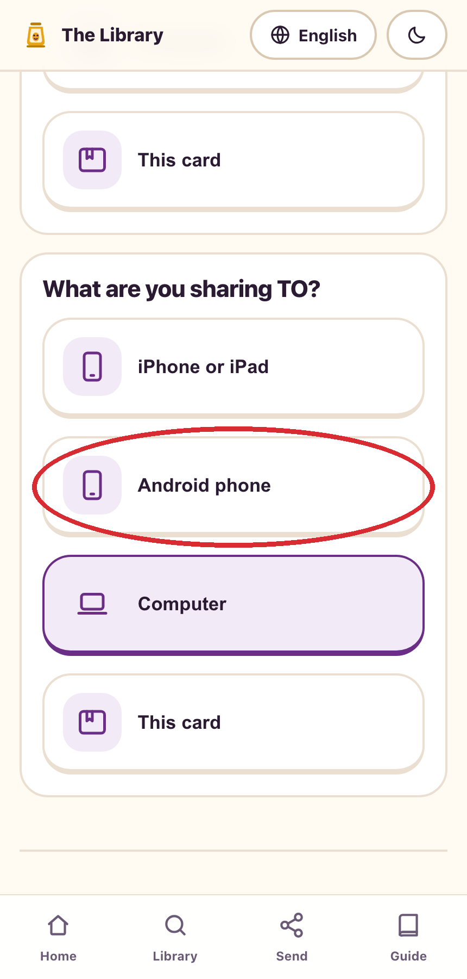
BibleTransfer123
17
MORE WAYS
Choose the receiving device
Pick the device you are sending TO.
Follow the numbered steps the app gives you.
The example here is an iPhone sending to Android.
Larry’s step-by-step guide
Notes:
Screenshots captured from the current local BibleTransfer123 app on 17 September 2026. Example pairing codes change each time.

Slide 18
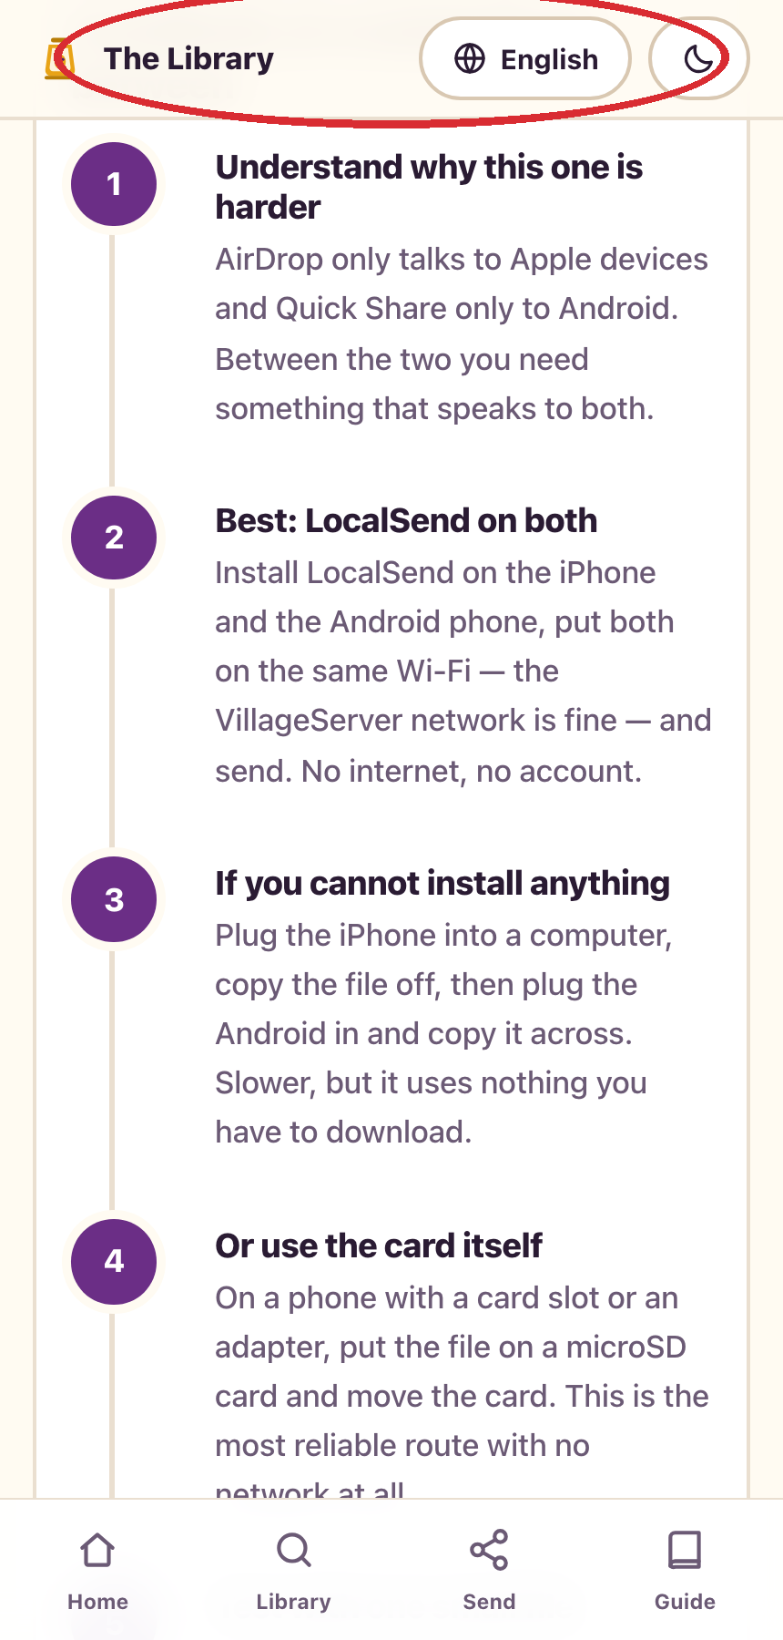
BibleTransfer123
18
REMEMBER
Three useful things to remember
A saved file stays on the phone after you leave the site.
On the website, an internet connection is needed for streaming and pairing.
Try one small file first, then open it on the receiving phone.
A prepared card or VillageServer can serve packed files without internet.
Larry’s step-by-step guide

