Slide 1
UX Scenario Document File Version 4.4
Infinity IPTV Player
Submission Date | 2026 / 10 / 25
App Ver. | 1.0.0
App Developer | Name: Asheesh Sahu E-mail: asheeshsahu7300@gmail.com

Slide 2
Table of Contents
1. Basic Information
2. Document History
3. Page Description (Application Overview)
4. Detailed Login & Portal Setup Information
5. Main Page Description (Dashboard)
6. Sub Page Description (Live TV, VOD, Series, Player, Settings)
7. Paid Content (Not Applicable)
8. In-App Ad (Not Applicable)
[Appendix] Remote Control Key Mapping & QA Notes

Slide 3
1. Basic Information
Category | Items | Infinity IPTV Player | Example
App Information | App Title | Entertainment
 | Category | Web App (.ipk packaged) | Entertainment / Game / Life
 | File Type | 1920*1080 (Full HD) | Web / Adobe Flash / Native App
 | Optimized Resolution | Global | 1280*720 / 1910*1080
 | Service Area Information | English | Global / KR, US
 | App Service Language | No | English, Spanish
 | Geo-IP Block | webOS (3.5 - 25.0) | Yes / No
 | SDK Version | Not Applicable | NetCast (XX. XX. XXX) / webOS (X. X. X)
 | In-App Ad | Not Applicable | Banner AD / AVOD / Not Applicable
 | Paid Content | Not Applicable (Media Player Audio Only) | Transaction / Subscription / Not Applicable
 | Sound (For Game Type) | Not Applicable (Packaged Offline IPK) | BGM (Yes / No), Sound Effect (Yes / No)
Test Information | Service URL (For Web Type) | com.infinity.iptvplayer_1.0.0_all.ipk | URL for LG Smart World/LG Content Store
 | Test URL (For Web Type) | webOS | URL only for QA (If necessary, please attach a test .ipk file to Test IPK File or Test URL section at LG Seller Lounge)
 | Service Platform |  | NetCast / webOS
Notes 1. Correct and detailed Basic Information required for App QA. 2. If you indicate Geo-IP Blocking as “Yes” you must white list the range of IPs required by the QA Team for testing. Please request the range of IPs to white list through the LG Seller Lounge 1:1 Inquiry. 3. You can use a 3rd party billing system for Paid Content. You shall be aware that you are liable for all claims arising from the use of a 3rd party billing system. 4. You can monetize your application with in-app advertising services with a 3rd party ad platform. Seller shall not violate LG’s content guideline and will be solely responsible for any claims from violation of the content guideline. 5. Game apps: If there is sound, detailed description of the BGM / Sound Effects, etc. is required. 6. Even though there may be no payment process within the app itself, having any related payment process outside the app such as paying on the app’s website, converting to a paid account, etc., will categorize the app as having Paid Content. If this is the case for your app, add detailed guidelines regarding the app’s paid content on the UX Scenario document, and mark the Paid Content option as “Transaction” or “Subscription” on the LG Seller Lounge. You can also mark the both options together.

Slide 4
2. Document History
No. | Sent | Version | File Name | Contents
1 | 25.10.2026 | 1.0.0 | Infinity_IPTV_Player_UX_Scenario.pptx | Initial official submission for LG Content Store Seller Lounge QA
Notes:
4

Slide 5

3. Page Description (Guideline)
1. Application Overview & Structure
Description
1. Dashboard | Main navigation hub for Live TV, Movies, Series, and Search
2. Live TV | Live broadcast streams with category filters and EPG program guide
3. Movies | VOD movies catalog with genre filters, synopsis, and cast info
4. Series | Episodic TV series with season/episode browser
5. TV Guide | Full Electronic Program Guide (EPG) grid timeline
6. Portals | Manage and connect IPTV playlists and credentials
7. Settings | Configure video playback engine, buffer sizes, and parental locks
- Place your app’s display image.
- Use unique number to indicate each menu or UI button correctly.
- Write the description on each menu or UI button of number at the right-side table.
- Next pages show examples with sample images and texts.
Detailed Information:
Infinity IPTV Player is a state-of-the-art IPTV application engineered specifically for LG webOS TV (v3.5 - 25.0).
- High Performance: Native 1080p hardware-accelerated rendering with Euclidean 2D spatial navigation.
- Multi-Source Support: Xtream Codes API, M3U / M3U8 Playlists, and MAC/STB Portals.
- Media Experience: Live TV with real-time EPG, VOD Movies catalog, episodic TV Series, and custom webOS video player.
*Note
- Description of each UI button’s function and location is required for better understanding, especially for non-English apps.

Slide 6

4. Detailed Login Information
Description
1 | Portal Name (Custom user label)
2 | Protocol Selector (Xtream / M3U / MAC)
Server URL / Host input field
4 | Username / MAC address input
5 | Password input field
6 | 'Connect Portal' submit action button
Pre-loaded Demo Public Streams Available
Xtream Host | http://demo.infinityiptv.com:8080
Username / Password | lgqa_test / lgqa_pass2026
Public M3U Stream | https://iptv-org.github.io/iptv/index.m3u
①
②
Detailed Information:
- Infinity IPTV Player follows a 'Bring Your Own Content' (BYOC) model. Users connect their IPTV provider via Xtream Codes, M3U URL, or MAC Portal.
- Test Credentials / Public Sample Streams are provided for LG QA engineers below to verify instant playback without requiring a personal subscription.

Slide 7
5. Main Page Description
1. Main Dashboard & Hub
UI Element & Action Description
1 | Branding Logo (Infinity IPTV Player)
2 | Quick Refresh Button (syncs portal data)
3 | Portals Button (switch / add IPTV portals)
4 | Settings Button (player engine & config)
5 | Search Content Pill (global search)
6 | TV Guide Pill (EPG program grid)
7 | Live TV Card (launches live streaming)
8 | Movies Card (opens VOD library)
9 | Series Card (opens episodic TV shows)
10 | Remote Back Key: Clean application exit
①
②
③
Detailed Information:
- Main Landing Screen (Dashboard): Provides immediate access to all media categories, global content search, and TV Guide.
- Remote Navigation: Directional keys navigate focus smoothly with Euclidean 2D spatial navigation.
- Over-scan Safe Zone: All elements are contained within LG's 1080p safe zone boundaries.
*Note
- Description of each UI button’s function and location is required for better understanding, especially for non-English apps.

Slide 8
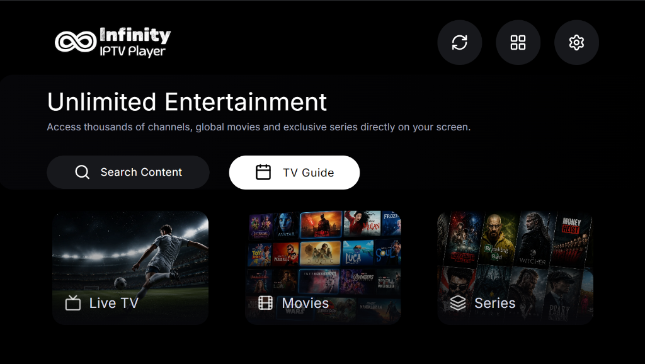
5. Main Page Description
2. Remote Focus States & Selection
Focus Movement & Behavior
1 | Live TV focused (highlighted border)
2 | Press Remote Right: Focus moves to Movies
3 | Press Remote Right: Focus moves to Series
4 | Press Remote Up: Focus moves to Search / EPG
5 | Press Remote OK: Opens selected category
6 | Magic Remote Pointer: Hover effect supported
①
②
Detailed Information:
- Visual Focus Indicator: In compliance with LG webOS Display Guidelines, focused elements feature an illuminated white border and subtle scale animation.
- Remote OK / Enter: Pressing OK on any focused category card immediately transitions to the selected media section.
*Note
- Description of each UI button’s function and location is required for better understanding, especially for non-English apps.

Slide 9
6. Sub Page Description
1. Live TV Streaming & Category Browser
Detailed Information:
- Live TV Interface: Categorized channel list with live preview and program timeline.
- Fast Channel Switching: Remote Up/Down changes channels instantly without loading delays.
- Favorite Channels: Users can toggle favorites with a single remote press.
*Note
- This page is added for better understanding for sub page’s location and movement during QA.
Notes:
9

Slide 10
6. Sub Page Description
2. Movies (VOD) Library & Details
Functionality
1 | Genre / Category Filter Bar
2 | Movie Poster Grid with HD/FHD badges
3 | Synopsis and Cast metadata modal
4 | 'Watch Now' button (starts player)
5 | Back key: Returns to previous menu
①
②
Detailed Information:
- Movies Library: Genre filtering (Action, Drama, Comedy, Sci-Fi) and search.
- Movie Details Modal: Synopsis, IMDb rating, release year, runtime, and cast.
- Playback: Pressing OK launches full-screen hardware-accelerated playback.

Slide 11
6. Sub Page Description
3. TV Series & Episodic Player
Player & Episode Controls
1 | Season Selector (Season 1, 2, ...)
2 | Episode List with duration and title
3 | Player OSD: Play/Pause/Seek controls
4 | Audio Track selection (multi-language)
5 | Subtitle selection (WebVTT / Embedded)
6 | Aspect Ratio: 16:9 / Original / Full
①
②
Detailed Information:
- TV Series Catalog: Multi-season and episode selector with episode thumbnail previews.
- Custom webOS Player OSD: On-Screen Display includes Play/Pause, Rewind (-10s), Fast Forward (+10s), Multi-Audio Track selector, Subtitles, and Aspect Ratio toggle (16:9, Original, Full Screen).

Slide 12
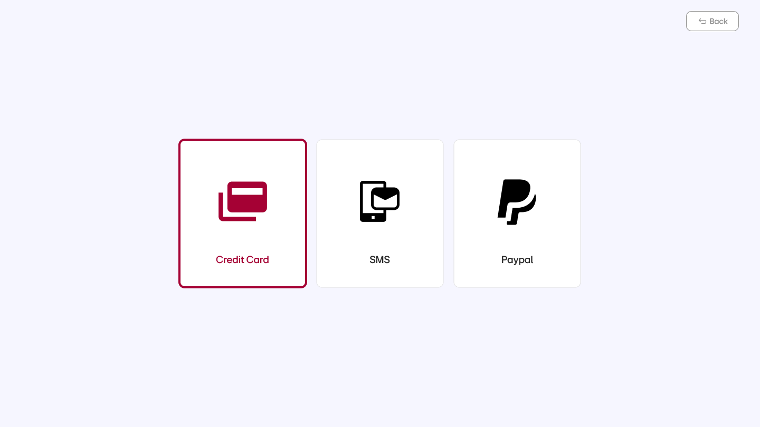
7. Paid Content
Status / Details
Paid Content Status | Not Applicable (N/A) - 100% Free
Payment Method | None (No payment processing)
In-App Purchases | None
Test Credit Cards | Not Required (No payment system)
Not Required
1 | Card No. / Expiry date / CVC
2 | Card No. / Expiry date / CVC
Test Voucher Codes (Mandatory)
1
2
3
①
Detailed Information:
* Important Note for LG QA:
- Infinity IPTV Player contains NO Paid Content, NO in-app purchases, and NO subscriptions.
- It is a 100% free media player application.
- Paid Content category on Seller Lounge is correctly marked as 'Not Applicable' (N/A).

Slide 13
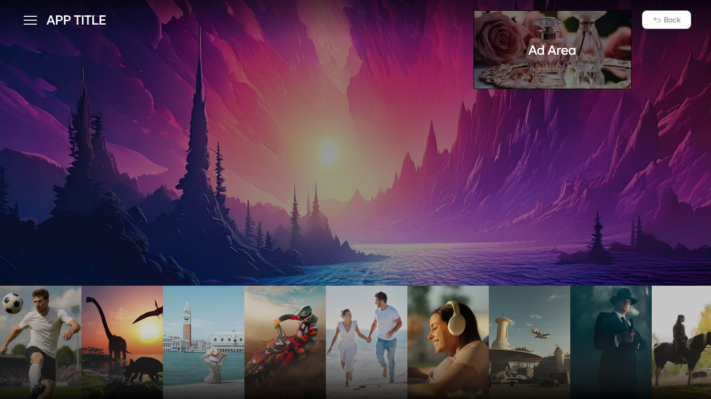
8. In-App Ad
1. Banner Type (Please Describe Ad Information)
Status / Information
Not Applicable (No Ads)
Ad Location | None
 | None
①
②
Detailed Information:
- Banner Advertisements: Not Applicable (N/A).
- Infinity IPTV Player does not contain any third-party banner ads, promotional popups, or interstitial advertisements.
Notes:
13

Slide 14

8. In-App Ad
2. Video Ad: N/A | Remote Control Key Guide
Defined Operation
Euclidean 2D spatial navigation between buttons
OK / Enter Key | Select focused button / toggle Player OSD
BACK Key | Return to previous screen / close modal
EXIT Key | Terminate app cleanly via webOS platformBack
Play / Pause Keys | Direct playback pause/resume
Rewind / Fast Forward | Seek -10 seconds / +10 seconds
Number Keys (0-9) | Direct channel number tuning
Magic Remote Pointer | Point-and-click and hover highlight
AD Area
Detailed Information:
- Video Ads: Not Applicable (No AVOD or video ads).
- Full Remote Support: The application is fully compliant with both LG Magic Remote Control (MMRC) and General Remote Control (TR).
- All D-Pad navigation, OK, Back, Exit, and Media keys operate according to LG webOS TV Human Interface Guidelines.
Notes:
14

Slide 15
[Appendix]
Infinity IPTV Player - LG Seller Lounge QA Verification Summary:
1. Application Package:
- App ID: com.infinity.iptvplayer
- Version: 1.0.0
- Package File: com.infinity.iptvplayer_1.0.0_all.ipk (Offline packaged web app)
- Resolution: Native 1920x1080 (Full HD, 16:9), Hardware Accelerated
2. Platform Compatibility:
- Target Platforms: LG webOS TV (webOS 3.5, 4.0, 4.5, 5.0, 6.0, 22, 23, 24, 25)
- Tested On: webOS 24 / webOS 25 OLED and UHD TV hardware
3. Video / Audio Codec Support:
- Streaming Protocols: HLS (m3u8), MPEG-TS (ts), HTTP Progressive (mp4, mkv)
- Video Codecs: H.264 (AVC), H.265 (HEVC), VP9
- Audio Codecs: AAC, MP3, AC3 (Dolby Digital), EAC3 (Dolby Digital Plus)
4. Quality Assurance Self-Check:
- All 53 Seller Lounge Self-Check List items verified (49 Pass, 4 N/A, 0 Fail).
- Safe zone adherence: All interactive controls are placed strictly within overscan margins.
- Clean termination via webOS application lifecycle handlers.
5. Developer Contact:
- Developer: Asheesh Sahu
- Email: asheeshsahu7300@gmail.com
- GitHub Repository: https://github.com/asheeshsahu7300/Infinity-IPTV-Player

