Slide 1
Winter 2019 Managing your marketing leads
Betty Kirschbaum
Coaching Manger

Slide 2
Rating Yodle, Marketing leads, call backs how it all ties in together
Rating Yodle Calls Correctly and Making Proper Notes
Following up on Marketing Leads
Managing Callbacks List and Making Proper Notes

Slide 3
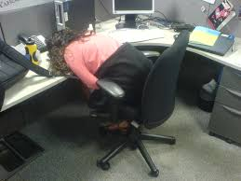
Why do yodle
Doing your job, checking on yodle, Not letting anyone else have your $$
It’s not important, why bother, it takes so much time, I don’t like it.
Notes:
What is the benefit of monitoring Yodle all day??

Slide 4
Expectations of what we want from our PCC’S * Call back from office before 24 hours! Call, leave message, or set the appointment before the 24 hours are up * Rating of Yodle calls as soon as you can-have the Yodle tab open and do this immediately following the call! * Current notes/dates of calls-if you do not leave a note how will anyone know a call was made? Make notes with your initials and date of the call
Notes:
Expectations and beyond

Slide 5
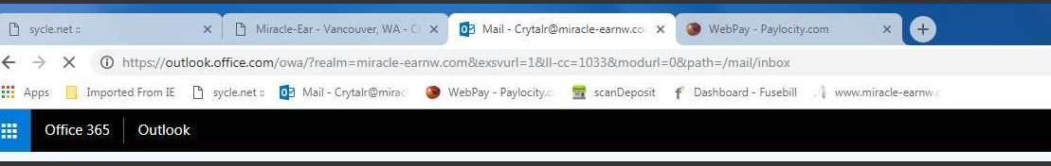
Let’s make this easy on you! Have the yodle tab open
Rating calls ASAP-It’s Your call, Your Office, Your job!
Do not skip this and leave it for someone else to take care of!!!
Notes:
Why have yodle tab open?

Slide 6
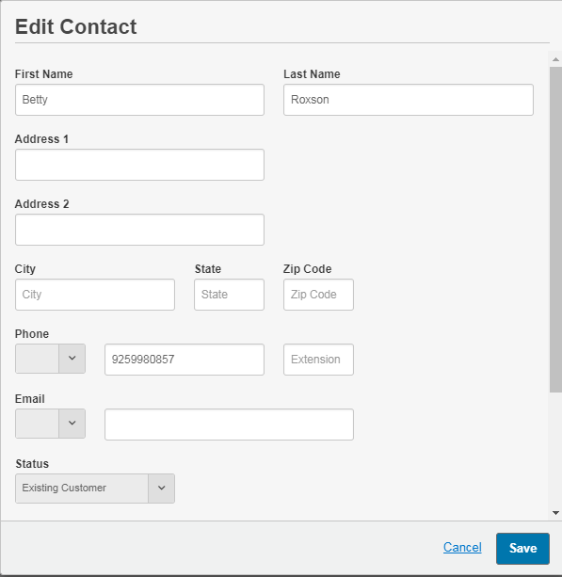
Correct yodle contact
This area is where you will enter the patient name and number.
If a caller is calling for their family-you need to decide who the person of contact is….
The patient or The caller.
Notes:
Necessary information here

Slide 7
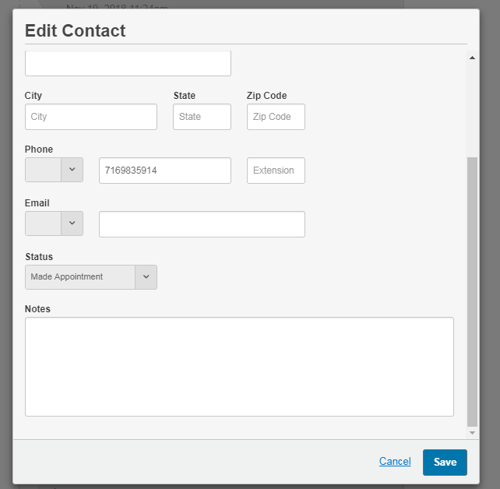
Yodle Contact
Enter the contact information correctly in Yodle.
Make a short note of the call
Keep it Simple and Fast
Simple Example: 1/28/19 blk Set HAE with FV.

Slide 8
What is a good rating? what is a bad rating for yodle?

Slide 9
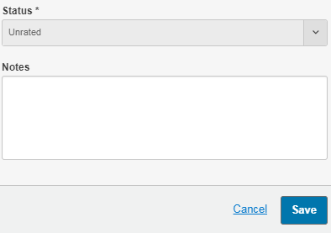
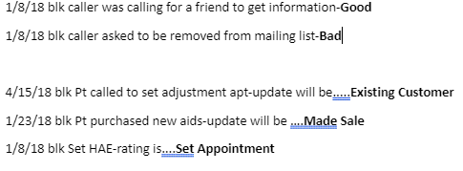
Rate those calls!!!!
Where to rate
Rating Examples

Slide 10
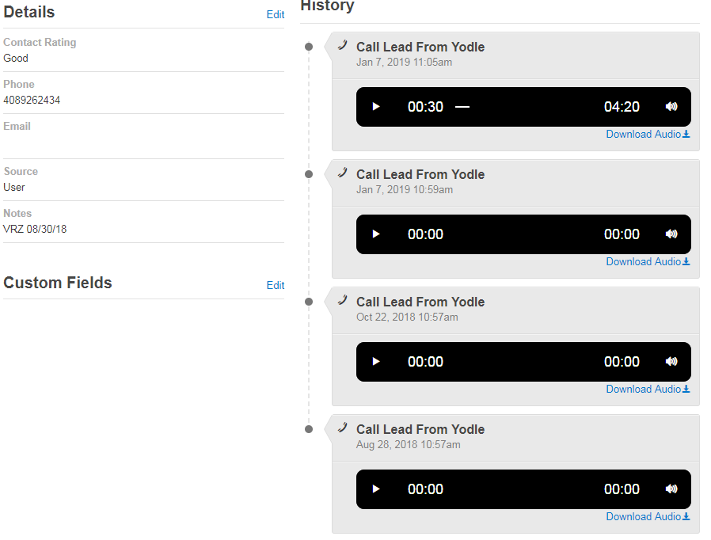
Current notes for current calls
VRZ took the call in August-no other notes for this call. Was HAE set-we don’t even know!
Another call in Oct-no notes
2 calls in Jan-no notes
You must update to keep this record current
Simple Example: 1/7/19 blk- Set Adjustment and C&C
Notes:
Just because there is a note VRZ and date….Does NOT mean the caller was contacted!

Slide 11

Update notes
When you update the notes in Yodle, you and everyone after you will have an idea of the previous calls that were taken.
This is really quick and easy to do.
Keep notes in chronological order
Always use date and initials!!!!!!

Slide 12

Don’t let those leads get away!!! That can be the next sale for your office That is your $$$$$$
You have 24 hours to make your move. If you chose to not take care of Yodle- it WILL be done for you.
Be sure that you take care of your office and your marketing leads!!
Notes:
If you do not do your job of taking care of Yodle-you loose out.

Slide 13
What is good customer service
Calling back within 24 hours?
What are your expectations when you call your Dr. or Dentist?
All Callers…are YOUR callers, YOUR future patients.
It takes a caller 4-7 years to pick up the phone-they are reaching out to you for help!! HELP THEM!!!!
Isn’t that why you are in the business?? You want to help people, right?
Treat people how you would want your Grandparents to be treated!!
Notes:
The customer/patient comes first!! Customer Service is #1 This is why you are in this position-to help people!

Slide 14
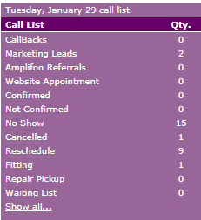
Following up on Marketing Leads
Several times a day you need to check for new Marketing Leads. These leads can come from online searches that people have done, or through Yodle.
Keep leads “under” 7 at all times

Slide 15
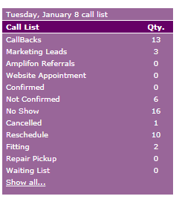
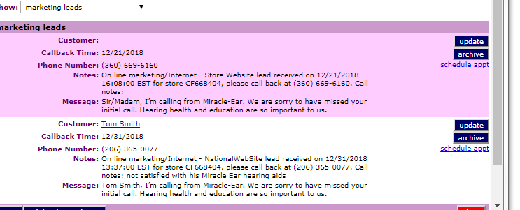
Calling Marketing Leads
Call List
*Marketing Leads
* Click on “Update”

Slide 16
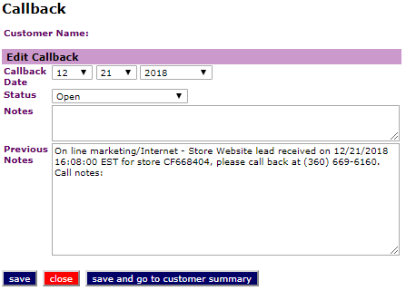
Open Calls
Call Back Area
This screen shows up after you click “update”
This is the area where you either “complete” or move the call out to a future date
Do not make a call to the person, make a note and not complete or reset the call back date!!!! Doing this only makes the Call List larger.
Either complete or reset call back date

Slide 17
Call back list
Check this area daily!
This is where you will find the calls that you have set for call backs!!
Check this area for all other types of call as well!!

Slide 18
Open Calls
In the “Status” area leave the call “OPEN”
Make Notes with the date and initials
Simple Example: 1/28/19 blk Need to call back after vacation
At “Call Back” area set the date when you plan to call the person
Save this and the call will appear on the date you set it for
Work you Call Back List DAILY!!!

Slide 19
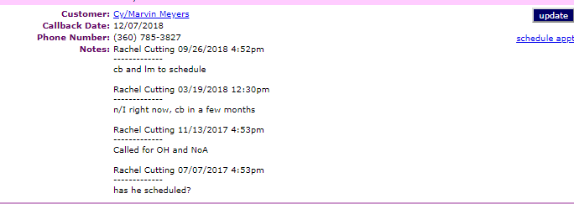
Open call back history notes
When you reset the date of “Open Call Backs” this is what it will look like.
This will keep the call list from getting out of control!
After the 24hr Callback –call daily or more until contact is made.
Call Weekly, Call Monthly, then call every 1-2 months-

Slide 20
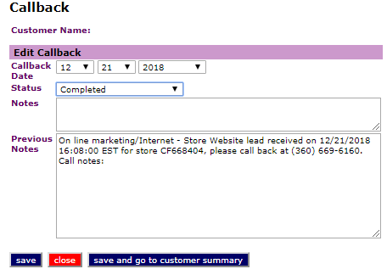
Completed calls
Once you have spoken to the caller, you will complete the call.
ADD NOTES with the date and your initials
Simple Example: 1/28/19 blk Caller set HAE w/FV.
Status is now “Complete”
Save-this removes the call from the call list!

Slide 21
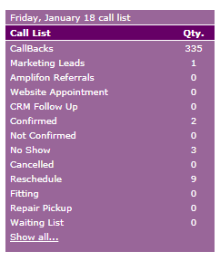
Call back list “out of control”
You want your Call Back List Manageable
Keep up daily and you will not have this going on
This is NOT taking care of your Call Backs List

Slide 22
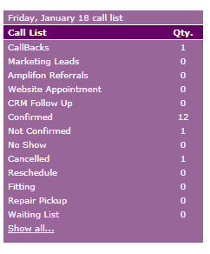
Well managed call list
THIS is what you want your Call List to look like
This is what it looks like when you are taking care of your Call Back List DAILY

Slide 23
How do you manage your call Backs List?
Notes:
Who checks their Marketing list first thing in the morning? How often do you check the Marketing Leads during the day?

Slide 24
Take care of your yodle, your marketing leads,……….it is your job!!!
ALWAYS DO NOTES IN SYCLE, YODLE AND FOR CALL BACKS
If there aren’t notes-it did NOT happen!!
Taking care of YOUR Yodle = more money for you in 2019!!!!
Notes:
The reason we must make notes-Sycle is our legal data base-if there aren’t notes in sycle-it didn’t happen. Protect your office, yourself and make notes on everything.

Slide 25

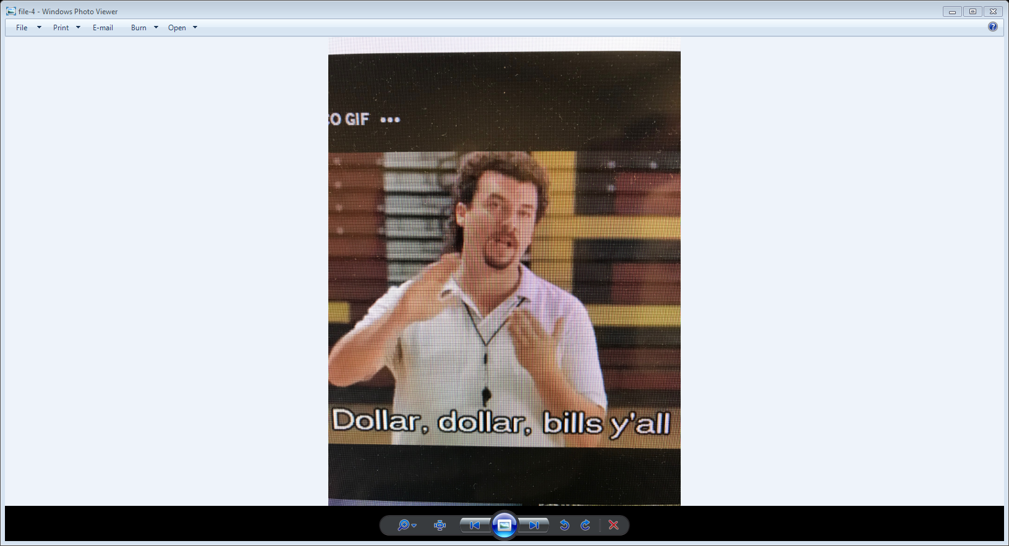
Notes:
$$$$$$$$$$$$$$$$$$$$$$$$$

