Slide 1
GenAI Powered
Data Analytics
Summer Internship / Virtual Job Simulation
Tata iQ • Forage
Ayush Shekhar | B.Tech CSE (Data Science) | Batch 2025–2029 | 1 Credit
IILM University • University Roll No.: 25SCS1003002962 • Completion: September 20, 2026
Tata iQ • GenAI Powered Data Analytics • Ayush Shekhar 1

Slide 2
1. Program Overview
Self-paced Tata iQ GenAI Powered Data Analytics job simulation on Forage.
Simulated role: AI Transformation Consultant in a financial-services analytics team.
Business case: helping Geldium Finance understand and predict credit-card delinquency risk.
Core themes: EDA, data quality, predictive modeling, GenAI assistance and responsible AI.
Tata iQ • GenAI Powered Data Analytics • Ayush Shekhar 2

Slide 3
2. Business Problem
Geldium Finance observed increasing credit-card delinquency and wanted a more structured, data-driven approach.
Existing process relied on historical trends and manual case handling.
Goal: identify at-risk customers earlier and support targeted intervention strategies.
Risk assessment should remain fair, explainable and responsible.
Tata iQ • GenAI Powered Data Analytics • Ayush Shekhar 3

Slide 4
3. Task 1 — EDA & Risk Profiling
Understand dataset structure and key variables.
Identify missing, inconsistent or anomalous data before modeling.
Explore relationships between customer variables and delinquency.
Document early risk indicators and data-quality observations.
Tata iQ • GenAI Powered Data Analytics • Ayush Shekhar 4

Slide 5
4. Data Quality & Missing Values
Assess why data is missing before choosing a treatment.
Possible approaches: deletion, statistical imputation, predictive imputation and carefully validated synthetic data.
GenAI can help detect gaps and suggest strategies, but final choices require analytical validation.
Reliable data is a prerequisite for reliable predictive modeling.
Tata iQ • GenAI Powered Data Analytics • Ayush Shekhar 5

Slide 6
5. Risk Factors Discussed
Payment history and previous missed/late payments.
Credit utilization and potential financial pressure.
Debt-to-income ratio and ability to manage obligations.
Recent credit activity plus employment/income stability.
Risk indicators should be investigated rather than treated as automatic causal conclusions.
Tata iQ • GenAI Powered Data Analytics • Ayush Shekhar 6

Slide 7
6. Synthetic Data
Synthetic data can supplement limited or incomplete datasets.
It should mimic relevant real-world patterns without exposing real customer information.
Validate generated data against real-world distributions and statistical expectations.
Use synthetic data as a supplementary tool, especially in regulated financial contexts.
Tata iQ • GenAI Powered Data Analytics • Ayush Shekhar 7

Slide 8
7. Task 2 — Predicting Delinquency
Move from exploration to predictive modeling.
Consider approaches such as logistic regression, decision trees and neural networks.
Use GenAI to assist with model logic, code drafting and interpretation.
Validate model outputs before using them to support decisions.
Tata iQ • GenAI Powered Data Analytics • Ayush Shekhar 8

Slide 9
8. Evaluation & Responsible AI
Use appropriate hold-out or cross-validation methods.
Assess classification performance beyond simple accuracy.
Check calibration, error patterns and subgroup performance where relevant.
Prioritize explainability, fairness, transparency and human oversight.
Tata iQ • GenAI Powered Data Analytics • Ayush Shekhar 9

Slide 10
9. Skills Gained
Exploratory Data Analysis and data-quality assessment.
Predictive analytics, model selection and model-validation concepts.
GenAI-assisted analysis and prompt-based exploration.
Business communication, strategic thinking and responsible AI reasoning.
Tata iQ • GenAI Powered Data Analytics • Ayush Shekhar 10

Slide 11
10. Conclusion
The simulation provided an end-to-end view of a data/AI project in a financial-services setting.
Key learning: good modeling starts with reliable data and clear problem framing.
Future extension: implement the workflow in Python, perform quantitative EDA, train and compare models, and build a monitoring dashboard.
Tata iQ • GenAI Powered Data Analytics • Ayush Shekhar 11

Slide 12
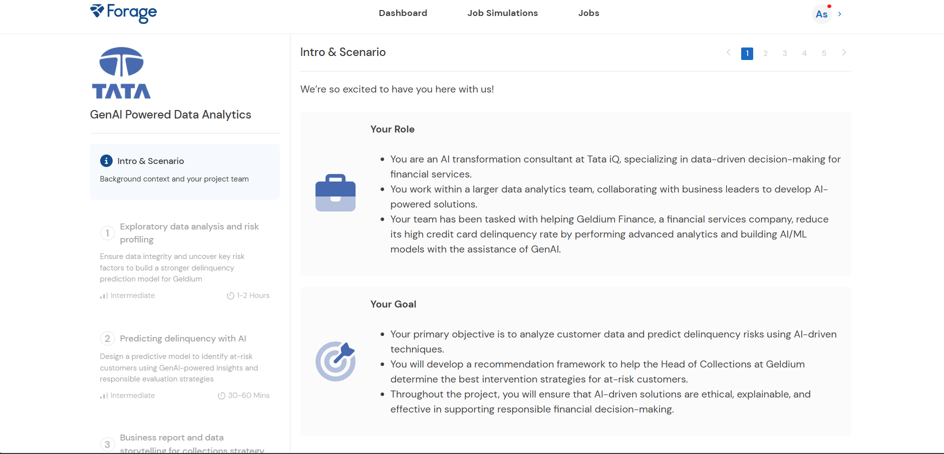
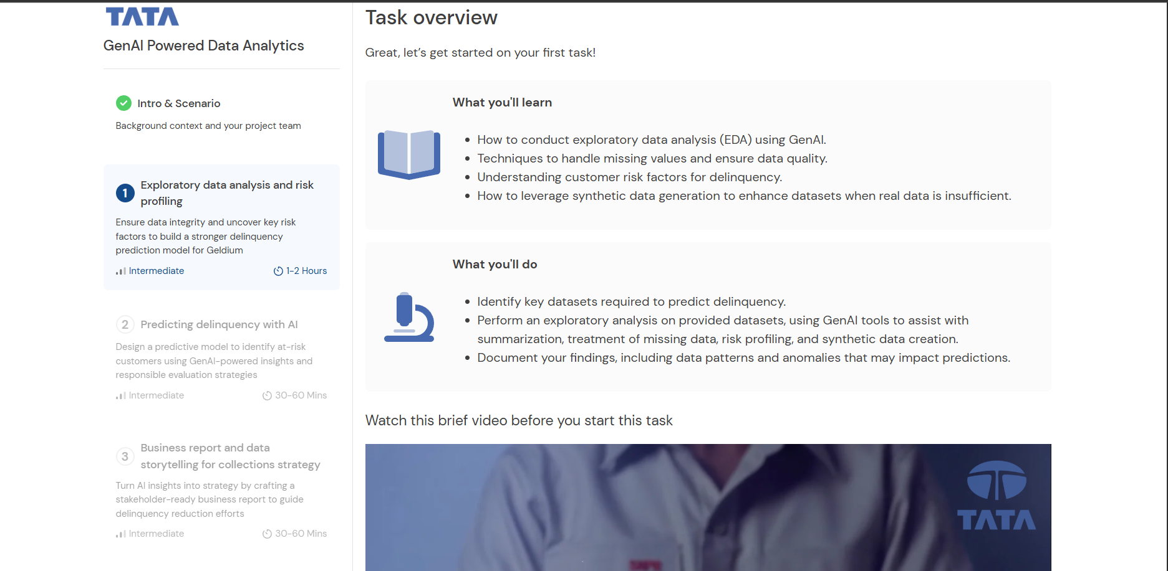
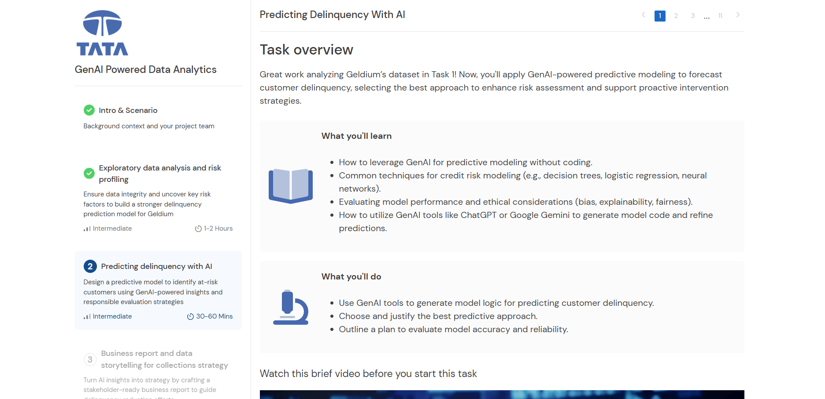
11. Evidence of Internship Activity
Selected screenshots from the supplied Forage learning path
Tata iQ • GenAI Powered Data Analytics • Ayush Shekhar 12

Slide 13
Thank You
GenAI Powered Data Analytics • Tata iQ / Forage
Tata iQ • GenAI Powered Data Analytics • Ayush Shekhar 13

