Slide 1
What is the learning curve to implementing a just culture?
Ashley Landin
CSD 380 DevOps
Module 9.2 Assignment
July 14, 2024

Slide 2
There needs to be a balance
When it comes to establishing a just, learning culture in an organization, the must crucial factor to consider is the response to when incidents occur in the workplace.
There needs to be a balance achieved between discouraging the behavior that caused the incident to occur, while also educating the team to empower them during the next incident.
Incidents are an inevitable part of an organization, it’s the response that can determine the success of the organization.
“Human error is not our cause of troubles; instead, human error is a consequence of the design of the tools that we gave them” (Kim, 2021).

Slide 3
Two methods to Achieve this Balance
Blameless Post-Mortems
Controlled Introduction of failures
Also referred to as retrospectives or learning reviews.
Their introduction can help a team focus on the situational aspects of the failure, and on the decision-making process conducted by the individuals that were involved.
By recreating failure scenarios in a controlled environment, this can reduce the negative impact of potential failures in a system.
By having the failures occur gracefully, it can have the team focus on building up the resistance of the system.

Slide 4
The process of a retrospective
A retrospective occurs in a group setting, with all members of a team analyzing the scenario in which the failure occurred.
One of the challenges that needs to be overcome by the team is the elimination of counterfactual statements.
This is because it contradicts the purpose of the retrospective in general, and doesn’t view the failure objectively.
Counterfactual statements don’t view the issues that occurred in terms of the system that exists, and instead view the issue as imagined by the individual making the counterfactual statement.
Eliminating their use during a retrospective can adjust the meeting to view the incident objectively, and come quicker to potential future solutions and protocols.

Slide 5
Redefining Failure
Another challenge to overcome within an organization is to readjust it’s values so that it’s members feel empowered to take calculated risks.
In order to do this, the leaders within the organization should foster a culture that allows every member of a team to feel safe and also comfortably take accountability for the failures that can come from these calculated risks that are taken.
When failure is redefined as a learning experience for the organization, it’s people are able to move the organization forward when it comes to innovative ideas. This can only occur if the environment allows for failures to occur safely as an element of the development process.

Slide 6
Controlled Introduction of Failures
Failure injection being implemented into the production environment can help a team increase it’s overall resilience to failures over time.
This can be achieved using various tools, the challenge arises with finding the best way for procedures to fail as to not completely dismantle the system.
Several tests must be conducted by the team to have them come to this consensus.
For this to happen, the team must feel comfortable with creating scenarios that cause the system to fail.

Slide 7
The benefits of controlled failure injection
The team is able to recreate failure scenarios, as well as test them consistently in a controlled environment to assess all causes and effects.
“A service is not really tested until we break it in production” (Kim, 2021).
With the data collected through continuous testing of fail scenarios, the team can begin to detect defects in the system that occur outside of the injected failures.
The frequency of the failure injections can help a team adjust faster when real incidents occur, they will have the knowledge and plans in place to fall back on when systems fail outside of controlled situations.

Slide 8
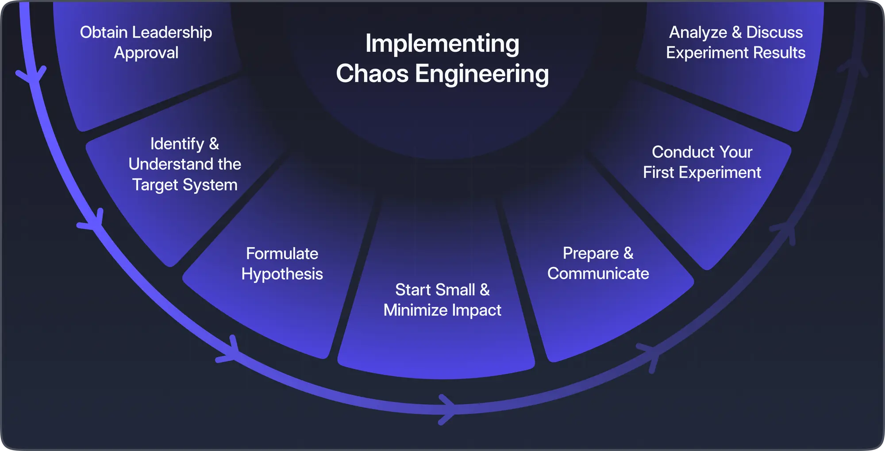
Image source: https://www.zenduty.com/blog/chaos-engineering/

Slide 9
Addressing the learning curve
The main challenge facing establishing a just, learning culture in an organization is breaking down traditional or reactionary approaches to incidents that occur during production.
Whether it be on the development side or business side of the process, all aspects must adopt the same attitude of creating an environment where it’s staff feel empowered to face potential failures.
This empowerment can only come as a result of proper training, education, and redefining of the concept of failure in the workplace.

Slide 10
References
Grant, A. (2021, February 3). Building a culture of learning at work. Strategy+business. https://www.strategy-business.com/article/Building-a-culture-of-learning-at-work
Kim, G., Humble, J., Debois, P., Willis, J., Forsgren, N., & Allspaw, J. (2021). The devops handbook: How to create world-class agility, reliability, & Security in Technology Organizations. IT Revolution Press.
Udasi, A. (2023, December 16). How chaos engineering boosts system stability: Zenduty. Zenduty Blog - Incident Management & Alerting. https://www.zenduty.com/blog/chaos-engineering/

